Slide 1
The Effect of the Temperature of the Environment
on the Speed of a Pea Plant Germination Process
Anne - Catherine de Ghellinck

Slide 2
Data
My data shows that the pea seeds in the warm temperature germinated faster than the peas in the normal temperature and cold temperature in a limit of four days. My data suggests that when given the same amount of time to germinate in different temperatures, the pea seeds in the warm temperature germinated faster than the other peas. This might be because peas need moisture and warmth to germinate successfully and fast.

Slide 3
Data
 | Temperatures of environments
Cool | 50 F.
Normal | 70 F.
Warm | 80 F.
 | Day 1 1/22 | Day 2 1/23 | Day 3 1/24 | Day 4 1/25
Peas in cool temp. | Pea seed - no roots | Pea seed - no roots | Pea seed - no roots | Peas started to grow root 0.4 cm long
Peas in normal temp. | Pea seed - no roots | Peas started to grow root 0.3 cm long | Peas grew root 1.1 cm long | Peas grew root and 8 out of 10 peas started to turn green 3.7 long root
Peas in warm temp. | Pea seed - no roots | Peas grew root 0.6 cm long | Peas grew root long 1.3 cm long | Peas grew root and started to turn green 4.5 cm long root

Slide 4
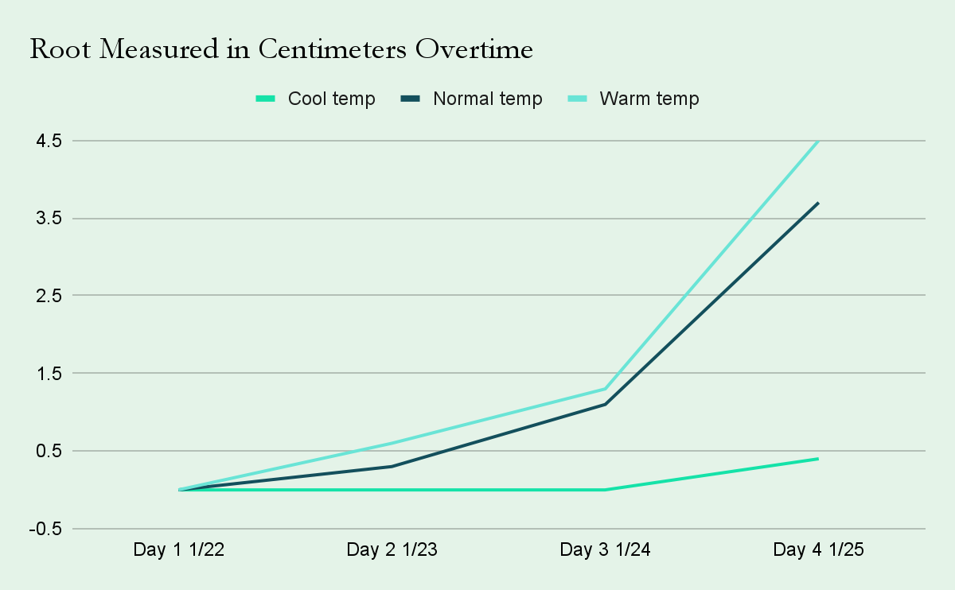
Chart

Slide 5
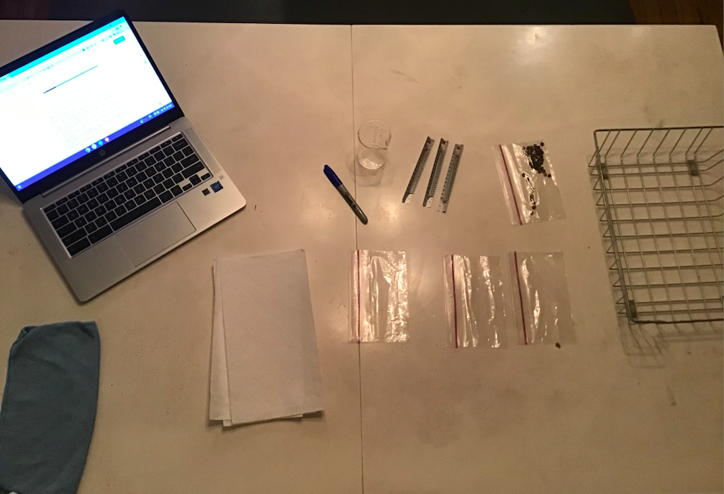
My Setup

Slide 6
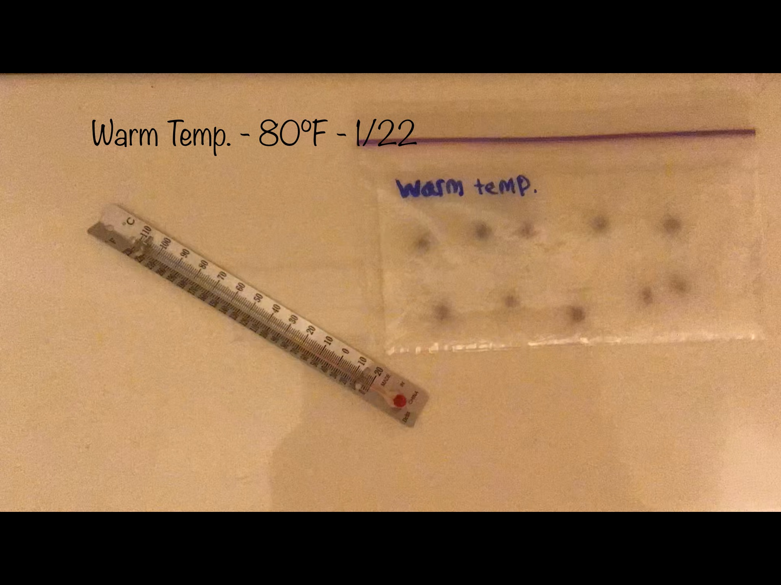
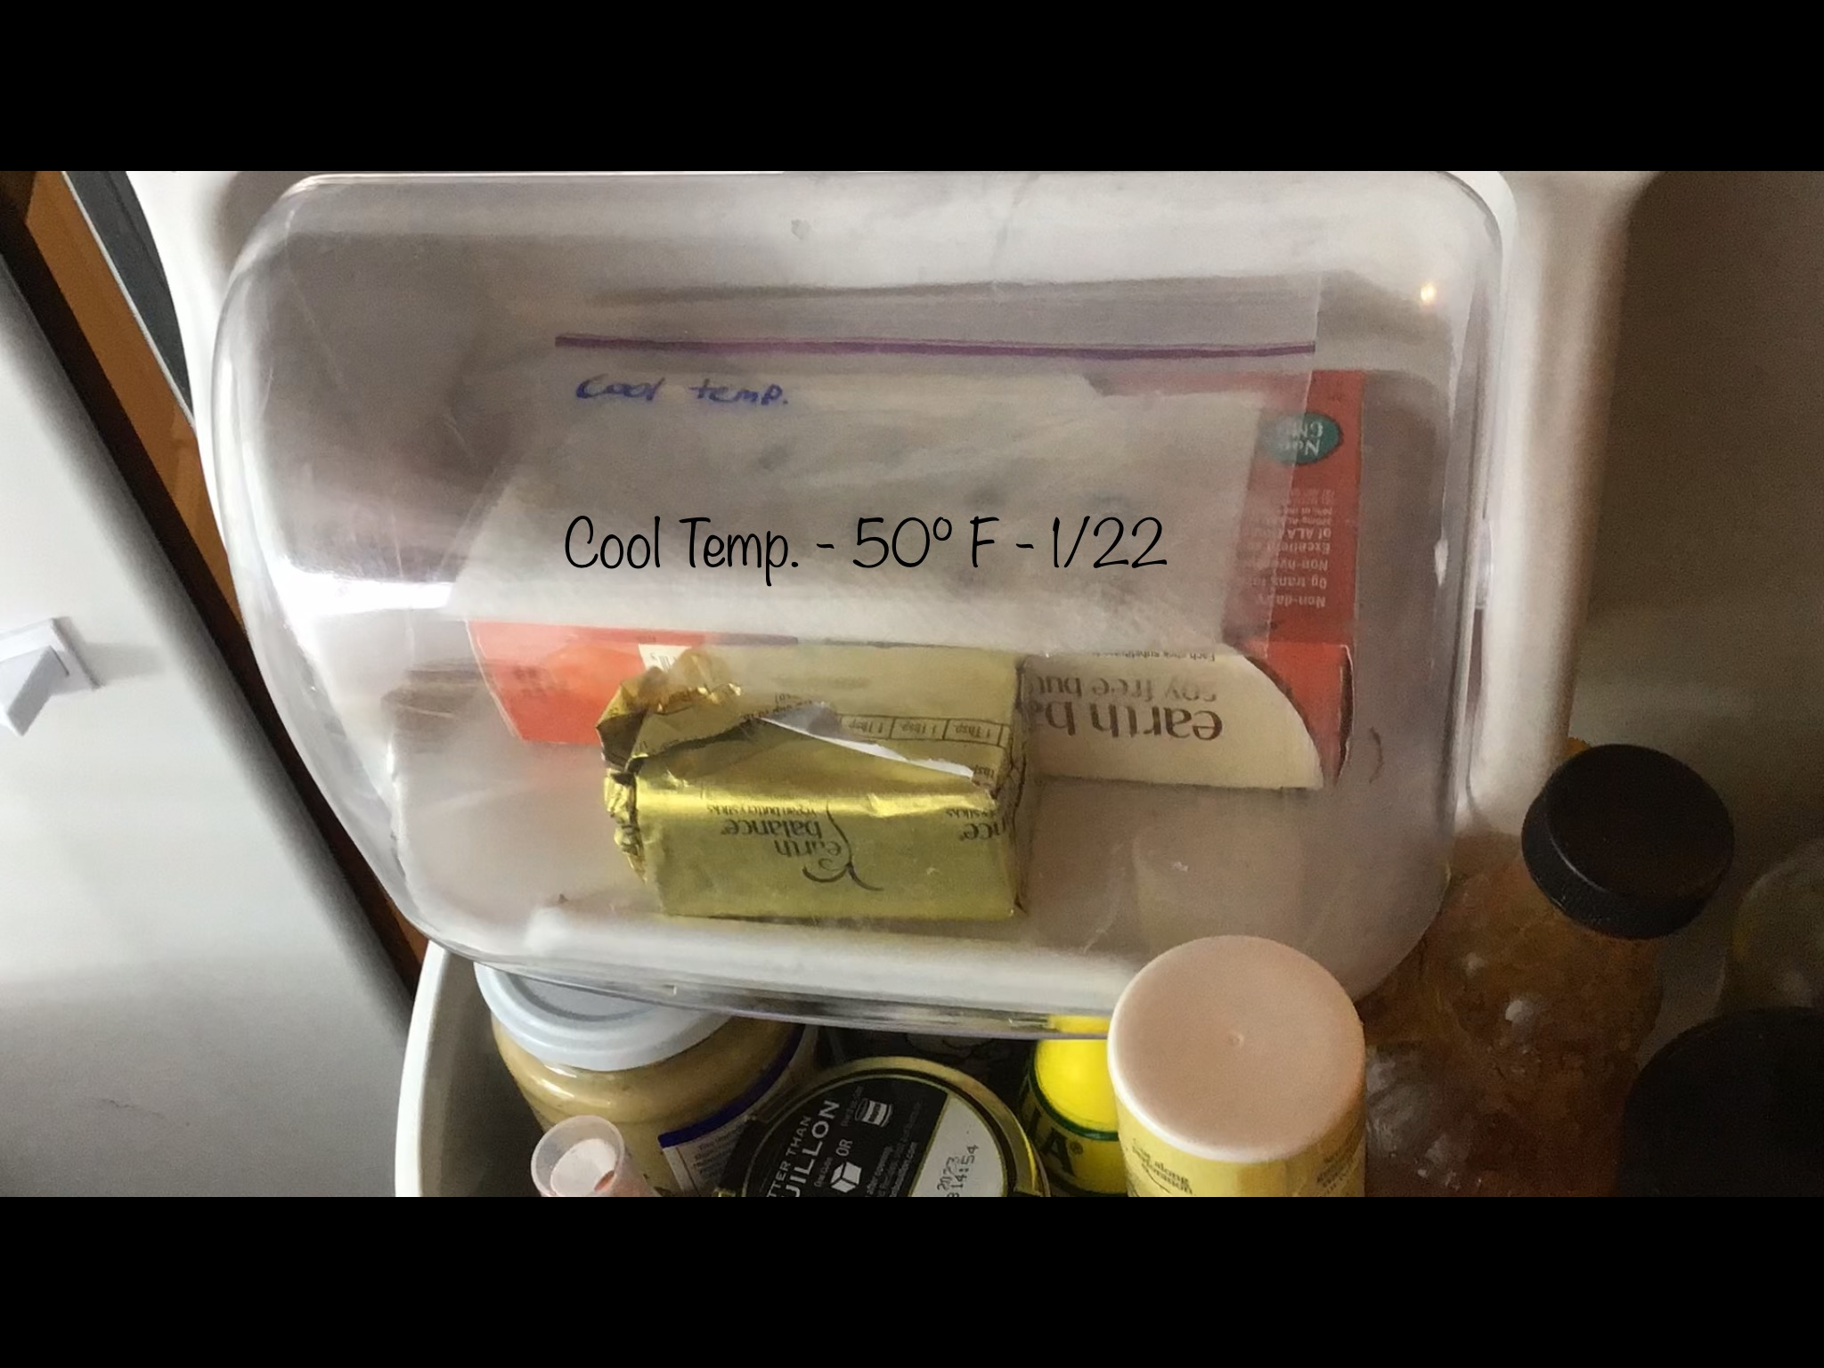
Day 1 Observations

Slide 7
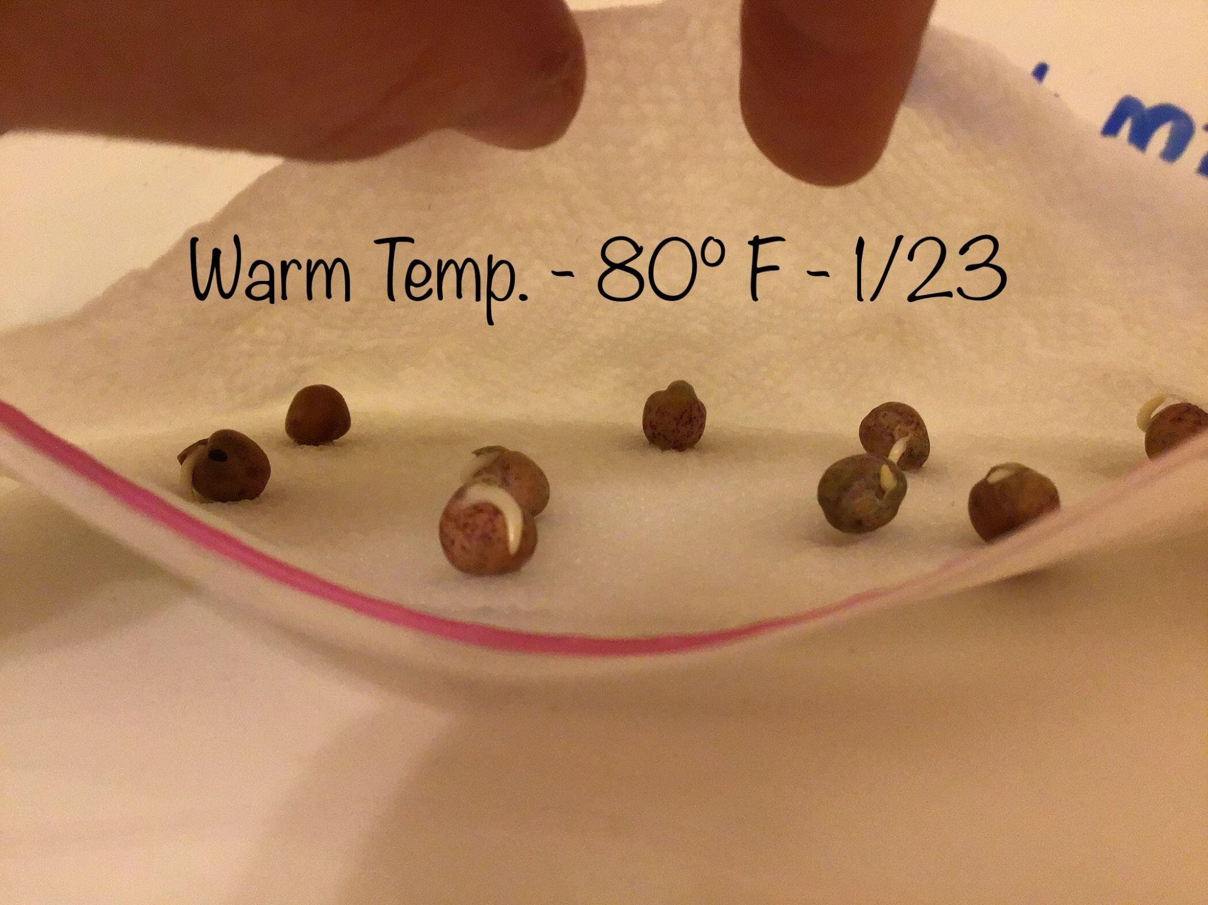
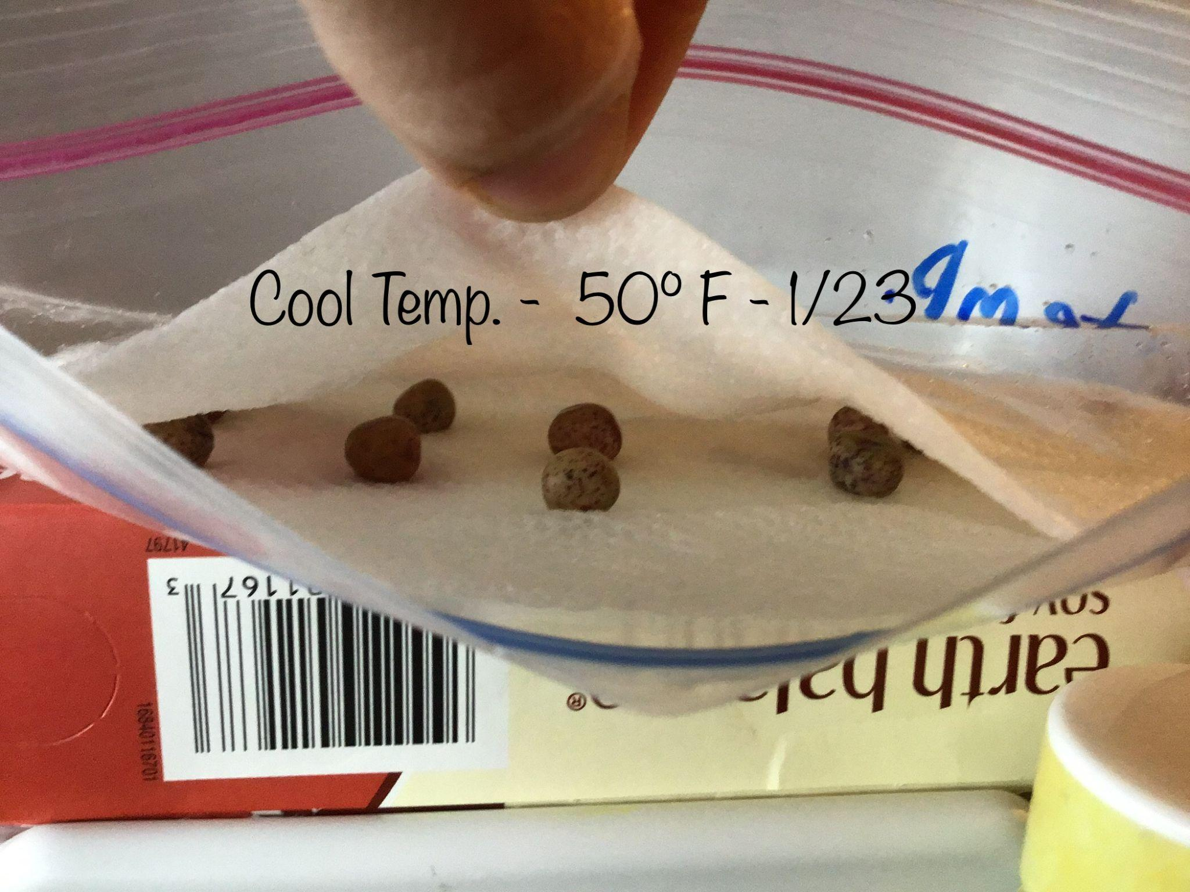
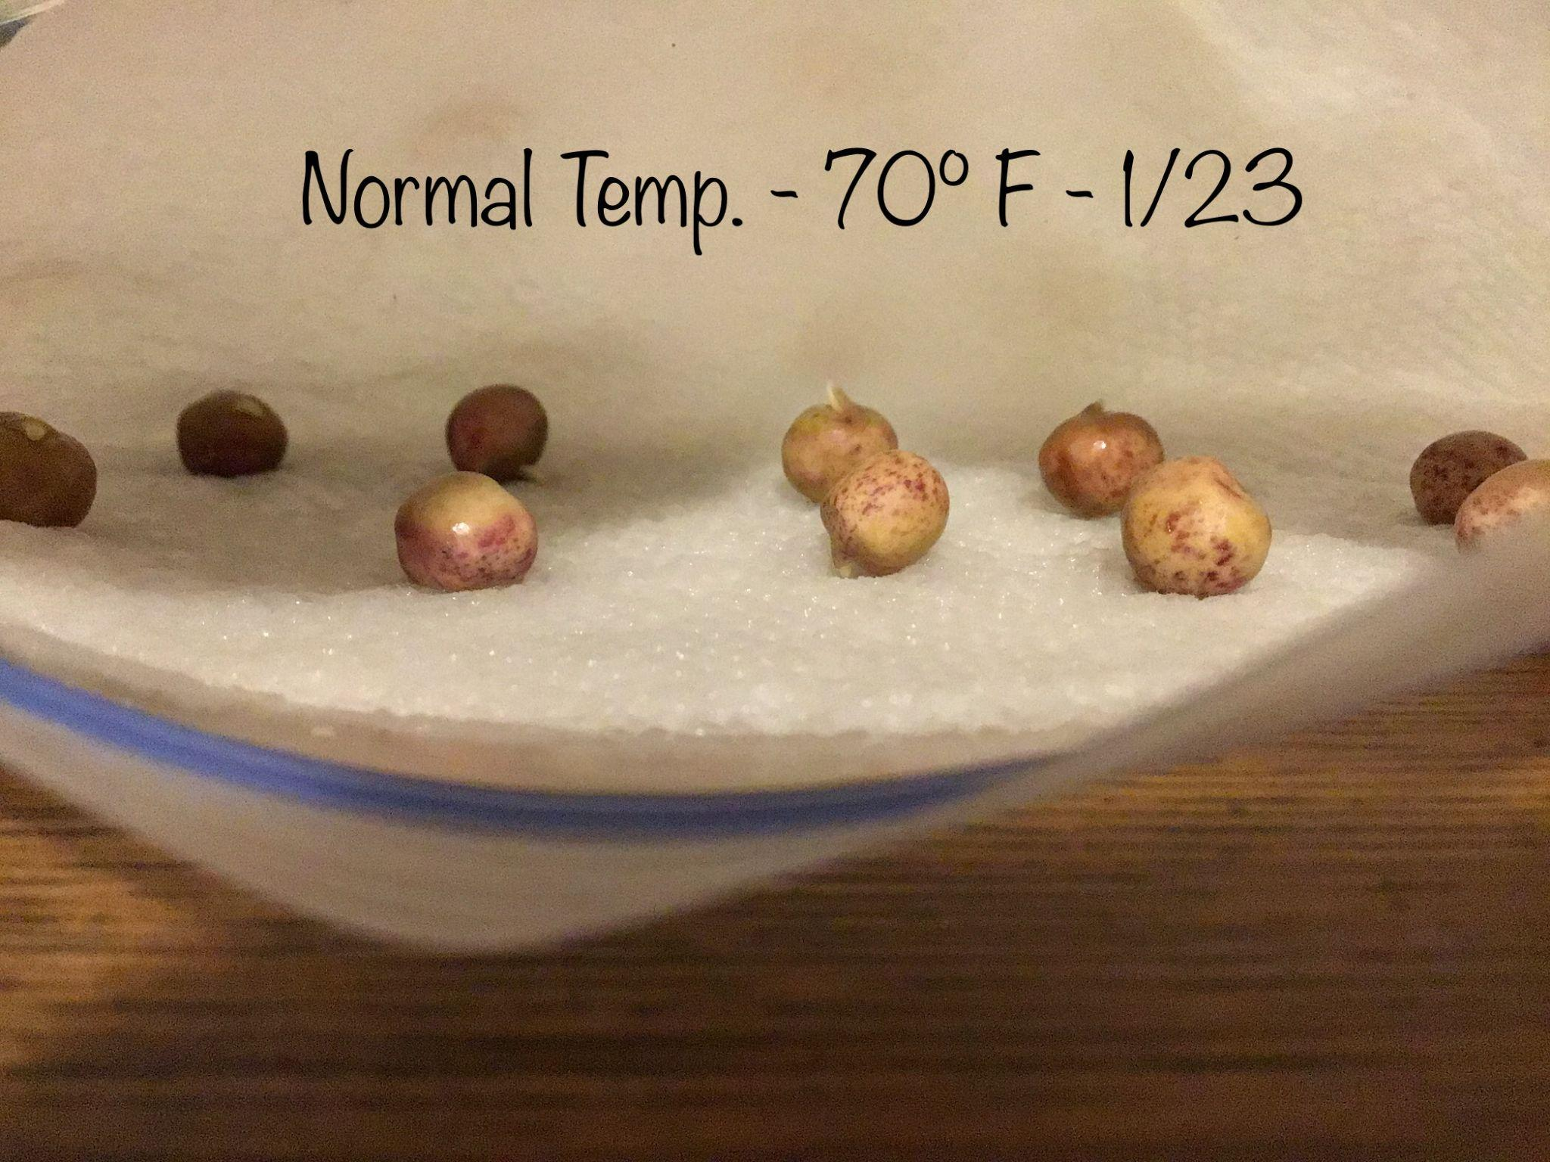
Day 2 Observations

Slide 8
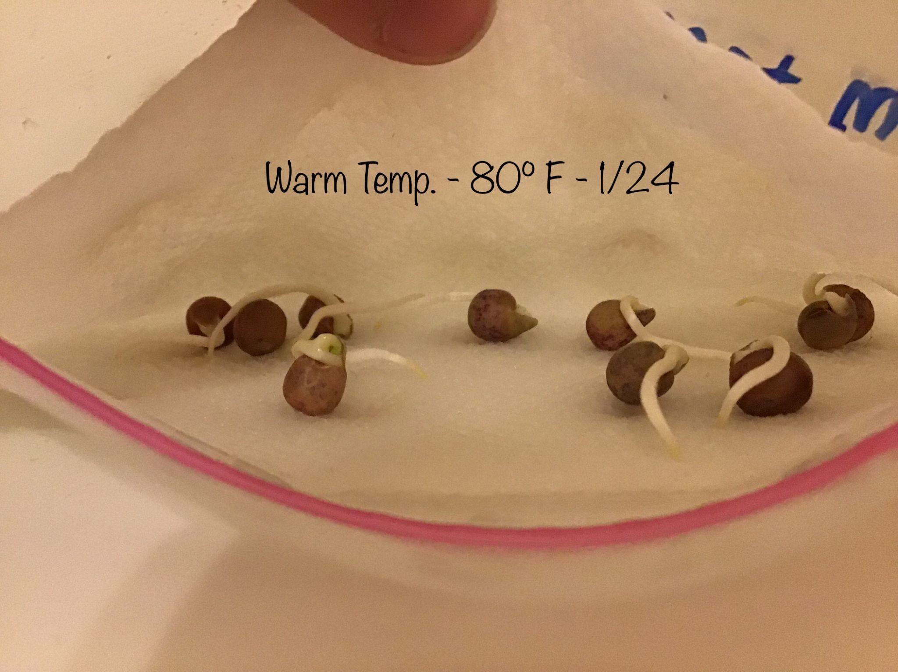
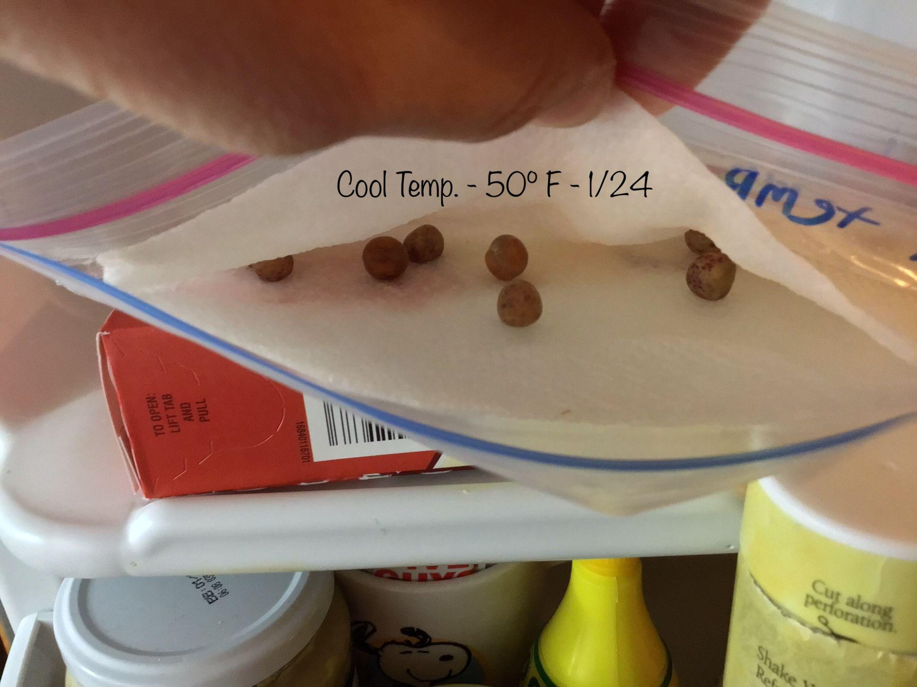
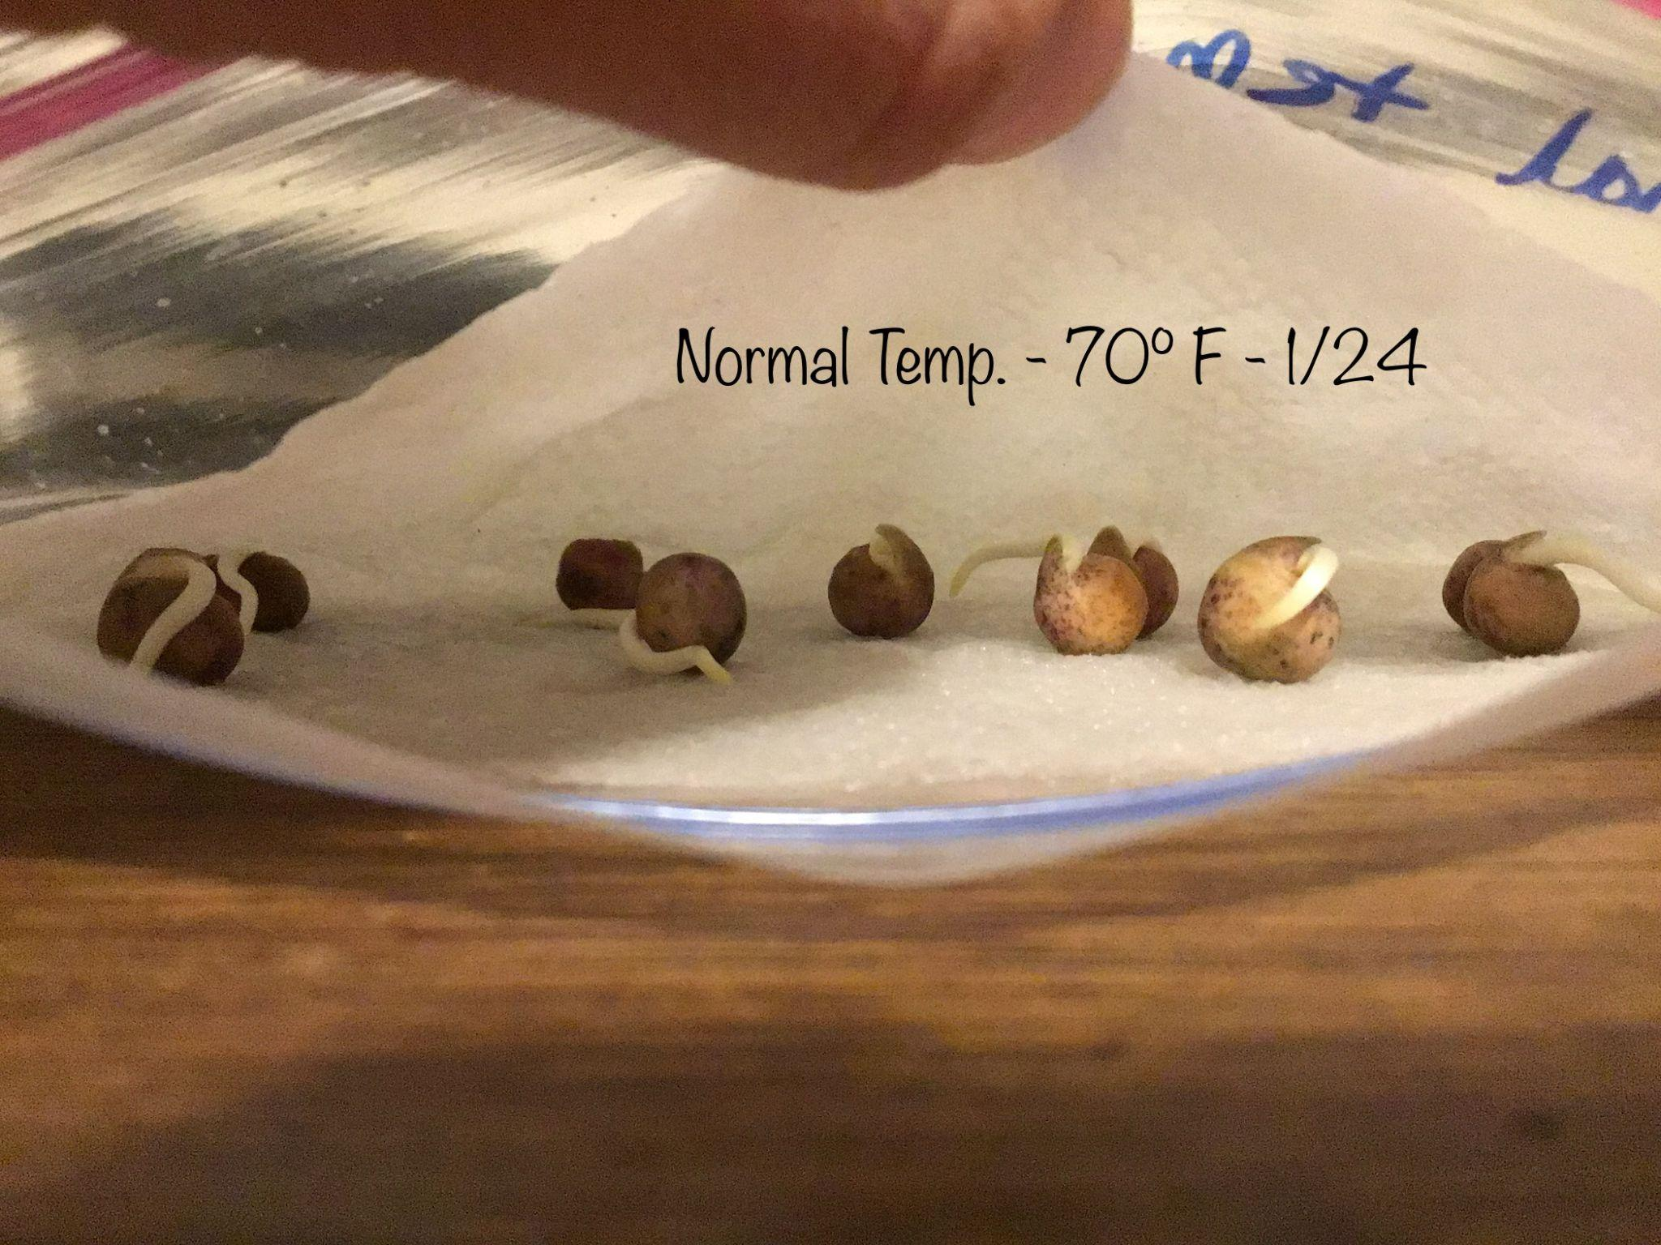
Day 3 Observations

Slide 9
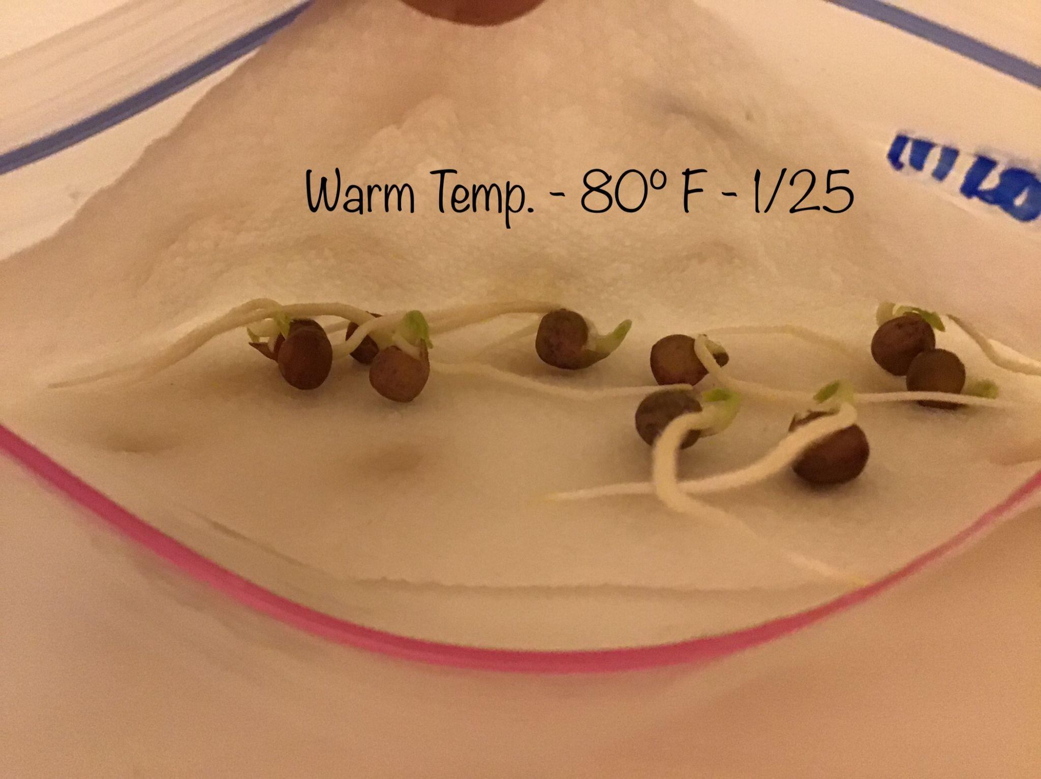
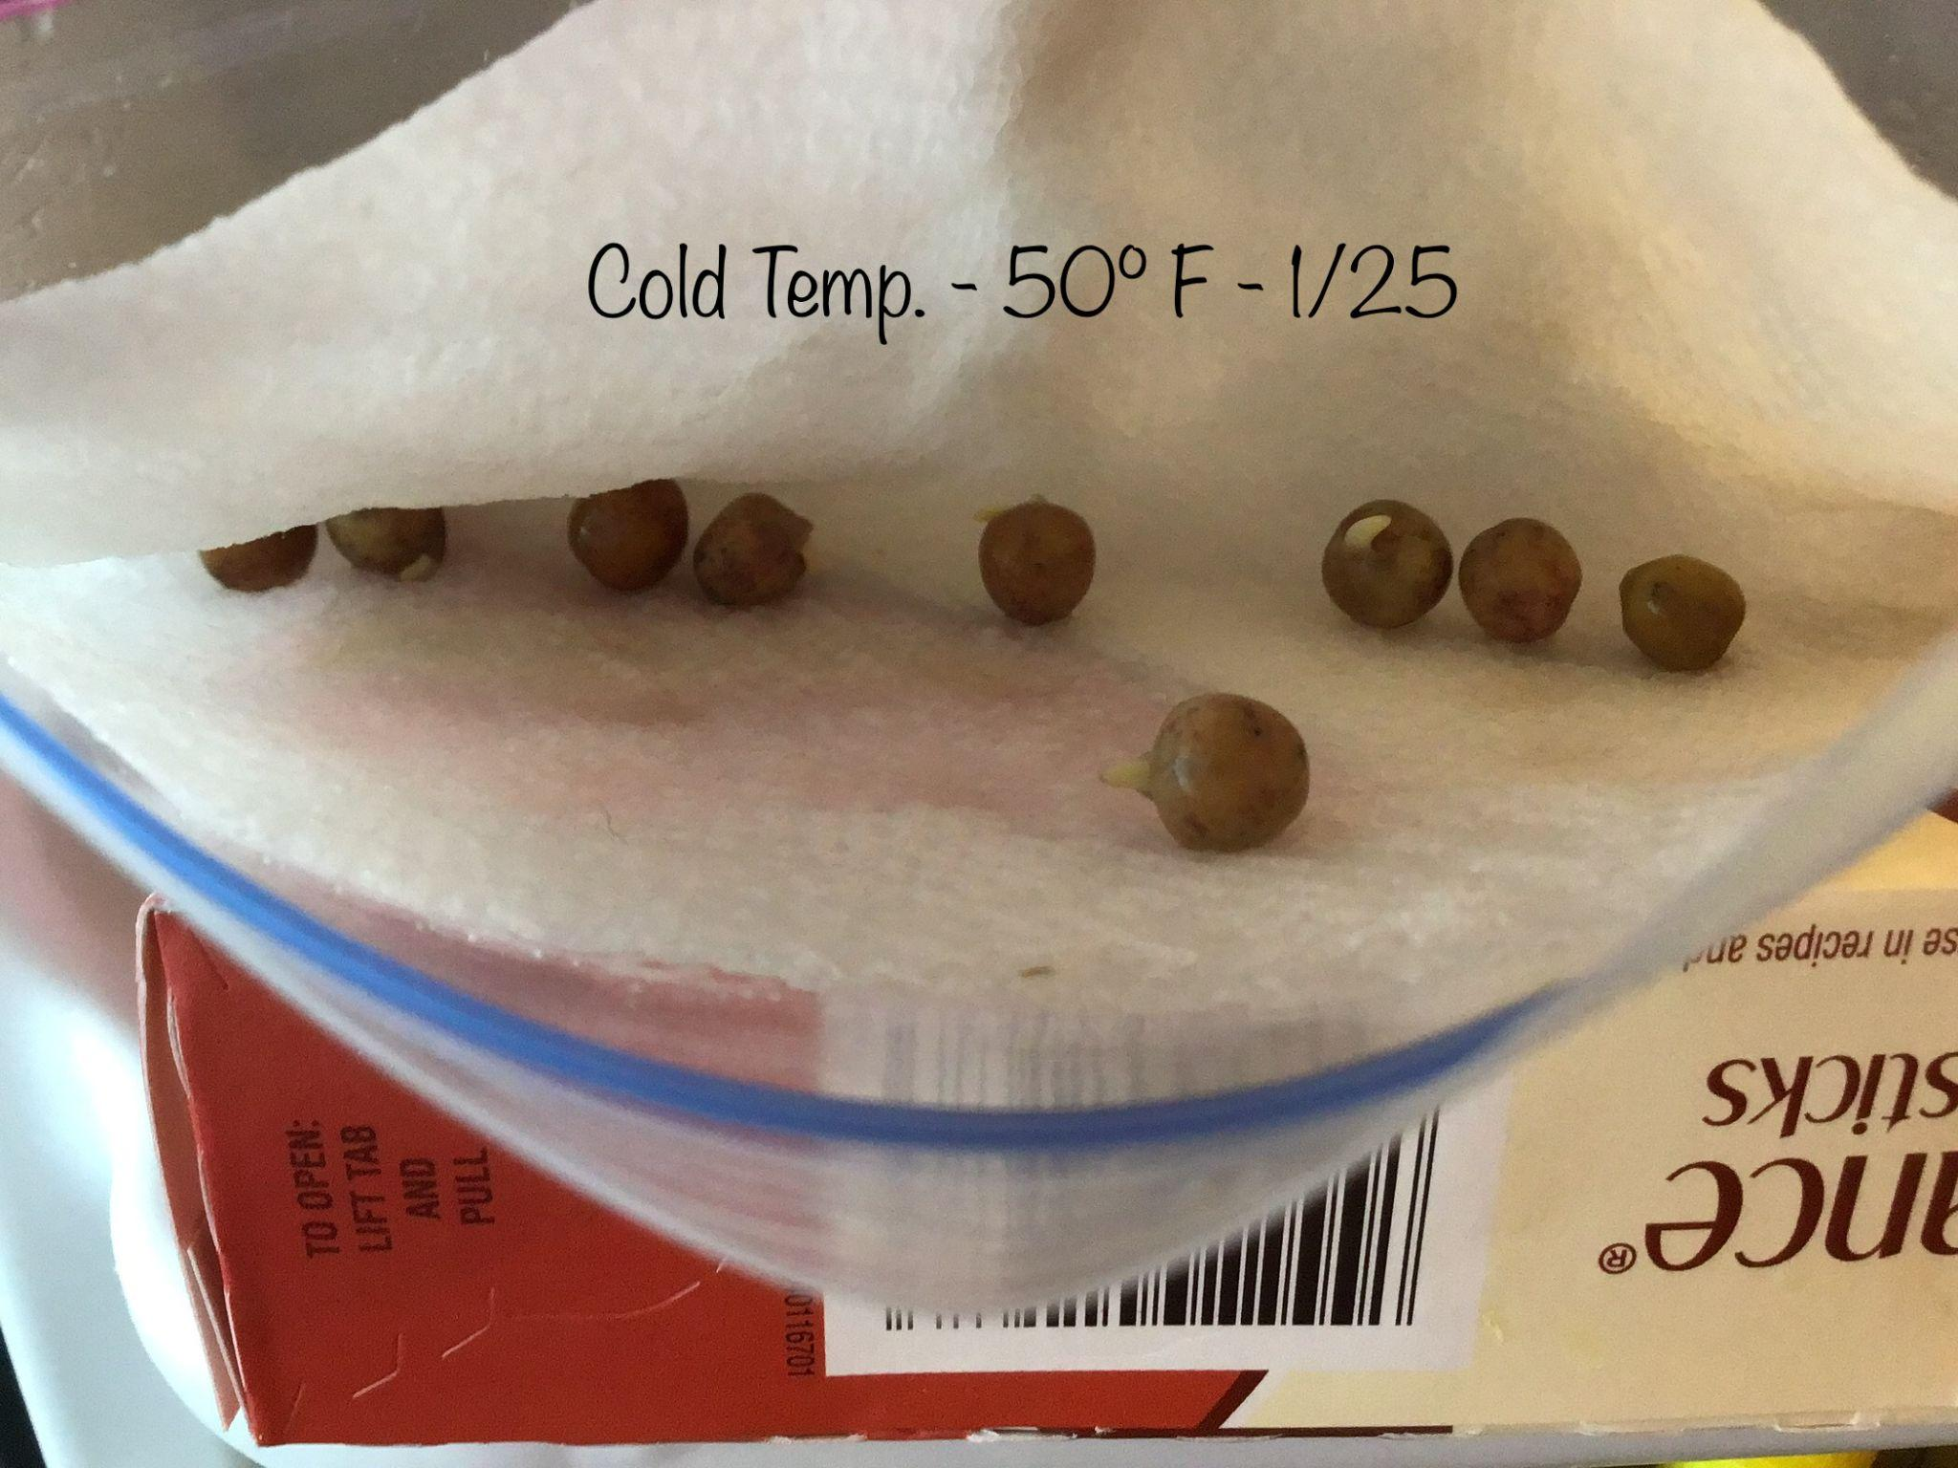
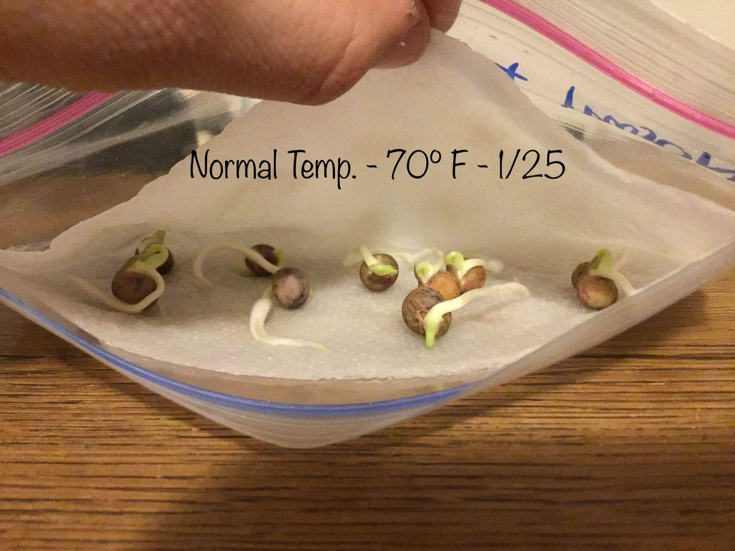
Day 4 Observations

Slide 10
Analysis
My data suggests that when given the same amount of time to germinate in different temperatures, the pea seeds in the warm temperature germinated faster than the other 20 peas.
This might be because peas need moisture, and warmth to germinate successfully and fast.
The other peas in the other temperatures did not grow as fast as the peas in the warm temperature. because of different temperatures which changed the levels of moisture the peas got.

Slide 11
Summary
My evidence does not support my claim. This is because the warm temp and normal temp have more moisture for the pea seeds to germinate.
The method I followed did allow me to answer my research question. I think this is because it gave me the data I needed to create a conclusion.
Some strengths in my method were that the method of germinating the pea seeds in a ziplock bag with a damp paper towel, sped up the germination process for the peas and so I was able to get results fast and easily.
Some weaknesses in my method were that I did not have enough quantitative data and would definitely benefit if there was another way to measure through quantitative measurements the speed of a pea seed germination.

Slide 12
Errors and Corrections
Some errors I did was that I did not manage my time on writing the procedure, materials and hypothesis so I had a time limit and had to redo it many times before conducting the experiment.
What I would do for the future would be to manage my time for brainstorming because I did not manage my time well on brainstorming.

