Slide 1
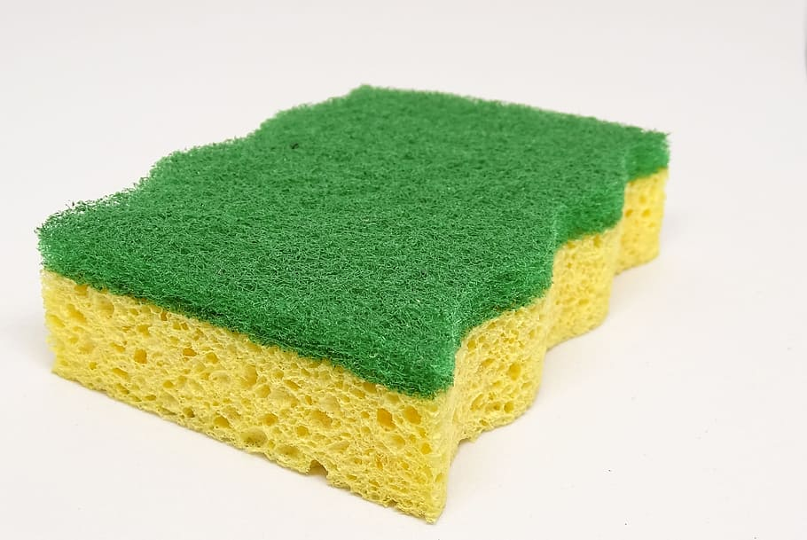
How Do Amounts of pH Affect a Sponge’s Performance
Grant Berness

Slide 2
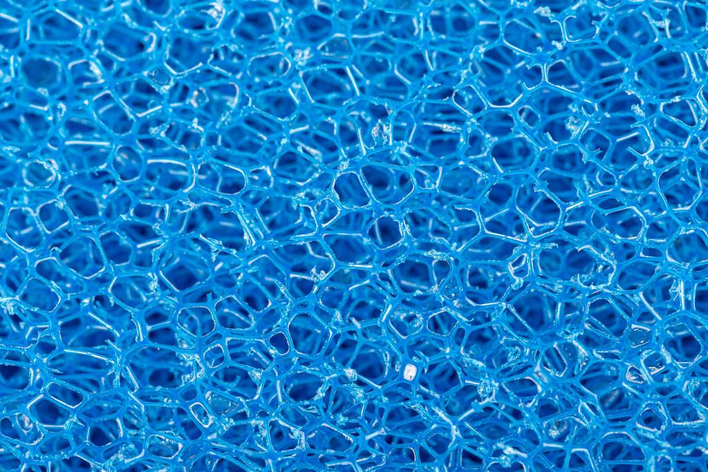
Hypothesis
I predict that If I add liquids with high pH to a sponge, then the sponge will soak up as much water the next day. I predicted that adding higher PH liquids to a sponge will result in the sponge soaking up less liquids (H2O) the next day. In the Ocean, as the water temp. gets higher the amount of pH drops in the Ocean causing the reefs to die. Since sea sponges absorb dead material, such as shells and dead reefs, this will cause sponges to take over the ecosystem of coral reefs. Since less pH helps sea sponges thrive, it would make sense that an artificial sponge, which shares characteristics with a sea sponge and that will shrink and be less absorbent than a sponge with less pH.

Slide 3
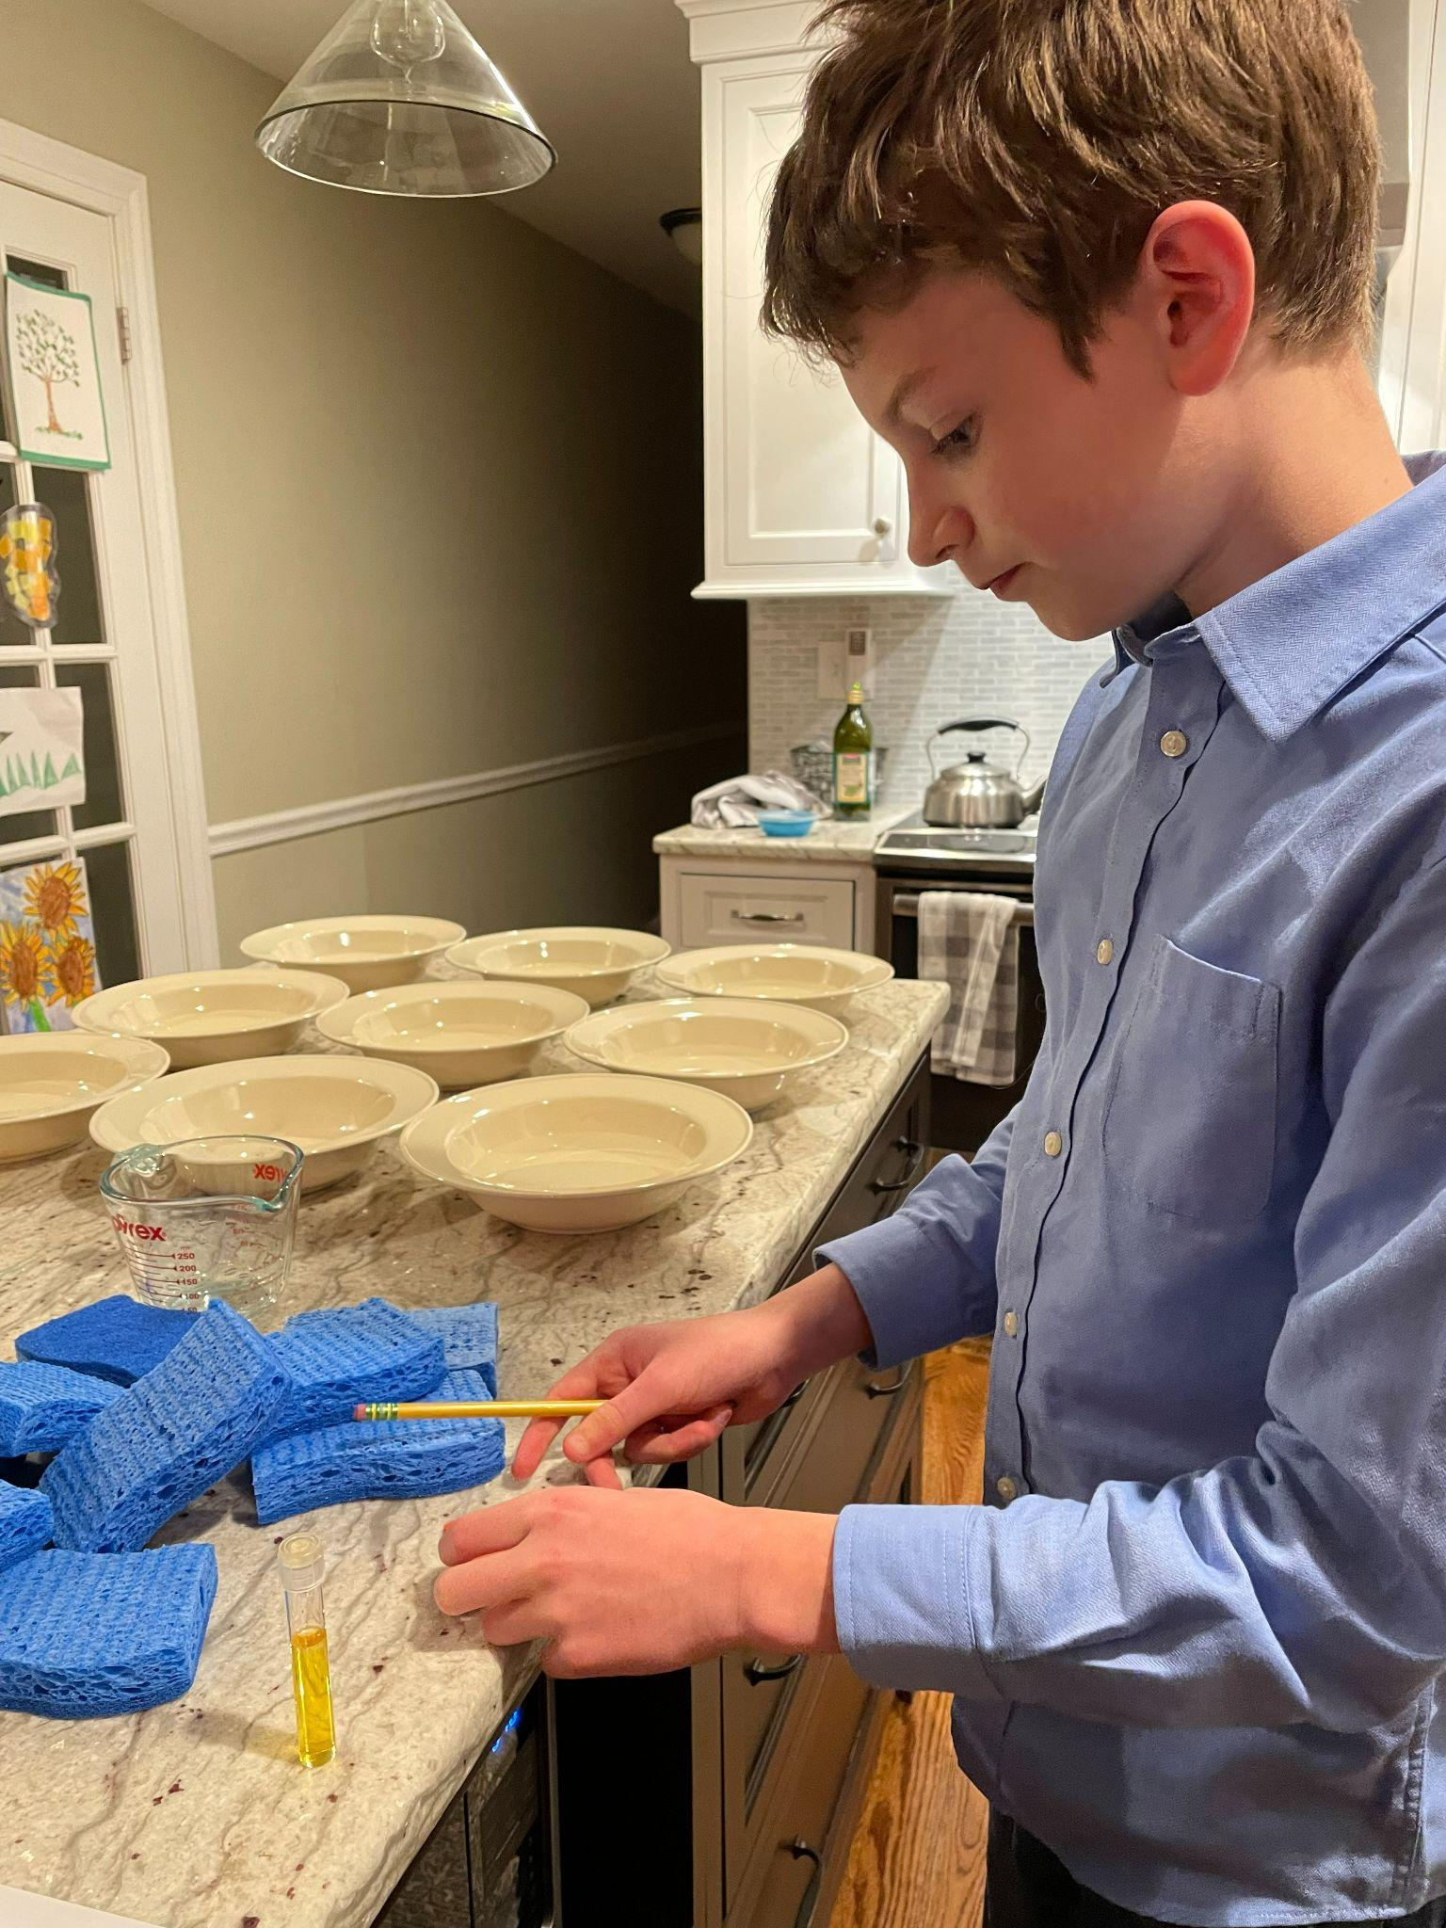
Materials
Equipment
9 Scotch-Brite Non-Scratch sponges
O.J 8oz. x3
Green tea 8oz. x3
Water 8 oz. x12
18 Bowls
post it notes
Measuring cup
timer
3 pH tests
Hair dryer
use of materials
For being dipped and soaked in liquids.
For soaking of sponges
For soaking of sponges
For soaking of sponges and for the sponges to absorb
For holding liquids.
For laboling liquids and sponges
Measuring water
For keeping track of time
For measuring how much pH each liquid has.
TO DRY THE SPONGES

Slide 4
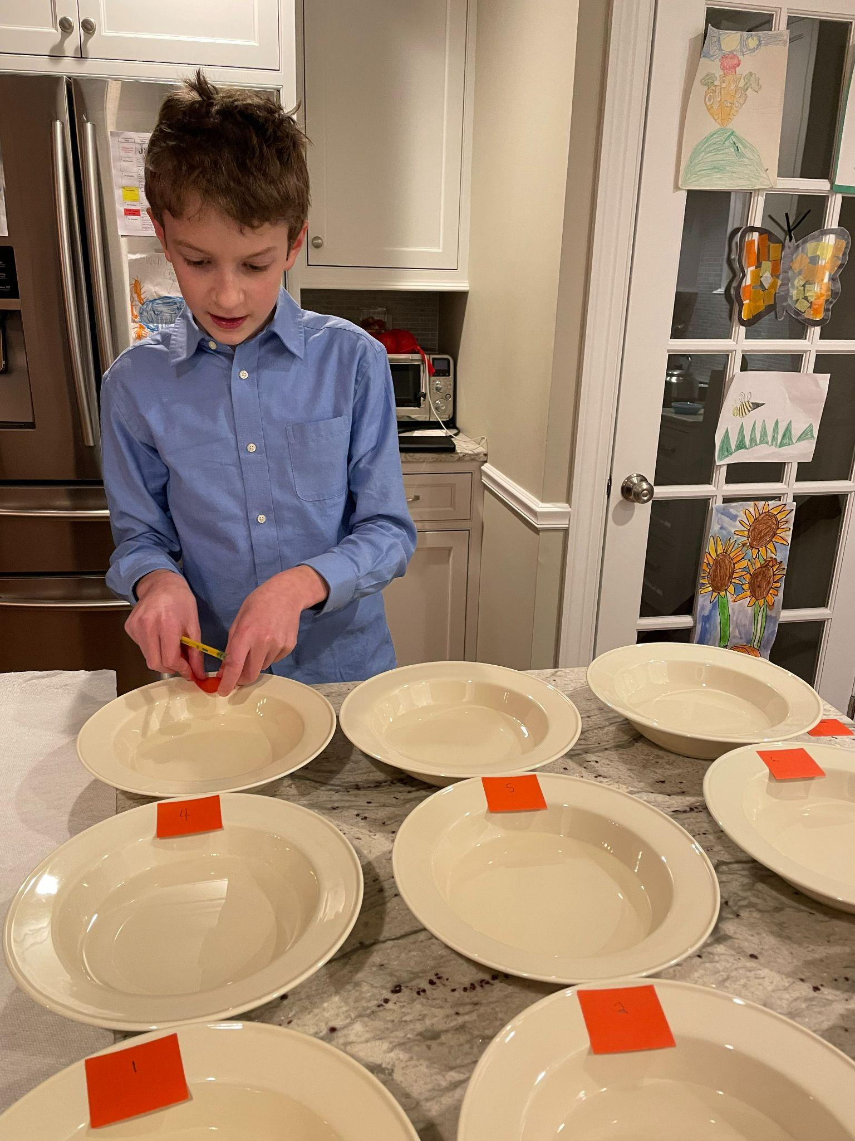
Procedures
1.Take out 9 bowls.
2.pour water into a measuring cup, fill the measuring cup to 8 oz.
3.Pour the water into one of the nine bowls.
4.Repeat steps 2 and 3 till all 9 bowls have 8oz of water.
5. Set a timer for 10 min. DO NOT PRESS START.
6.Put the 9 sponges in the water at the same time as pressing play on the 10 minute timer.
7.While the ten minute timer is still going, take nine more bowls and place them on a nearby flat surface.
8.Use the measuring cup again (which you must rinse and dry out) to measure 8oz. of Orange Juice. Repeat 3 times and add the orange juice to three of the empty bowls.
9.Use the measuring cup again (which you must rinse and dry out) to measure 8oz. of Green tea Repeat 3 times and add the Green tea to three of the empty bowls.
10.Use the measuring cup again (which you must rinse and dry out) to measure 8oz. of water Repeat 3 times and add the water to the last three empty bowls.
Please note: If you would like to add post-it notes to mark which bowl is holding each liquid feel free to do it. It is also highly advised.
11.When the timer for ten minutes runs out remove the sponges and put the leftover water in the measuring cup after you clean it again write down how much water the sponge absorbed
11B.When the sponge is taken out of any liquid throughout the procedure squeeze out the extras and use a hair dryer to finish drying it then you may put the sponge in the next liquid. This will apply to every time you take a sponge out of a liquid.
12.put the sponges in the other bowls that you just prepared which are holding water, green tea, and O.J. Set a timer for 24 Hours immediately.

Slide 5
Procedures Continued
9.Use the measuring cup again (which you must rinse and dry out) to measure 8oz. of Green tea Repeat 3 times and add the Green tea to three of the empty bowls.
10.Use the measuring cup again (which you must rinse and dry out) to measure 8oz. of water Repeat 3 times and add the water to the last three empty bowls.
Please note: If you would like to add post-it notes to mark which bowl is holding each liquid feel free to do it. It is also highly advised.
11.When the timer for ten minutes runs out remove the sponges and put the leftover water in the measuring cup after you clean it again write down how much water the sponge absorbed
11B.When the sponge is taken out of any liquid throughout the procedure squeeze out the extras and use a hair dryer to finish drying it then you may put the sponge in the next liquid. This will apply to every time you take a sponge out of a liquid.
12.put the sponges in the other bowls that you just prepared which are holding water, green tea, and O.J. Set a timer for 24 Hours immediately.
13.Clean the other bowls and reset the bowls to be holding 8oz. each again. (all nine of the original water holding bowls).
14.When the 24hr. Timer goes off, puts the sponges (after you repeat step 11B.) into the newly prepared water and sets a timer for 10 min. PRESS START IMMEDIATELY.
15. After ten minutes take the sponges out of the water and dump the leftover water from each bowl (keep separate and do one at a time). into the measuring cup. Write down the amount left for each.
16. Look at the amount of pH in each of the liquids and see if the amount of pH affects the amount of water a sponge can absorb from the amount the sponge absorbed in the beginning compared to the end.
17. Record your data.
16. Clean up all materials.

Slide 6
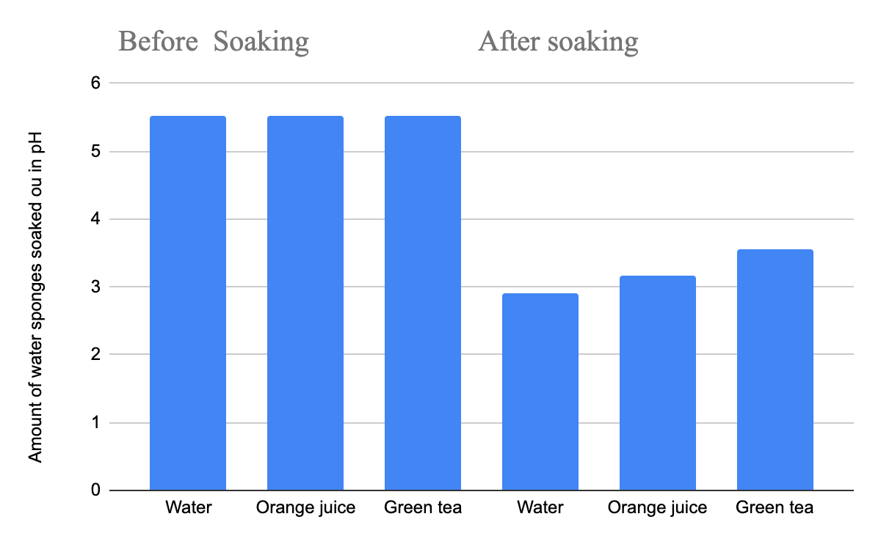
Data
Sponge # and how much water they absorbed in oz. before the experiment.
5.53 Water
5.53
5.53
5.53 Orange juice
5.53
5.53
5.53 Green tea
5.53
5.53
Sponge # and how much water they absorbed in oz.after after soaking in different liquids
2.9 Water
2.9
2.9
3.17 Orange Juice
3.17
3.17
3.55 Green tea
3.55
3.55

Slide 7
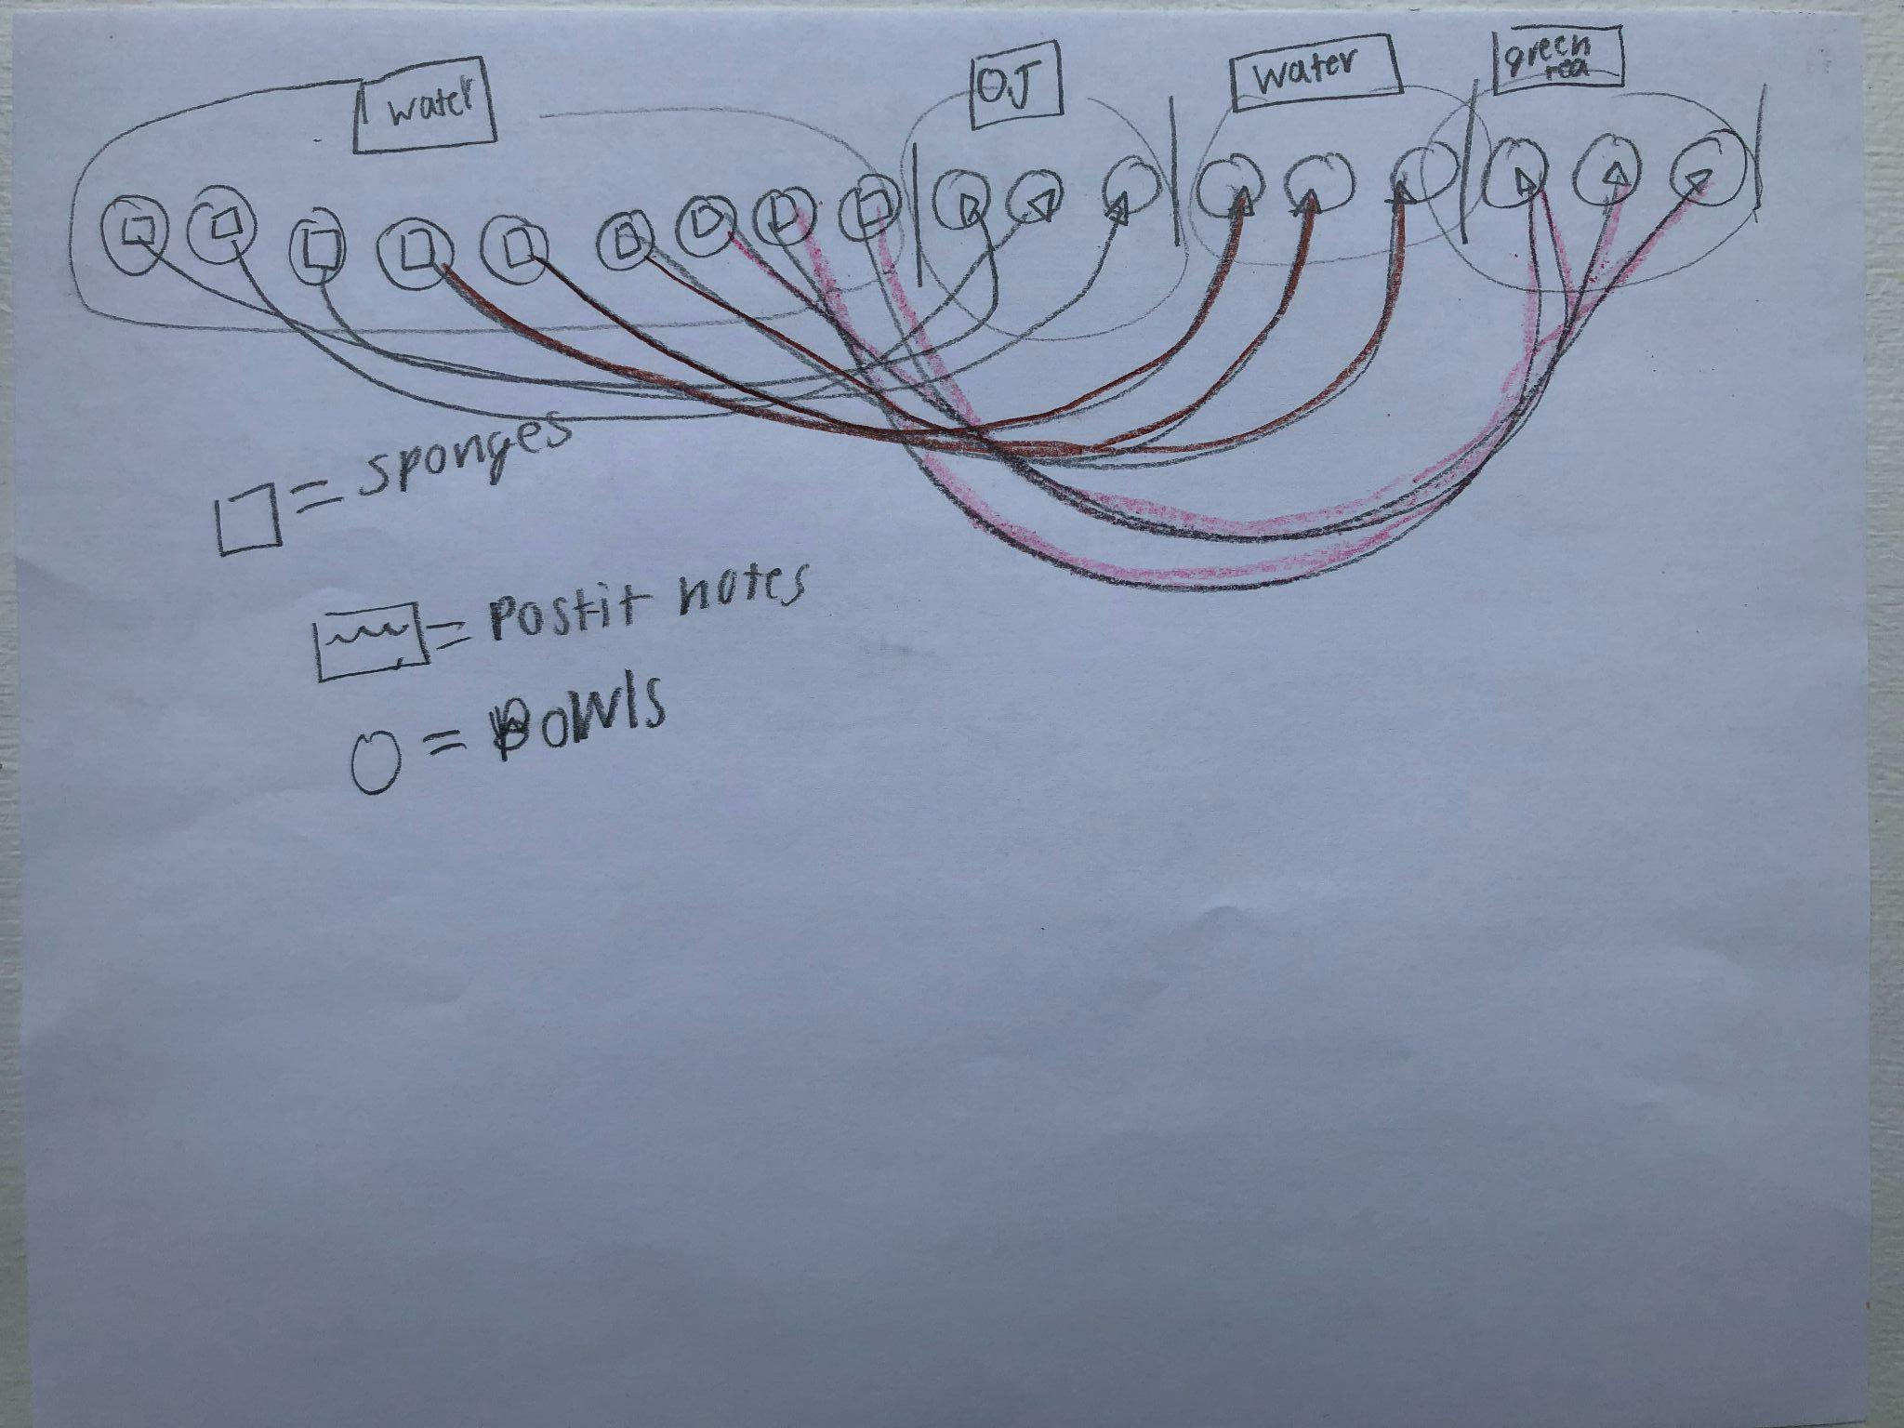
Labeled Diagram

Slide 8
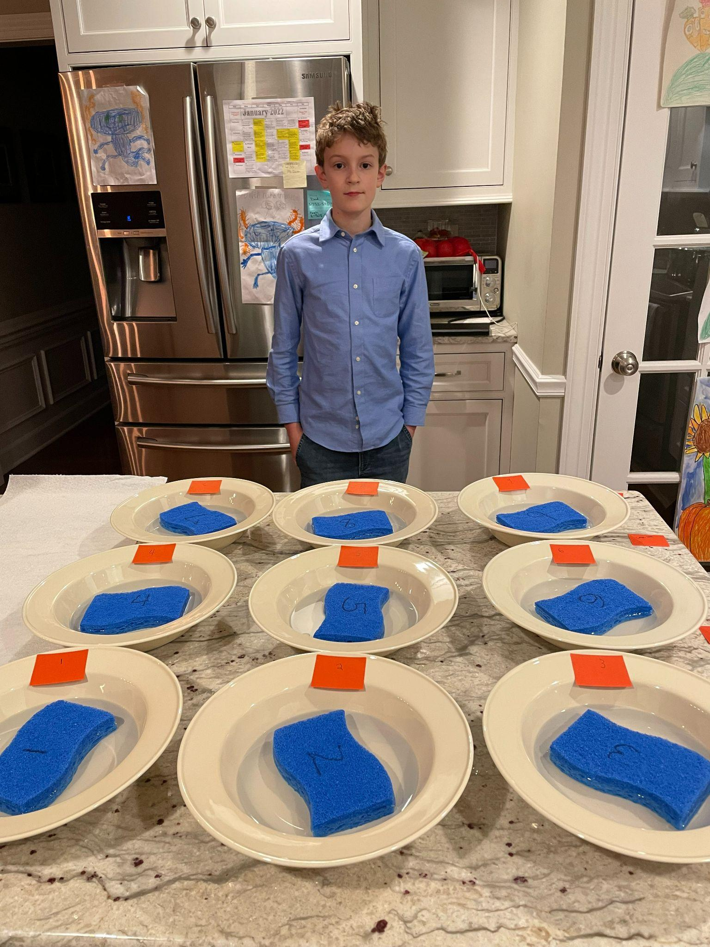
Analysis
After, Sponges where absorbing less overall
the more pH there was in the liquid the less it absorbed after for O.j only absorbed 3.17 oz. while green tea picked up 3.55 oz. yet the water absorbed the least so there was no clear result. In the Ocean, as the water temp. gets higher the amount of pH drops in the Ocean causing the reefs to die. Since sea sponges absorb dead material, such as shells and dead reefs, this will cause sponges to take over the ecosystem of coral reefs. Since more pH helps sea sponges thrive, it would make sense that an artificial sponge, which shares similar characteristics with a sea sponge would have shrunk and be less observant than a sponge with more pH. But the data was unclear and the more pH helped the most yet the least pH helped the second most. This proves that sea sponges and artificial sponges have different characteristics.
Me waiting

Slide 9
Summary
Before I dipped the 9 sponges in Orange juice, Water, and green tea the sponges could soak up 5.53 oz. on average. Now, after that the procedure was done and the sponges have soaked I can see the Orange juice soaked sponges only picked up 3.17 oz. Water soaked sponges picked up 2.9 oz. And Green tea sponges picked up 3.55 oz. All of the sponges were affected and performed poorly compared to the first soaking. But one of the things I noticed was that water did the worst and green tea did the best. Leaving me to conclude the more pH a liquid has, the better the sponge will do compared to a liquid with high pH.
While conducting the experiment I realized that the water picked up the least amount of liquids 2.9 oz. which leads me to result that the experiment may be argued to be faulty. There were not that many clear results and should be continued to further research.

Slide 10
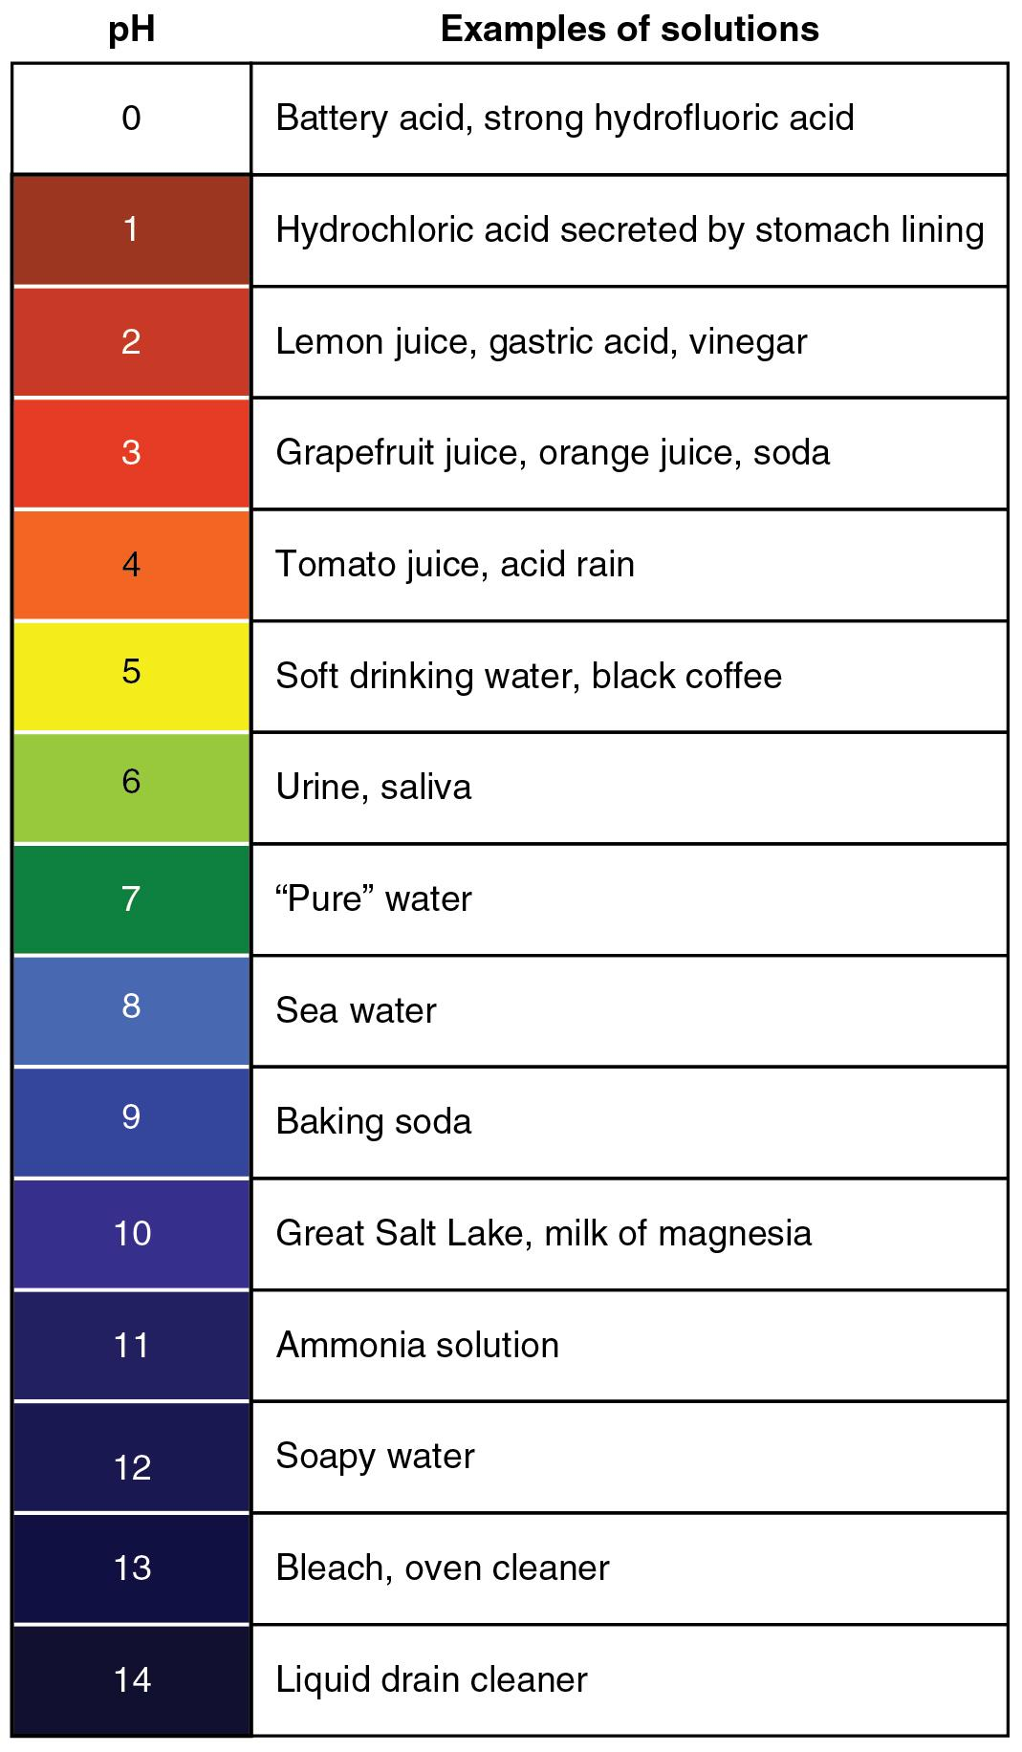
Errors Analysis
Like I have previously mentioned, I did not get clear enough data. So, if I had the opportunity to reconduct my experiment I would make sure there were more sponges so I could get more data. Hopefully, It would give me clearer answers on how the pH in liquids affects the sponges. Another thing I could have done would have been adding more liquids with different pH levels so I could be more precise on whether more pH effects sponges less.

