Slide 1
Background Information
Questions Regarding Sunscreen Itself
Applying sunscreen is one of the most important and effective methods of protecting your skin against the UV rays the sun emits. Sunscreen helps the skin by minimizing the chances for severe sunburns, skin cancer, and various skin disorders. We all know the importance of sunscreen and its use, however we must answer some more specific and scientific questions about sunscreen before we continue with this experiment.
What are the types of sunscreen and the differences between them?
What are the types of sunscreen and the differences between them?
What are the active ingredients in both types of sunscreens?
What is SPF and how does it affect the sunscreen?
What are the active ingredients in both types of sunscreens?
What is SPF and how does it affect the sunscreen?
The types of sunscreen are chemical and mineral, which is also commonly referred to as physical. The main difference between the two is how they protect against sunlight. Mineral/physical sunscreen physically sits on the skin and reflects the sun’s rays, acting as a barrier. In contrast to this, chemical sunscreens form a thin layer and are absorbed into the skin. They continue to absorb the UV light the skin is exposed to, and convert them into heat.
The types of sunscreen are chemical and mineral, which is also commonly referred to as physical. The main difference between the two is how they protect against sunlight. Mineral/physical sunscreen physically sits on the skin and reflects the sun’s rays, acting as a barrier. In contrast to this, chemical sunscreens form a thin layer and are absorbed into the skin. They continue to absorb the UV light the skin is exposed to, and convert them into heat. The different ingredients as well as the different consistencies can help you determine whether a sunscreen is chemical or mineral.
SPF stands for sun protection factor, and is a measure of how much solar energy it will take to penetrate the skin and cause sunburn with sunscreen in comparison to how much solar energy it will take when fully exposed. The higher the SPF, the more protection the sunscreen provides against UV light.
SPF stands for sun protection factor, and is a measure of how much solar energy it will take to penetrate the skin and cause sunburn with sunscreen in comparison to how much solar energy it will take when fully exposed. The higher the SPF, the more protection the sunscreen provides against UV light.
Active ingredients in chemical sunscreen are oxybenzone, avobenzone, octisalate, octocrylene, homosalate, and octinoxate, and active ingredients in mineral sunscreen are titanium dioxide and zinc oxide. Knowing the active ingredients in both types can help you distinguish whether a sunscreen is chemical, mineral, or a combination of the two.
Active ingredients in chemical sunscreen are oxybenzone, avobenzone, octisalate, octocrylene, homosalate, and octinoxate, and active ingredients in mineral sunscreen are titanium dioxide and zinc oxide.

Slide 2
Background Information
Questions Regarding The Experiment
Now that we know more about the science of sunscreen, we must delve into how this experiment will be conducted.
What will be used to find how well the sunscreen protects skin?
How will the experiment be conducted and performed?
What are RGB values and what do they mean? What are some important rules of RGB values?
What is SPF and how does it affect the sunscreen?
What are the types of sunscreen and the differences between them?
What are the active ingredients in both types of sunscreens?
Cards will be coated with different sunscreens and taken outside to be exposed to the sunlight. The colors will be recorded in different time increments; instantly, after 10 seconds, 30 seconds, 1 minute, 3 minutes, and 5 minutes. These colors will be evaluated by their RGB values, and then assessed as a scale number from 1-5 that represents how well it protects against UV light. Due to the fact that the sunscreen cannot be perfectly applied in an even layer, the lightest and the darkest hues on the card will be recorded and averaged.
The types of sunscreen are chemical and mineral, which is also commonly referred to as physical. The main difference between the two is how they protect against sunlight. Mineral/physical sunscreen physically sits on the skin and reflects the sun’s rays, acting as a barrier. In contrast to this, chemical sunscreens form a thin layer and are absorbed into the skin. They continue to absorb the UV light the skin is exposed to, and convert them into heat. The different ingredients as well as the different consistencies can help you determine whether a sunscreen is chemical or mineral.
SPF stands for sun protection factor, and is a measure of how much solar energy it will take to penetrate the skin and cause sunburn with sunscreen in comparison to how much solar energy it will take when fully exposed. The higher the SPF, the more protection the sunscreen provides against UV light.
RGB values are a way of color coding different colors. The r stands for red, the g stands for green, and the b stands for blue. The RGB color coding system states that every color is composed of red, green, and blue. The first prominent rule about RGB values is that the larger the numbers are, the lighter the color will be. The second most prominent rule is that when all the values of R, G, and B are equal, the color produced will be neutral (white, black, gray). Lastly, when the values are closer together, they are closer to being neutral. The farther the colors are away from each other, the purer and stronger the color.
UV sensitive cards will be used to find how well a sunscreen protects the skin.
Active ingredients in chemical sunscreen are oxybenzone, avobenzone, octisalate, octocrylene, homosalate, and octinoxate, and active ingredients in mineral sunscreen are titanium dioxide and zinc oxide.
How do UV sensitive materials work?
UV sensitive materials are coated in chemicals that will respond when exposed to light waves by changing color. The darker the color, the less protection there is.

Slide 3
Testable Question
Hypothesis
What brands, SPFs, Types of Sunscreens, and amount of sunscreen provides the best protection against UV light?
The sunscreens with higher SPFs will provide more protection against UV light, and mineral sunscreens will protect for longer because SPF is correlated with how much protection a sunscreen provides, and because mineral sunscreens create a barrier that stays on your skin. More sunscreen will also increase the amount of protection since it will give more coverage and stability to minimize exposure to UV rays.

Slide 4
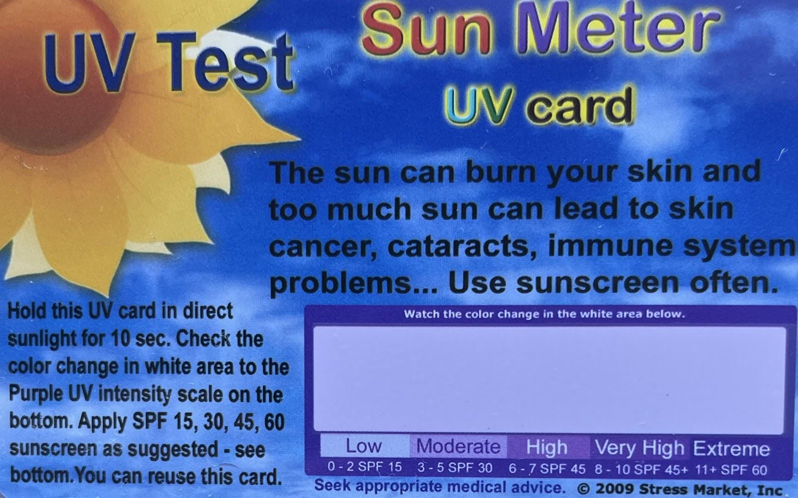
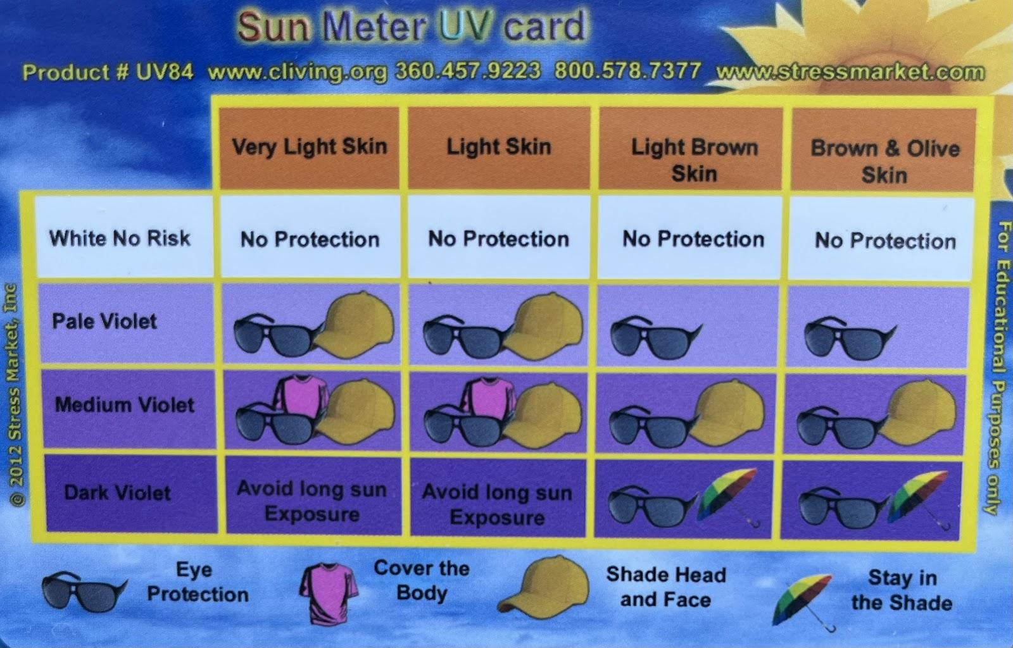
Materials
UV sensitive cards or paper
Portable tray(s)
A cover for the tray
Coppertone Tanning Sunscreen Lotion
Neutrogena Ultra Sheer (I had one with 30 SPF, one with 55 SPF, and one with 70 SPF)
Neutrogena Sheer Zinc
Coppertone Pure & Simple Baby Sunscreen Lotion
UV sensitive card (front)
Ultrasun Professional Protection Face (I had one with 30 SPF and another with 50+ SPF)
Skinceuticals Physical Fusion
Sun Bum (I had one with 30 SPF, and another with 50 SPF)
Lamer UV Protecting Fluid
Coppertone Kids Tear Free Sunscreen Lotion
Banana Boat Sport Ultra Spray
Tatcha Silken Pore Perfecting Sunscreen
Device with an app to determine
color/color values (I used the app Pixel Picker)
Device to record and take pictures
Device to record time
UV sensitive card (back)

Slide 5
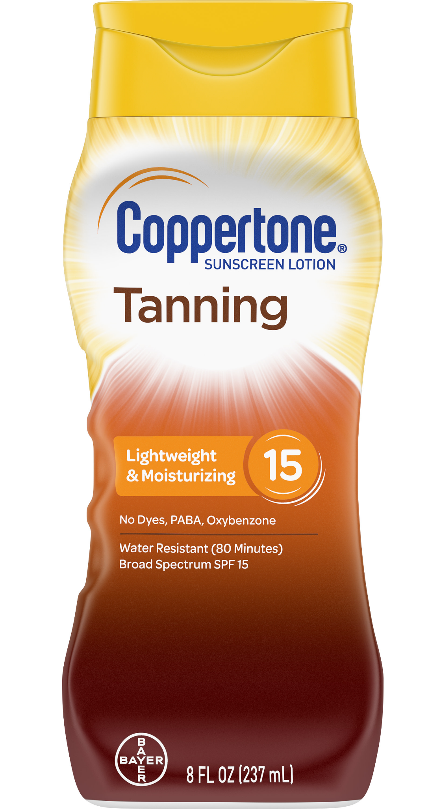
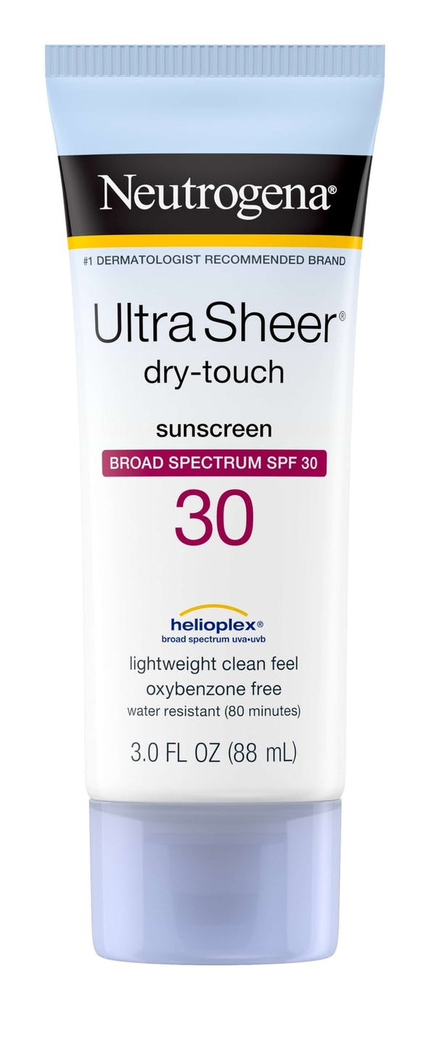
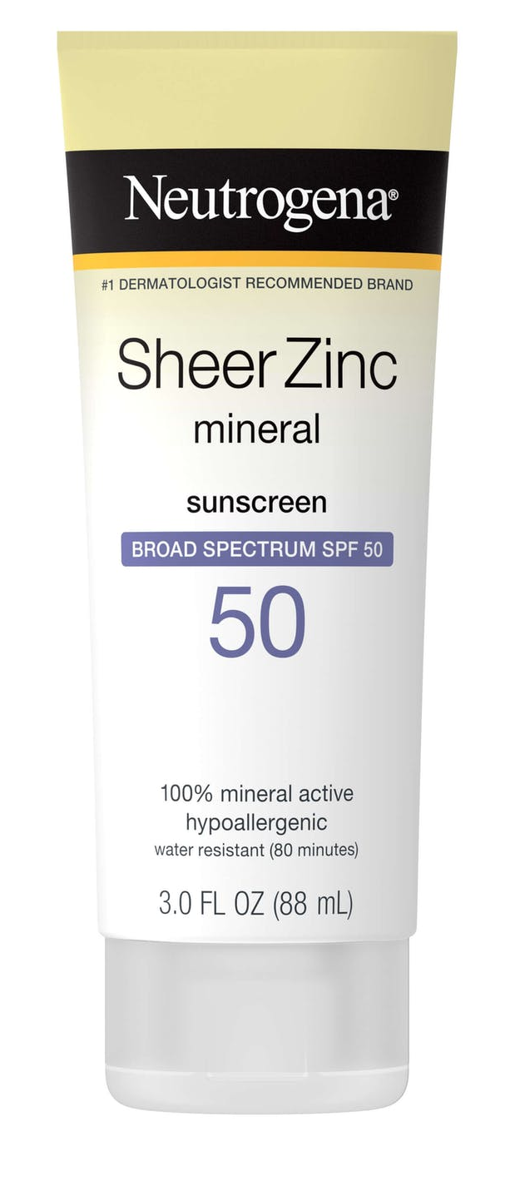
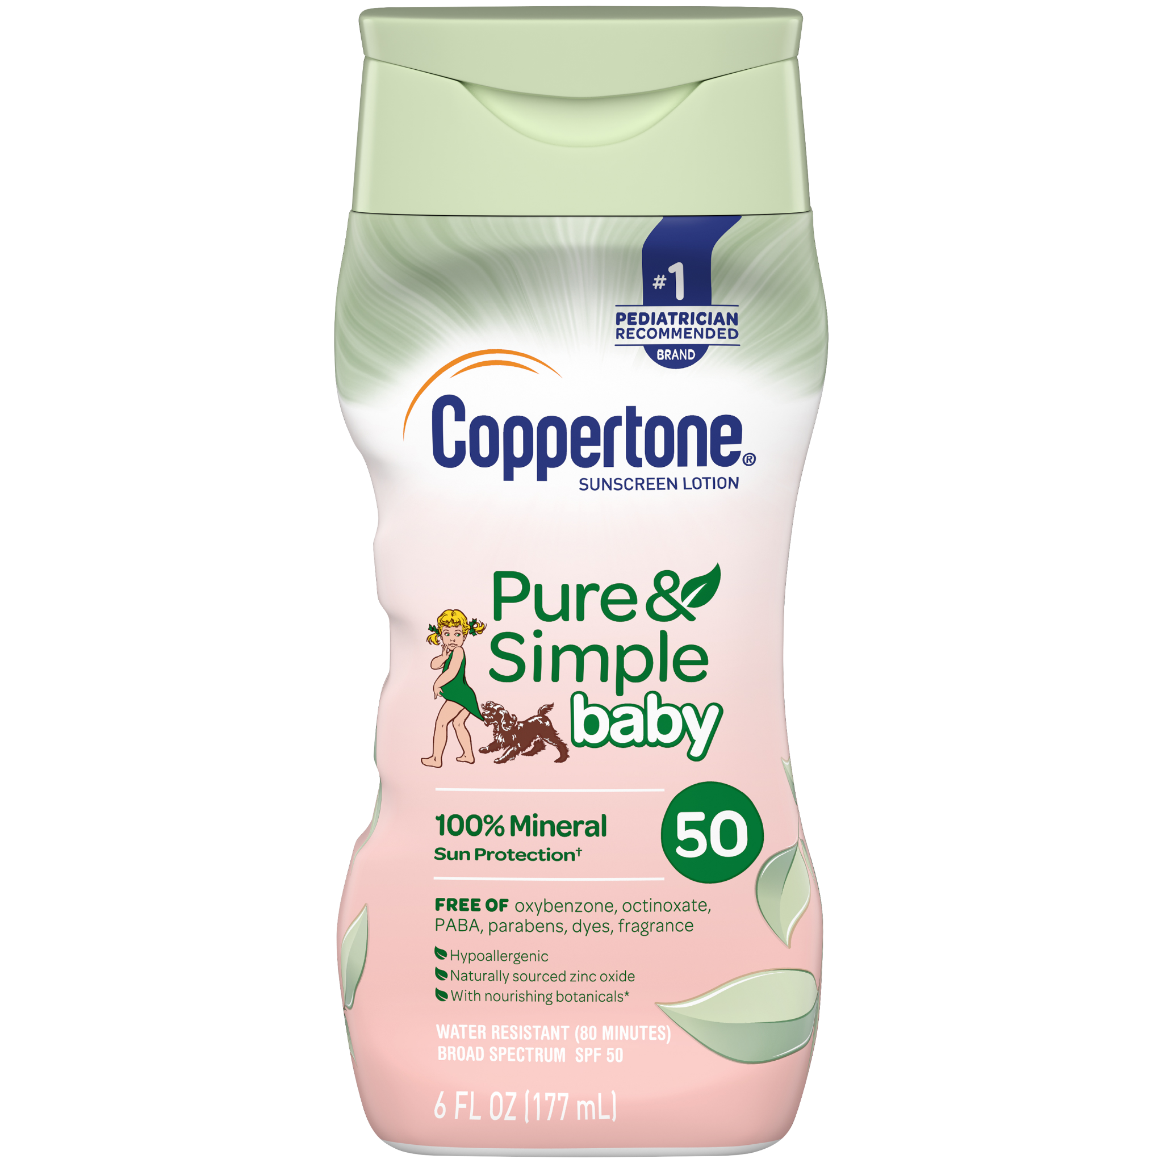
Materials
Each sunscreen had been assigned a number to easily refer to and identify which sunscreen it was. Throughout this project, I will refer to each sunscreen as its corresponding number.
1.
2.
3.
4.
5.
6.
7.
8.
(SPF 15)
(SPF 30)
(SPF 55)
(SPF 50+)
(SPF 50)
(SPF 50)
(SPF 70)
(SPF 50)
9. 10. 11. 12. 13. 14. 15.
(SPF 50)
(SPF 50)
(SPF 50)
(SPF 50+)
(SPF 30)
(SPF 30)
(SPF 35)

Slide 6
Data
After the RGB values were all evaluated, they were assigned a number on a scale of 1-5, with 1 being very protective, and a low chance of dangerous UV exposure, and with 5 being the least protective, and the most extreme chance of being exposed to dangerous UV rays. All results were averaged among all 3 trials. Examples of these tables are provided below.
1 (Averages of all Trials for “Instant”) | Scale #
Darkest hue | 1.33 (2, 1, 1)
Lightest hue | 1.17 (1.5, 1, 1)
Average | 1.25
1 (Averages of all Trials for “10 seconds”) | Scale #
Darkest hue | 2 (3, 2, 1)
Lightest hue | 1.33 (2, 1, 1)
Average | 1.67
Due to the fact that there were too many tables and pictures to compile into this slide presentation alone, the full collection of 150 tables and multiple photos recorded from the experiment will all be provided in this linked document. This document has also been attached to the final project assignment.
https://docs.google.com/document/d/1tniLBJP8eVqB4H6fqlS-vOwiQI9209enZHsOH_LN86o/edit

Slide 7
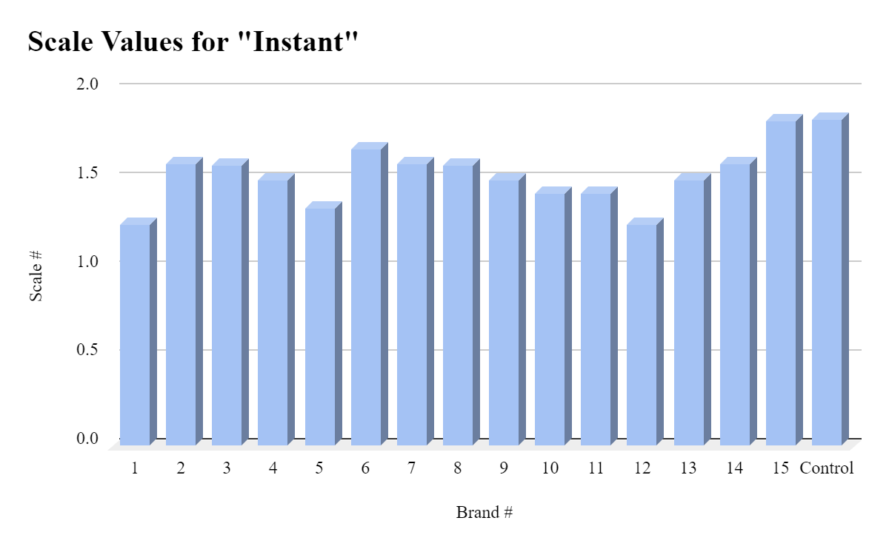
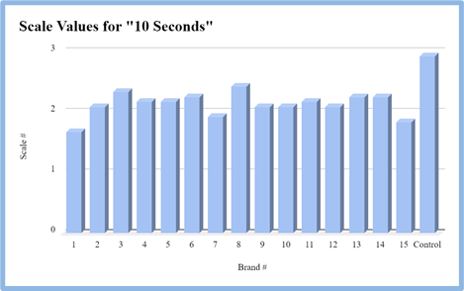
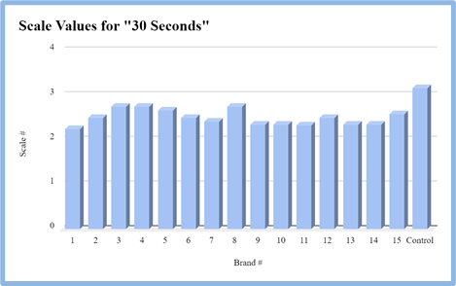
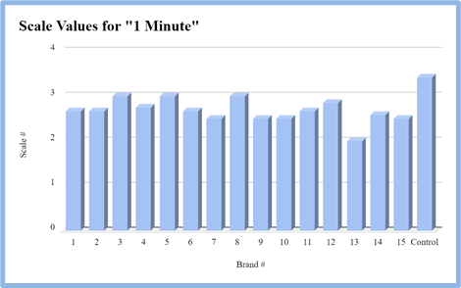
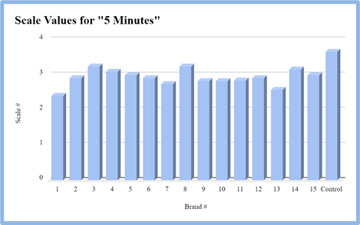
Data

Slide 8
Analysis
Outcomes and Discoveries
It is difficult to determine whether the SPF truly correlates to the protection based on this experiment alone.
Surprisingly, number 1 performed very well, despite it having the lowest SPF out of every sunscreen. Numbers 1 and 7 were the most notable in producing the lightest colors in general.
Numbers 8 and 3 were the most notable in producing the darkest colors.
2, 3, 6, 7, 11, 13, 14, and 15 were all quite successful in trial 3, where the most sunscreen was applied. All of these numbers scored constant 1s with their lightest hues from Instant all the way to 5 minutes.
3, 4, 6, 14, and 15 were the numbers that all reached the highest number on our scale, 5. The majority of these scores can be found at the 5 minute mark.
I’m not exactly sure why some of these results were the way they were, however I assume they were most likely faults with the method I had used. These cards cannot accurately represent real human skin and how well a sunscreen can protect against the sun. An idea I had on why number 1 specifically performed so well is that it did not work on the card as it actually would on skin. Chemical sunscreens are absorbed into the skin, which is the primary way in which they protect the skin from UV rays. However, on the cards, the chemical sunscreens may not have been able to be absorbed, which only created a layer of sunscreen on top. This would not be an accurate representation of how chemical sunscreen functions on human skin in a real scenario.

Slide 9
Analysis
Outcomes and Discoveries
Number 8 was constantly shown for having some of the darkest colors. Something to note is that number 8 was the only sunscreen that was tinted. While every other sunscreen was white or clear, number eight was a tannish brown color, which may have affected the color perception. Since this test was determining the amount of protection a sunscreen provides by color alone, it may have been a bit disproving for this particular sunscreen.
Chemical sunscreens that were thicker were typically more consistent. Number 12, which was the only spray, was also notably very consistent, with the largest difference between the darkest and lightest value only being 1.5, and the greatest difference between multiple trials 1. Sprays are not as affected by human error or inconsistency, which is why it was a very constant, clear color. Number 12 was also quite an outlier in this sense, due to the fact that it was the only spray. Although it was very consistent, it was also more difficult to apply more of. When you apply more and more spray, it just clumps up as a liquid.
The amount of time the cards were exposed to the sun also had a clear difference. However, when you layer the sunscreen thick enough, you can retain the state of little exposure. Of course, it is inconvenient and strange to apply sunscreen in extremely thick layers. In this regard, this experiment also enforces the importance of reapplying sunscreen. Instead of applying large amounts of sunscreen, remember to apply the recommended amount and constantly reapply.
When I applied very little in trial 1, and then added larger amounts in trials 2 and 3, there were significant differences especially with the mineral sunscreens. In general, thicker layers of sunscreen provide more protection, and this was very clearly displayed with the mineral sunscreens, as well as the combination sunscreens. For example, number 6’s lightest hue dropped from 3.5 all the way to one (from trial 1 to trial 3). I think this is because the mineral sunscreens act physically as a barrier, and need more full and thick layers to be able to completely protect the skin. Chemical sunscreens are not hindered by the amount you apply as much, due to the fact that they are absorbed by the skin in the first place.

Slide 10
Analysis
Notable Sunscreens
Notable for Instant:
Lowest/lightest colors: 1, 12, 5
Highest/darkest colors (NOT including control): 15, 6, 7 & 14 & 2
Notable for 10 seconds
Lowest/lightest colors: 1, 7, 15
Highest/darkest colors (NOT including control): 3, 8, 6 & 13 & 14
Notable for 30 seconds
Lowest/lightest colors: 1, 11, 9 & 10 & 13 & 14
Highest/darkest colors (NOT including control): 3, 4, 8
Notable for 1 minute
Lowest/lightest colors: 13, 7 & 9 & 10
Highest/darkest colors (NOT including control): 3, 5, 8
Notable for 3 minutes
Lowest/lightest colors: 1 & 7 & 9 & 10 & 14
Highest/darkest colors (NOT including control): 3, 8, 15
Notable for 5 minutes
Lowest/lightest colors: 1, 13, 7
Highest/darkest colors (NOT including control): 3, 8, 4

Slide 11
Analysis
Sources of Error and Ways to Improve this Experiment
A majority of the experimentation relied on the judgement of the person running the experiment, aka by human perception. For example, it was by my judgement to attempt to find the most noticeable dark hue and the most noticeable light hue.
A problem that I encountered was that due to the fact that the tray I had was slightly indented, there was a shadow cast over a few of the cards, making the color most likely inaccurate from the true color. It made the colors seem very dull and grayish in the photos I had taken, when in real life, they were not.
I used the sun as my way of exposing the cards to UV rays. Although the sun is surely the most realistic to compare to a real life scenario, in an experiment like this it would’ve been better to have a stable, controlled light source. The sun’s intensity could have fluctuated throughout the experiment and changed multiple times. I could improve this by getting a UV lamp to apply constant, even light to all of the cards.
I attempted to apply the same amount of sunscreen for each one, however some sunscreens may have recommended amounts for application that differ from any other sunscreen. This may have given some sunscreens an advantage as their actual recommended amount was used, while some may not have been able to access how they are intended to be used.
The amount of sunlight and how the sunlight was shining could’ve made some cards look different in multiple pictures, and could’ve slightly distorted the true color of each one.
Every color was determined off of photographs I had taken during the experiment, where many outside factors such as lighting and positioning would have altered the data.
The method of using the darkest and lightest point may not have been the most accurate or efficient way, for the lightest or darkest hues themselves could have both been outliers of what the actual color was.

Slide 12
Conclusion
It is difficult to determine whether SPF truly matters in this experiment, however there are many sources with real, practical scenarios that prove the importance of SPF. Using color as the sole factor to measure the amount of protection sunscreen can provide is necessarily a bad method, but it is extremely flawed. Tinted sunscreens have a clear disadvantage, and the paper or card material does not truly replicate the human skin. This experiment in itself proved my hypothesis incorrect. There is no distinct difference between how well chemical and mineral sunscreens perform, however mineral sunscreens must be applied more thickly. Some things I would do to improve the experiment would first be to minimize the area for human error and outside factors. I could calculate the RGB values more intricately; for example, I could evaluate the scale numbers based on how far the RGB values were away from 255, or I could find the differences between the values. A method like this could minimize the chance of human error, since in this experiment I evaluated the scale numbers by eye, and by no mathematical method. I would also search for a more efficient and accurate way to represent how it would work on actual skin.

