Slide 1
Purpose/Motivation
Thousands of people die and billions of dollars in property damage are lost annually due to hurricanes. Predicting the upcoming hurricane season with high accuracy prompts better preparation.
A previous paper, published in Geophysical Research Letters Journal, noted the correlation between Outgoing Longwave Radiation (OLR) July data and hurricane prediction, using the meridional gradient of OLR data over Africa as a predictor to obtain the number of hurricanes and storms for the upcoming season with high accuracy. However, they did not succeed in accurately predicting the season’s intensity (ACE index) with higher accuracy than the National Oceanic and Atmospheric Association (NOAA). I believed that using the entire July OLR map will give more information and increase the accuracy of prediction for hurricane intensity.
My previous project used Sea Surface Temperature (SST) maps as input for a neural network to classify each hurricane season into two classes: high and medium-low intensity, but the neural network did not perform well with 3 classes: high, medium, and low. NOAA classifies hurricane intensity into 3 classes, and they interpret the corresponding number of hurricanes based on the intensity class, so using the same 3 classes offers a better understanding of the upcoming hurricane season outlook.

Slide 2
Hypothesis
Using Outgoing Longwave Radiation Maps as input for Machine Learning classifiers will result in a high accuracy seasonal hurricane prediction in 3 classes: high, medium, and low intensity.

Slide 3
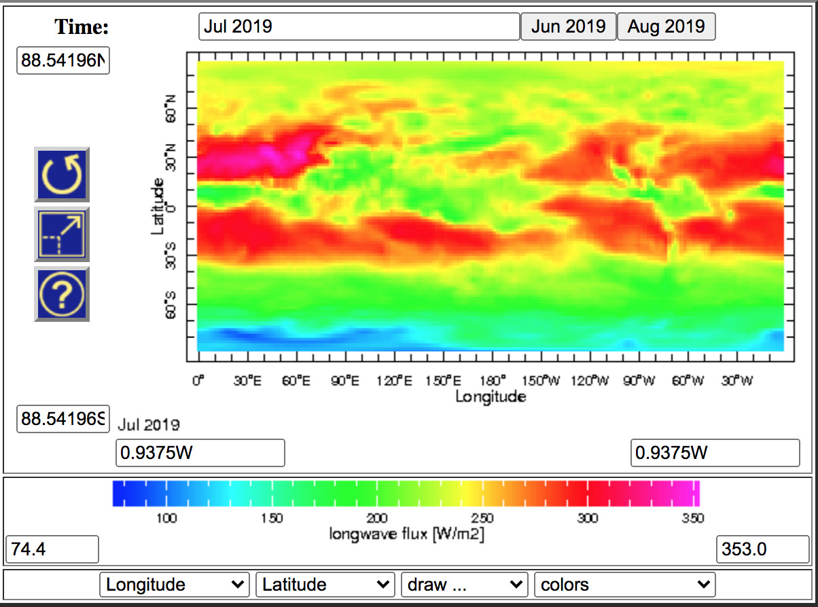
Data
Sample OLR image for July, 2019 (NOAA, n.d.)
Outgoing Longwave Radiation (OLR) maps were used as input for the machine learning algorithms, which is a novel method.
OLR measures the amount of energy the Earth’s surface, oceans, and atmosphere release into space.
73 OLR maps (from 1949-2021), downloaded from the NOAA website, were used.
Each hurricane season was classified into 3 intensity classes: high, medium, and low and labeled according to their Accumulated Cyclone Energy (ACE) value.
ACE class labels were constructed using NOAA’s classification in high, medium and low intensity seasons: if ACE > 111 10^4 kt^2, the season’s activity is considered high, if ACE < 66 10^4 kt^2, the season’s activity is low, and the season’s activity is considered to be medium for values in between

Slide 4
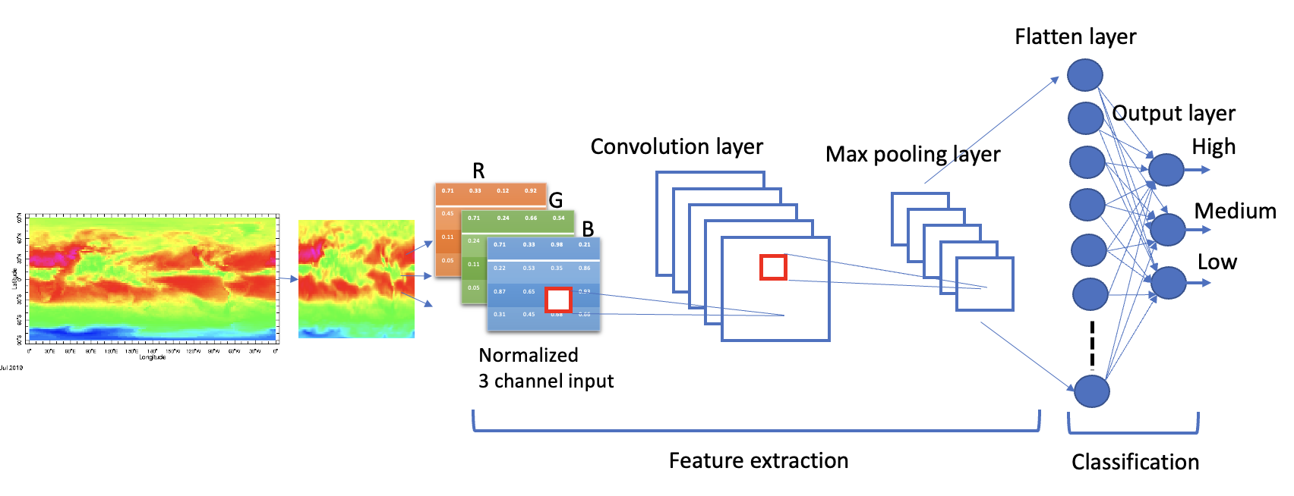
Machine Learning Algorithms: Convolutional Neural Networks
Convolutional Neural Networks (CNNs) are best for image classification because of their two parts: feature extraction, which serves to get a better understanding of the image, and classification.
My CNN consists of 5 layers: the input layer, the convolutional layer, the max pooling layer, the Flatten layer, and the output layer, as seen in the figure below.
The input data is the OLR images, which are then cropped and resized for reduced dimensionality and to obtain square images, which work best for CNNs. Since OLR images are color images, the input is described by three matrices, each characterizing the pixels’ RGB values.
Neural Networks require a large amount of samples to prevent overfitting (when the algorithm learns the training set so well that it cannot make generalizations for the test set).
Since only 73 OLR maps were available, I generated random slight transformations of the image set to make noisy images (image augmentation). For each training epoch, the training set generated 30 times the amount of samples and the diversity of the training samples increased.
image done by student

Slide 5
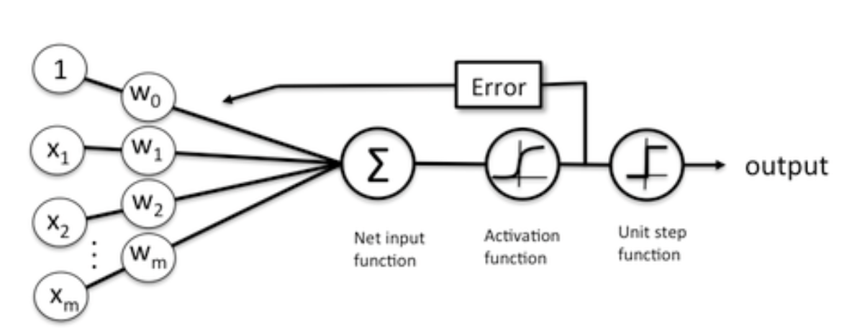
Machine Learning Algorithms: Logistic Regression
Binary Logistic Regression takes vectors of data as input, and outputs either 0 or 1 for a binary classification
Logistic regression can be seen as a very simple one layer neural network that applies a sigmoid activation function to the sum of the weighted input vector components and then a threshold function for a binary classification.
As seen in the figure, learning from the test set example implies adjusting the weights to minimize the classification error. Minimum square error can be used as an error cost function to be minimized.
Multiclass logistic regression is equivalent to one layer neural network with softmax activation, which is the classification network part of the CNN architecture.
The input vector to the classifier is the flattened OLR image.
(“What is the relation between Logistic Regression and Neural Networks and when to use which,” 2014).

Slide 6
Machine Learning Algorithms: k-Nearest Neighbors
k-NN is the simplest algorithm that can be used for supervised classification.
No learning is performed.
The training samples (vectors) are used as references (with known classes) to compute the distance between a new test sample and the training samples. Then, the k nearest samples are determined and used to make a decision on the test sample’s class by majority voting.
For different data, different values of k may give different accuracy performance; for example, in this project, k=10 worked best for 2 class classification, and k=5 worked best for 3 class classification.
The input vector to the classifier is the flattened OLR image.

Slide 7
Results: Ten Experiments for CNN Prediction with 2 and 3 Classes
Experiments | Two classes (High, Medium-Low) Prediction Accuracy | Three classes (High, Low, Medium) Prediction Accuracy
1 | 92.86% | 73.33%
2 | 92.86% | 80%
3 | 78.57% | 80%
4 | 92.86% | 86.67%
5 | 92.86% | 80%
6 | 92.86% | 60%
7 | 92.86% | 80%
8 | 92.86% | 80%
9 | 92.86% | 73.33%
10 | 92.86% | 80%
Mean | 91.43% | 77.33%
Standard deviation | 4.52% | 7.17%
Standard error | 1.43% | 2.267%
95% Confidence Interval | [88.63%, 94.23%] | [72.89%, 81.78%]

Slide 8
Results
Two Class Machine Learning Algorithm Comparison
ML alg | CNN SST | CNN OLR | Logistic Regression OLR | k-NN k=1 OLR | k-NN k=3 OLR | k-NN k=5 OLR | k-NN k=10 OLR | k-NN k=15 OLR
Accuracy | 83% | 91.43% | 85.7% | 78.57% | 78.57% | 64.29% | 85.7% | 71.42%
Three Class OLR Machine Learning Algorithm Comparison
ML alg | CNN | Logistic Regression | k-NN k=1 | k-NN k=3 | k-NN k=5 | k-NN k=10
Accuracy | 77.33% | 73.33% | 47.33% | 53.33% | 73.33% | 66.66%

Slide 9
Results: Comparison with NOAA
Year | NOAA Prediction August | OLR CNN Prediction August (based on July data) | Actual ACE Class (ACE>111 High, ACE <= 111 and >=66 Medium, <66 Low)*
2006 | High: 75%, medium: 20%, low: 5% | Low: 45.04%, medium: 28.89%, high: 26.06% | Medium (79)
2007 | High: 85%, medium: 10%, low: 5% | Medium: 58.28%, low:31.92%, high: 9.8% | Medium (74)
2008 | High: 85%, medium: 10%, low: 5% | High: 65.58%, medium: 28.36%, low: 6.05% | High (146)
2009 | Medium: 50%, low: 40%, high: 10% | Low: 42.81%, high: 32.55%, medium: 24.63% | Low (53)
2010 | High: 90%, medium: 10%, low: 0% | High: 59.7%, medium: 40.14%, low: 1.68% | High (165)
2011 | High: 85%, medium: 15%, low: 0% | High: 67.94%, medium: 26.13%, low: 5.91% | High (126)
2012 | Medium: 55%, high: 35%, low: 15% | Medium: 53.03%, high: 41.06%, low: 5.89% | High (129)
Year | NOAA Prediction August | OLR CNN Prediction August (based on July data) | Actual ACE Class (ACE>111 High, ACE <= 111 and >=66 Medium, <66 Low)*
2013 | High: 70%, medium: 25%, low: 5% | Low: 71.25%, medium: 21.35%, high: 7.21% | Low (36)
2014 | Low: 70%, medium: 25%, high: 5% | Medium: 83.28%, high: 11.64%, low: 5.07% | Medium (67)
2015 | Low: 90%, medium: 10%, high: 0% | Medium: 71.59%, high: 75.81%, low: 10.55% | Low (63)
2016 | Medium: 50%, high: 35%, low: 15% | High: 61.84%, medium: 28.78%, low: 9.37% | High (141)
2017 | High: 60%, medium: 30%, low: 10% | High: 81.16%, medium: 12.77%, low: 6.06% | High (223)
2018 | Low: 60%, medium: 30%, high: 10% | High: 62.5%, medium: 26.08%, low: 11.4% | High (132)
2019 | High: 45%, medium: 35%, low: 20% | High: 75.2%, medium: 21.67%, low: 3.12% | High (130)
2020 | High: 85%, medium: 10%, low: 5% | High: 55.67%, medium: 40.94%, low: 3.37% | High (180)
Prediction accuracy | 46.7% | 80%

Slide 10
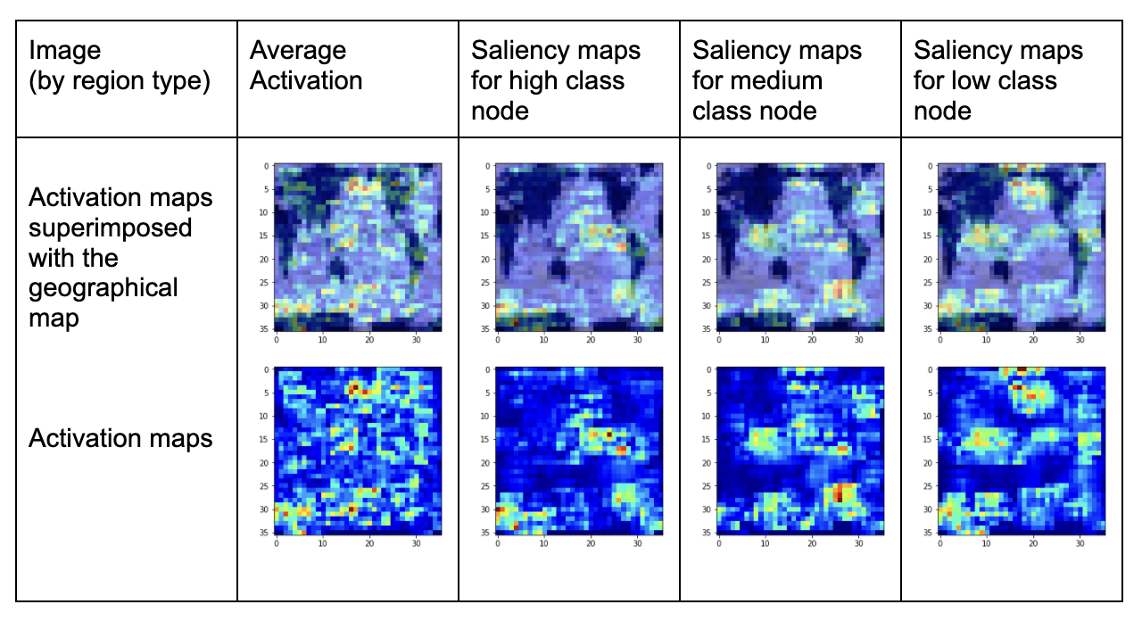
Data Analysis: Saliency Maps
Saliency maps are activation maps that highlight the pixels in an image that are most important for the prediction in order to understand the reason behind a prediction outcome.
The regions of activations in this map suggest that both the Pacific and the Atlantic regions contribute greatly to the prediction skill.
Sample saliency map for the July 2019 OLR map

Slide 11
Classification Skill Comparison
OLR Map Classification Skills Comparison with 3 Classes
Regions | All Map | African continent region | Atlantic basin (85W-30E) | Pacific basin (120E - 85W)
accuracy | 77.33% | 60% | 65% | 50%
After seeing the regions of activations in the saliency maps, and given the knowledge from the previous scientific paper about the meridional gradient over Africa, a classification skills comparison was performed for all of the map, the African continent region, the Atlantic basin, and the Pacific basin
All three regions were found to contribute to the prediction skill. However, the entire map region works best, with a 77.33% recognition rate (averaged over 10 runs), which demonstrates the advantage of using the entire OLR map for prediction.
The Atlantic and Pacific basin prediction skills can be explained by the well-known impact of both the tropical Atlantic region on the strength of the upcoming hurricane season, as well as the Pacific basin, which is known to impact the intensity of the hurricane season because of El Nino and La Niña signals. El Nino reduces the intensity of the Atlantic hurricane season, while La Niña intensifies the strength of the Atlantic hurricane season.

Slide 12
Conclusions/Impact
The novel CNN OLR-based average seasonal hurricane intensity prediction was 71% more accurate than NOAA’s average prediction for the past 15 years.
OLR maps contain more useful information for prediction than the SST maps, used in my previous project, and the OLR index, used by the previous paper’s author.
The higher accuracy of the CNN using OLR maps compared to the previous paper's results, using an OLR based index, is statistically significant.
The CNN using OLR’s accuracy advantage over my previous work using SST maps is statistically significant.
CNN with 2 classes obtains a higher accuracy than Logistic Regression and k-NN with 2 classes (the difference in accuracy is statistically significant).
Although CNN with 3 classes has the highest average accuracy compared to Logistic Regression and k-NN with 3 classes, this difference is not statistically significant.
My results were validated by saliency maps and a classification skill comparison, combined with geophysical knowledge.
The prediction results will be disseminated through a website: hurricaneprediction.net. This website publishes both the early seasonal hurricane intensity prediction using SST, in February, and a more accurate updated OLR prediction in August (based on July data). This will allow for more people to benefit from a high accuracy prediction for the upcoming Atlantic hurricane season intensity.

