Slide 1
Safe Distance: Quantitative Analysis on the Trajectory of Pathogen-Containing Droplets in the Air and Respiratory Airways
Alvin Miao
Princeton International School of Mathematics and Science

Slide 2
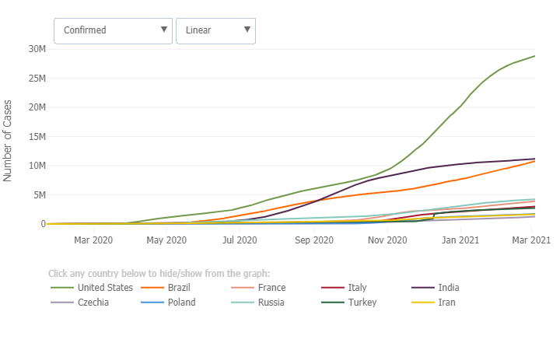
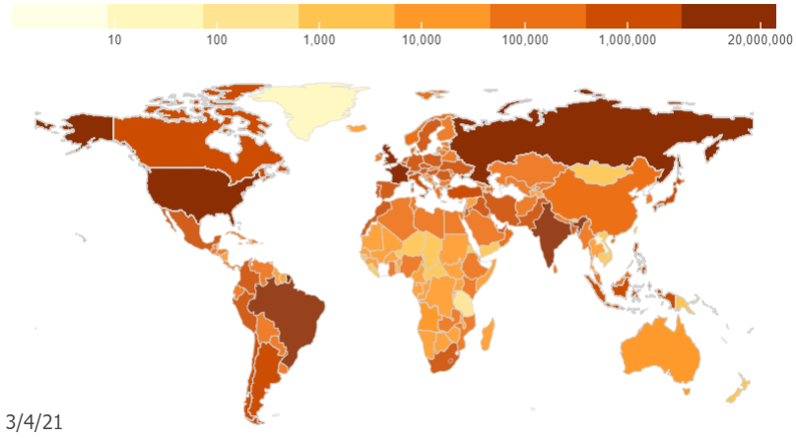
CRITICAL TRENDS
OF COVID-19
CUMULATIVE CASES OVER TIME
CUMULATIVE CASES BY DATE

Slide 3
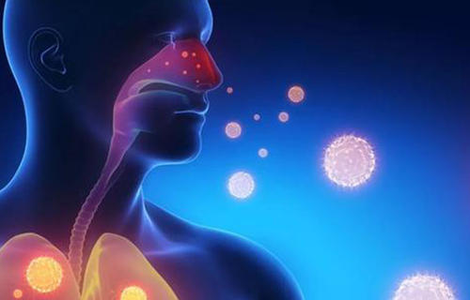
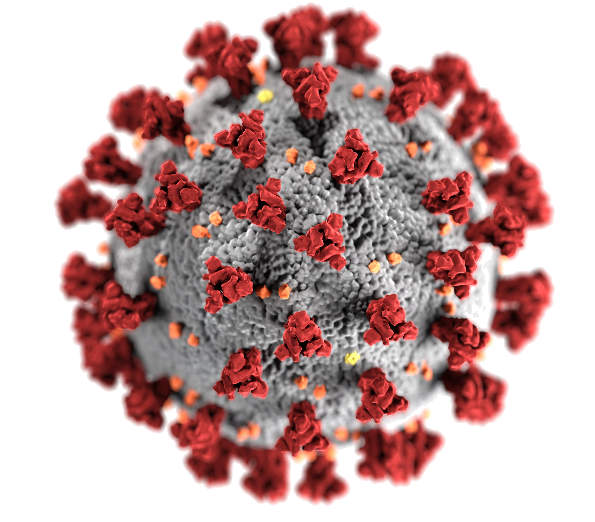
CORONAVIRUS

Slide 4
Research Plan
-- Theoretical simulation on the transmission of COVID 19 virus in the air, considering air resistance, viscoelasticity of the mucosalivary liquid contaminated with the virus, and turbulence effect on the virus entity.
-- Estimation of the safe distance based on the simulation
-- Computer and mathematical modeling to approximate the inability of COVID 19 viruses, the transmission speed of them inside the respiratory airway, and the stoke number of viruses with different radii.

Slide 5
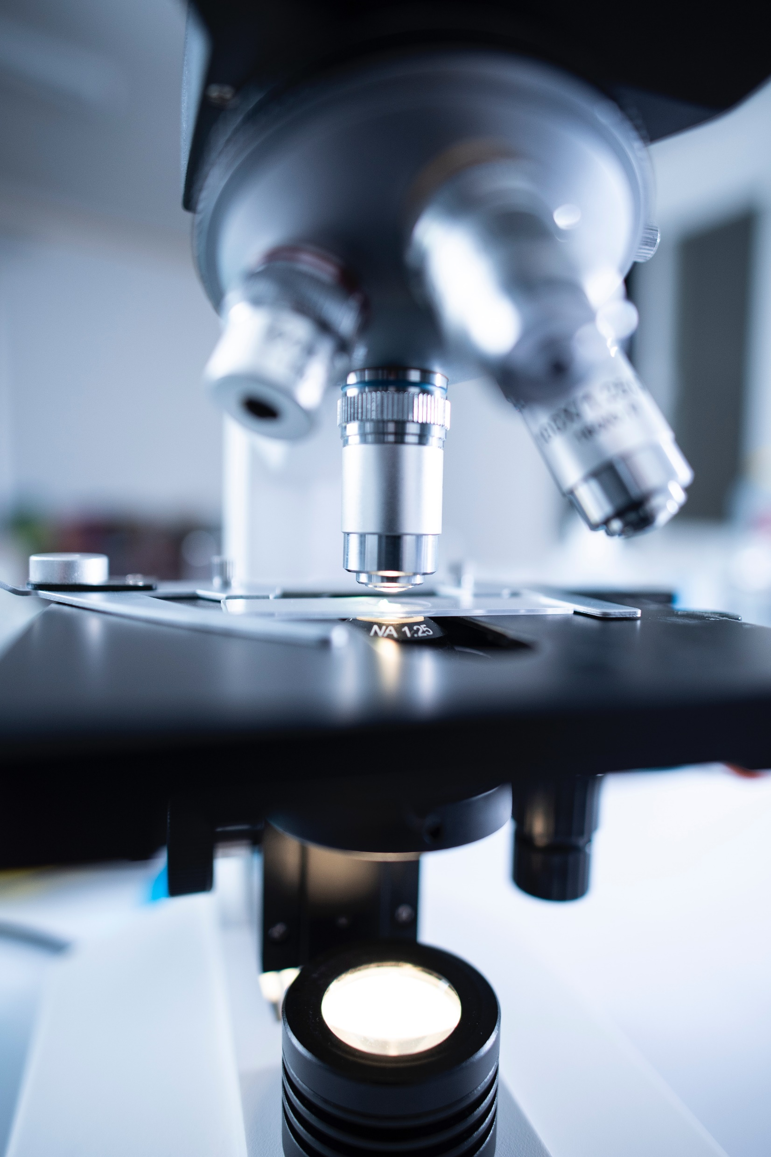
Innovation
-- Combination of Einstein equation for diffusivity of a particle and the Gaussian distribution of the particles in Brownian movement the estimation of transmission process of COVID-19 virus.
-- Application of mathematical and coding modeling in the estimation process
-- Consideration of the process both inside the respiratory airway and outside in the air-- Evaluation of inhalability and stoke’s number to generate more accurate estimation

Slide 6
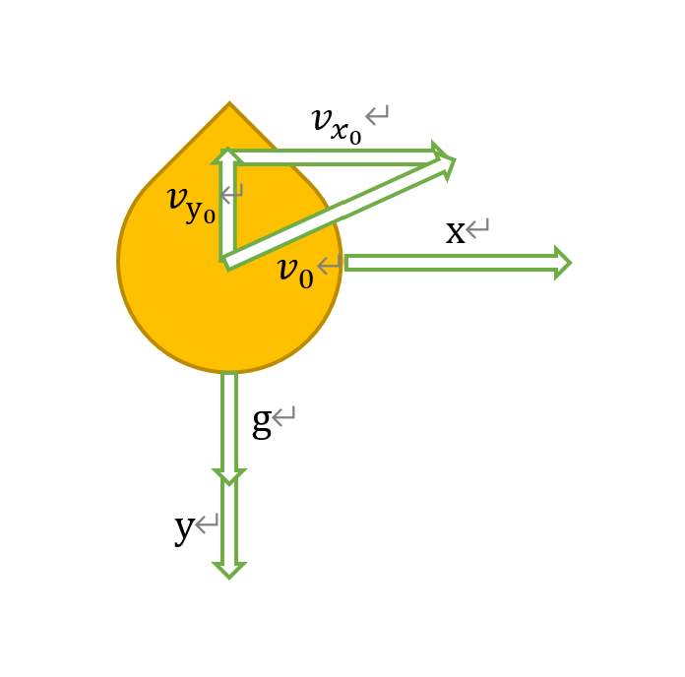
Materials and Methods
Constants used
$$g=9.806m/s^{2}$$
$$ρ=1⋅{10}^{3}kg⋅m^{3}$$
$$R=5.0⋅{10}^{−6}m$$
$$η=1.87×{10}^{-5}\text{Pa}⋅\text{s}$$
$$h=1.76\text{m}$$

Slide 7
Materials and Methods
$\overset{→}{v}\left(t=0\right)=\overset{→}{v_{0}}=\left(x_{0},y_{0}\right)$, $\frac{d}{dt}m\overset{→}{v}=\overset{→}{F}=\left(F_{x},F_{y}\right)$
$F_{x}=F_{D}=-6πηRv_{x}$, $F_{y}=mg-6πηRv_{x}$
$m=ΔρV=Δρ\frac{4π}{3}R^{3}$, $Δρ=ρ_{\text{liquid}}-ρ_{\text{air}}$
$$\frac{9η}{2RΔρ}=β$$
$\frac{dv_{x}}{dt}=-βv_{x}$ => $v_{x}=v_{x_{0}}e^{-βt}$
$\frac{d}{dt}mv_{y}=mg-6πηRv_{x}$ => $\frac{dv_{y}}{dt}=g-\frac{6πηRv_{y}}{\frac{4π}{3}R^{3}Δρ}=g-βv_{y}$ => $v_{y}e^{βt}=g\int_{0}^{t}{e^{βt}dt}+v_{y_{0}}→v_{y}=\frac{g}{β}\left(1-e^{-βt}\right)+v_{y_{0}}e^{-βt}$

Slide 8
Materials and Methods
$v_{x}=v_{x_{0}}e^{-βt}=\frac{dx}{dt}$, $x\left(t=0\right)=x_{0}=0$ => $x\left(t\right)=-\frac{v_{x_{0}}}{β}e^{-βt}{\left.\right|}_{0}^{t}=-\frac{2RΔρv_{x_{0}}}{9η}\left(1-e^{\frac{9η}{2RΔρ}t}\right)$
$\frac{dy}{dt}=\frac{g}{β}\left(1-e^{-βt}\right)+v_{y_{0}}e^{-βt}$, $y\left(t=0\right)=y_{0}=h$ => $y=\frac{gt}{β}+\frac{g}{β^{2}}e^{-βt}{\left.\right|}_{0}^{t}+\frac{v_{y_{0}}}{β}\left(1-e^{-βt}\right)+h=\frac{gt}{β}+\frac{g}{β^{2}}\left(e^{-βt}-1\right)+\frac{v_{y_{0}}}{β}\left(1-e^{-βt}\right)+h$

Slide 9
Materials and Methods
The relationship between the horizontal displacement $x$ and time $t:$
$$x\left(t\right)=−\frac{v_{x_{0}}}{β}\left.\left.e^{−βt^{′}}\right.\right|{}_{0}^{t}=−\frac{2RΔρv_{x_{0}}}{9η}\left(1−e^{\frac{9η}{2RΔρ}t}\right)$$
The displacement on y-direction:
$$y=\frac{gt}{β}+\frac{g}{β^{2}}\left.\left.e^{−βt^{′}}\right.\right|{}_{0}^{t}+\frac{v_{y_{0}}}{β}\left(1−e^{−βt}\right)+h=\frac{gt}{β}+\frac{g}{β^{2}}\left(e^{−βt}−1\right)+\frac{v_{y_{0}}}{β}\left(1−e^{−βt}\right)+h$$

Slide 10
Materials and Methods
Express $y$ in terms of $x:$
$$y=\frac{g}{β^{2}}ln\frac{1}{1−\frac{β}{v_{x_{0}}}x}−\frac{g}{βv_{x_{0}}}x+\frac{v_{y_{0}}}{v_{x_{0}}}x+h$$
Relationship between the vertical displacement $y$ and time $t:$
$$y\left(t\right)=\frac{8gR^{3}Δρ^{3}}{81η^{2}t}−\frac{4gR^{2}Δρ^{2}}{81η^{2}}\left(1−e^{\frac{9η}{2RΔρ}t}\right)+\frac{2RΔρv_{y_{0}}}{9η}\left(1−e^{\frac{9η}{2RΔρ}t}\right)+h$$

Slide 11
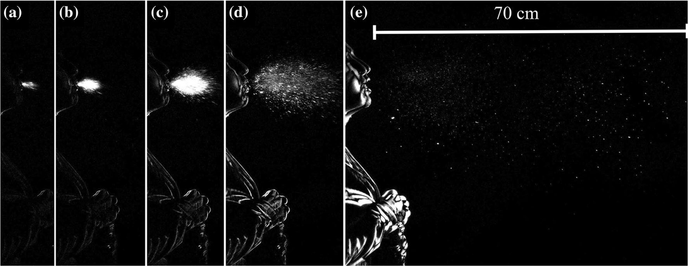
Materials and Methods
Extracting Data from Previous Paper to Calculate the Initial Velocity $v_{x_{0}}$ and $v_{y_{0}}$

Slide 12
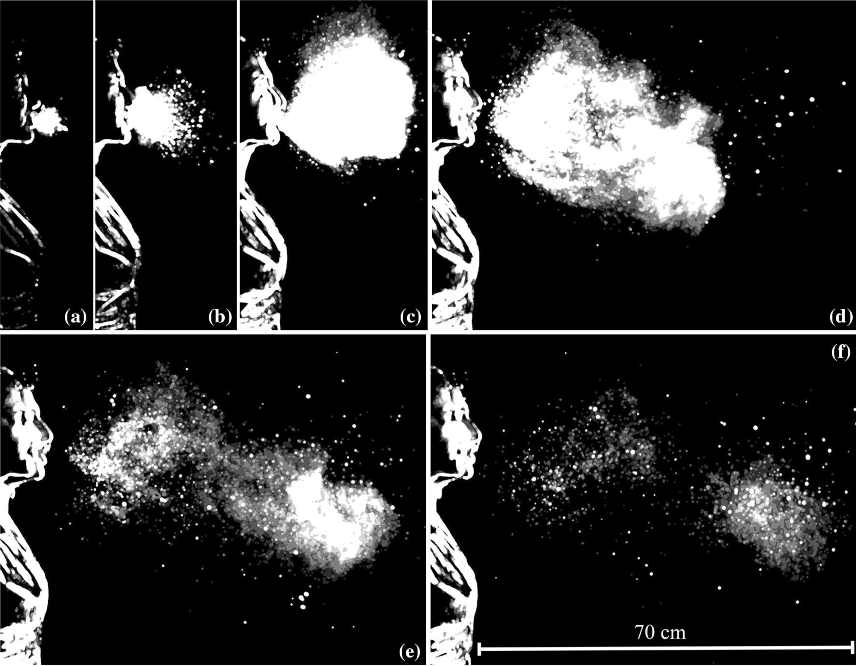
Materials and Methods
Extracting Data from Previous Paper to Calculate the Initial Velocity $v_{x_{0}}$ and $v_{y_{0}}$

Slide 13
Materials and Methods
Original Data Gathered from the Previous Paper
 | A | B | C | D | E
Time (s) | 0.005 | 0.008 | 0.015 | 0.032 | 0.150
Nose-to-hand Distance in Graph (cm) | 5.80 | 5.80 | 5.80 | 5.80 | 5.80
Known Horizontal Displacement of Sneeze Ejecta (cm) | NA | NA | NA | NA | 70.00
Known Horizontal Displacement of Sneeze Ejecta in Graph (cm) | NA | NA | NA | NA | 13.0
Ratio of Distance in Real Life to Distance in Graph | NA | NA | NA | NA | 5.39
Nose-to-hand Distance (cm) | 31.2 | 31.2 | 31.2 | 31.2 | 31.2
The Distance between the Center of Mass of the Cloud of Sneeze Ejecta and the Mouth in Graph (cm) | 0.28 | 0.50 | 0.95 | 1.77 | 6.80
The Ratio of the Distance between the Center of Mass of the Cloud of Sneeze Ejecta and the Mouth in Graph to Nose-to-hand Distance in Graph | 0.048 | 0.086 | 0.0164 | 0.0305 | 1.17
The Distance between the Center of Mass of the Cloud of Sneeze Ejecta and the Mouth (cm) | 1.50 | 2.69 | 5.12 | 9.53 | 36.60
Thickness of the Cloud of Sneeze Ejecta in Graph – Measured by the Vertical Line Passing through the Center of Mass of the Cloud of Sneeze Ejecta (cm) | 0.19 | 0.62 | 1.11 | 2.12 | 5.45
The Ratio of Thickness of the Cloud of Sneeze Ejecta in Graph to Nose-to-hand Distance in Graph | 0.033 | 0.107 | 0.191 | 0.366 | 0.94
Thickness of th Cloud of Sneeze Ejecta (cm) | 1.03 | 3.34 | 5.96 | 11.4 | 29.4
Vertical Displacement of Sneeze Ejecta – Calculated by Dividing the Thickness of the Cloud of Sneeze Ejecta by 2 (cm) | 0.52 | 1.67 | 2.98 | 5.72 | 14.6
Range (Angle) of the Cloud of Sneeze Ejecta () | 50 | 55 | 64 | 88 | 94

Slide 14
Materials and Methods — Two Methods to Interpret the Data from the Previous Paper
Method 1
Mathematical Regression (Cubic Polynomial)
Method 2
Python Regression (Coding)

Slide 15
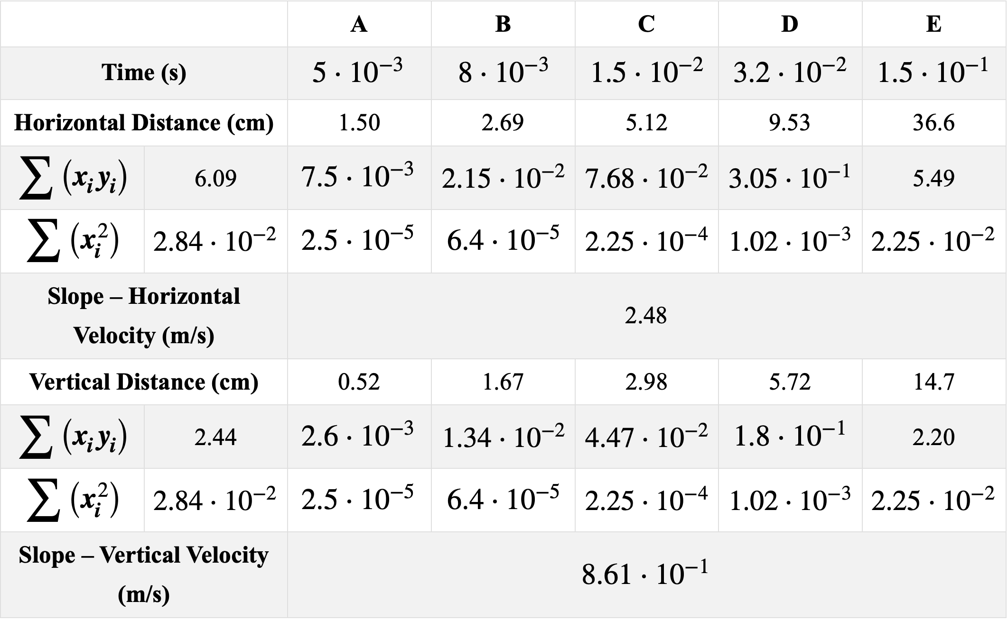
Materials and Methods
Mathematical Regression — Analysis of the Original Data

Slide 16
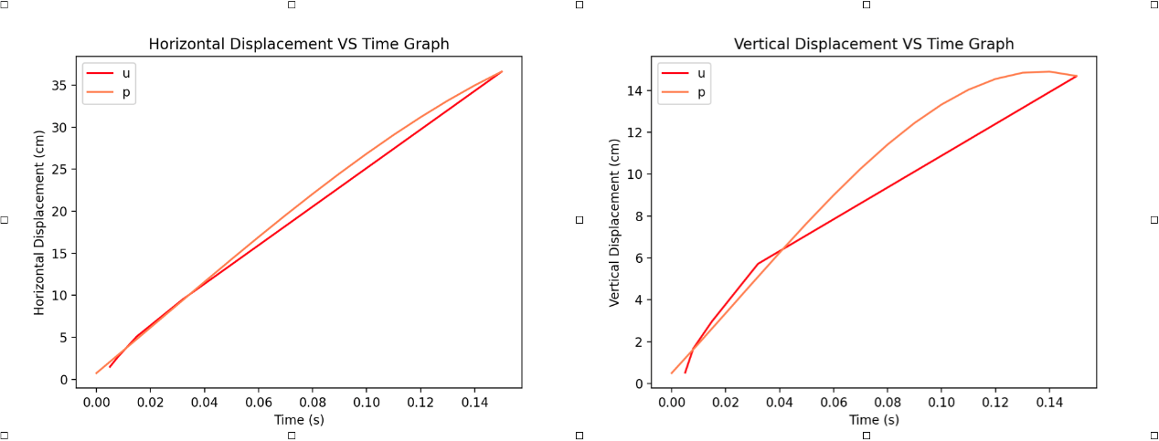
Materials and Methods
Coding Regression — Resulting Polynomial Plot

Slide 17
Materials and Methods
Coding Regression — Final Result
Horizontal Initial Velocity (cm/s) | 320
Vertical Initial Velocity (cm/s) | 300
Angel between the Direction of Net Velocity and Horizontal Direction (˚C) | 43.15

Slide 18
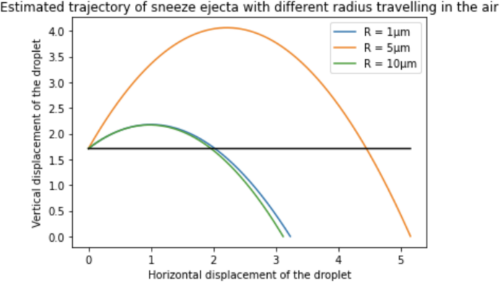
Materials and Methods
Visualization of the Result — Curve showing the relationship between horizontal and vertical displacement

Slide 19
Materials and Methods
Calculation with Mathematical Regression Result
$v_{x_{0}}=1.92\text{m/s}$, $v_{y_{0}}=0.69\text{m/s}$, $β=−1.683×{10}^{−2}\frac{\text{Pa⋅s⋅}{\text{m}}^{2}}{\text{kg}}$
$$y=3.462×{10}^{4}\ln\left(\frac{1}{1+8.7656×{10}^{−3}x}\right)+3.035×{10}^{2}x−0.359x+h$$
$$3.462×{10}^{4}\ln\left(\frac{1}{1+8.7656×{10}^{−3}x}\right)+3.035×{10}^{2}x−0.359x=0→x=0.24\text{m}$$

Slide 20
Materials and Methods
Calculation with Computer Regression Result
$v_{x_{0}}=3.20\text{m/s}$, $v_{y_{0}}=3.00\text{m/s}$, $β=−1.683×{10}^{−2}\frac{\text{Pa⋅s⋅}{\text{m}}^{2}}{\text{kg}}$
$$y=3.461×{10}^{4}ln({\frac{1}{1+5.29×{10}^{−3}x}})+1.821×{10}^{2}x−0.9375x+h$$
$$3.462×{10}^{4}\ln\left(\frac{1}{1+5.259×{10}^{−3}x}\right)+1.821×{10}^{2}x−0.9375x=0→x=4.03\text{m}$$

Slide 21
Materials and Methods
Calculation of Inhalability
$EP=\frac{\int_{x=1}^{x=50}{NF\left(x\right)IH\left(x\right)DE\left(x\right)}⋅\left(\frac{1}{6}πx^{3}\right)dx}{\int_{x=1}^{x=50}{NF\left(x\right)}⋅\left(\frac{1}{6}πx^{3}\right)dx}×100\%$, $NF\left(x\right)=\frac{0.43}{0.54⋅\sqrt{2π}x}e^{−\frac{1}{2}\left(\frac{\log\left(x\right)−\log\left(13.5\right)}{0.54}\right)}$
 | 1 | 2 | 3 | 5 | 7 | 10 | 15 | 20 | 30 | 50
IH(x) | 99.2 | 99.2 | 99.2 | 98.9 | 98.5 | 98.1 | 97.3 | 96.4 | 52.5 | 13.9
DE(x) | 6.2 | 6.9 | 8.5 | 19.4 | 41.2 | 58.2 | 51.6 | 57.4 | 54.4 | 45.5

Slide 22
Materials and Methods
Calculation of Inhalability
$EP=\frac{\int_{x=1}^{x=50}{NF\left(x\right)IH\left(x\right)DE\left(x\right)}⋅\left(\frac{1}{6}πx^{3}\right)dx}{\int_{x=1}^{x=50}{NF\left(x\right)}⋅\left(\frac{1}{6}πx^{3}\right)dx}×100\%$, $NF\left(x\right)=\frac{0.43}{0.54⋅\sqrt{2π}x}e^{−\frac{1}{2}\left(\frac{\log\left(x\right)−\log\left(13.5\right)}{0.54}\right)}$
 | 1 | 2 | 3 | 5 | 7 | 10 | 15 | 20 | 30 | 50
IH(x) | 99.2 | 99.2 | 99.2 | 98.9 | 98.5 | 98.1 | 97.3 | 96.4 | 52.5 | 13.9
DE(x) | 6.2 | 6.9 | 8.5 | 19.4 | 41.2 | 58.2 | 51.6 | 57.4 | 54.4 | 45.5

Slide 23
Materials and Methods — Two Methods to Interpret the Data of IH(x) and DE(x) from the Previous Paper
Method 1
Mathematical Regression (Cubic Polynomial)
Method 2
Python Regression (Coding)

Slide 24
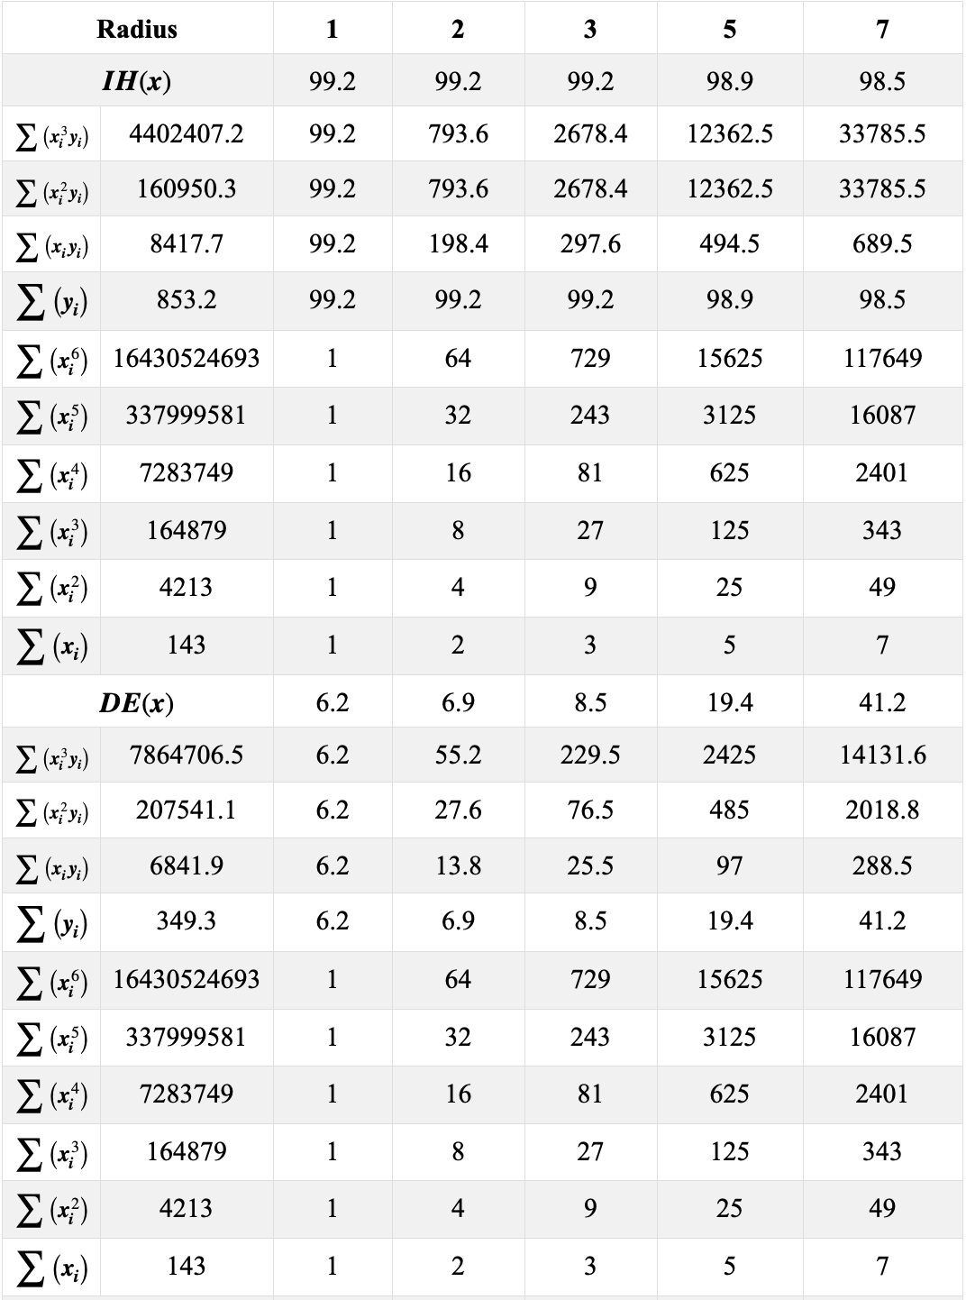
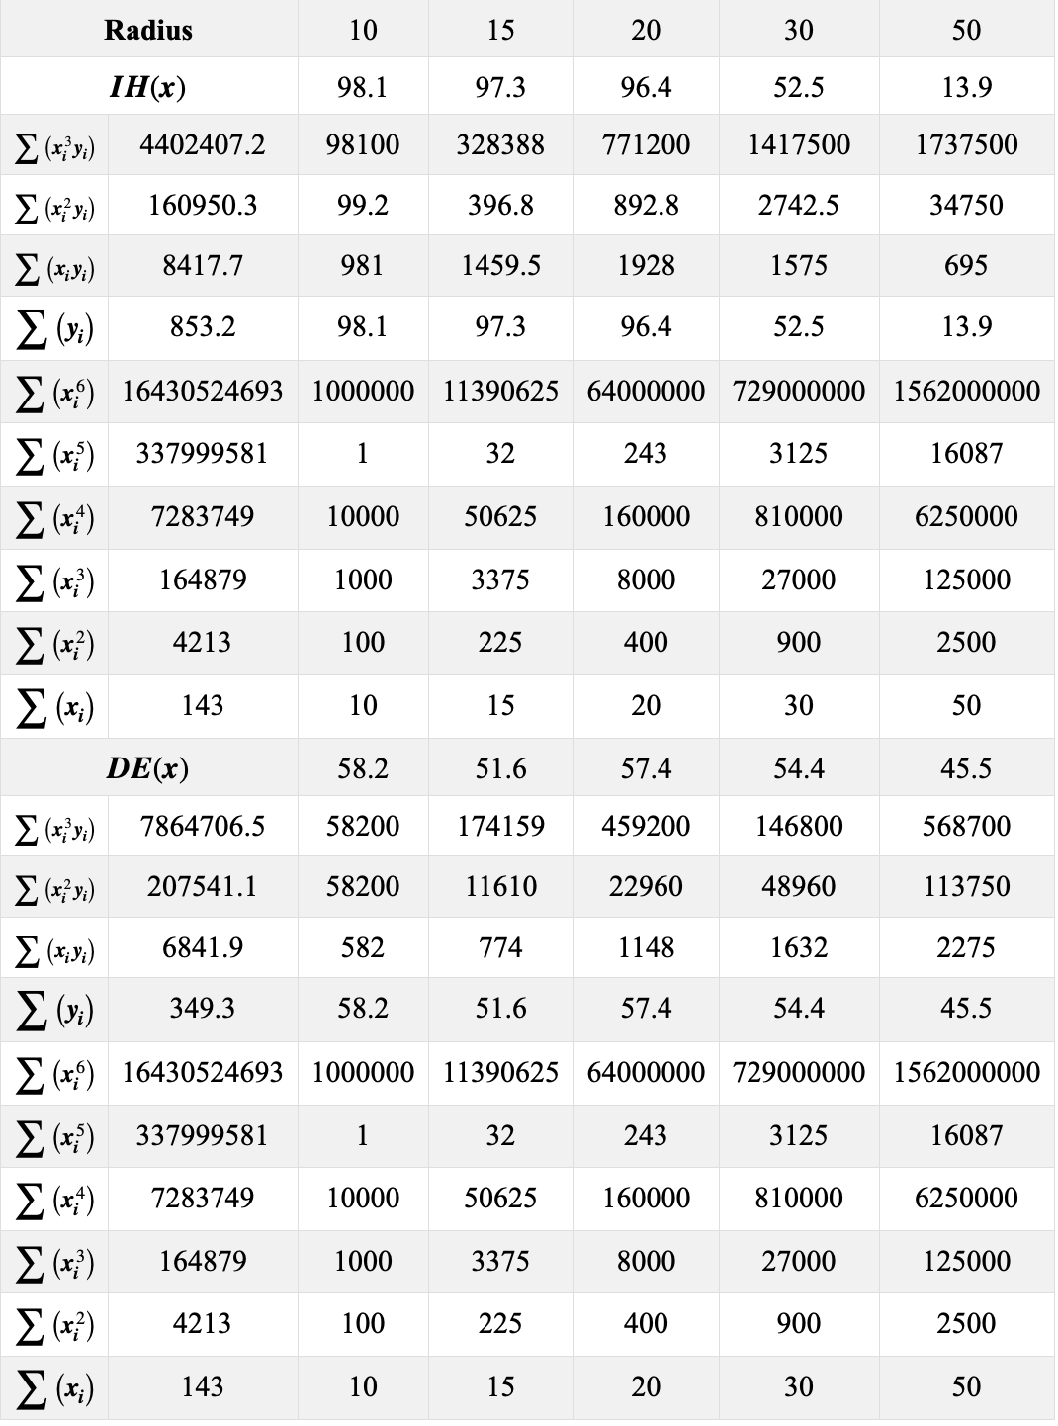
Materials and Methods
Mathematical Regression — Analysis of the Original Data

Slide 25
Materials and Methods
Mathematical Regression — Analysis of the Original Data — IH(x)
$$4402407.2=16430524693a+337999581b+7283749c+164879d$$
$$60950.3=337999581a+7283749b+164879c+4213d$$
$$8417.7=7283749a+164879b+4213c+143d$$
$$853.2=164879a+4213b+143c+10d$$
$$a=−0.000002269469,b=−0.0345421987348,c=−0.072701192567,d=100.949673567$$
$$IH\left(x\right)=(−2.27×{10}^{−6})⋅x^{3}+(3.45×{10}^{−2}{)⋅x}^{2}+(7.27×{10}^{−2})⋅x+100.95$$

Slide 26
Materials and Methods
Mathematical Regression — Analysis of the Original Data — IH(x)
$$7864706.5=16430524693a+337999581b+7283749c+164879d$$
$$205714.1=337999581a+7283749b+164879c+4213d$$
$$6841.9=7283749a+164879b+4213c+143d$$
$$349.4=164879a+4213b+143c+10$$
$$a=−0.000086597085,b=−0.060782201405,c=3.9819729492,d=5.02313199152$$
$$DE\left(x\right)=(−8.66×{10}^{−5})⋅x^{3}+(6.08×{10}^{−2}{)⋅x}^{2}+3.982⋅x+5.02$$

Slide 27
Materials and Methods
Mathematical Regression — Result of Analysis of the Original Data
$$IH\left(x\right)=−0.00000227x^{3}+0.0345x^{2}−0.0727x+100.950$$
$$DE\left(x\right)=−0.0000866x^{3}+0.0608x^{2}+3.982x+5.023$$
$$EP=\frac{16800648.29×{10}^{−6}}{4727.11034395}×100\%=3.553\%≈3.6\%$$

Slide 28
Materials and Methods
Mathematical Regression — Result of Analysis of the Original Data
$$x=1→IH\left(x\right)=99.2\%→IH\left(x\right)⋅\left(1−EP\right)=95.675424\%≈95.68\%$$
$$x=5→IH\left(x\right)=98.8\%→IH\left(x\right)⋅\left(1−EP\right)=95.386083\%≈95.39\%$$
$$x=10→IH\left(x\right)=98.1\%→IH\left(x\right)⋅\left(1−EP\right)=94.614507\%≈94.61\%$$
$$x=50→IH\left(x\right)=13.9\%→IH\left(x\right)⋅\left(1−EP\right)=13.406133\%≈13.41\%$$

Slide 29
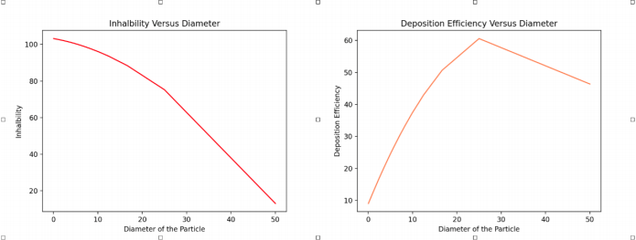
Materials and Methods
Coding Regression — Result of Analysis of the Original Data

Slide 30
Materials and Methods
Mathematical Regression — Result of Analysis of the Original Data
$$IH\left(x\right)≈\left(−0.0273x^{2}−0.434x+103.177\right)×{10}^{−6}×100\%$$
$$DE\left(x\right)≈\left(−0.0527x^{2}+3.387x+8.867\right)×{10}^{−6}×100\%$$
$$EP=0.301176\%≈0.30\%$$

Slide 31
Materials and Methods
Mathematical Regression — Result of Analysis of the Original Data
$$x=1→IH\left(x\right)=99.2\%→IH\left(x\right)⋅\left(1−EP\right)=98.9024\%≈98.90\%$$
$$x=5→IH\left(x\right)=98.9\%→IH\left(x\right)⋅\left(1−EP\right)=98.6033\%≈98.60\%$$
$$x=10→IH\left(x\right)=98.1\%→IH\left(x\right)⋅\left(1−EP\right)=97.8057\%≈97.81\%$$
$$x=50→IH\left(x\right)=13.9\%→IH\left(x\right)⋅\left(1−EP\right)=13.8583\%≈13.86\%$$

Slide 32
Materials and Methods
Velocity of Pathogen-Containing Mucosalivary Droplets after Entering the Respiratory Airway
$F=ma$, $m=ρ\frac{3}{4}π{\left(\frac{x}{2}\right)}^{3}=\frac{1}{6}πx^{3}$ => $\frac{1}{6}ρπx^{3}\frac{dv_{p}}{dt}=\frac{6πηx}{2}\left(v_{a}−v_{p}\right)→\frac{dv_{p}}{dt}=\frac{18η}{ρx^{2}}\left(v_{a}−v_{p}\right)+g$
$C_{c}=1+\frac{2λ}{x}\left(1.257+0.4e^{−\frac{1.1x}{2λ}}\right)$ => $\frac{dv_{p}}{dt}=\frac{18η}{ρx^{2}C_{c}}\left(v_{a}−v_{p}\right)+g$, $\frac{1}{\frac{18η}{ρx^{2}C_{c}}\left(v_{a}−v_{p}\right)+g}dv_{p}=dt→∫\frac{1}{\frac{18η}{ρx^{2}C_{c}}\left(v_{a}−v_{p}\right)+g}dv_{p}=∫dt=t$
$v_{d}=18\text{L/min}=300{\text{cm}}^{3}\text{s}$, $V=0.059m^{3}=59000{\text{cm}}^{3}$ => $t=\frac{v}{v_{d}}=\frac{59000{\text{cm}}^{3}}{300{\text{cm}}^{3}\text{/s}}=196.667s≈197s$

Slide 33
Materials and Methods — Two Methods to Get the Initial Velocity (Calculation in Part 1)
Method 1
Mathematical Regression (Cubic Polynomial)
Method 2
Python Regression (Coding)

Slide 34
Materials and Methods
Computational
$$v_{A}=\sqrt{{3.2}^{2}+{3.0}^{2}}=4.386\text{m/s}$$
$$x=1→C_{c}=2.857→∫\frac{1}{\frac{3.36×{10}^{−4}}{2857×{\left(1×{10}^{−6}\right)}^{2}}\left(4.386−v_{p}\right)+9.806}dv_{p}=196.667$$
$$x=5→C_{c}=1.328→∫\frac{1}{\frac{3.36×{10}^{−4}}{1328×{\left(5×{10}^{−6}\right)}^{2}}\left(4.386−v_{p}\right)+9.806}dv_{p}=196.667$$
$$x=10→C_{c}=1.082→∫\frac{1}{\frac{3.36×{10}^{−4}}{1082×{\left(1×{10}^{−5}\right)}^{2}}\left(4.386−v_{p}\right)+9.806}dv_{p}=196.667$$
$$x=50→C_{c}=1.032→∫\frac{1}{\frac{3.36×{10}^{−4}}{1032×{\left(5×{10}^{−5}\right)}^{2}}\left(4.386−v_{p}\right)+9.806}dv_{p}=196.667$$

Slide 35
Materials and Methods
Computational
$$x=1→−\frac{2857\log\left(736862007871−1.68×{10}^{11}x\right)−2857\log{2857}−8571\log{5}−5714\log{2}}{3.36×{10}^{8}}=196.667→v_{p}=4.38607≈4.39\text{m/s}$$
$$x=5→−\frac{83\log{(1842526949−4.2×{10}^{8}})−83\log{83}−249\log{5}−166\log{2}}{840000}=196.667→v_{p}=4.38687≈4.39\text{m/s}$$
$$x=10→−\frac{541\log\left(3686892523−8.4×{10}^{8}\right)−541\log{5}41−1623\log{5}−1082\log{2}}{1680000}=196.667→v_{p}=4.38884≈4.39\text{m/s}$$
$$x=50→−\frac{43\log\left(12491629−28×{10}^{7}\right)−43\log{43}−129\log{5}−86\log{2}}{5600}=196.667→v_{p}=4.45362≈4.45\text{m/s}$$

Slide 36
Materials and Methods
Mathematical
$$v_{A}=\sqrt{{2.48}^{2}+{0.86}^{2}}=2.040\text{m/s}$$
$$x=1→C_{c}=2.857→∫\frac{1}{\frac{3.36×{10}^{−4}}{2857×{\left(1×{10}^{−6}\right)}^{2}}\left(2.040−v_{p}\right)+9.806}dv_{p}=196.667$$
$$x=5→C_{c}=1.328→∫\frac{1}{\frac{3.36×{10}^{−4}}{1328×{\left(5×{10}^{−6}\right)}^{2}}\left(2.040−v_{p}\right)+9.806}dv_{p}=196.667$$
$$x=10→C_{c}=1.082→∫\frac{1}{\frac{3.36×{10}^{−4}}{1082×{\left(1×{10}^{−5}\right)}^{2}}\left(2.040−v_{p}\right)+9.806}dv_{p}=196.667$$
$$x=50→C_{c}=1.032→∫\frac{1}{\frac{3.36×{10}^{−4}}{1032×{\left(5×{10}^{−5}\right)}^{2}}\left(2.040−v_{p}\right)+9.806}dv_{p}=196.667$$

Slide 37
Materials and Methods
Mathematical
$$x=1→−\frac{2857\log\left(342734007871−1.68×{10}^{11}x\right)−2857\log{2857}−8571\log{5}−5714\log{2}}{3.36×{10}^{8}}=196.667→v_{p}=2.04007≈2.04\text{m/s}$$
$$x=5→−\frac{83\log\left(857206949−4.2×{10}^{8}\right)−83\log{83}−249\log{5}−166\log{2}}{840000}=196.667→v_{p}=2.04087≈2.04\text{m/s}$$
$$x=10→−\frac{541\log\left(171362652523−8.4×{10}^{8}\right)−541\log{5}41−1623\log{5}−1082\log{2}}{1680000}=196.667→v_{p}=2.04003≈2.04\text{m/s}$$
$$x=50→−\frac{43\log\left(5922829−28×{10}^{7}\right)−43\log{43}−129\log{5}−86\log{2}}{5600}=196.667→v_{p}=4.45362≈4.45\text{m/s}$$

Slide 38
Materials and Methods
Velocity of Pathogen-Containing Mucosalivary Droplets after Entering the Respiratory Airway
$τ=\frac{ρx^{2}}{18η}$, $dc=0.02\text{m}$
$μ_{f}$ = $v_{a}$

Slide 39
Materials and Methods
Computational
$$μ_{f}=4.386\text{m/s}$$
$$x=1μ\text{m→}Stk=\frac{ρx^{2}μ_{f}}{18ηdc}dx=0.000652<1$$
$$x=5μm→Stk=\frac{ρx^{2}μ_{f}}{18ηdc}dx=0.0163<1$$
$$x=10μm→Stk=\frac{ρx^{2}μ_{f}}{18ηdc}dx=0.0652<1$$
$$x=50μm→Stk=\frac{ρx^{2}μ_{f}}{18ηdc}dx=1.63>1$$

Slide 40
Materials and Methods
Mathematical
$$μ_{f}=2.040\text{m/s}$$
$$x=1μ\text{m→}Stk=\frac{ρx^{2}μ_{f}}{18ηdc}dx=0.000306<1$$
$$x=5μm→Stk=\frac{ρx^{2}μ_{f}}{18ηdc}dx=0.00766<1$$
$$x=10μm→Stk=\frac{ρx^{2}μ_{f}}{18ηdc}dx=0.0306<1$$
$$x=50μm→Stk=\frac{ρx^{2}μ_{f}}{18ηdc}dx=0.766<1$$

Slide 41
Conclusion & Discussion
The safe distance: 3~4 m — slightly longer than the data presented by CDC, but fits the result of experiments proceeded by MIT researches
Martin Z. Bazant, John W. M. Bush. “A guideline to limit indoor airborne transmission of COVID-19,” PNAS 118(2021)17. Doi: https://doi.org/10.1073/pnas/2018995118.
Pathogen-containing particles with a diameter of 10 µm is relatively the most dangerous among the four types of particles (1 µm, 5 µm, 10 µm, and 50 µm) tested.
High IH(x) — high potential to be inhaled
High velocity in the respiratory airway — fast infection
Stoke’s number < 1 — can enter deep in lung

Slide 42
Further Development
Currently, my research is extracting data generated from two previous papers — “Visualization of Sneeze ejecta: Steps of Fluid Fragmentation Leading to Respiratory Droplets” by B. E. Scharfman et al. and “Deposition features of inhaled viral droplets may lead to rapid secondary transmission of COVID-19 ” by Yidan Shang et al. — to get the average initial speed of sneeze ejecta edited from noses and the inhalability as well as deposition efficiency of the sneeze ejecta emitted respectively. A potential future research of this project is to use complete my own experiment measuring these qualities, which would yields more accurate and trustable first-handed result.
Moreover, for the mathematical modeling, the result significantly differs from the common sense. This is probably due to me neglecting the factor of evaporation, meaning that the sizes of pathogen-bearing particles are continuously decreasing as they travel through the air. If the condition of evaporation is also considered, the accuracy of mathematical modeling can be strictly improved (the computer coding regression results in a precise estimation though, so that it is unnecessary to be changed).

Slide 43
References
[1] B.E.Scharfman, A.H.Techet, J.W.M.Bush, and L.Bourouiba. “Visualization of sneeze ejecta: steps of fluid fragmentation leading to respiratory droplets.” Exp Fluids (2016) 57:24. dois:10.1007/s00348-015-2078-4.
[2] Yidan Shang, Yao Tao, Jingliang Dong, Fajiang He, and Jiyuan Tu (9 January 2021). “Deposition features of inhaled viral droplets may lead to rapid secondary transmission of COVID-19”. Journal of Aerosol Science, 154(2021) 105745. https://doi.org/10.1016/j.jaerosci.2021.105745.
[3] Page J, Hinshaw D, McKay B (26 February 2021). “In Hunt for Covid-19 Origin, Patient Zero Points to Second Wuhan Market – The man with the first confirmed infection of the new coronavirus told the WHO team that his parents had shopped there”. The Wall Street Journal.
[4] Centers for Disease Control and Prevention (CDC). “Symptoms of COVID-19”, 22 February 2021. https://www.cdc.gov/coronavirus/2019-ncov/symptoms-testing/symptoms.html.
[5] Centers for Disease Control and Prevention (CDC). “Frequent Asked Questions”, 21 October 2021. Coronavirus (COVID-19) frequently asked questions | CDC.
[6] Betsch, C., Korn, L., et al. (2020). “Social and behavioral consequences of mask policies during the COVID-19 pandemic”. Proceedings of the National Academy of Sciences, 117(36), pp. 21851–21853.
[7] World Health Organization. “Coronavirus disease (COVID-19): How is it transmitted?". https://www.who.int/emergencies/diseases/novel-coronavirus-2019/coronavirus-disease-answers?query=How+it+spreads&referrerPageUrl=https%3A%2F%2Fwww.who.int%2Femergencies%2Fdiseases%2Fnovel-coronavirus-2019%2Fcoronavirus-disease-answers. Retrieved 6 December 2020.
[8] Centers for Disease Control and Prevention (CDC). “Coronavirus Disease 2019 (COVID-19)”. Retrieved 6 December 2020. https://www.cdc.gov/coronavirus/2019-ncov/index.html.
[9] Centers for Disease Control and Prevention (CDC). “Coronavirus Disease 2019 (COVID-19)”. 25 October 2020. https://www.cdc.gov/coronavirus/2019-ncov/prevent-getting-sick/about-face-coverins.html.
[10] New Youth Anesthesia Daily. “People’s Daily: Can Wearing Facemask prevents COVID-19”, 22 January 2020. https://www.sohu.com/a/368399258_377325.
[11] National Aeronautics and Space Administration (NASA). “What is Drag”, Retrieved 6 December 2020. https://www.grc.nasa.gov/www/k-12/airplane/drag1.html.
[12] Symon, Keith R. Mechanics (3rd Edition), December 1971. Boston, MA: Addison-Wesley. ISBN 978-0-201-07392-8.

Slide 44
References
[13] Hirt, C., Claessens, S., Fecher, T., Kuhn, M.; Pail, R., Rexer, M (2013). “New ultrahighresolution picture of Earth's gravity field”. Geophysical Research Letters, 40 (16), pp. 4279–4283. doi:10.1002/grl.50838.
[14] Ball, Philip (2008). "Water: Water—an enduring mystery". Nature, 452 (7185), pp. 291–2. doi:10.1038/452291a.
[15] Our World Data. “Human Height”, May 2019. https://ourworldindata.org/human-height.
[16] Detailed description of both methods is written in the “Appending” section.
[17] The codes responsible for generating these plots are recorded in the “Appending” section.
[18] Cunningham, E., “On the velocity of steady fall of spherical particles through fluid medium,” Proc. Roy. Soc. A 83(1910)357. doi:10.1098/rspa.1910.0024
[19] NCBI. Benjamin J. Delgado, Tushar Bajaj. “Physiology, Lung Capacity”, July 26, 2021. https://www.ncbi.nlm.nih.gov/books/NBK541029/.
[20] Cameron Tropea, Alexander Yarin, John Foss, eds. Springer Handbook of Experimental Fluid Mechanics, 9 October 2007. New York: Springer.
[21] Specific model and classification of different parts of the respiratory system can be found in the “Attachment” section.
[22] NCBI. Joshua J. Hurley, Jeremy L. Hensley, “Physiology, Airway Resistance”, 22 September 2021. https://www.ncbi.nlm.nih.gov/books/NBK542183/.
[23] CDC. “How to Protect Yourself & Others”, 13 August 2021. https://www.cdc.gov/coronavirus/2019-ncov/prevent-getting-sick/prevention.html.
[24] Martin Z. Bazant, John W. M. Bush. “A guideline to limit indoor airborne transmission of COVID-19,” PNAS 118(2021)17. Doi: https://doi.org/10.1073/pnas/2018995118.
[25] Hamed Mortazavi, Hamidreza Mortazavy Beni, Fatemeh Aghaei, Seyed Hossein Sajadiana (11 November 2020). “SARS-CoV-2 droplet deposition path and its effects on the human upper airway in the oral inhalation”. Computer Methods and Programs in Biomedicine 200(2021) 105843. https://doi.org/10.1016/j.cmpb.2020.105843.

Slide 45
Thanks
Acknowledgement
Thanks to Professor Gerald Fuller from Stanford University for teaching me the fundamental basis of this project and helping me with my research.

