Slide 1
The Effects of Chemicals On
Pea Growth
By: Nico Downie

Slide 2
Hypothesis
I predict that if I supplement pea plants with different ratios of vitamins, that the vitamins will lower the development time and decrease the germination time of my pea plants whereas the control peas will grow at a normal rate. This is because all of the vitamins I will be supplementing are necessary in order for plants to flourish so therefore each chemical should assist the peas. Other evidence that supports my hypothesis is that in an article by PubMed NCBI, they stated that “Certain chemicals are known to stimulate plant growth and yield. Many growth regulators also increase the protein content of plants.”
Critical reviews in Food Science and Nutrition vol. 14,1 (1981): 49-109. doi:10.1080/10408398109527298

Slide 3
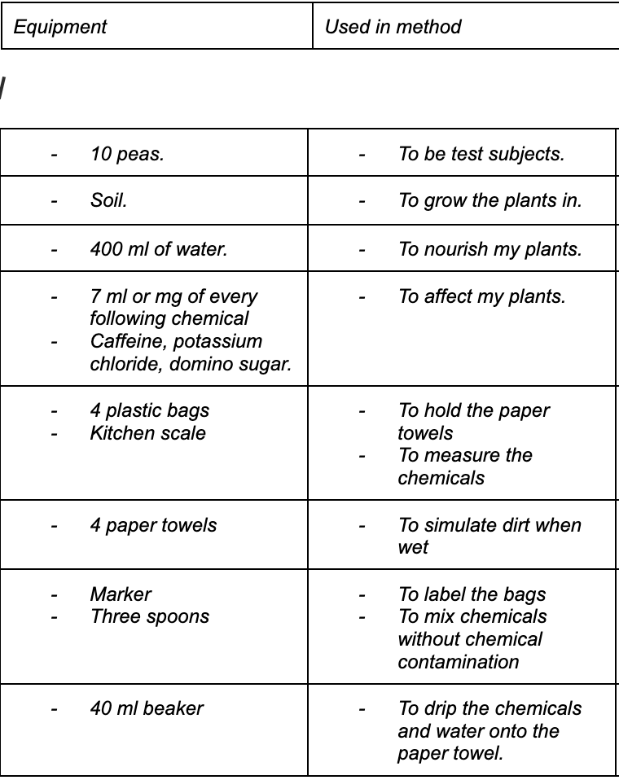
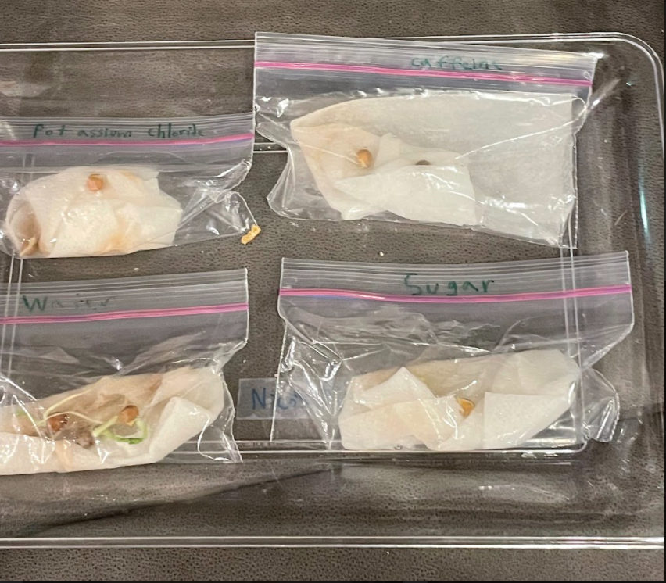
Materials

Slide 4
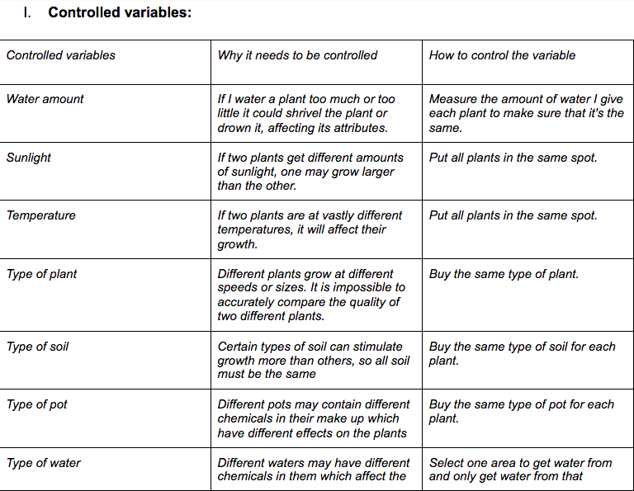
Variables

Slide 5
Procedures
Obtain materials
Fill the beakers with 40 ml of water and 7 ml of each individual beaker’s assigned chemical
Wrap the peas in paper towels
Put 2 peas in each plastic bag except for the 4 control peas which are put in a separate bag
Give each bag a label
For 4 days check each pea plant at 3:00 pm, 6:00 pm, and 9:00 pm
Record the germination time of all ten peas
Represent the data in a double bar graph
Take pictures

Slide 6
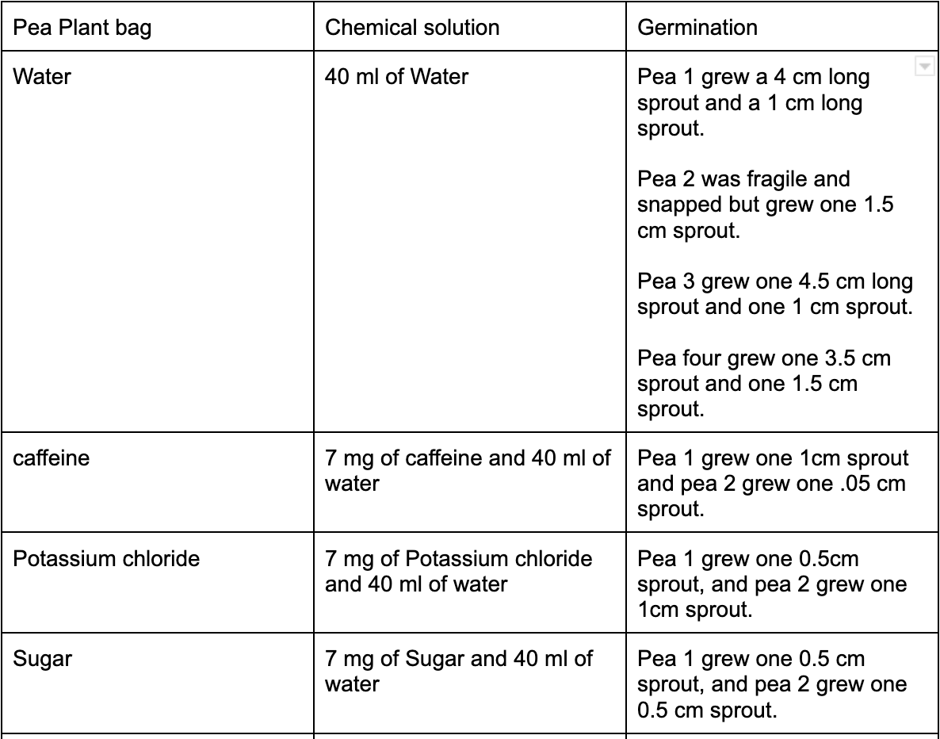
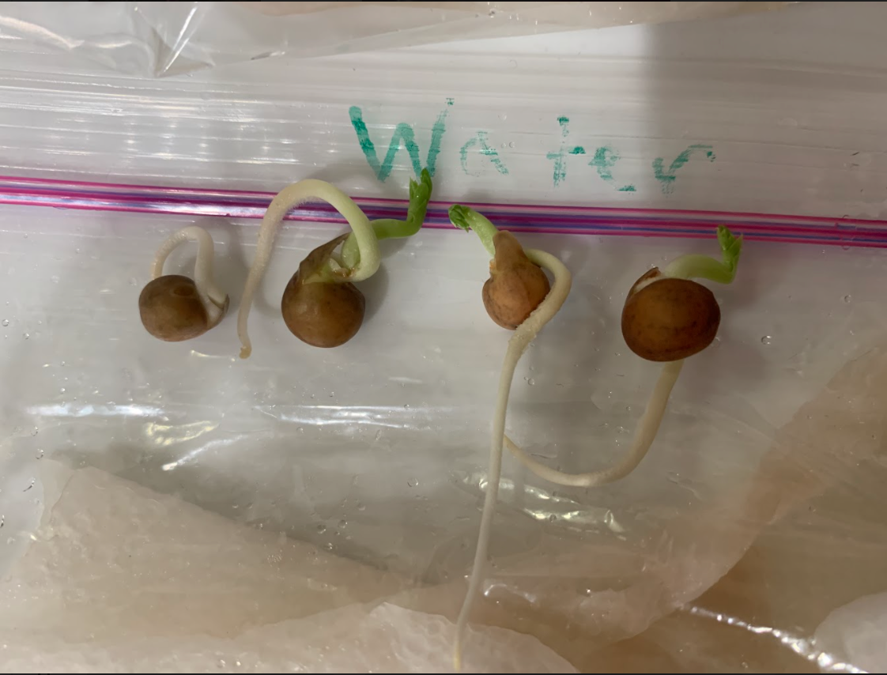
Data
Caffeine
1 cm
0.5 cm
1 cm
0.5 cm

Slide 7
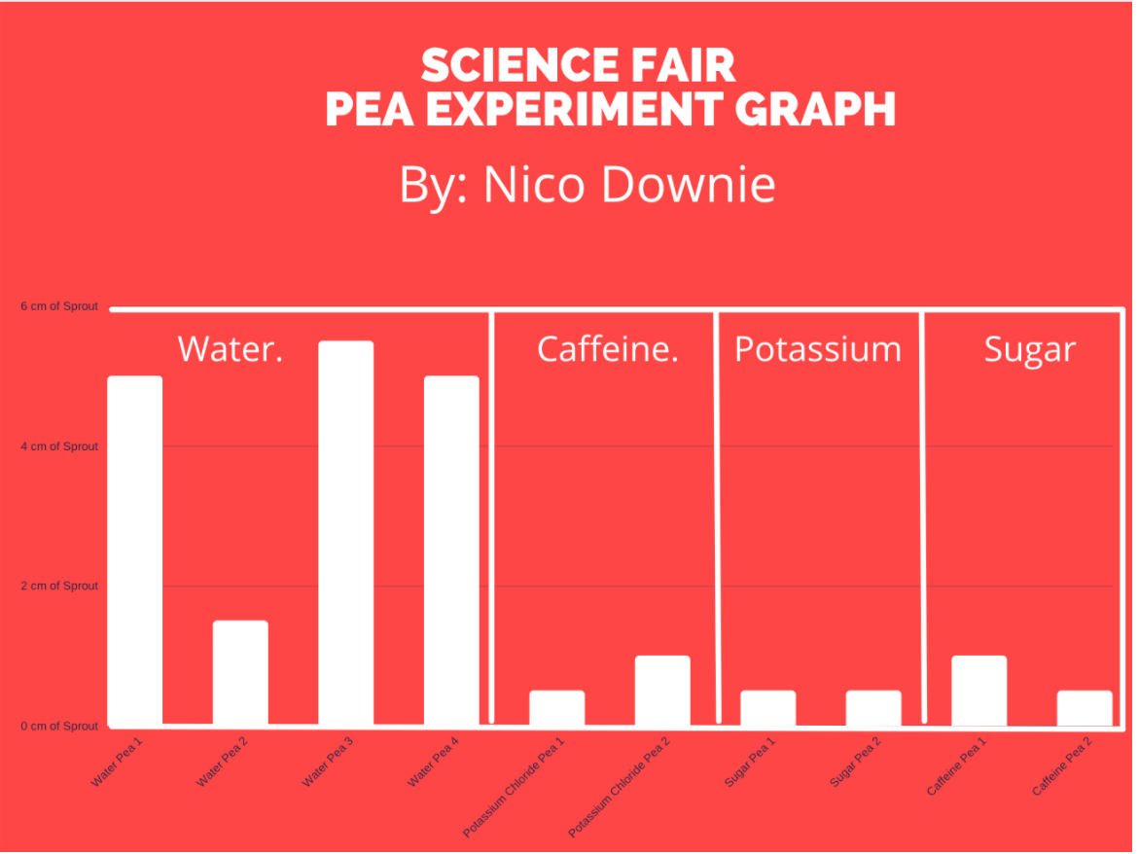
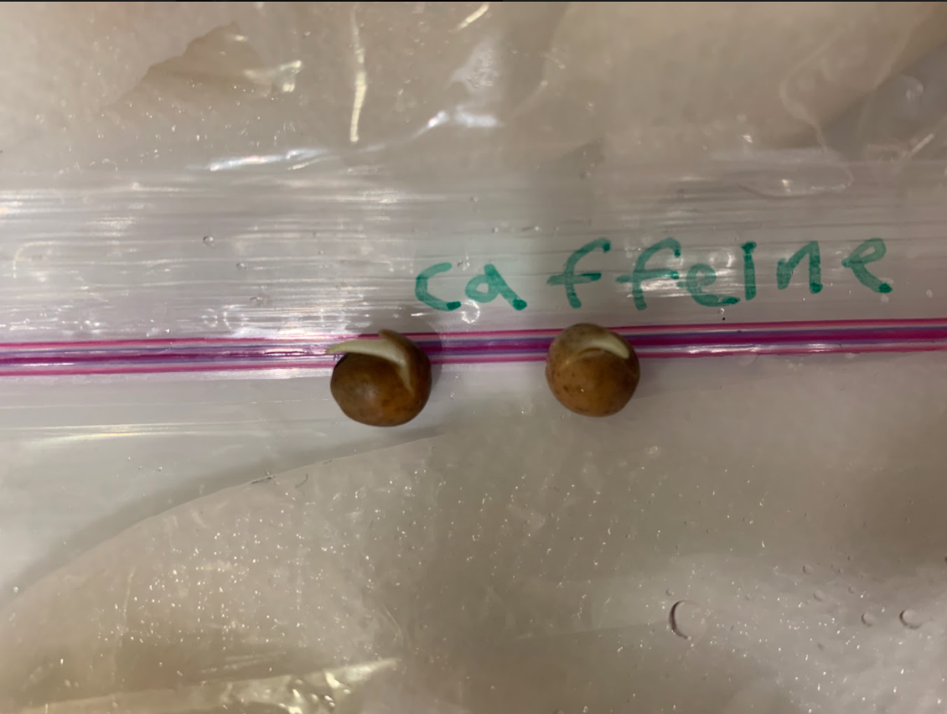
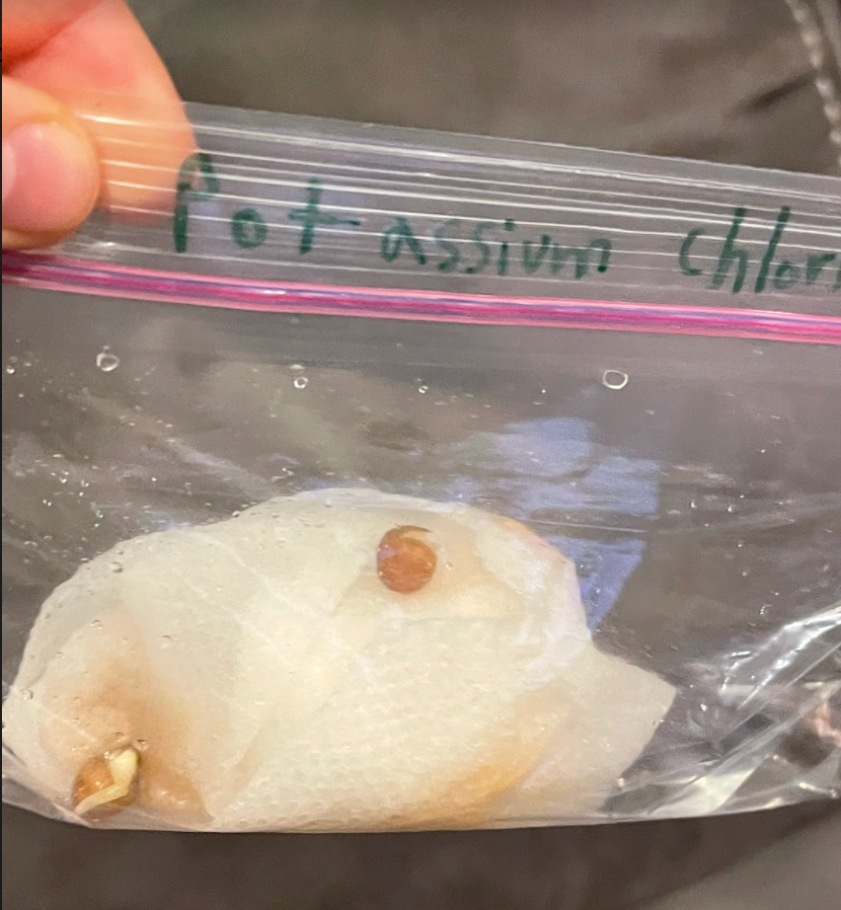

Slide 8
Analysis
This data suggests that processed sugar, potassium chloride, and caffeine are poisonous to plants.
This is most likely because all of the chemicals are associated with plants, but are not necessarily healthy for plants.
My data shows that the peas which are given water will grow faster than peas with sugar, caffeine, or potassium chloride.
The data shows that these chemicals stunt growth and poison peas, shriveling them, muting their natural color tone, and severely slowing their growth rate, causing them to only grow sprouts that are about a half to one centimeter.

Slide 9
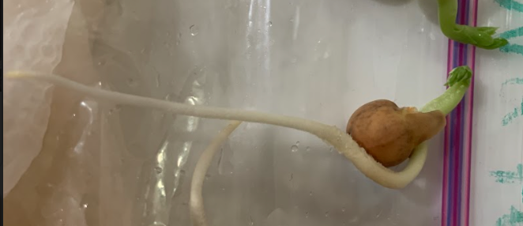
Summary
My hypothesis was that if tested, the peas with chemicals would grow faster than the other peas. My hypothesis was incorrect. It instead turned out that the chemicals I had chosen poisoned the peas, but were so diluted that they did not kill them. The peas had their growth stunted and so grew only half to one centimeter as opposed to the normal peas which grew up to four point five centimeters. I believe that the reason for this was that the chemicals I had chosen were not natural, but instead associated with nature. Processed sugar is not good for plants, caffeine comes from coffee beans but I was growing peas, and potassium chloride may come from plants, but is not necessarily good for them.

Slide 10
Labeled Diagram
Plastic Bag
Tray
Wet Paper Towel
Peas

Slide 11
Thank You
For Listening

