Slide 1
Introduction
Currently, there are no commercialized product that utilizes deep learning solutions to stabilize videos.
Challenges:
Deep learning methods require vast amount of training data that are hard to obtain
Training deep learning models require high computing potential
Research Objective: Analyze current deep learning video stabilization methods and incorporate a method into a user-friendly application
Figure 1. decorative photo

Slide 2
Existing Work
Traditional methods
2D & 3D video stabilization
Stabilize through Extracting feature points & creating an extimated stable camera trajectory
Pros:
Relatively mature technology
Cons:
Bad stabilization result when feature points aren’t obvious
Can’t achieve real-time video stabilization since it need both past & future frames
Deep learning methods
Most use Convolutional Neural Networks (CNN)
Sometimes incoporate other networks to work together
Pros:
No limitations
More potential (better quality + possible real-time stabilization)
Cons:
Less mature
Require extensive computing power to train models

Slide 3
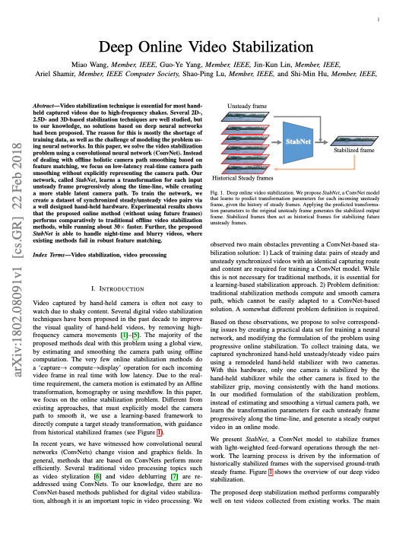
Preliminary Study
Analyzed multiple research papers including deep learning video stabilization methods.
Multiple papers referenced Wang et al. 2018’s StabNet model as a comparison and also utilized their DeepStab dataset which consisted of 61 pairs of stable & unstable videos.
I chose to analyze Wang et al. 2018’s Deep Online Video Stabilization method deeper.
Figure 2. Wang et al. 2018 Deep Online Video Stabilization paper pg.1

Slide 4
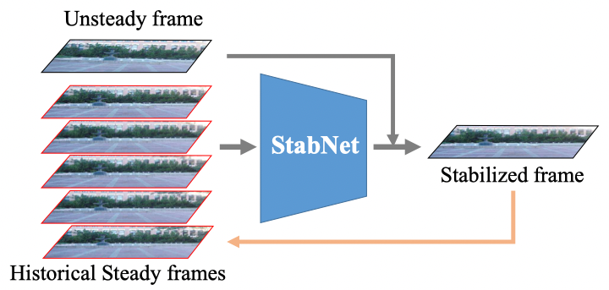
Concept Overview
The StabNet model features a CNN & Siamese Network inside
Figure 3. process map from Wang et al. 2018 paper

Slide 5
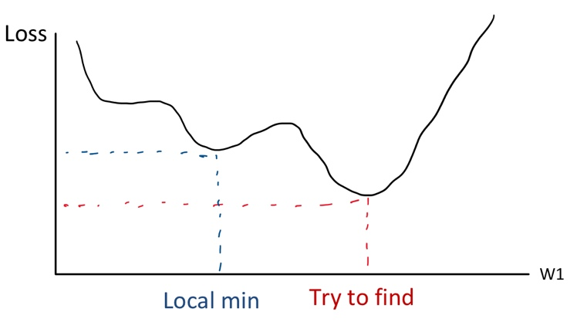
Convolutional Neural Network (CNN)
1
image
2
convolutional layers
pooling layers
3
fully connected layers
4
output
Feed forward neural network
Three kind of layers
Convolutional
Pooling
Fully Connected
Goal of CNN: Find a minimum loss value (y-value) by changing its w1 (x-value) using derivatives
Problem: might only find a local minimum instead of global minimum
Solution: train multiple times + add a momemtum (jump)
CNN in StabNet utilizes a ResNet50 network
Figure 4. visualization of what CNN is trying to find

Slide 6
Siamese Network
Two Identical Networks work simultaneously with two different inputs to compare outputs to get the loss feature, including stability loss and temporal loss
Stability loss: compare processed frame & stable frame
Temporal loss: compare current processed frame & previous processed frame
Figure 5. visualization of how the Siamese Network works

Slide 7
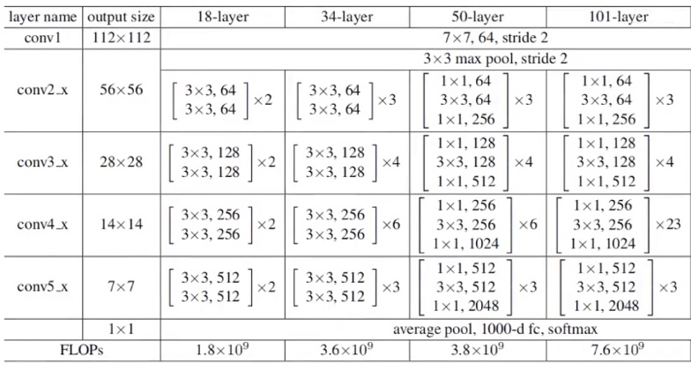
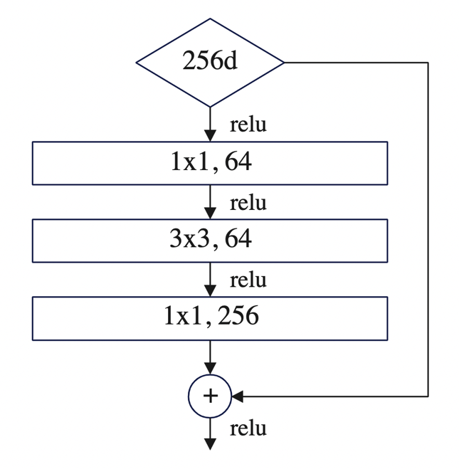
ResNet50
ResNet50 is a training network strcture that consists of 4 blocks including 3, 4, 6, and 3 units.
It is special becuaser of its skip connections, which allows it to jump over some layers so the model can train faster.
Figure 6. ResNet structure explanatory chart
Figure 7. how ResNet50 jumps over layers

Slide 8
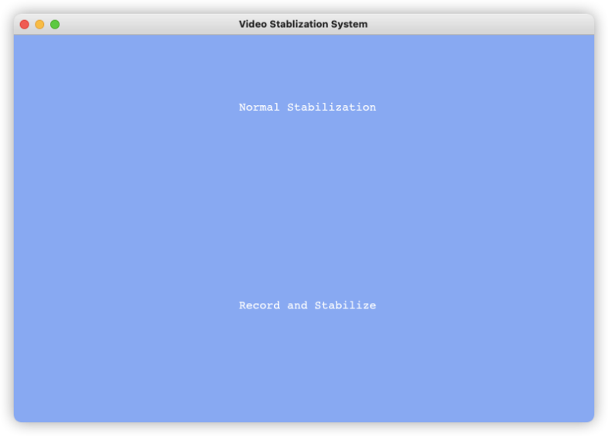
App Development
I used PyQt5 to design the application and incorporated two modes
Normal stabilization: choose file and stabilize
Record & stabilize: user record the video using the app first
Straightforward functions, easier to use than Adobe Premiere Pro for video stabilization
Figure 8. Start page
Figure 9. record & stabilize mode
Figure 10. normal stabilization mode

Slide 9
Data Analysis & Findings
When compared to the well-known commercialized application Adobe Premiere Pro (Pr), our stabilization method performs better in 1 scenerio but worse in the other 2. On average the stability of our method is only 9% less than Pr.
This stability result is successful for the less mature deep learning method.
Limitations: The FOV & Sharpness of videos processed through our application performes worse than Pr.
Figure 11. Stability comparison chart
Figure 12. FOV & Sharpness comparison chart

Slide 10
Conclusion
Deep Learning Method
Traditional Method
We successfully brought a deep learning based video stabilization method into a user-friendly application. The stability result of the less mature deep learning method is already comparable to the state-of-the-art feature that Adobe Premiere Pro incorporated.
The Future of Video Stabilization is deep learning.

