Slide 1
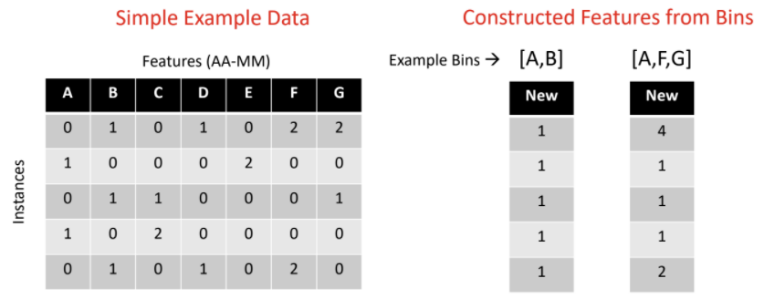
Background
Rare Variant Features
Features (i.e., variables) with rare variant states complexify disease association analysis
Rare variant features remain unexplained but are believed to hold the key to explaining missing heritability in complex diseases
Interactions between features (e.g., epistasis) are critical for disease
Rare variant features outside of genetics
→ Donor-recipient HLA amino acid mismatches and transplantation
Binning Features
Binning considers groups of features additively
Overcomes limitations of univariate analyses of rare variants (statistical power)
Figure 1: Example of feature binning with simple dataset. All images (figures and tables) are created by the student researcher.

Slide 2
Literature Review: Rare Variant Analysis Methods
Table 1. Previous studies on rare variant analysis methods.
Method | Description | Considers Interactions? | Relies on Expert Knowledge? | Applicable Beyond Genetics?
GWAS | Statistically underpowered due to low frequency of rare variants | No | Flexible | No
CAST | Combines rare variants in a single region to one variable | No | Entirely | No
WST | Burden testing, assigns weights to rare variants in a region | No | Entirely | No
SKAT | Multiple regression model assigns weights to rare variants in a region | Yes | Entirely | No
BioBin | Candidate bins constructed using a variety of biological annotations | Not directly | Entirely | No
Ideal method | Yes | Option to do so | Yes
Goal of project (RARE)

Slide 3
Development of RARE
1) Develop a novel evolutionary algorithm that can reliably construct bins of rare variant features with optimal association to outcome
2) Validate RARE with simulated datasets (i.e., tests for the algorithm)
Capable of constructing bins with both univariate and interaction effects
Options to operate with or without expert knowledge input
Versatile for applications beyond just genetics/genomics

Slide 4
Methods: RARE Algorithm
Relevant Association Rare-variant-bin Evolver (RARE)
Figure 2. Schematic of RARE.
The steps of RARE are
(1) data preprocessing
(2) bin initialization
(3) repeated evolutionary cycles
(a) bin fitness evaluation
(b) genetic operations
(c) creation of the next
generation of bins
(4) final bin evaluation
(5) summary of the top bins
RARE made open source at https://github.com/UrbsLab/RARE

Slide 5
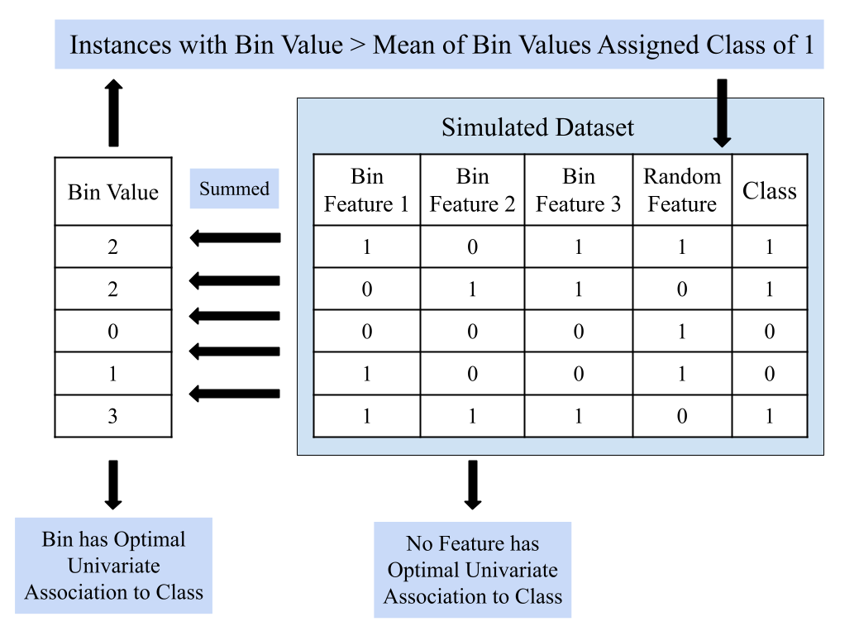
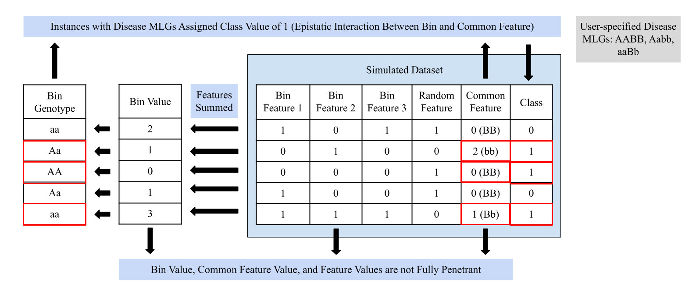
Methods: Rare Variant Data Simulators
Figure 3. Schematic of the rare variant data simulator for a univariate association bin. Outputs data such that no one feature is predictive of outcome (class) but a bin of features is predictive of outcome.
Figure 4. Schematic of the rare variant data simulator for an epistatic interaction bin. Outputs data such that no one feature is predictive of outcome, no bin of features is predictive of outcome, but a bin of features holds an interaction with another feature to determine outcome.
Data simulators output synthetic datasets where the optimal bin of rare variant features is known, so testing RARE on simulated data allows measurement of RARE’s accuracy
Data simulators open source at https://github.com/UrbsLab/RARE

Slide 6
Results: Validation of RARE
Tests on Constructing Bins with Univariate Association
94.22% accuracy in binning features that belonged to the known optimal bin with MultiSURF scoring (in 30 trials)
100% accuracy with chi-square scoring (in 30 trials)
Tests on Constructing Bins with Epistatic Interaction
RARE with chi-square scoring failed to construct bins with interactions
RARE with MultiSURF scoring achieved 96.00% accuracy (in 30 trials)
Evaluating Expert Knowledge
Without expert knowledge: 94.22% accuracy, 286.48 cycles to reach 80%
With partial expert knowledge: 99.00% accuracy, 21.57 cycles to reach 80%

Slide 7
Background for Application: HLA Amino acid Mismatches & Kidney Transplantation
Kidney transplantation failure poses a high burden of psychological and medical morbidity, affecting about 20% of transplant recipients
Increased risk of transplantation failure in third world countries (e.g., Iraq and Brazil) with struggles in donor-recipient matching
Previous efforts analyzing HLA amino acid mismatches in transplantation challenged by multicollinearity and low frequency of mismatches
Important question: contribution of mismatches at DRB1 vs. DQB1 loci
Low frequency amino acid mismatches are rare variant features
→ RARE can elucidate the role of mismatches in transplantation failure

Slide 8
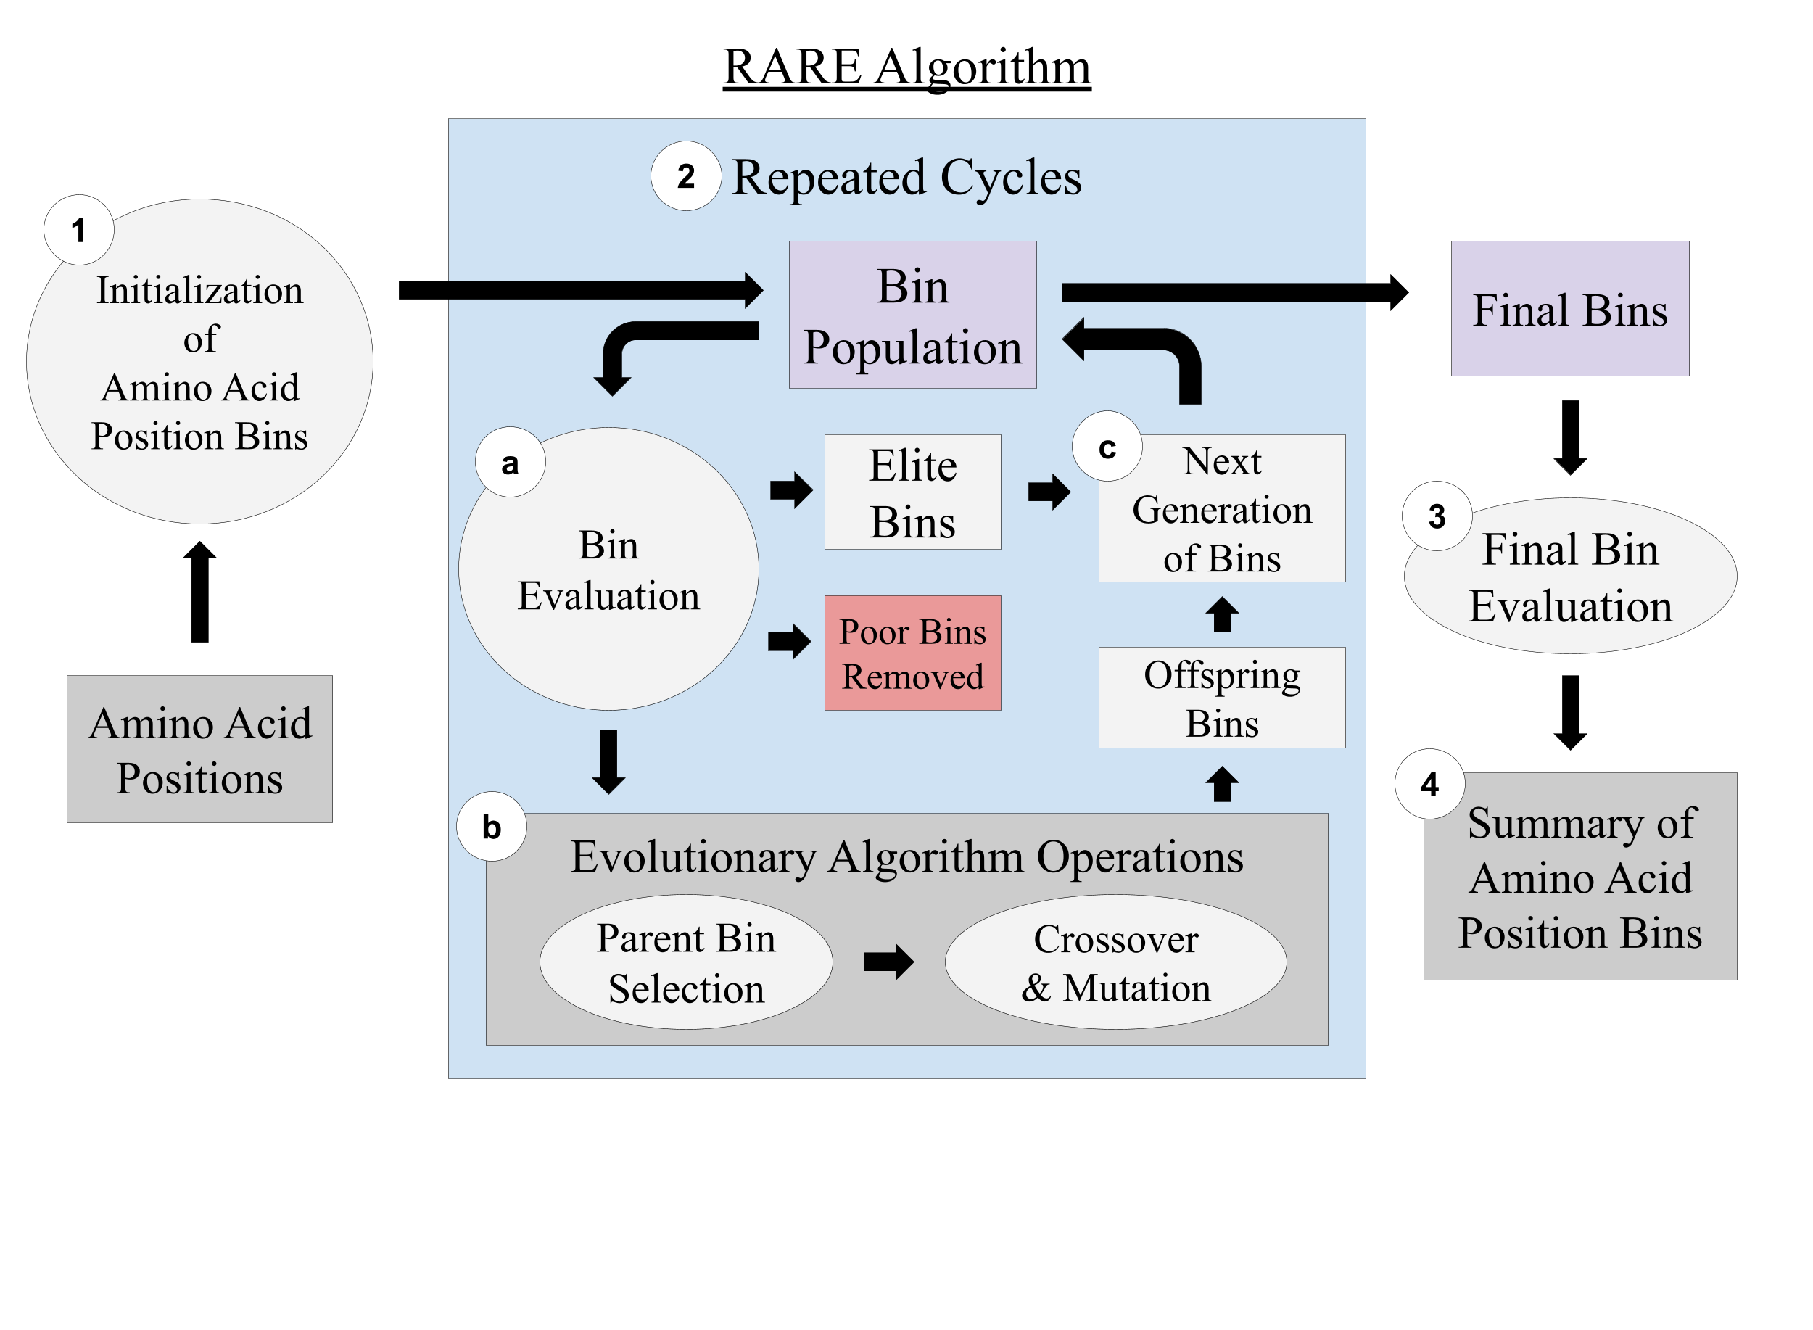
Application of RARE
Apply RARE to construct bins of HLA amino acid mismatches with association to kidney transplantation failure
Bin across all 5 HLA loci in study (A, B, C, DQB1, and DRB1)
Compare RARE’s best bin with sequence feature variant type (SFVT) expert knowledge bins
Run RARE on each individual locus separately
Figure 5. Schematic diagram of application of RARE to HLA amino acids and kidney transplantation. Univariate scoring (chi-square test) used for bin fitness evaluation.
Description of Transplantation Data
Obtained from Scientific Registry of Transplantation Recipients
49,459 donor-recipient pairs from 2005 to 2017
306 HLA features (amino acid positions)
Imputed from serologic antigen specificities using haplotype frequencies developed by National Marrow Donor Program

Slide 9
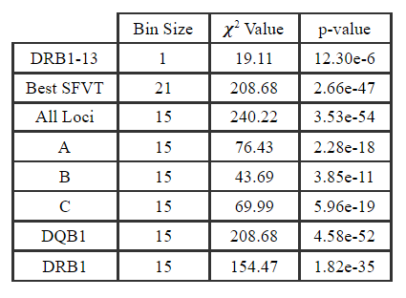
Results: Applying RARE to Transplantation Data
Binning across all 5 loci
RARE’s best bin shares 12 amino acid positions with the best SFVT bin, demonstrating RARE’s ability to generate biologically relevant bins.
RARE’s best bin outperforms the best SFVT (expert knowledge) bin, showing the utility of RARE’s data-driven approach
Binning across each loci separately
DRB1 bin has highest association to graft failure, followed by DQB1 bin, then A bin, C, and lastly B
Table 2. Results from applying RARE to construct bins of HLA amino acid mismatches with association to transplantation failure. DRB1-13 is the amino acid position with highest association to outcome.

Slide 10
Conclusions
Applications
Overcame limitations of previous methods
RARE is sensitive to interactions, not entirely dependent on expert knowledge, and has applications beyond genetics
Reliably constructs bins with both univariate and epistatic effects
Application of RARE suggests mismatches at peptide-binding sites of HLA-DRB1 are most strongly associated with kidney transplantation failure
RARE can pinpoint key rare variant features that guide predictive models, diagnostic methods, and drug targets
Applicable to a wide range of complex diseases
Aid in a clinical setting for informing evaluation of transplantation donor-recipient pairs
Inform development of new CRPA (HLA sensitization test before transplantation) and U.S. Gov. Organ Procurement and Transplantation Network’s new continuous distribution initiative

Slide 11
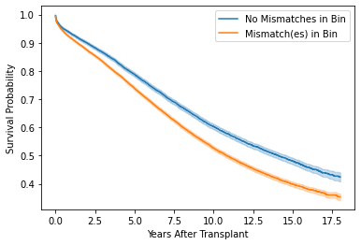
Ongoing Future Investigations
Using RARE to investigate transplantation failure within a year vs. beyond a year
Potential future collaboration with Children’s Hospital of Pennsylvania using RARE to analyze genetic underpinnings of congenital heart disease
Evaluate alternative bin evaluation (scoring) methods (e.g., mutual information)
Developing statistical methods for capturing epistatic interactions between HLA amino acid mismatches under absence of main effects
Additional work developing rare variant data simulators as a tool for the broader computer science research community
Applying RARE to survival analysis
Figure 6. A brand new, days-old idea I am testing is the integration of RARE into survival analysis. This version of RARE utilizes a log-rank test as the bin fitness metric and seeks to optimize bins’ ability to stratify risk of transplantation failure over time. Advantages include interpretability and immediate clinical significance as an improvement over the current gold standard, 0-ABDR risk stratification.

Slide 12
Publications
Manuscript detailing development of RARE peer-reviewed, published, and presented as paper in Genetic and Evolutionary Computation Conference (Track: Evolutionary Algorithms for Problems with Uncertainty):
Dasariraju, S., & Urbanowicz, R. J. (2021). RARE: Evolutionary feature engineering for rare-variant bin discovery. Proceedings of the Genetic and Evolutionary Computation Conference Companion, 1335–1343. https://doi.org/10.1145/3449726.3463174
Abstract detailing application of RARE in transplantation peer-reviewed and presented at American Society for Histocompatibility and Immunogenetics Annual Meeting; published in Human Immunology:
Dasariraju, S., Wager, G. L., Gragert, L., Kamoun, M., & Urbanowicz, R. J. (2021). Machine Learning Approach for Binning Donor-Recipient HLA Amino Acid Position Mismatches to Detect Association with Kidney Graft Failure. Human Immunology, 82 (Supplement), 41–42. https://doi.org/10.1016/j.humimm.2021.08.002

