Slide 1
1. Research Background
As the technology developed, robotic hands become more and more common in industry. However, those robotic hand used in the industry usually follows a specific motion and they only grab specific things. What if I need a robotic hand which can grab a lot of different things with different shape and material?
Most of the robotic hand for civil use are good at grabbing things but not at pinching things.
Therefore, I try to make a hand which can not only grab variety of things but also be able to pinch small things. In a word, this robotic hand will have a wider grabbing range.
All the pictures in this PowerPoint are made by the researcher

Slide 2
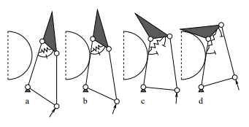
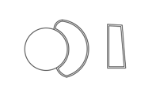
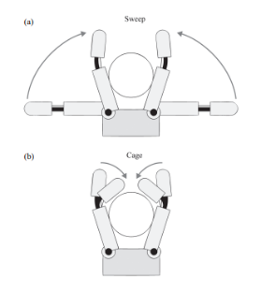
1. Research Background
Different kinds of hands | Picture | Advantages | Disadvantages
Synergy-based hands | [1] | Tightness | Complexity Cannot fit some special shapes
Soft material based hands |  | 1. Fitness | Difficult to produce Not tight
Knuckle-used hands | [2] | Between them: Tightness + Fitness | Between them: Structure is kinds of complex Not very tight
Competition of several kinds of current robotic hand.
All the pictures in this PowerPoint are made by the researcher

Slide 3
2. Theoretical design
Red line: elastic band
All the pictures in this PowerPoint are made by the researcher

Slide 4
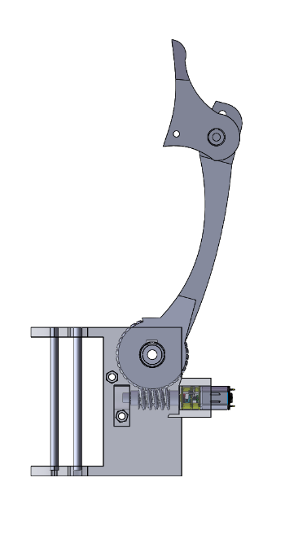
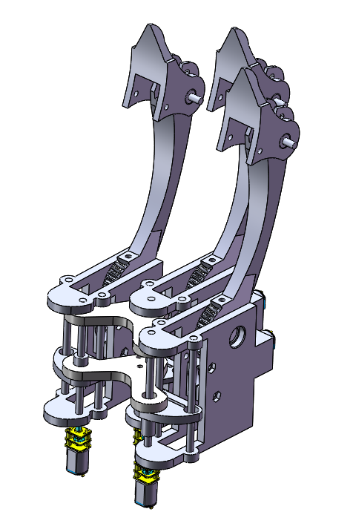
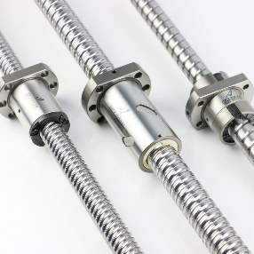
2. Theoretical Design
All the pictures in this PowerPoint are made by the researcher
A finger include an inter part which include the whole body of the finger and a outer shell which is used to put motors and other components like travel switch and worm.
Inner part: Solid part
Outer part: transparent part
The hand have total three fingers which are connected with a board. The middle finger is fixed on the board while the fingers on two sides can rotate on the board.
However, the board’s shape need to be calculated.Since we want the three fingers able to form a circle
Finger tip
The board
three of them
Finger body
The moving of the tip is controlled by a lead screw and a screw nut on it. The rotate of the lead screw will lead to the vertical movement of the nut. This movement will stretch or release the elastic band which is connected to the fingertip.

Slide 5
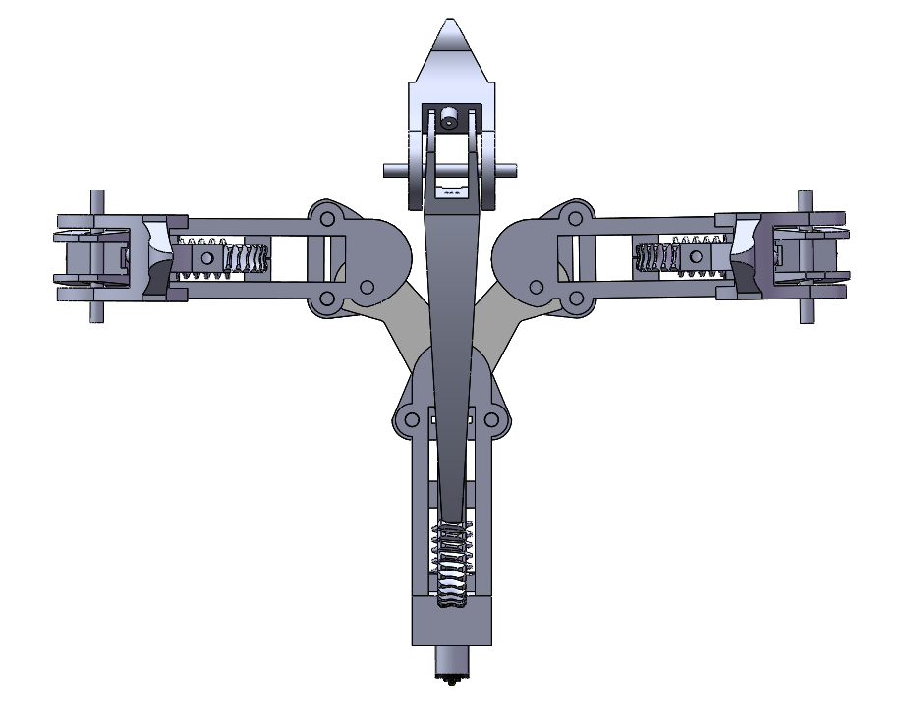
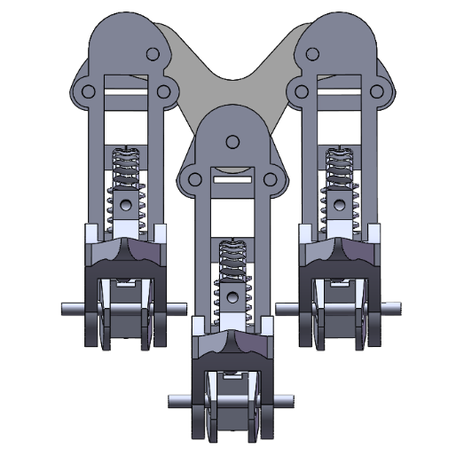
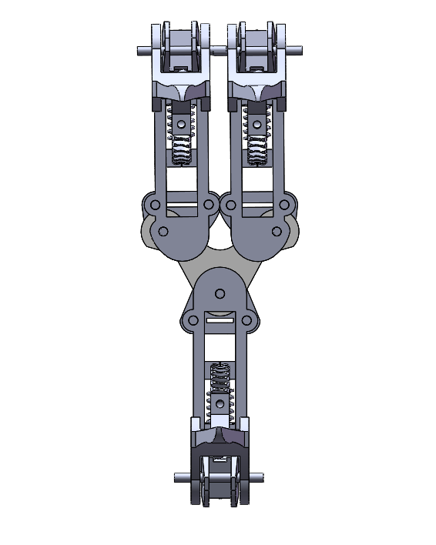
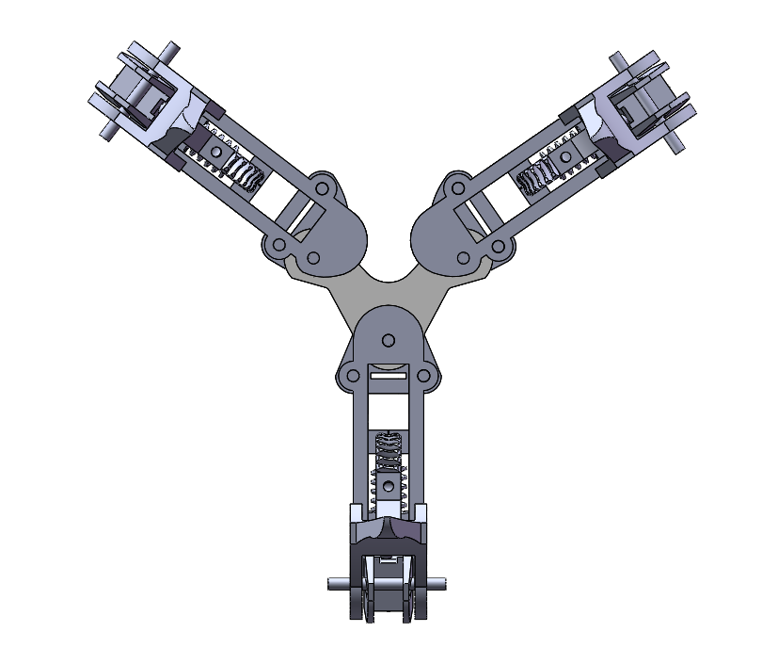
2. Theoretical design
The rotation of the fingers on two sides gives the hand four modes
Initial mode
Two-fingers mode
Circle mode – the shape of the connection need to be calculated
Two-sides mode
2
1
4
All the pictures in this PowerPoint are made by the researcher
3

Slide 6
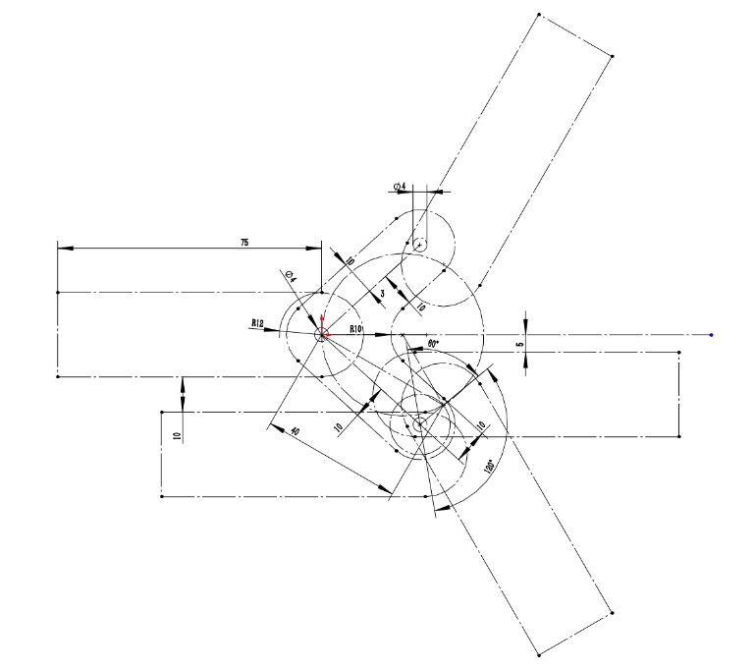
2. Theoretical design
However, to make sure the fingers in the circle mode can for a shape of a circle, the shape of the middle board needs to be calculated precisely. On the left picture is the model built in solid work.
At the same time, the shape of the middle board will also affect the performance in the two-sides mode.
All the pictures in this PowerPoint are made by the researcher

Slide 7
3. Software & Electronics
Therefore, we need:
3 motor drivers: each of them can drive 2 motors or servers.
A circuit board that can have enough ports for the connection of this hardware.
Bluetooth module for user to control the hand.
Others: help to make the wire connection easier and decrease the ports we need.
Hardware:
4 motors: 3 for the band of the motor, 1 for the rotation of the lead screw.
2 servers: Both for the rotation of the fingers on two sides.
6? Travel switches: 2 on each finger to protect the finger and help to locate the finger.
All the pictures in this PowerPoint are made by the researcher

Slide 8
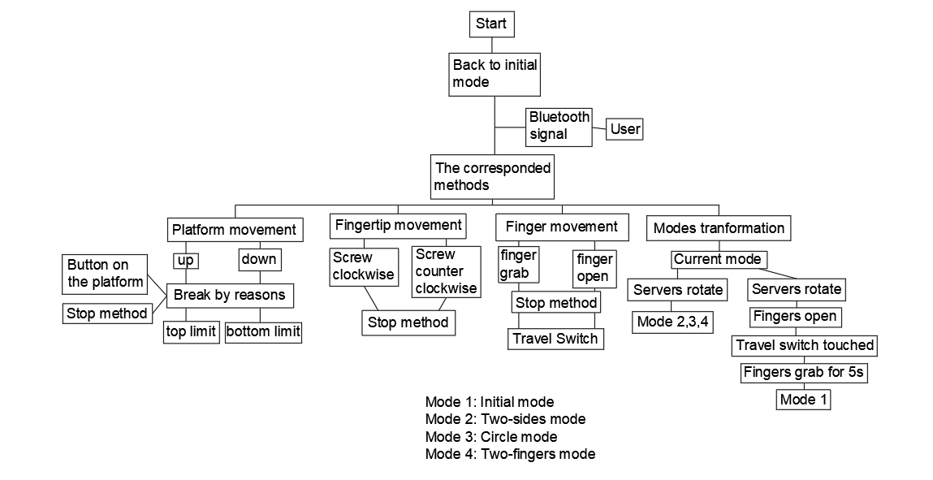
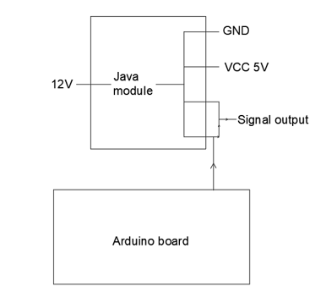
3. Software & Electronics
A java module which can take a 12V input and gives out four output: GND, VCC(5V), and two empty connected signal output.
This module works like a hub. It can provide 5V power and two same output but only need one input. This means it can save a VCC port and an analog port for the arduino board
The logic map of the program
All the pictures in this PowerPoint are made by the researcher

Slide 9
3. Software & Electronics
Power supply
The Arduino board
Steering gear
A4950
Java module
L298N
The picture of the whole electronics
All the pictures in this PowerPoint are made by the researcher

Slide 10
4. Experiments
Experiment 1: Testing the grabbing ability of the hand.
Use the hand to grab things with different shapes. Objects are things in daily life. They have things with size from a soccer ball to a small screw.
The user will grab the things three times and if two or more times the hand can catch the thing and hold it, the grabbing will be considered a success.
Experiment 2: Testing the maximum weight each modes can grab.
Specially, all the grabbing in the experiment will only use the tips of the hand instead of using the finger bodies because doing so will harm the structure of the gears, especially when the weight is too big.
(using the fingers’ bodies will provide a stronger grasp)
All the pictures in this PowerPoint are made by the researcher

Slide 11
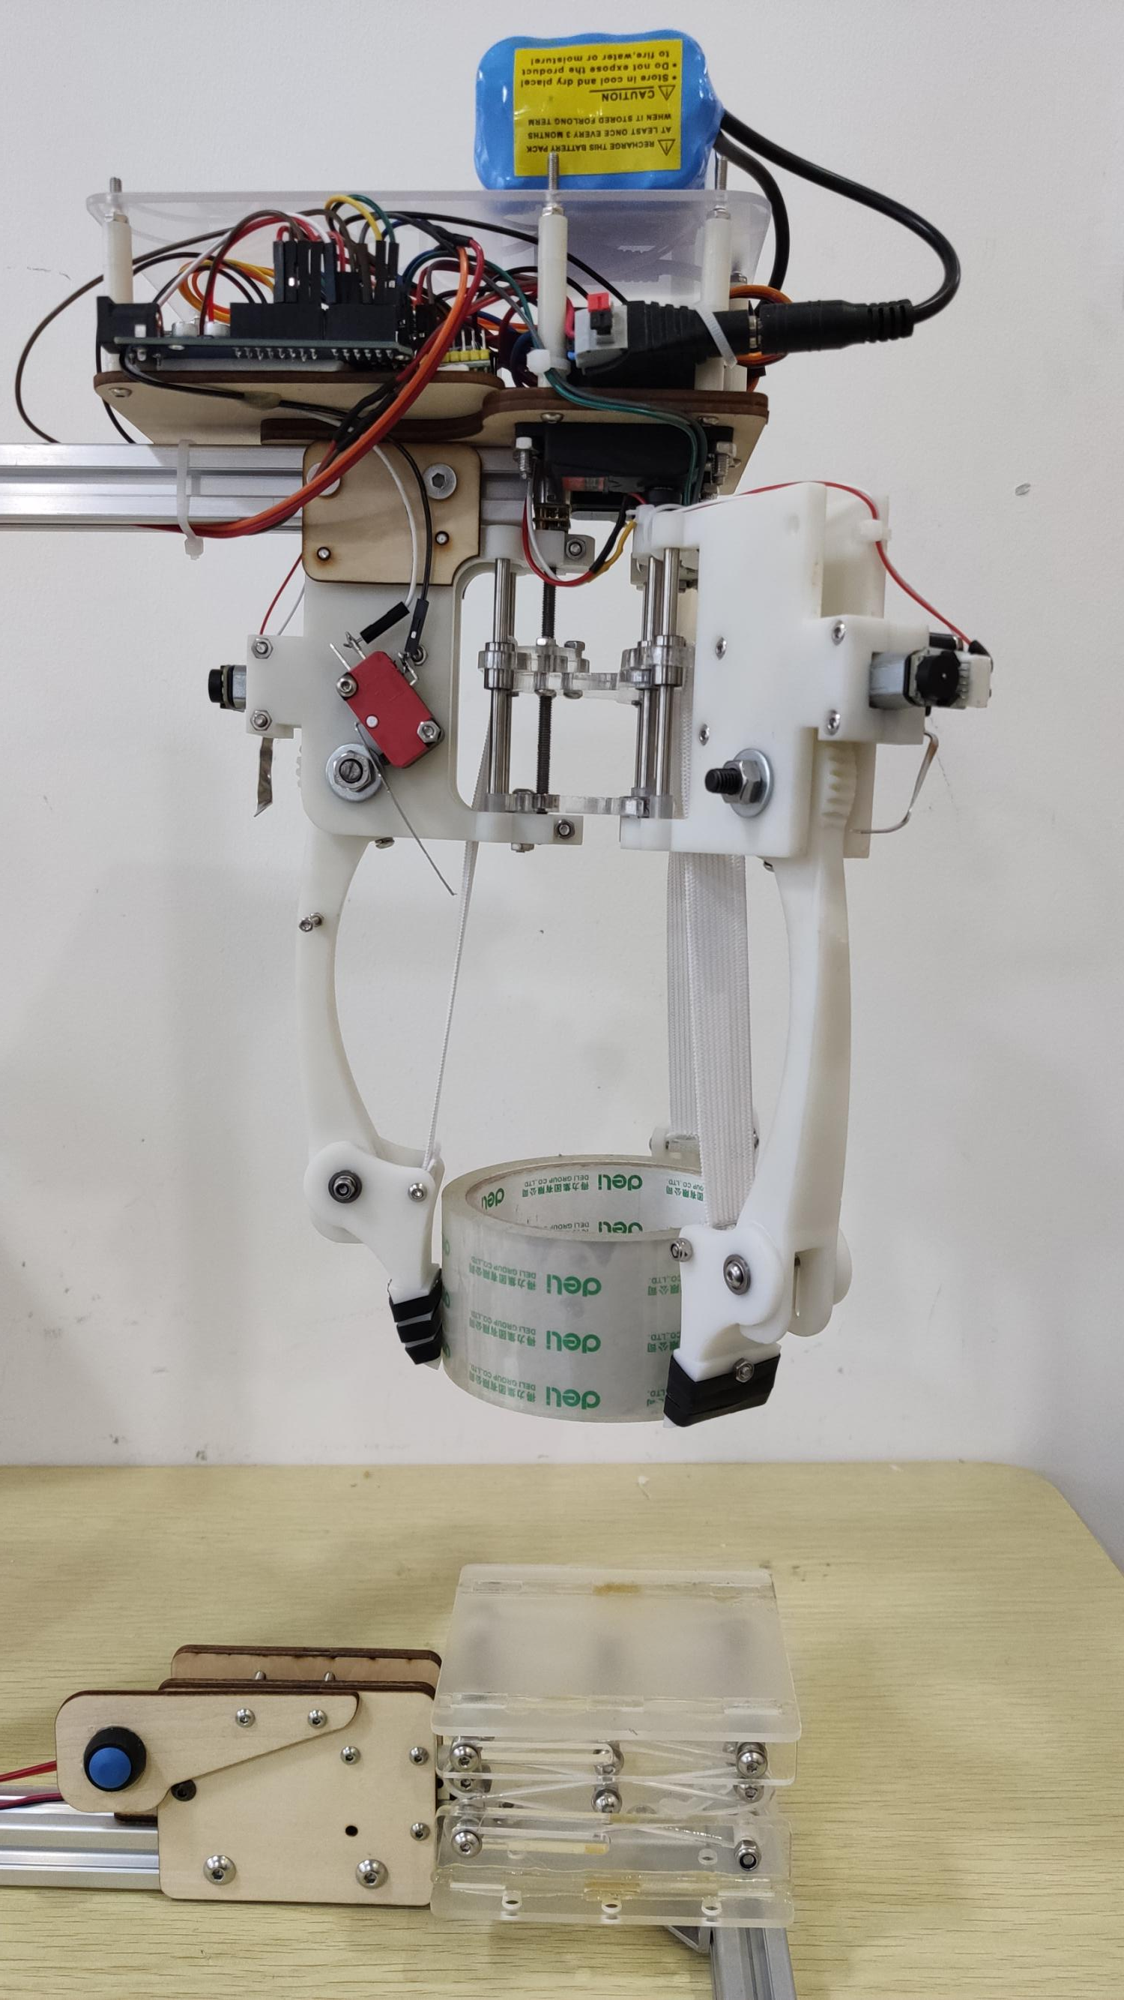
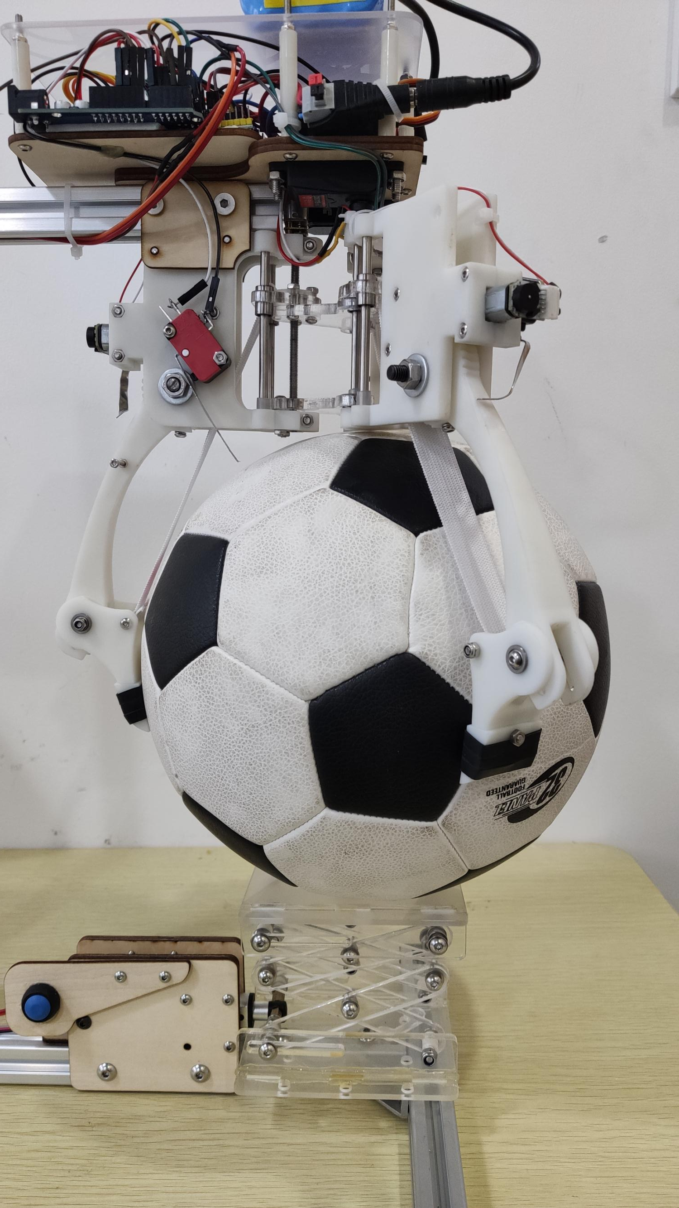
4. Experiments
Experiment 1 result: all the grabbing success.
Experiment 2 result:
Pictures
Circle mode: 428.3 gram
Two sides mode: 404.1 gram
Two fingers mode: 272.4 gram
The result is not ideal. The main reason is that the container I use to carry weight is made of plasitc and it’s soft. It will change shape which means that the friction is smaller.
All the pictures in this PowerPoint are made by the researcher

Slide 12
5. Conclusion
The hand had a strong grabbing fitness and it is pretty tight. It can grab most of the things in our daily life as showed in the experiment part.
However, it’s preciseness and the function of tip still need to be improved. One big problem is the motor’s rotational speed. Motors have a slight difference in their speed. The elastic band also causes a problem. The difference between the three elastic bands may cause the tip to have different position which makes the hand difficult to pinch.
All the pictures in this PowerPoint are made by the researcher

