Slide 1
Introduction
By: Ada Metaxas
Alzheimer's Disease (AD) is a progressive neurodegenerative disease characterized by the buildup of protein amyloid-beta (Aβ) aggregations.
(Alzheimer's Association, 2021)
It is believed to be a disease of trace metal imbalances because amyloid-beta has high affinity to trace metals copper and zinc. This binding is believed to cause a conformational change in Aβ, transforming Aβ into a configuration more amenable to forming aggregations.
Currently, the role of trace metals copper and zinc as beneficial or harmful in AD remains controversial. Also, the impact of Aβ-trace metal binding on trace metal homeostasis in AD is also unknown.
*All figures and images done by finalist, unless otherwise indicated

Slide 2
Hypothesis
If amyloid-beta aggregations increase in an Alzheimer’s Disease model, then these aggregations are induced by trace metal imbalances because dyshomeostasis of one trace metal triggers further dyshomeostasis of other trace metals.
Alzheimer’s Disease
Trace Metal Dyshomeostais

Slide 3
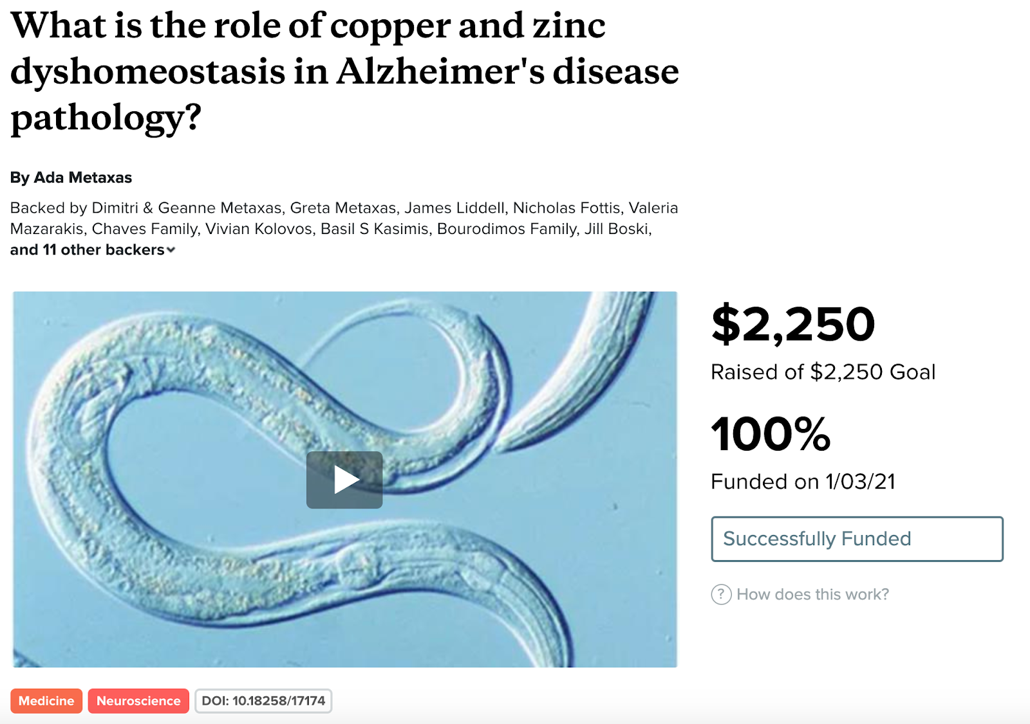
Materials and Fundraising
Materials
Caenorhabditis elegans, a non-parasitic nematode whose connectome has been fully established, is an advantageous model for studying Alzheimer’s.
2 strains:
CL2006: express the toxic Aβ42-peptide in muscle cells. Thus, Aβ aggregations result in the paralysis of C. elegans, allowing the extent of Aβ aggregation to be viewed macroscopically.
N2: wild type
C. elegans food and housing: Petri Dishes, Incubator, Agar, E. coli
Wire poker: to test C. elegans for paralysis
Materials for lysis: L15 buffer, centrifuge
Microscope
150 μM CuCl₂ and 500 μM ZnSO₄
Copper and Zinc Colorimetric Assays
Colorimeter
4 months fundraising on the research crowdfunding website experiment.com

Slide 4
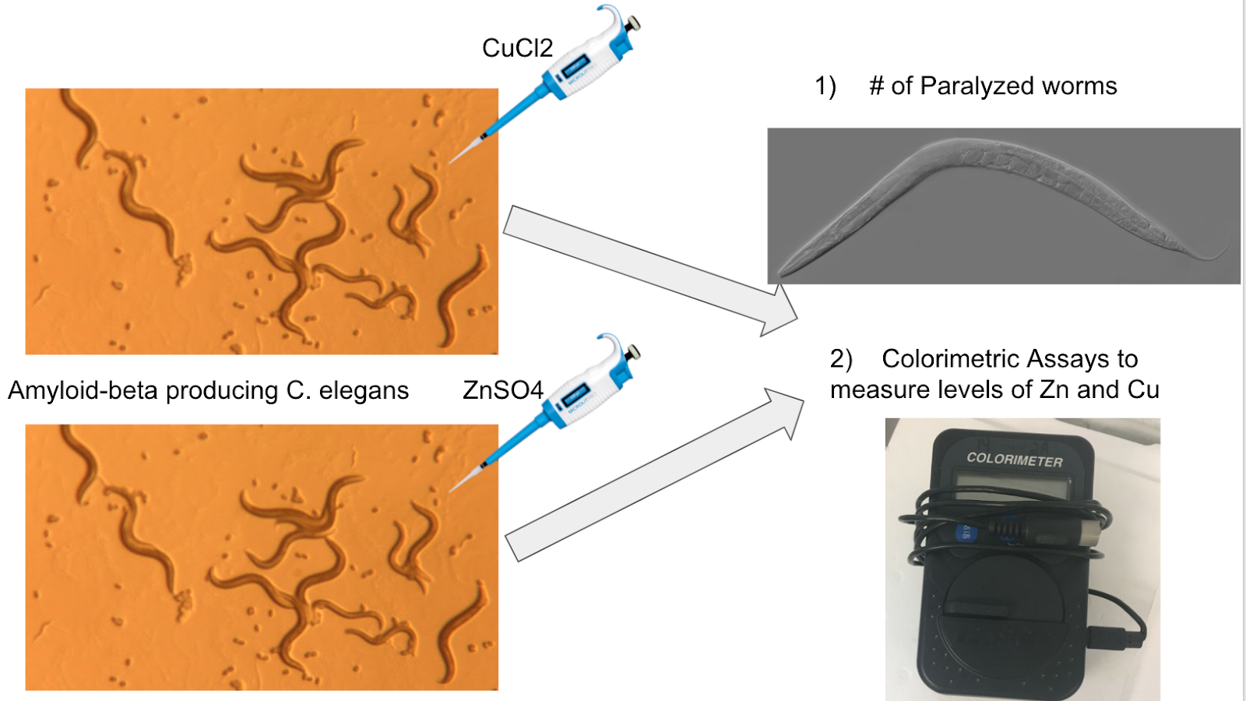
Procedures Summary
Amyloid-beta producing C. elegans (strain CL2006) and wild type C. elegans (strain N2) were age synchronized
A group of CL2006 and a group of N2 worms were supplemented with 150 μM CuCl₂
A group of CL2006 and a group of N2 worms were supplemented with 500 μM ZnSO₄
On days 6 and 9 after synchronization, 20 worms from the Cu-supplemented and Zn-supplemented CL2006 and N2 groups were tested for paralysis by tapping their noses with a platinum wire. Paralysis indicates the extent of Aβ-aggregation development.
Also on days 6 and 9, 30 worms from the Cu-supplemented and Zn-supplemented CL2006 and N2 groups were lysed. Colorimetric assays were applied to quantify Cu and Zn levels.

Slide 5
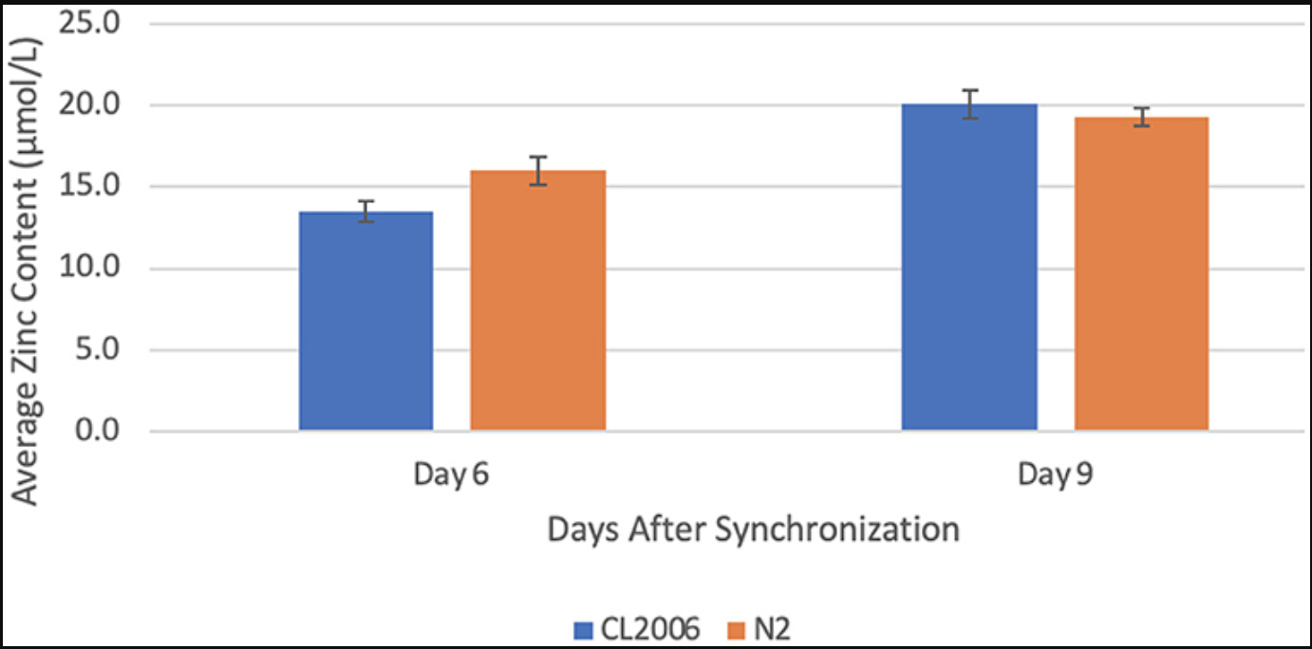
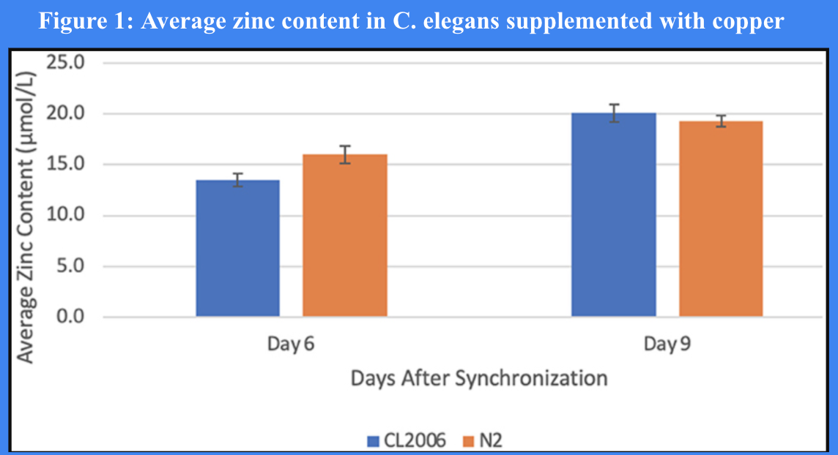
Results
Figure 1: Average zinc content in C. elegans supplemented with copper
When amyloid-beta producing C. elegans (CL2006) were supplemented with copper, a statistically significant (p = 0.013) increase in the average zinc content occurred from day 6 (13.5 ± 0.6 μmol/L) to day 9 (20.1 ± 0.9 μmol/L). Similarly, when non-amyloid-beta producing C. elegans (N2) were supplemented with copper, a statistically significant (p = 0.041) increase in the average zinc content occurred from day 6 (16.0 ± 0.9 μmol/L) to day 9 (19.3 ± 0.6 μmol/L). Values are mean ± SEM and are representative of 2 experiments where 30 C. elegans were analyzed at each time point.

Slide 6
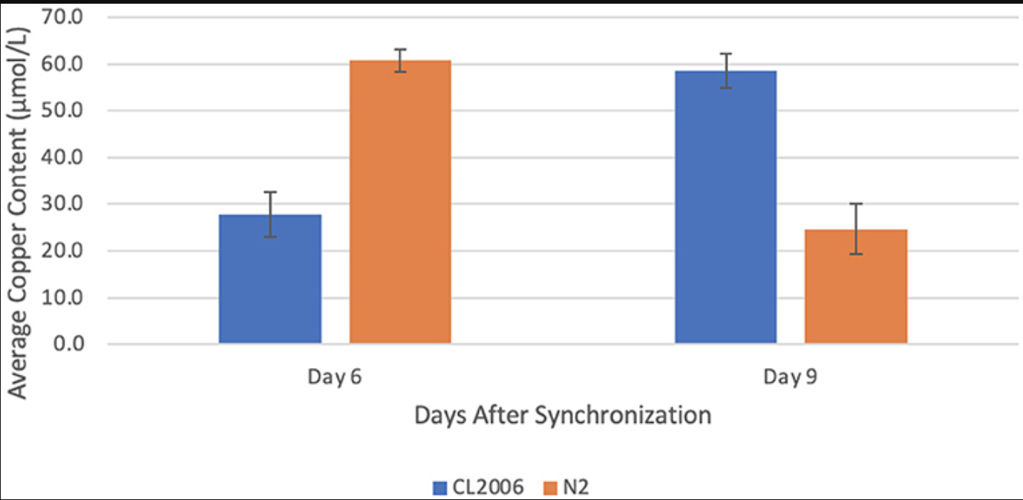
Results Continued
Figure 2: Average copper content in C. elegans supplemented with zinc
When amyloid-beta producing C. elegans (CL2006) were supplemented with zinc, a statistically significant (p = 0.022) increase in the average copper content occurred from day 6 (27.8 ± 4.9 μmol/L) to day 9 (58.6 ± 3.7 μmol/L). In contrast, when non-amyloid-beta producing C. elegans (N2) were supplemented with zinc, a statistically significant (p = 0.012) decrease in the average copper content occurred from day 6 (60.8 ± 2.4 μmol/L) to day 9 (24.7 ± 5.4 μmol/L). Values are mean ± SEM and are representative of 2 experiments where 30 C. elegans were analyzed at each time point.

Slide 7
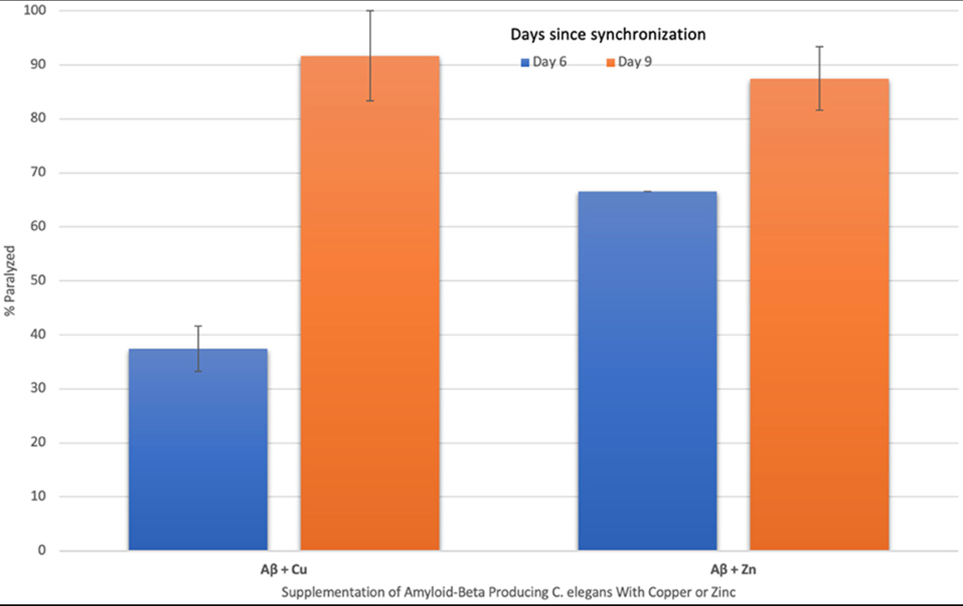
Results Continued
Figure 3: The effect of supplementing amyloid-beta producing C. elegans with copper and zinc on percent paralyzed over time
When amyloid-beta producing C. elegans were supplemented with copper, a statistically significant (p = 0.014) increase in % paralyzed occurred from day 6 (37 ± 4) to day 9 (92 ± 8). When supplemented with zinc, a statistically significant (p = 0.019) increase in % paralyzed also occurred from day 6 (67 ± 0) to day 9 (87 ± 4). The change in percent paralyzed is larger for the copper-supplemented group compared to the zinc-supplemented group. Values are mean ± SEM and are representative of 2 experiments where 20 C. elegans were analyzed at each time point.

Slide 8
Analysis
Positive Feedback Loop
Negative Feedback Loop
Quantity 1
Quantity 2
versus
Quantity 1
Quantity 2
-In Aβ-producing C. elegans, imbalances in trace metals copper or zinc trigger further trace metal dyshomeostasis.
When supplemented with copper, zinc levels increase significantly and when supplemented with zinc, copper levels increase significantly.
Thus, an imbalance in either trace metal causes a cascading effect resulting in further imbalances.
This triggering of further trace metal imbalances might explain why the % of worms paralyzed, which correlates to Aβ-aggregation levels, significantly increases in both copper and zinc supplemented mutant worms from day 6 to 9.
-In wild-type worms, however, dyshomeostasis of copper or zinc ultimately triggers a return to equilibrium.
When copper levels increase through supplementation, zinc levels correspondingly increase from day 6 to 9.
In contrast, when zinc levels increase through supplementation, copper levels decrease from day 6 to 9.
Therefore, it is possible that through a negative feedback mechanism loop, an increase in copper triggers an increase in zinc which ultimately causes a return to equilibrium.

Slide 9
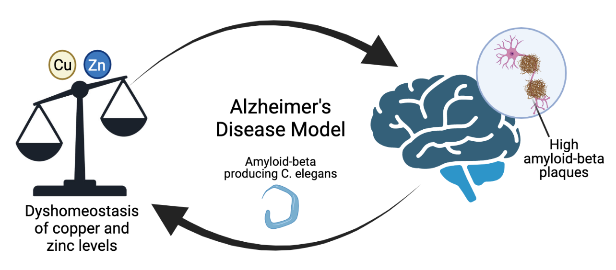
Conclusions and Future Directions
Overall, this study demonstrates that copper or zinc dyshomeostasis triggers further trace metal dyshomeostasis in Aβ-producing C. elegans, while dyshomeostasis of copper or zinc triggers a return to equilibrium in non-Aβ-producing C. elegans.
This might indicate that the inability to return to trace metal homeostasis in Aβ-producing C. elegans is part of the cause of higher amyloid-beta aggregations, supporting the hypothesis.
Therefore, this molecular interaction between trace metals and amyloid-beta can be targeted in Alzheimer’s Disease therapies.
Future directions include elucidating the mediating factors (such as chaperone proteins) that facilitate Aβ-trace metal binding, which can be targeted in Alzheimer’s Disease therapies.
Notes:
Highlight the project and its results
Indicate how the results reflect the hypothesis

