Slide 1
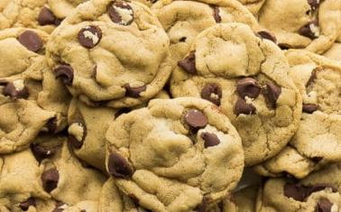
The Effect of Different Sweeteners on Cookie Size and Shape
By Angela Du

Slide 2
The Effect of Different Sweeteners on Cookie Size and Shape
By Angela Du

Slide 3
Question
What happens to the cookie size and shape when the sweetener is changed?

Slide 4
Research
Using granulated white sugar will make a harder and whiter cookie. The sugar is “hygroscopic” so it will absorb the liquid and make the development of the gluten slower. Because of this, the cookie will be harder. Using brown sugar will result in softer cookies. The brown sugar is also hygroscopic but it has more acidity making it thicker.
Honey is mostly used as a sweetener but for some cookies it can keep it moist and keep the unique qualities present(Velazquez)
The splenda sugar produced dry and crumbly cookies while the agave cookies were dry but tough. The honey cookies were really soft and gooey even after they cooled (Rowe)

Slide 5
Risk Analysis
Heating safety(while baking some pain and/or burns if you touch the cookies while hot)
Hygiene safety( Do NOT eat raw dough, unless you're 100% sure everything is clean, do not)
Electrical appliance safety (the use of an electric mixer may frighten or injures any inexperienced users)

Slide 6
Variables
Independent variable: The sweetener
Dependent variable: The difference in size and shape
Controlled variables: The things that were kept the same were the amount of the chosen sweetener and the amount of flour,eggs,baking powder, chocolate chip, the amount of dough in each cookie and the time and heat each cookie was baked

Slide 7
Hypothesis
If agave, honey, white sugar, brown sugar, powdered sugar, and Splenda are compared, then the honey will produce cookies with the largest radius

Slide 8
Materials
Oven
2 1⁄4 cups (306g) of all-purpose flour
1 tsp ( 4.2g) baking soda
1⁄2 tsp (2.1g) salt
2 large bowls
1 1⁄2 cups ( 204g) of selected sweetener
1 cup ( 227g) of softened butter.
electric mixer
2 tsp (8.4 mL ) of vanilla extract
2 large eggs
One 12oz (56.68g) bag of chocolate chips

Slide 9
Procedure
● Preheat the oven to 350 F.
● Mix 2 1⁄4 cups (306g) of all-purpose flour, 1 tsp ( 4.2g) baking soda and 1⁄2 tsp ( 2.1g) salt in a medium-sized
bowl and set aside.
● In a separate bowl add 1 1⁄2 cups ( 204g) of selected sweetener and 1 cup ( 13g) of softened butter. Mix
together with a wooden spoon until the mixture becomes smooth.
● Add 2 tsp ( 8.4g) of vanilla and 2 large eggs, one at a time, to the butter mixture and mix thoroughly
● Add dry ingredients gradually to the creamed butter mixture until dough forms.
● Mix one 12oz ( 56.68g) bag of chocolate chips into the dough.
● Use a cookie scooper or tablespoon to drop dough onto a greased cookie sheet, 4 inches (cm) apart or six
in a pan
● Bake for 10-12 minutes.
● Cool on cookie rack for 30 minutes.
● Measure diameter of each cookie and record.

Slide 10
Data/Observations
The Effect of Sweetener on Cookie Size and Height
Types of sweeteners | height/thickness (cm) | Diameter/size (cm) | hardness | sweetness
Brown sugar | 2.5 | 6.4 | hard with caramelized edges , dense on the inside | sweet
powdered sugar | 2.5 | 5.4 | hard with soft edges | not very sweet, a bit salty
Splenda | 2.5 | 6.8 | soft and extremely dense | very sweet flavor that stayed for a long time
agave | 1.9 | 6.2 | soft (with small hard patches). Very clumped | sweet
honey | 1.7 | 6.4 | soft and extremely clumpy( very sticky on the outside too) | very sweet
white sugar(base | 1.5 | 7.8 | hard with caramelized edges, becomes a little bit thick after a while | very sweet

Slide 11
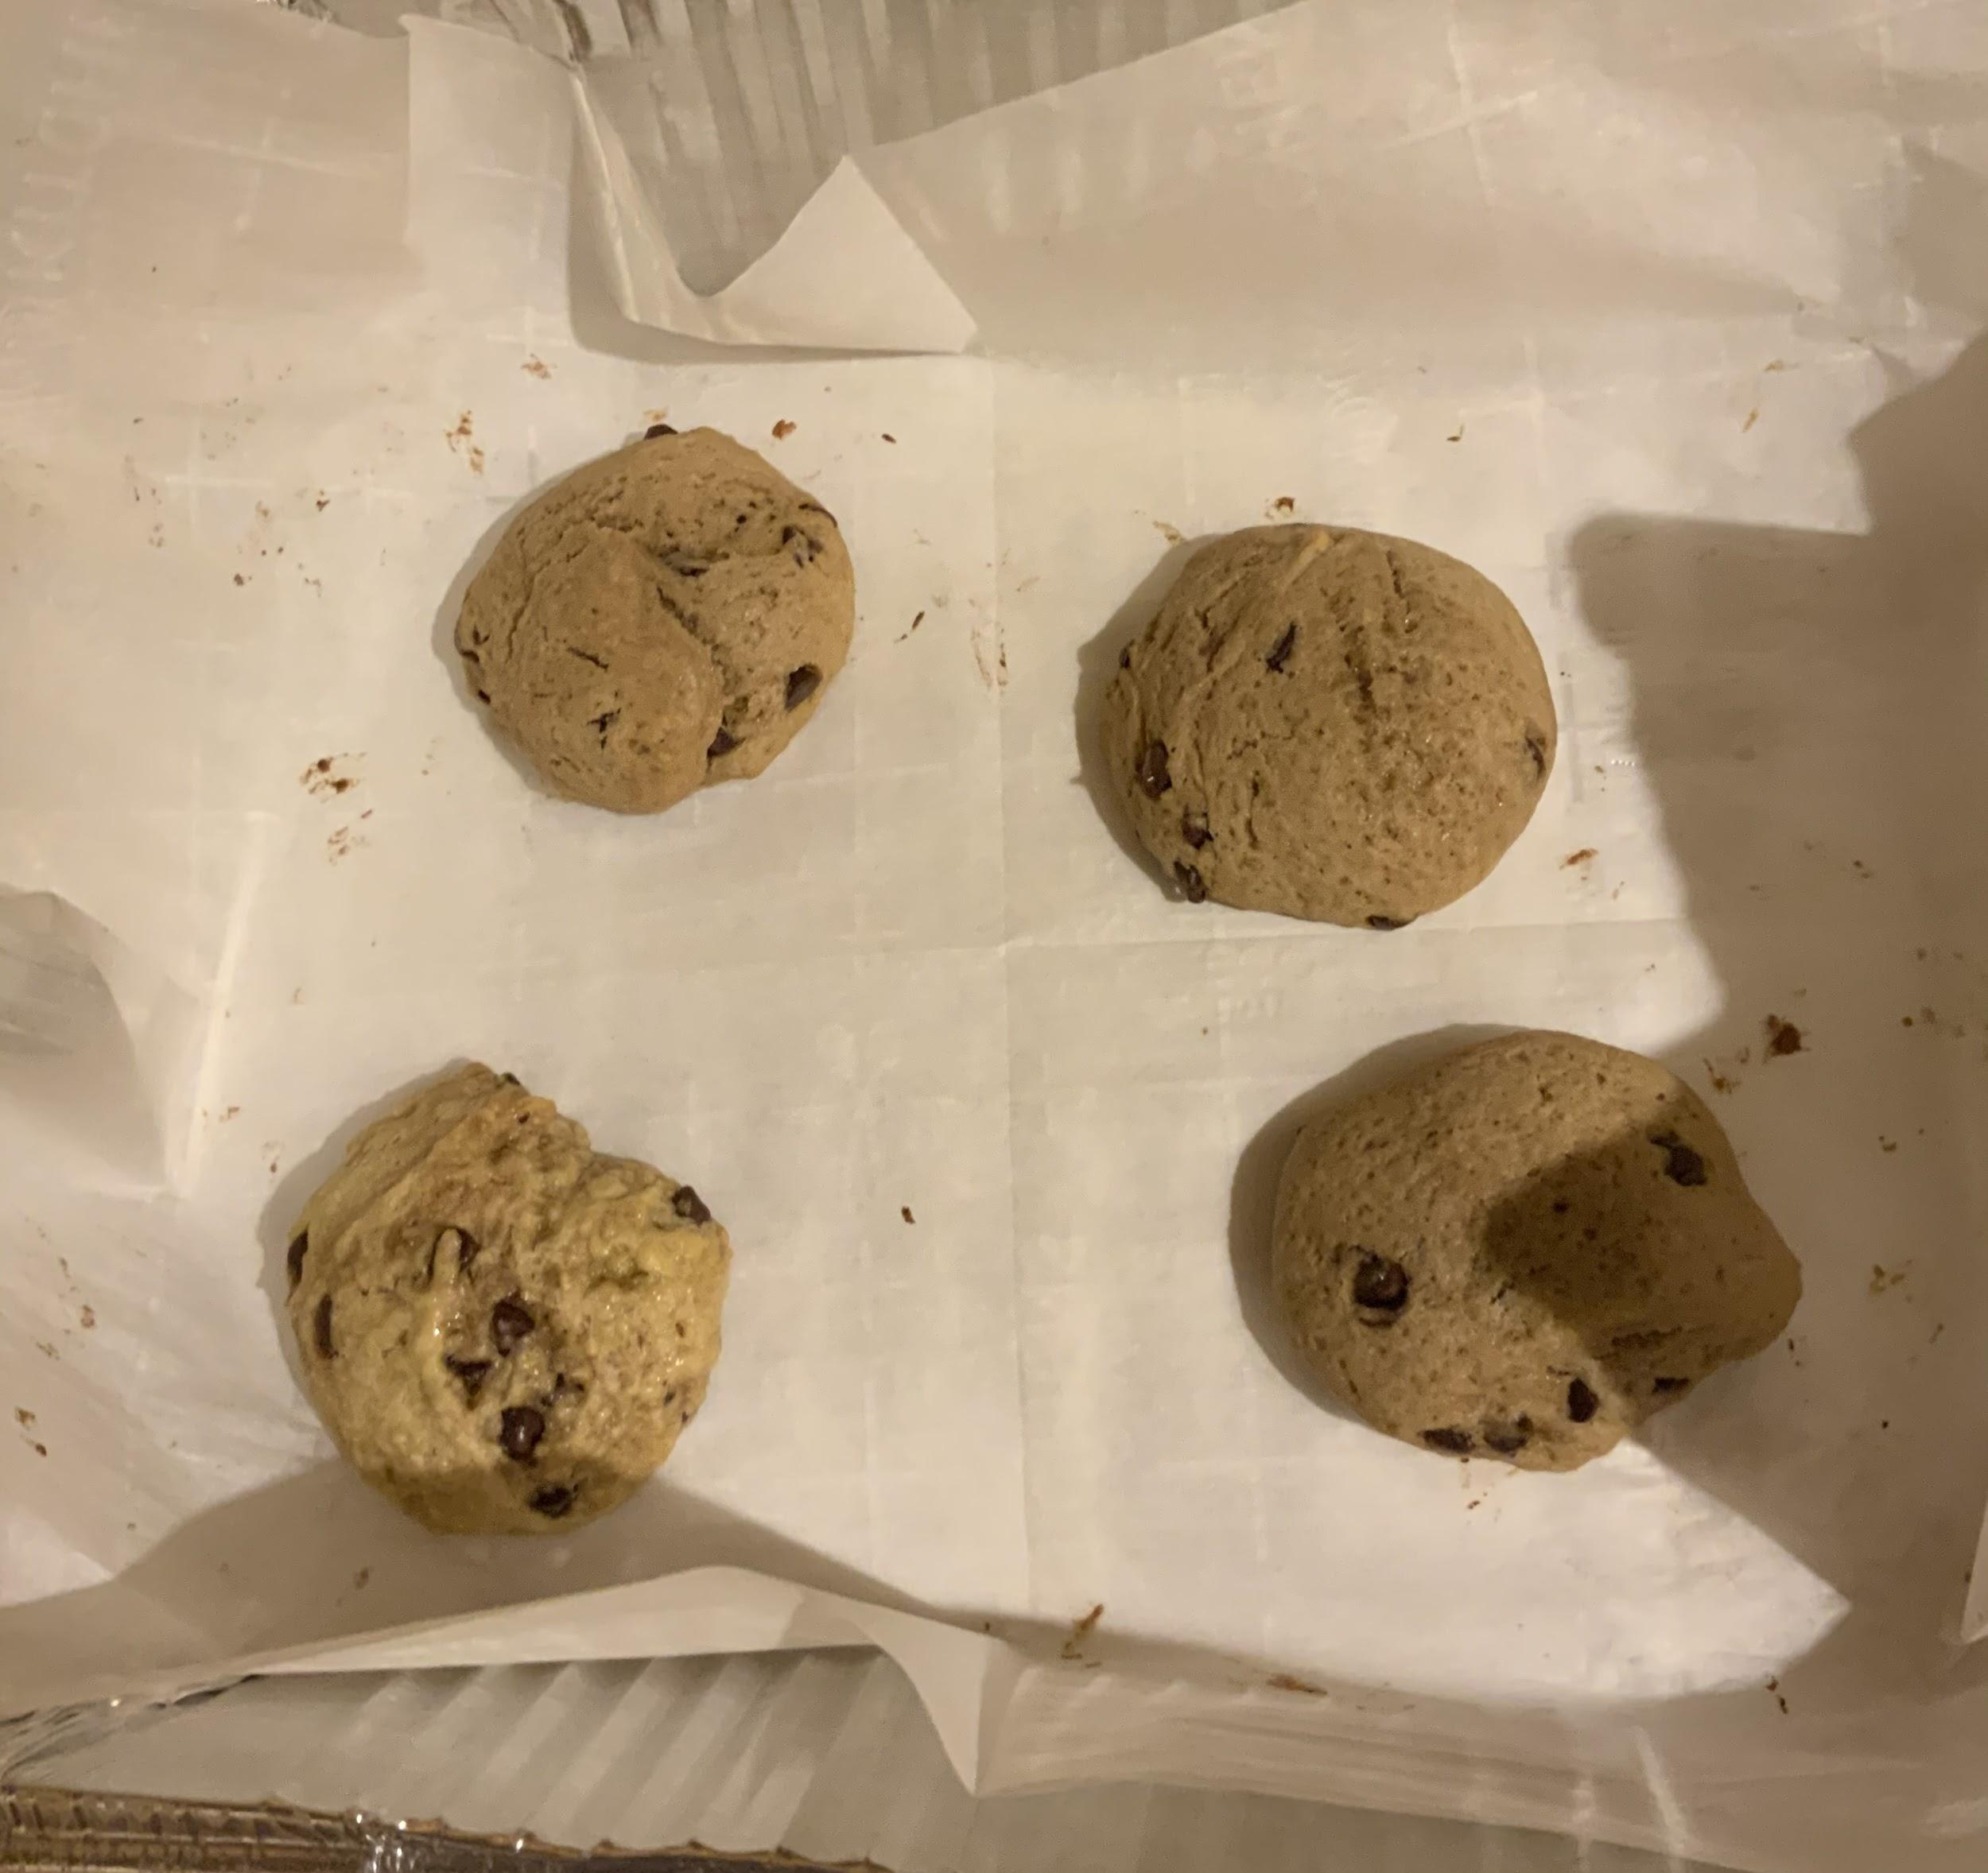
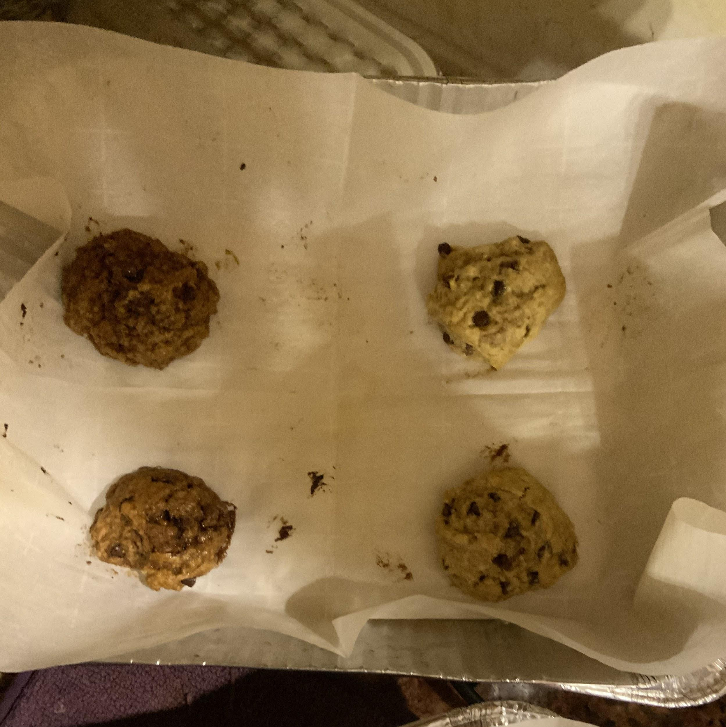
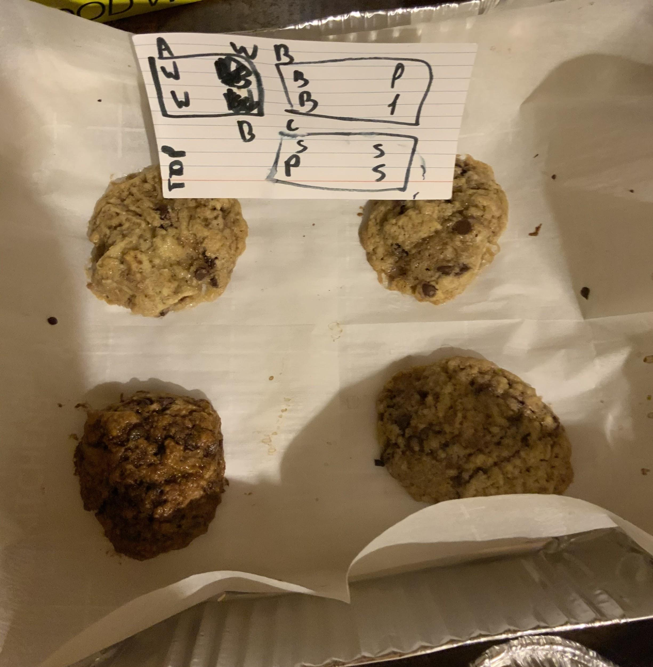
There are the Splenda cookies and there’s one powdered sugar cookie
Here there are two brown sugar cookies and two powdered sugar cookies
Here are three white sugar cookies and one brown sugar cookie

Slide 12
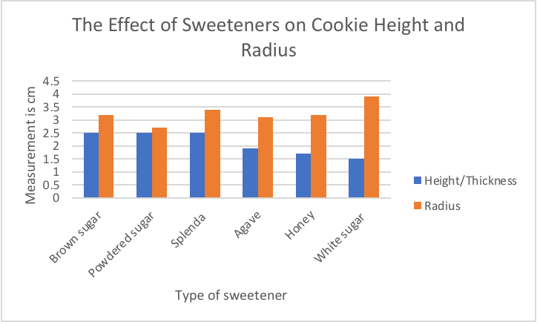
Graph

Slide 13
Conclusion
The hypothesis that if agave, honey, white sugar, brown sugar, powdered sugar, and Splenda are compared, then the honey will produce cookies with the largest radius and smallest height is rejected. While the radius of the honey cookie was 3.2cm, the white sugar cookie was 3.9cm, making it the largest. The height of the white sugar cookie was also the smallest at 1.5cm while the brown sugar, Splenda, and powdered sugar cookies tied at the largest with 2.5cm. The reason for this might be because honey caramelized when baking, making it firmer but extremely soft. An explanation for the white sugar might be because it also caramelized but mostly melted, making it shorter and having caramelized edges.

Slide 14
Error Analysis
There were several possible random errors in the procedure. One of them could be an inconsistent amount of heat baking each cookie due to fluctuations in the oven. Another random error could have been how well the dough was mixed. Even if there was a specific number of seconds used to mix the dough, it still might not have been mixed evenly. A systemic error could have been the number and size of chocolate chips put in each cookie. Although there was also a specific chocolate chip amount, no chocolate chip could have been exactly the same. The effect of these errors could have been avoided by making more replicates of the cookies or trying the recipe again with no chocolate chips.

Slide 15
Works Cited
Megan Rowe 2/21/2019 Nutrition, Prevention. “The Different Types of Sugar: A Chocolate Chip Cookie Taste Test.” Healthy Balance, 25 Feb. 2020, blog.uvahealth.com/2019/02/21/different-types-of-sugar/.
“Six Ingredients That Affect Your Cookies: Home Made Simple US.” Homepage, www.homemadesimple.com/kitchen/6-ingredients-that-affect-your-baking/.
Velazquez, S. R. (2016). Chemistry of Cooking. Retrieved Autumn, 2020, from http://chemofcooking.openbooks.wpengine.com/open/download?type=mpdf
All images were taken by student

