Slide 1
Analyzing Sex-Biased Gene Expression in Autoimmune Diseases
Notes:
Hello everyone. Today I am going to be talking about analyzing sex-biased gene expression in autoimmune diseases.

Slide 2
Hello!
I am Vidya Vedula.
Notes:
For those of you who don’t know me, I’m Vidya Vedula, and I’m a junior. I’m excited to tell you a little bit of what I did this past semester.

Slide 3
Background
1
Notes:
So first, I’m going to talk about the background of my project.

Slide 4
Autoimmune Diseases
What are they?
Notes:
My project is about autoimmune diseases, so I think it’s appropriate to know a few things about them. What are they?

Slide 5
When your immune system, which defends your body against disease, decides your healthy cells are foreign. As a result, your immune system attacks healthy cells.
Healthline.com
Notes:
Autoimmune diseases are when your immune system has decided that your healthy cells are foreign and starts to attack them.

Slide 6
Causes
No exact cause
Suspected causes:
Sex
Race
Genetics
Diet
Hygiene hypothesis
Notes:
An exact cause of autoimmune diseases hasn’t been pinpointed yet. However, scientists have suspected many causes such as: sex, twice as many women suffer from autoimmune dusease compared to men; race, some autoimmune diseases are common in some races. For example, Systemic Lupus Erythematosus is much more common in African Americans and Hispanics compared to Caucasians. Genetics also play a big role. Some autoimmune diseases run in the family, and while it might not be the same disease passed down, the susceptibility is passed down. The “western diet”, high in cholesterol, fat, and sugar has also been suspected. These foods can cause inflammation, which can set off an immune system response, but this hasn’t been proven yet. . Another suspect is the “hygiene hypothesis”. Due to the technology of vaccines, many children today aren’t as exposed to germs as before. Due to this, the immune system might have an overreaction to the most harmless substances.

Slide 7
Examples
Multiple Sclerosis
Rheumatoid Arthritis
Systemic Lupus Erythematosus (SLE)
Type 1 Diabetes
Notes:
What are some examples of autoimmune diseases? Some examples are multiple sclerosis, which is when your immune system eats away at the protective layer of your neurons; rheumatoid arthritis, which is when your immune system attacks joint linings, causing painful swelling; systemic lupus erythematosus, which is when your immune system attacks its own tissues such as the skin, brain, and blood vessels, causing painful inflammation; and type 1 diabetes, which is when the pancreas produces an inadequate amount of insulin. As you can see, most of these diseases are very known to us. That leads us to wonder, how common are autoimmune diseases?

Slide 8
23.5 million
8 million
Top 10
Suffer with autoimmune diseases in the US
Additional people have autoantibodies, making them susceptible to autoimmune diseases
Leading causes of death in young girls and women
Notes:
In the US, 23.5 million people have autoimmune diseases. An additional 8 million people have autoantibodies, antibodies which are made against the body which make them more susceptible to autoimmune diseases. Also, autoimmune diseases are one of the top 10 leading causes of death in girls and women.

Slide 9
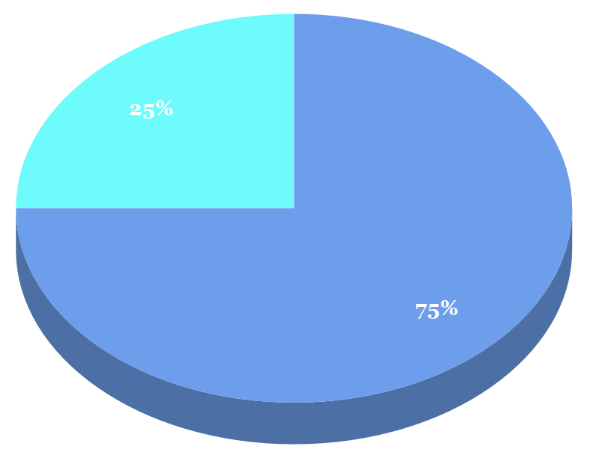
Men
Women
Notes:
As I said before, there is also a huge sex disparty in autoimmune diseases. In all of the people who suffer from autoimmune diseases, women make up 75% while men only make up 25%.

Slide 10
What are some genes that contribute to the disparity in autoimmune diseases?
Notes:
This leads us to the question, what are some genes that contribute to the disparity in autoimmune diseases?

Slide 11
Previous Research
Hormonal factors
Notes:
A lot of previous research was done before about the higher prevalence of autoimmune diseases in women. One proposition to explain this are hormonal factors. Research has shown that sex hormones should bind to estrogen receptors expressed by the immune cells in order to balance immune function. However, only a few cells express estrogen receptors. Another piece of evidence is that T cells increased cytokine production, which are molecules important in cell signaling, when exposed to estrogen. Estrogen can also negatively affect the apoptosis of B cells, the antibody making cell, causing clones of autoreactive cells. As we all know, the hormonal levels in a female fluctuate constantly, so the excess of hormones can cause immune system responses. Prolactin is another hormone that has been suspected. One study was done on the effects of excess and lack of prolactin in female mice. The study found that mice with a prolactin-inhibitor had longer longevities and had more antibodies that detect SLE. On the other hand, mice with glands that produce more prolactin had accelerated mortality and proteins in their urine, which is a key symptom of SLE.

Slide 12
Method and Materials
2
Notes:
Next I’m going to be talking about the methods and materials of my project.

Slide 13
RStudio - to compute statistically
Notes:
To compute statistically, I used R and RStudio. This has helped me to process and analyze large amounts of data.

Slide 14
Dataset
Database containing information about donors
Sex
Race
Age
Ethnicity
Count of immune cells per 1 million transcripts
14 donors were tested again after a varied amount of days
Collected by using RNA-Seq
Notes:
The dataset I used is a database called DICE which contains information about the donor’s sex, race, ethnicity, and the count of different immune cells per 1 million transcripts. Some donors’ count was done again after a few days. This data was collected by using RNA-Seq.

Slide 15
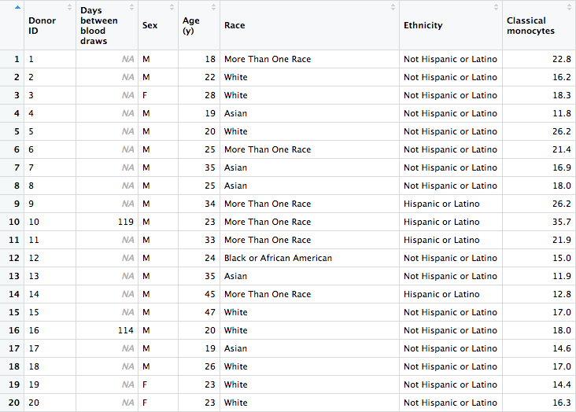
Notes:
Here is an image of the dataset for your clarification. As you can see, there are different columns containing information of each donor. The right-most column contains the information for classical monocytes, but there are many more cell types and only one was shown here for your clarification.

Slide 16
RNA-Seq
Sequencing technique to quantify the RNA in a biological sample
Used in mapping of zebrafish and African clawed frog
Notes:
RNA-Seq is a sequencing technique to quantify RNA in a sample. This technology was declared the Breakthrough of the Year by Science in 2018 when it was used to map the genome of zebrafish and african clawed frog.

Slide 17
mRNA
cDNA
Sequencing adapters are added
Short sequence is obtained
Exonic reads
Junction reads
Poly(A) end reads
Base-resolution expression profile
Notes:
First, mRNA is converted into small fragments of cDNA. Sequencing adapters are added to the ends of the cDNA fragments, and a short sequence is obtained from each cDNA fragment. They are then aligned with the reference genome or transcriptome and classified as either exonic reads, junction reads, or poly(A) end reads. These are then used to generate a base-resolution expression profile

Slide 18
Code
Essential Information
Filtration of
Sexes
Average of
Cell Types
Difference
Between Sexes
Arrange the
Differences
Notes:
We are now halfway through the presentation. Now, I have my dataset, so let’s talk about the code I used. The first step I did was to obtain the essential information.

Slide 19
Essential Information
Select columns to be used in analysis
Donor ID
Sex
Cell Types
Commands Used
select(.data, …)
Notes:
For this, I selected just the columns needed for my analysis to keep it simple, which includes the Donor ID, sex, and all of the cell types. For this, I used the command shown on the right, where .data represents the dataset.

Slide 20
Code
Essential Information
Filtration of
Sexes
Average of
Cell Types
Difference
Between Sexes
Arrange the
Differences
Notes:
The next step is to filter the sexes.

Slide 21
Filtration of Sexes
Divide the data into male and female
Commands Used
filter(.data, …)
Notes:
For this, I divided the dataset into male and female. For this, I used the command “filter”.

Slide 22
Code
Essential Information
Filtration of
Sexes
Average of
Cell Types
Difference
Between Sexes
Arrange the
Differences
Notes:
The next step was to find the average of the cell types.

Slide 23
Average of Cell Types
Calculate mean of each cell type in both male and female
Commands Used
colMeans(.data)
Notes:
For this, I calculated the mean of each cell type for each divided dataset. For this, I used the command “colMeans”.

Slide 24
Code
Essential Information
Filtration of
Sexes
Average of
Cell Types
Difference
Between Sexes
Arrange the
Differences
Notes:
The next step was to find the difference between the sexes.

Slide 25
Difference Between Sexes
Calculate difference of average in females and males
Commands Used
abs(Female Average - Male Average)
Notes:
Instinctively, for this step, I subtracted the male average from the female average for each cell type.

Slide 26
Code
Essential Information
Filtration of
Sexes
Average of
Cell Types
Difference
Between Sexes
Arrange the
Differences
Notes:
Finally, the last thing to do is to arrange the differences

Slide 27
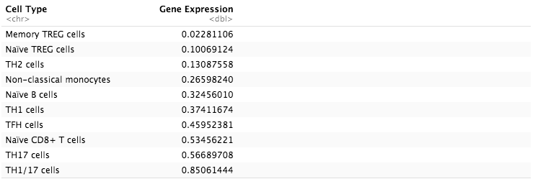
Arrange the Differences
Notes:
After using the “arrange” command, this is the table with the differences between the sexes arranged in ascending order.

Slide 28
Results
3
Notes:
Now, we’ll be talking about the results.

Slide 29
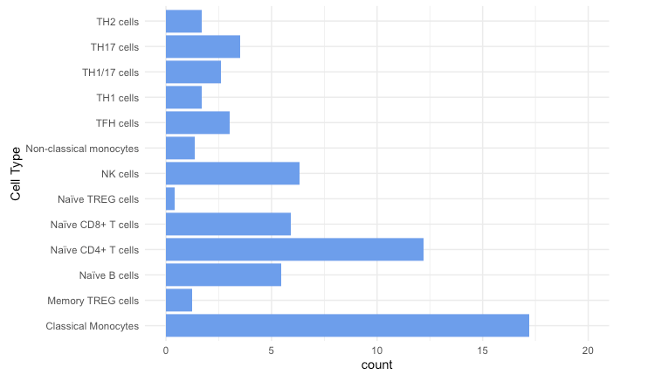
Average Count in Females
Notes:
This graph shows the average count in females across the cell types. As you can see, classical monocytes have the highest count, and Naive TREG cell have the fewest count.

Slide 30
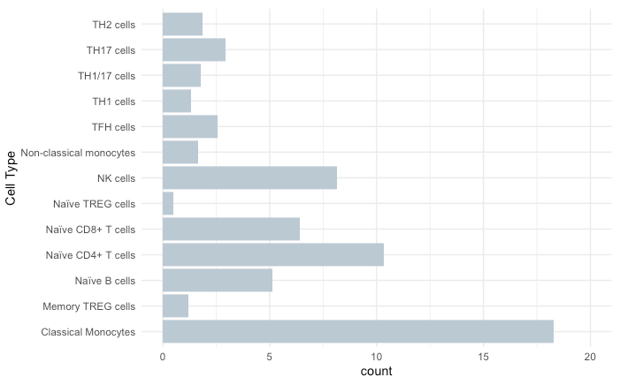
Average Count in Males
Notes:
This graph shows the average count in males across the cell types. As with the graph in females, classical monocytes have the highest count, and Naive TREG cell have the fewest count.

Slide 31
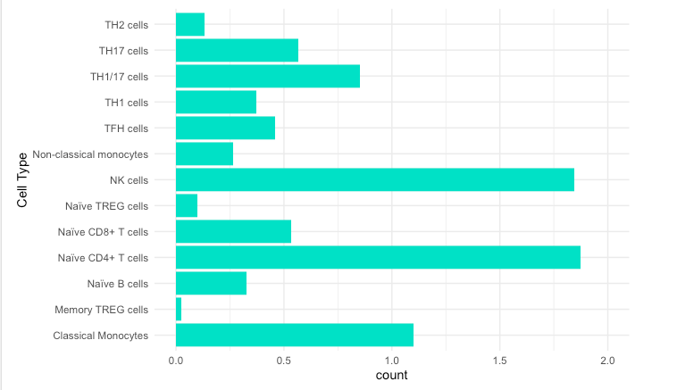
Difference in Average Count
Notes:
This graph shows the difference in average female count and average male count. As you can see, NK Cells and Naive CD4+ T cells have the largest difference.

Slide 32
Discussion and Analysis
4
Notes:
Now, I am moving to the discussion and analysis.

Slide 33
NK Cells and Naïve CD4+ T Cells
Notes:
As I said before, NK Cells and Naive CD4+ T cells have the highest difference in counts between the sexes, so these are the cells I will be focusing on those. First, I’ll be talking about NK cells.

Slide 34
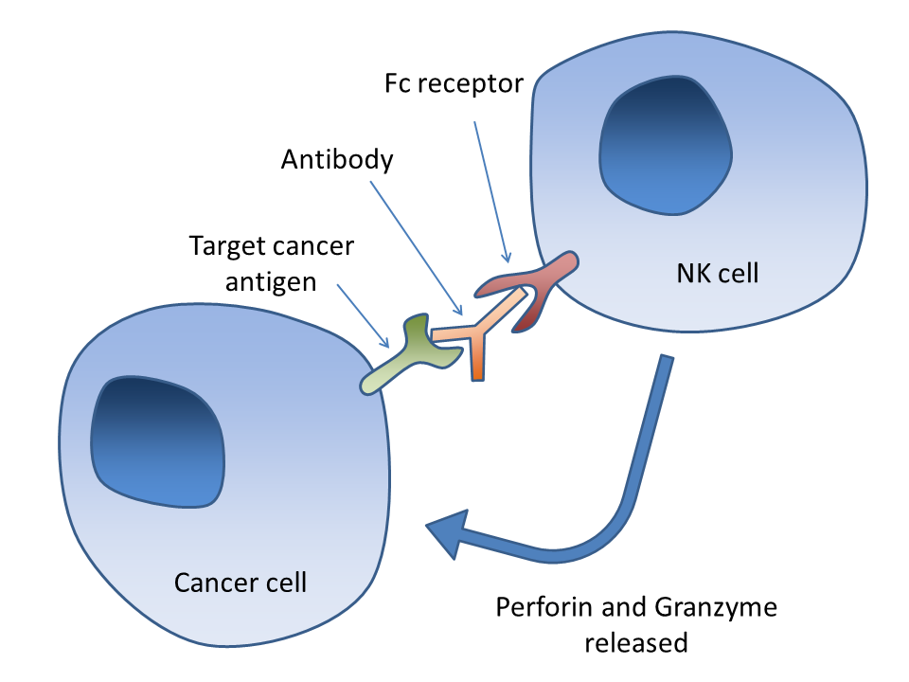
NK Cells
Type of lymphocyte
Defends host from infections
Attacks aging, infected, and cancerous cells
Notes:
NK cells are a type of lymphocyte that defends the body from infections. One of their defining functions are attacking aging, infected, and cancerous cells. This picture here shows how a NK cell attacks a cancerous cell. After the activation of the receptor, cytotoxic molecules are released into the intracellular space that was formed because the nk cell and cancer cell got joined as shown above. The cytotoxic molecules contain proteins that ends up killing the cancer cells.

Slide 35
NK Cell Types
CD56dim NK cells
Express killer immunoglobulin-like receptors (KIR)
Killer immunoglobulin-like receptors (KIR) → serve as key regulators of NK cell function
CD56bright NK cells
Doesn’t express KIR
Notes:
There are two different NK cell types. One is CD56 NK Cells which express killer immunoglobulin-like receptors or KIR, which serve as the key regulators of the cell function. The second type is CD56bright Nk cells, which don’t express KIR

Slide 36
NK Cells in Autoimmune Diseases
Human NK cells express 3 NCRs → NKp46, NKp44, NKp30
NCR → Natural cytotoxicity receptors
Can promote injuries during chronic inflammation by exerting cytotoxic effects against other cells with NCRs
Notes:
What is relation between NK cells and autoimmune diseases? Human NK cells express 3 natural cytotoxicity receptors, receptors that receive cytotoxic elements. These 3 NCRs are NKp46, NKp44, and NKp30, and all three of these are genes that have been researched and associated with autoimmune diseases. NK cells can also promote inflammation by giving out cytotoxic effects against other types of cells with NCRs, which respond by either killing the cell or releasing cytokines

Slide 37
NK Cells in Autoimmune Diseases
Women have a lower number of NK cells
Lower count of NK cells have been associated with autoimmune diseases
Notes:
In terms of the sex disparity we see, women have a lower number of NK cells, which has been associated with autoimmune diseases.

Slide 38
Naïve CD4+ T cells
Differentiated in the thymus
Undergone test to confirm that the cell is CD4+ or CD8+ cell
Undergone positive and negative processes of central selection
Processes of eliminating any developing cells reactive to self
Notes:
Now we move on to the other type of cells, Naive CD4+ T cells. These cells are differentiated in the thymus, meaning that they were confirmed to be CD4+ cells. They underwent positive and negative processes of central selection, meaning they eliminated any developing cells that are reactive to self.

Slide 39
Naïve CD4+ T cells in Autoimmune Diseases
Functionally impaired in rheumatoid arthritis
Higher count in women
Notes:
These type of cells do not have research that suggests there is as strong correlation with autoimmune diseases as NK cells. Anyways, there is a still research that has been done. Naive CD4+ T cells have been found to be functionally impaired in people with rheumatoid arthritis. They have also been observed to be in a higher count in women.

Slide 40
How will this benefit the scientific community?
Notes:
As I said, autoimmune diseases are one of the top 10 leading causes of death among women. By determining which genes play the largest role in this disparity, the scientific community can come up with ideas to diminish it. For example, if it turns out that this disparity is due to the overexpression of a gene, we can design an inhibitor. Solving this problem will benefit everyone.

Slide 41
Future Plans
Narrow Down on Specific Genes
Explore Correlation with Race
Explore Correlation with the Varied Days of Blood Draws
Notes:
This semester, I have identified some different cell types that could be associated in the sex disparity of autoimmune diseases. For my future plans, the next thing to do is to narrow down on specific genes. After this, I would like to explore the correlation with race. It is known that some races have higher autoimmune rates than other. I think it would be interesting to explore that more. Another correlation I would like to explore is if the counts changed after a few days. As you remember, some people had their blood drawn on two days, and seeing whther if the count changed would be interesting.

Slide 42
Credits
I would like to thank Mr. Mohlhenrich for his support and encouragement for this project.

Slide 43
References
References

Slide 44
Thanks!
Any questions?

