Slide 1
The Effect of the Material of the Physical Obstruction and Distance on the Strength and
Speed of the Signal for the
WiFi
By Joyce Xia

Slide 2
Background Information:
What exactly is WiFi and how does it work?
WiFi, which stands for Wireless Fidelity, functions using the same mechanic as other wireless devices, using radio frequencies to send signals between devices. For wifi to function, a computer's wireless adapter translates data into a radio signal and sends the signal with the use of an antenna. A wireless router then receives the signal and decodes it. The router transmits the information to the Internet using a physical, wired Ethernet connection.
How is WiFi speed and strength measured?
WiFi speed in downloading and uploading is measured in mbps, or megabits per second. The time it takes between sending a request and receiving a response, is called ping, which is measured in ms (milliseconds). The speed refers to the rate at which the data or content travels from the Web to your device. The desirable internet speed is at 25 mbps or above this number. Any speeds ranging in this area will be able to support most online activity, such as HD streaming, playing games online, or browsing on the web. Since ping is measured in milliseconds, a measure of time, a very low ping is most advantageous.
How is WiFi speed and strength measured?
(continued)
Anything from 50 to 100 is deemed as average, below 20 as exceptional, and anything at or above 150 as high or undesirable. WiFi strength is most commonly measured as dbm, or decibel milliwatts. An easy way to define dbm is the amount of power an amplifier or antenna is capable of producing. Decibel milliwatts are expressed in negative numbers, and the closer the number to zero, the more desirable the strength. For example, a -30 dbm represents one of the best possible WiFi signal strengths, while a -90 dbm will be practically impossible to experience a wireless connection.

Slide 3
Background Information: (continued)
What will be used to measure the WiFi strength and speed in this experiment?
While the most common way to easily find WiFi strength is to look at the number of bars displayed on the WiFi image commonly displayed on the home screen of many devices, it is not a very effective method since it does not directly say the strength or speed. While it is a good system to quickly and generally check the WiFi, on this experiment apps that measure the speed and strength will be used. The apps being used to measure the strength, speed, and the ping will be iWifi and Airport Utility on an iPhone X.
What things/materials can affect WiFi?
WiFi is not always perfectly received, and many different materials can affect the travel of the signal. Metal, concrete walls, plaster and metal lath, ceramic tiles, windows/glass, mirrors, drywall, other devices, neighboring WiFi networks, water, appliances, and furniture are the top twelve things that can block or slow down WiFi signals.
What is the purpose of this experiment?
The purpose of this experiment is to determine what affects the transportation of WiFi signals the most and/or least. This knowledge of what can affect the signal strength and speed can be extremely practical, especially now since many schools and activities operate via meets online. With this experiment, people can figure out how to increase the strength and speed of their WiFi without excessive research of their own.

Slide 4
Background Information: (continued)
How will this experiment be conducted?
In this experiment, I will cover the router with a physical obstruction made of a specific material, and then measure the strength, download and upload speed, and ping from 12 and 24 feet away (horizontally), and 12 feet across and 12 feet above. The materials of the obstructions are wood, a thin metal, a thicker metal, glass, porcelain, drywall, foam, fabric (made of cotton), cardboard, and plastic. A test of the ping, speed and strength without any obstructions will be conducted as well.
Citations Used for background research:
Top 12 Materials that Block WiFi Signals
How WiFi Works | HowStuffWorks
How to measure signal strength in Decibels on your cell phone?
How to Check Your Wi-Fi Signal Strength
Citations Used for background research:
(continued)
dB & dBm Differences in Relation to Cellular Signal Boosters
How Fast is My Internet? How Internet Speed Is Measured
Internet Speed Classifications | What is Fast Internet?

Slide 5
Testable Question:
Hypothesis:
What is the effect of the material of physical obstructions on the strength and speed of the signal for the wifi?
If there are metal objects present, the wifi signal strength and speed will be weaker since metal is an electricity conductor, therefore it will absorb the radio waves wifi emits.

Slide 6
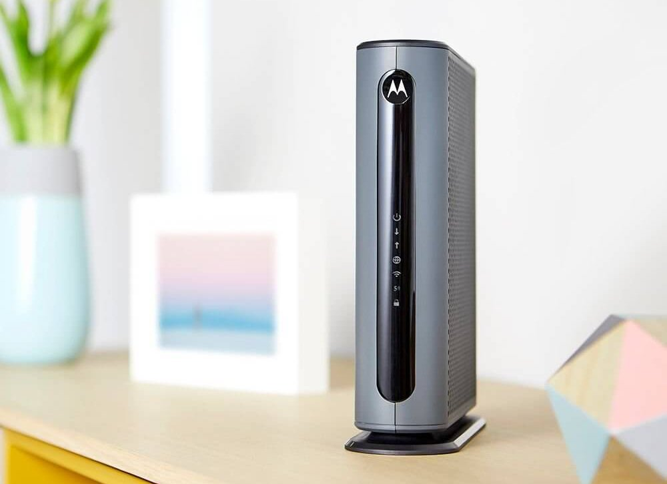
Materials:
(Router model)
A Router (Mine was a Motorola, Model: MG7550)
A Device with apps iWifi (to measure WiFi speed and ping) and Airport Utility (to measure WiFi strength)
A Tape measure
Two Wooden boxes (or one, but is able to completely cover the router.)
A Metal tin box
A Metal pot
A Glass cylinder
A Box made of porcelain tiles (5 tiles, excluding the bottom)
A Box made of drywall (5 tiles, excluding the bottom)
A Foam box
A Rug (made of cotton fabric)
A Cardboard box
A Plastic bin
Note: The number of the objects used to cover the router may vary depending on what the shape and size of the object is, as well as the shape and size of the router. I have simply written the number in which I needed to cover the router, however feel free to change the number depending on your situation.

Slide 7
Procedure:
Step 1: Gather all materials needed for the experiment.
Step 2: Place the router in the desired position and use a tape measure to find where you will be 12 feet across from, 24 feet across from, and 12 feet across and above from the router.
Step 3: Once you have your router and positions determined, prepare your physical obstructions to cover the router.
Step 4: Place the obstruction over the router and move to the determined location 12 feet away. Be sure to act carefully and not harm yourself when placing and moving the objects.
Step 5: Measure the ping, speed, and strength using the apps iWifi and Airport Utility. Using iWifi, select the network you want to measure and go on the speed section. Press start to measure the ping, the download speed, and the upload speed. When going on Airport Utility press the WiFi Scan option and press scan. On the scan option it will then display multiple networks nearby and the information regarding them, which contains the strength (dbm).
Step 6: Repeat step 5 three times.
Step 7: Next, move to the position 24 feet away from the router.
Step 8: Repeat step 5 three times again to determine the ping, speed, and strength from a distance of 24 feet.
Step 9: Move to the position located 12 feet from and 12 feet above the router.
Step 10: Once more, repeat step 5 three times to determine the ping, speed, and strength of the WiFi.
Step 11: Remove the obstruction off the router and prepare the next type of material to be tested.
Step 12: Repeat steps 4-11 until all types of obstacles have been tested and completed.
Safety Precautions
While preparing materials, be careful not to harm yourself or others by breaking or dropping the heavier items. For example, the glass.
When removing and covering the router with the items, especially heavier items, take caution again to not injure yourself.

Slide 8
Data:
Nothing/No material:
12 feet
 | Ping (ms) | Download speed (mbps) | Upload speed (mbps) | Strength (dbm)
Trial 1 | 10.0 | 46.78 | 12.75 | -48
Trial 2 | 5.0 | 46.34 | 11.96 | -44
Trial 3 | 3.0 | 44.44 | 6.6 | -44
24 feet
 | Ping (ms) | Download speed (mbps) | Upload speed (mbps) | Strength (dbm)
Trial 1 | 3.0 | 45.99 | 12.63 | -51
Trial 2 | 4.0 | 35.0 | 5.17 | -51
Trial 3 | 3.0 | 47.68 | 8.06 | -54
12 feet across, 12 feet above
 | Ping (ms) | Download speed (mbps) | Upload speed (mbps) | Strength (dbm)
Trial 1 | 5.0 | 47.88 | 6.83 | -54
Trial 2 | 3.0 | 40.0 | 10.94 | -51
Trial 3 | 3.0 | 46.94 | 8.38 | -47

Slide 9
Data:
Wood:
12 feet
 | Ping (ms) | Download speed (mbps) | Upload speed (mbps) | Strength (dbm)
Trial 1 | 7.0 | 47.89 | 6.82 | -52
Trial 2 | 7.0 | 44.82 | 11.68 | -45
Trial 3 | 4.0 | 41.03 | 11.14 | -60
24 feet
 | Ping (ms) | Download speed (mbps) | Upload speed (mbps) | Strength (dbm)
Trial 1 | 4.0 | 36.98 | 11.43 | -59
Trial 2 | 5.0 | 39.33 | 6.2 | -62
Trial 3 | 10.0 | 48.9 | 9.09 | -59
12 feet across, 12 feet above
 | Ping (ms) | Download speed (mbps) | Upload speed (mbps) | Strength (dbm)
Trial 1 | 5.0 | 46.51 | 10.47 | -46
Trial 2 | 3.0 | 40.28 | 13.6 | -45
Trial 3 | 5.0 | 42.59 | 14.78 | -46

Slide 10
Data:
Metal (thinner):
12 feet
 | Ping (ms) | Download speed (mbps) | Upload speed (mbps) | Strength (dbm)
Trial 1 | 3.0 | 31.21 | 3.81 | -66
Trial 2 | 7.0 | 38.12 | 9.81 | -65
Trial 3 | 5.0 | 29.51 | 8.82 | -61
24 feet
 | Ping (ms) | Download speed (mbps) | Upload speed (mbps) | Strength (dbm)
Trial 1 | 6.0 | 1.44 | 6.27 | -64
Trial 2 | 7.0 | 27.92 | 12.03 | -80
Trial 3 | 4.0 | 10.97 | 2.84 | -69
12 feet across, 12 feet above
 | Ping (ms) | Download speed (mbps) | Upload speed (mbps) | Strength (dbm)
Trial 1 | 6.0 | 48.07 | 12.89 | -66
Trial 2 | 6.0 | 46.26 | 12.47 | -75
Trial 3 | 7.0 | 48.76 | 10.21 | -71

Slide 11
Data:
Metal (thicker):
 | Ping (ms) | Download speed (mbps) | Upload speed (mbps) | Strength (dbm)
Trial 1 | 3.0 | 31.9 | 3.63 | -59
Trial 2 | 6.0 | 28.17 | 9.84 | -59
Trial 3 | 5.0 | 36.09 | 10.24 | -62
12 feet
24 feet
 | Ping (ms) | Download speed (mbps) | Upload speed (mbps) | Strength (dbm)
Trial 1 | 5.0 | 34.44 | 5.22 | -70
Trial 2 | 3.0 | 16.58 | 5.76 | -66
Trial 3 | 3.0 | 10.98 | 2.59 | -67
12 feet across, 12 feet above
 | Ping (ms) | Download speed (mbps) | Upload speed (mbps) | Strength (dbm)
Trial 1 | 4.0 | 38.14 | 11.63 | -60
Trial 2 | 7.0 | 30.94 | 10.88 | -61
Trial 3 | 3.0 | 24.57 | 10.55 | -59

Slide 12
Data:
Glass:
12 feet
 | Ping (ms) | Download speed (mbps) | Upload speed (mbps) | Strength (dbm)
Trial 1 | 7.0 | 44.0 | 0.0 | -55
Trial 2 | 3.0 | 35.57 | 10.32 | -51
Trial 3 | 7.0 | 42.42 | 6.53 | -49
24 feet
 | Ping (ms) | Download speed (mbps) | Upload speed (mbps) | Strength (dbm)
Trial 1 | 10.0 | 41.37 | 11.53 | -62
Trial 2 | 3.0 | 34.85 | 10.2 | -62
Trial 3 | 3.0 | 36.31 | 11.24 | -63
12 feet across, 12 feet above
 | Ping (ms) | Download speed (mbps) | Upload speed (mbps) | Strength (dbm)
Trial 1 | 6.0 | 49.41 | 13.73 | -52
Trial 2 | 5.0 | 37.27 | 5.96 | -60
Trial 3 | 5.0 | 47.09 | 12.29 | -65

Slide 13
Data:
Porcelain:
 | Ping (ms) | Download speed (mbps) | Upload speed (mbps) | Strength (dbm)
Trial 1 | 3.0 | 47.54 | 9.99 | -54
Trial 2 | 7.0 | 46.39 | 7.91 | -56
Trial 3 | 4.0 | 31.82 | 12.61 | -59
12 feet
24 feet
 | Ping (ms) | Download speed (mbps) | Upload speed (mbps) | Strength (dbm)
Trial 1 | 3.0 | 27.47 | 5.13 | -64
Trial 2 | 5.0 | 38.25 | 12.63 | -71
Trial 3 | 6.0 | 36.12 | 11.93 | -69
12 feet across, 12 feet above
 | Ping (ms) | Download speed (mbps) | Upload speed (mbps) | Strength (dbm)
Trial 1 | 3.0 | 47.77 | 11.09 | -55
Trial 2 | 3.0 | 23.52 | 0.0 | -54
Trial 3 | 5.0 | 47.98 | 0.0 | -51

Slide 14
Data:
Drywall:
 | Ping (ms) | Download speed (mbps) | Upload speed (mbps) | Strength (dbm)
Trial 1 | 4.0 | 47.87 | 6.45 | -51
Trial 2 | 3.0 | 45.69 | 12.54 | -58
Trial 3 | 6.0 | 46.68 | 12.42 | -60
12 feet
24 feet
 | Ping (ms) | Download speed (mbps) | Upload speed (mbps) | Strength (dbm)
Trial 1 | 5.0 | 44.6 | 10.17 | -67
Trial 2 | 6.0 | 33.29 | 9.57 | -60
Trial 3 | 7.0 | 45.88 | 10.18 | -64
12 feet across, 12 feet above
 | Ping (ms) | Download speed (mbps) | Upload speed (mbps) | Strength (dbm)
Trial 1 | 6.0 | 46.01 | 12.94 | -60
Trial 2 | 3.0 | 44.48 | 10.72 | -67
Trial 3 | 5.0 | 47.9 | 13.09 | -60

Slide 15
Data:
Foam:
 | Ping (ms) | Download speed (mbps) | Upload speed (mbps) | Strength (dbm)
Trial 1 | 10.0 | 46.97 | 11.08 | -52
Trial 2 | 5.0 | 46.55 | 6.77 | -48
Trial 3 | 5.0 | 48.07 | 9.92 | -49
12 feet
24 feet
 | Ping (ms) | Download speed (mbps) | Upload speed (mbps) | Strength (dbm)
Trial 1 | 5.0 | 36.71 | 10.4 | -61
Trial 2 | 6.0 | 49.49 | 12.1 | -62
Trial 3 | 7.0 | 25.87 | 8.71 | -55
12 feet across, 12 feet above
 | Ping (ms) | Download speed (mbps) | Upload speed (mbps) | Strength (dbm)
Trial 1 | 3.0 | 47.03 | 11.12 | -59
Trial 2 | 7.0 | 44.71 | 9.52 | -60
Trial 3 | 5.0 | 46.92 | 6.42 | -51

Slide 16
Data:
Fabric:
 | Ping (ms) | Download speed (mbps) | Upload speed (mbps) | Strength (dbm)
Trial 1 | 10.0 | 46.09 | 10.39 | -47
Trial 2 | 4.0 | 50.34 | 10.84 | -59
Trial 3 | 7.0 | 46.94 | 10.54 | -52
12 feet
 | Ping (ms) | Download speed (mbps) | Upload speed (mbps) | Strength (dbm)
Trial 1 | 5.0 | 44.4 | 10.73 | -68
Trial 2 | 6.0 | 47.48 | 11.93 | -67
Trial 3 | 3.0 | 46.15 | 14.26 | -74
24 feet
12 feet across, 12 feet above
 | Ping (ms) | Download speed (mbps) | Upload speed (mbps) | Strength (dbm)
Trial 1 | 6.0 | 37.66 | 9.11 | -53
Trial 2 | 7.0 | 30.031 | 12.86 | -59
Trial 3 | 5.0 | 5.33 | 11.16 | -54

Slide 17
Data:
Cardboard:
12 feet
 | Ping (ms) | Download speed (mbps) | Upload speed (mbps) | Strength (dbm)
Trial 1 | 6.0 | 43.98 | 13.08 | -54
Trial 2 | 7.0 | 36.98 | 12.21 | -52
Trial 3 | 5.0 | 48.5 | 11.61 | -49
24 feet
 | Ping (ms) | Download speed (mbps) | Upload speed (mbps) | Strength (dbm)
Trial 1 | 5.0 | 32.9 | 12.33 | -63
Trial 2 | 6.0 | 25.5 | 10.56 | -60
Trial 3 | 7.0 | 11.38 | 9.5 | -58
12 feet across, 12 feet above
 | Ping (ms) | Download speed (mbps) | Upload speed (mbps) | Strength (dbm)
Trial 1 | 5.0 | 48.25 | 13.42 | -54
Trial 2 | 4.0 | 45.79 | 9.71 | -56
Trial 3 | 5.0 | 46.55 | 11.24 | -54

Slide 18
Data:
Plastic:
12 feet
 | Ping (ms) | Download speed (mbps) | Upload speed (mbps) | Strength (dbm)
Trial 1 | 4.0 | 48.67 | 10.34 | -45
Trial 2 | 6.0 | 48.7 | 11.65 | -48
Trial 3 | 4.0 | 49.21 | 11.91 | -48
24 feet
 | Ping (ms) | Download speed (mbps) | Upload speed (mbps) | Strength (dbm)
Trial 1 | 6.0 | 40.22 | 11.03 | -68
Trial 2 | 4.0 | 44.43 | 12.52 | -63
Trial 3 | 5.0 | 45.56 | 11.8 | -64
12 feet across, 12 feet above
 | Ping (ms) | Download speed (mbps) | Upload speed (mbps) | Strength (dbm)
Trial 1 | 6.0 | 36.14 | 6.61 | -48
Trial 2 | 4.0 | 42.04 | 11.47 | -60
Trial 3 | 7.0 | 47.81 | 12.29 | -57

Slide 19
Data:
Averages: 12 feet away
Material | Average ping (ms) (rounded to the nearest whole number) | Average download speed (mbps) (rounded to the nearest hundredth) | Average upload speed (mbps) (rounded to the nearest hundredth) | Average strength (dbm) (rounded to the nearest negative whole number)
Nothing | 6.0 | 45.85 | 10.44 | -45
Wood | 6.0 | 44.58 | 9.88 | -52
Metal (thinner) | 5.0 | 32.95 | 7.48 | -64
Metal (thicker) | 5.0 | 32.05 | 7.9 | -60
Glass | 6.0 | 40.66 | 5.62 | -52
Porcelain | 5.0 | 41.92 | 10.17 | -56
Drywall | 4.0 | 46.75 | 10.47 | -56
Foam | 7.0 | 47.2 | 9.26 | -50
Fabric | 7.0 | 47.79 | 10.59 | -53
Cardboard | 6.0 | 43.15 | 12.3 | -52
Plastic | 5.0 | 48.86 | 11.3 | -47

Slide 20
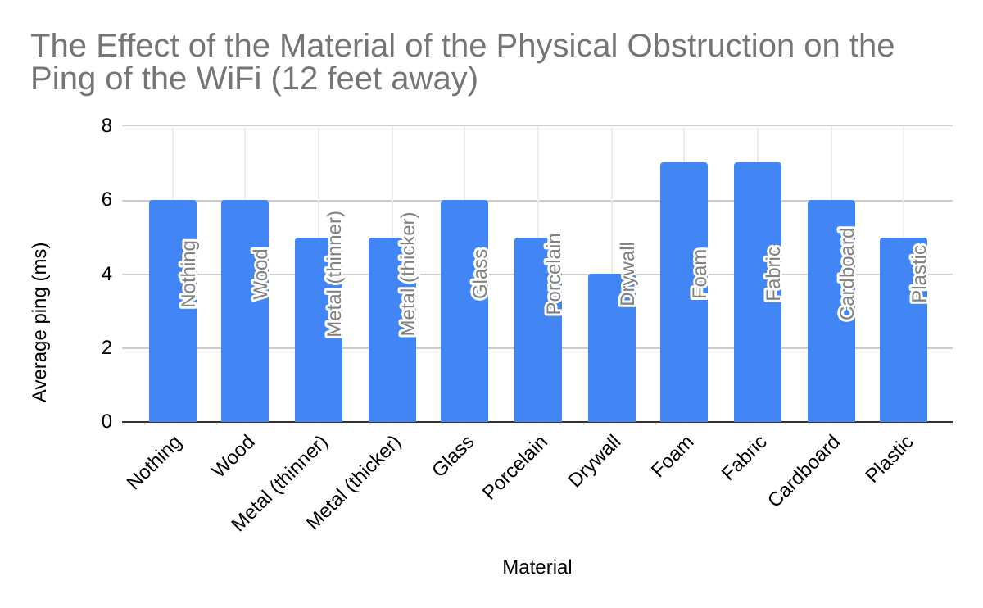
Data:
Averages: 12 feet away

Slide 21
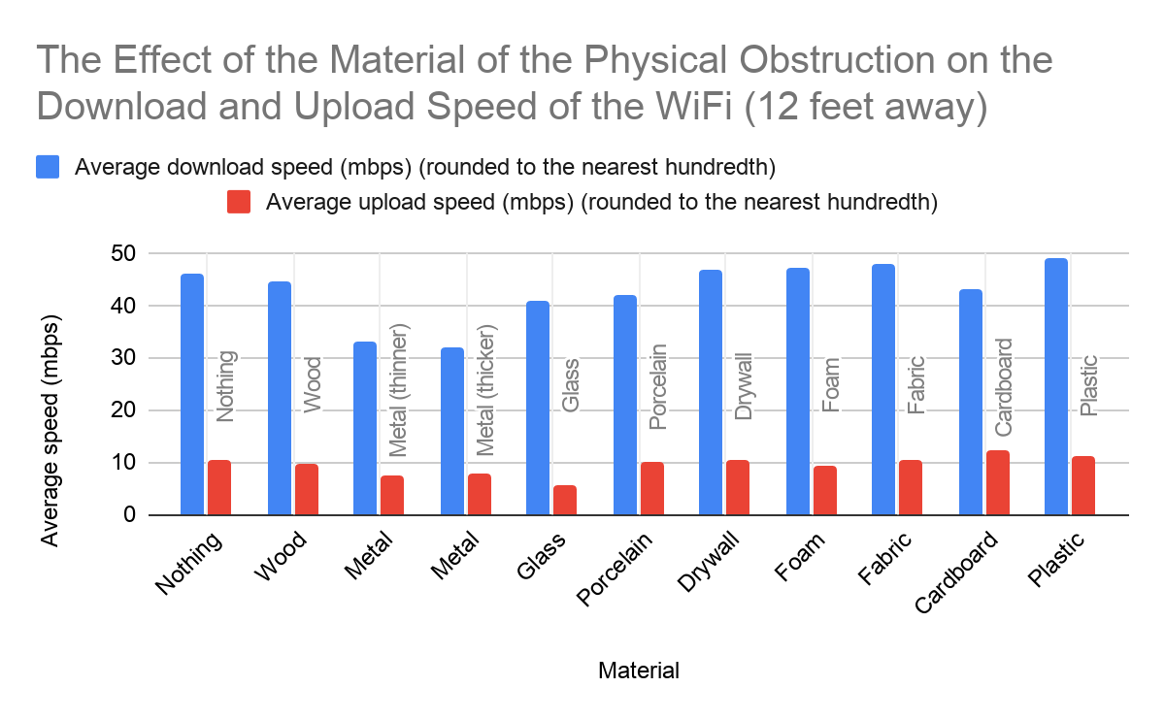
Data:
Averages: 12 feet away

Slide 22
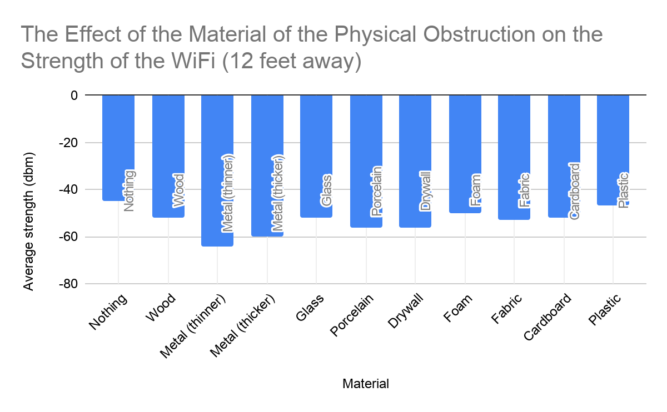
Data:
Averages: 12 feet away

Slide 23
Data:
Averages: 24 feet away
Material | Average ping (ms) (rounded to the nearest whole number) | Average download speed (mbps) (rounded to the nearest hundredth) | Average upload speed (mbps) (rounded to the nearest hundredth) | Average strength (dbm) (rounded to the nearest negative whole number)
Nothing | 3.0 | 42.89 | 8.62 | -52
Wood | 6.0 | 41.74 | 8.91 | -60
Metal (thinner) | 6.0 | 13.44 | 7.05 | -71
Metal (thicker) | 4.0 | 20.67 | 4.52 | -68
Glass | 5.0 | 37.51 | 10.99 | -62
Porcelain | 5.0 | 33.95 | 9.9 | -68
Drywall | 6.0 | 41.26 | 9.97 | -64
Foam | 6.0 | 37.36 | 10.4 | -59
Fabric | 5.0 | 46.11 | 12.31 | -70
Cardboard | 6.0 | 23.26 | 10.8 | -60
Plastic | 5.0 | 43.40 | 11.78 | -65

Slide 24
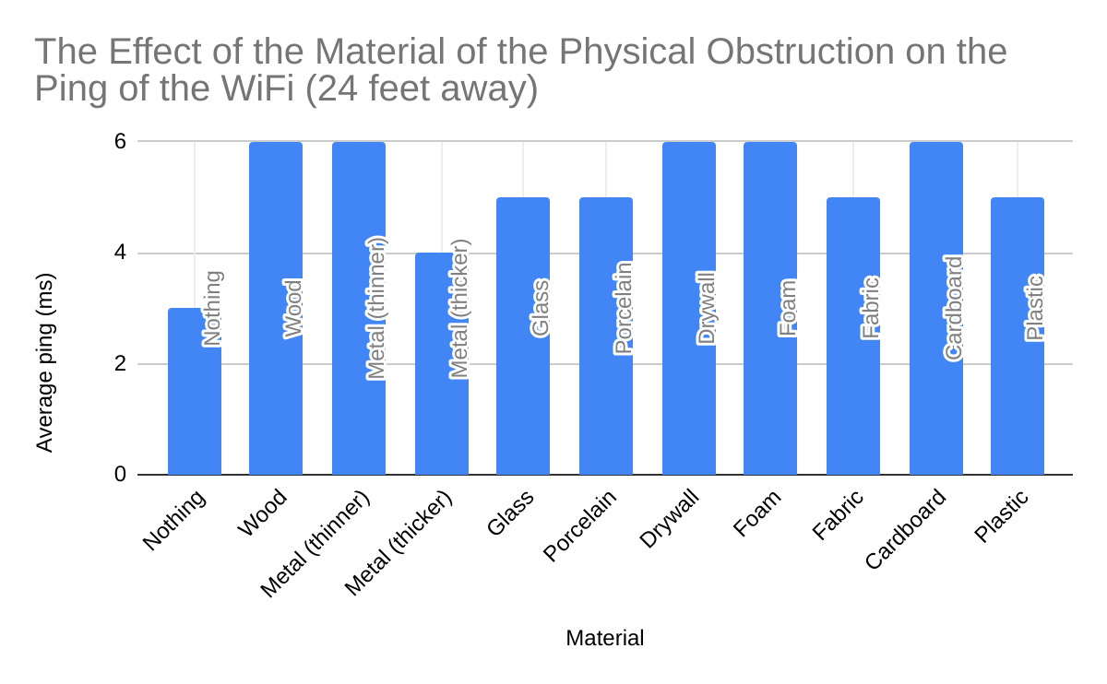
Data:
Averages: 24 feet away

Slide 25
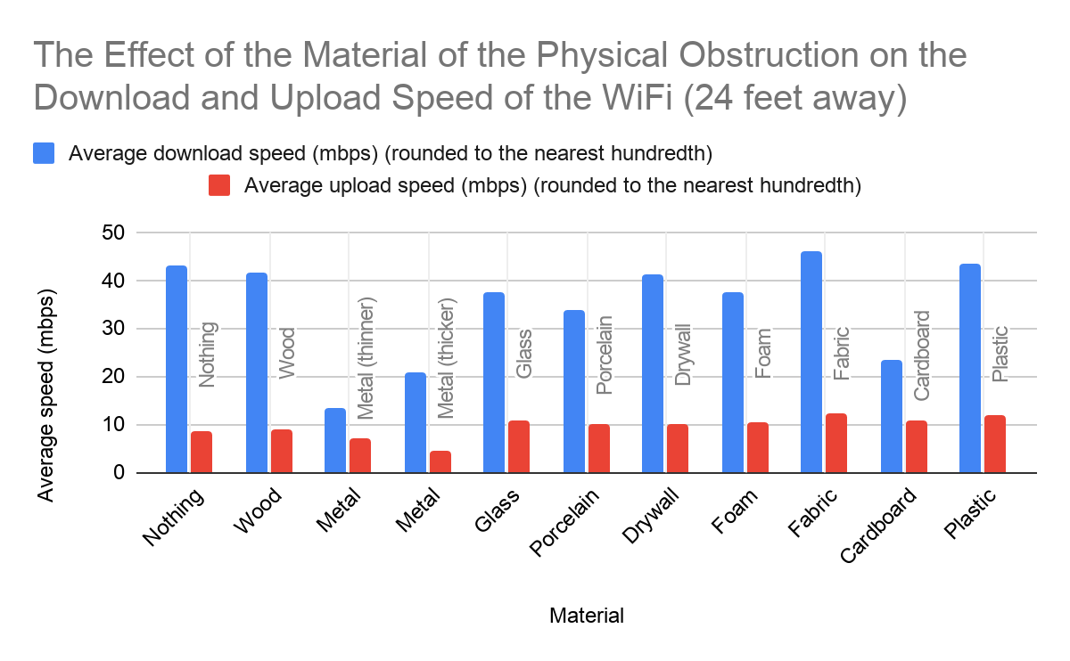
Data:
Averages: 24 feet away

Slide 26
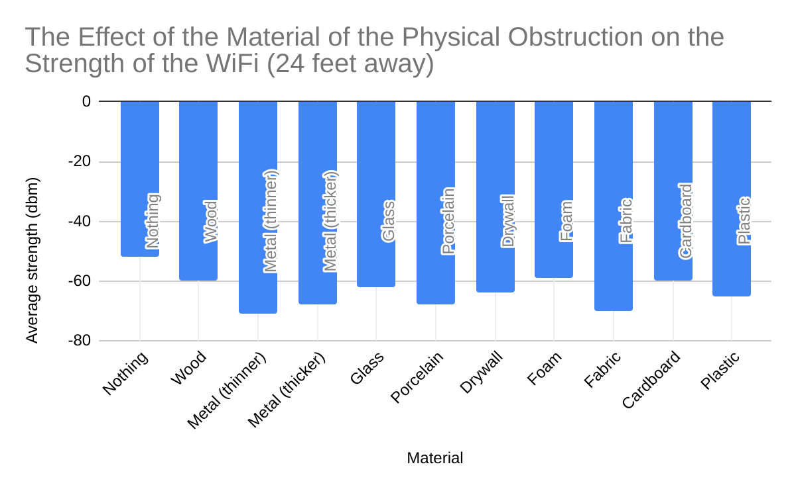
Data:
Averages: 24 feet away

Slide 27
Data:
Averages: 12 feet away, 12 feet above
Material | Average ping (ms) (rounded to the nearest whole number) | Average download speed (mbps) (rounded to the nearest hundredth) | Average upload speed (mbps) (rounded to the nearest hundredth) | Average strength (dbm)(rounded to the nearest negative whole number)
Nothing | 4.0 | 44.94 | 8.72 | -51
Wood | 4.0 | 43.13 | 12.95 | -46
Metal (thinner) | 6.0 | 47.7 | 11.86 | -71
Metal (thicker) | 5.0 | 31.22 | 11.02 | -60
Glass | 5.0 | 44.59 | 10.66 | -59
Porcelain | 4.0 | 39.76 | 3.7 | -53
Drywall | 5.0 | 46.13 | 12.25 | -62
Foam | 5.0 | 46.22 | 9.02 | -57
Fabric | 6.0 | 24.34 | 11.04 | -55
Cardboard | 5.0 | 46.86 | 11.45 | -55
Plastic | 6.0 | 42 | 10.12 | -55

Slide 28
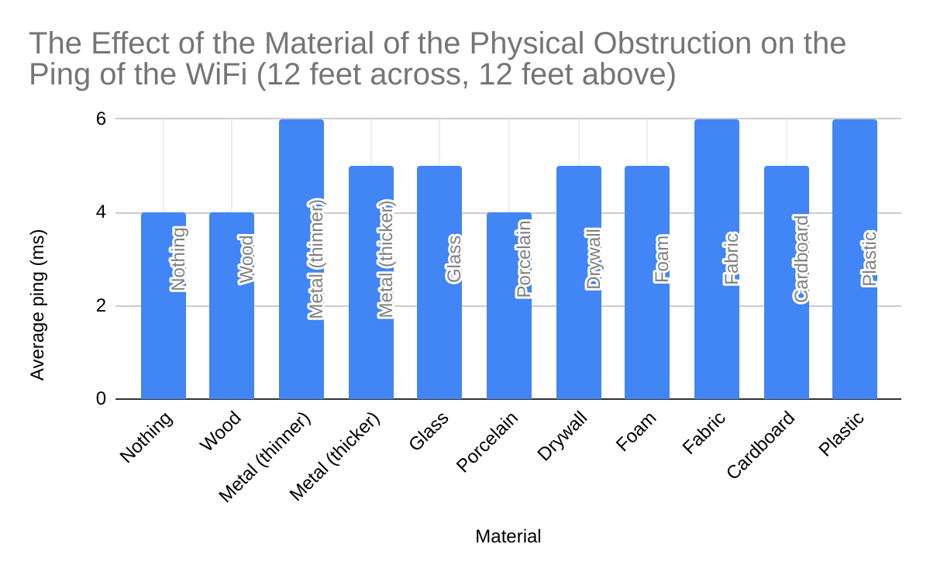
Data:
Averages: 12 feet away, 12 feet above

Slide 29
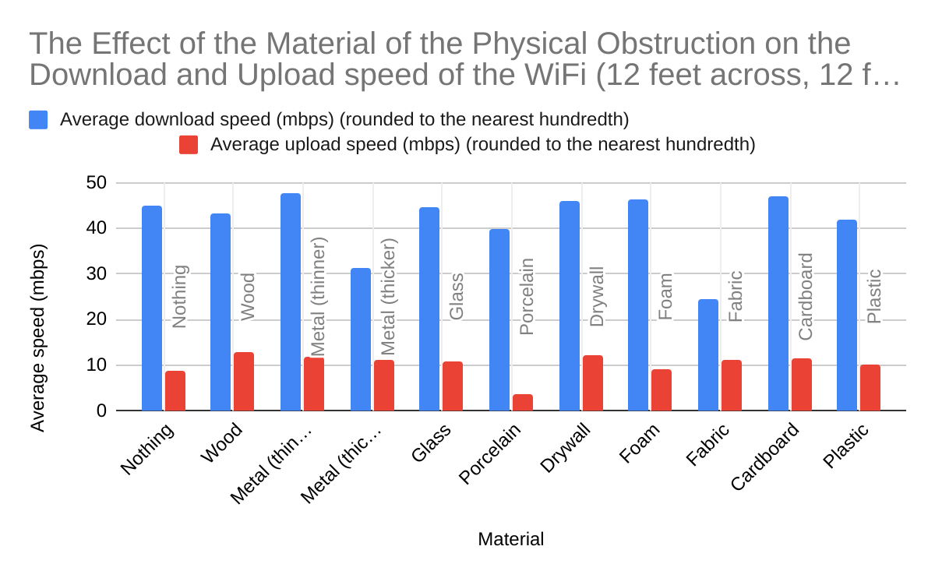
Data:
Averages: 12 feet away, 12 feet above

Slide 30
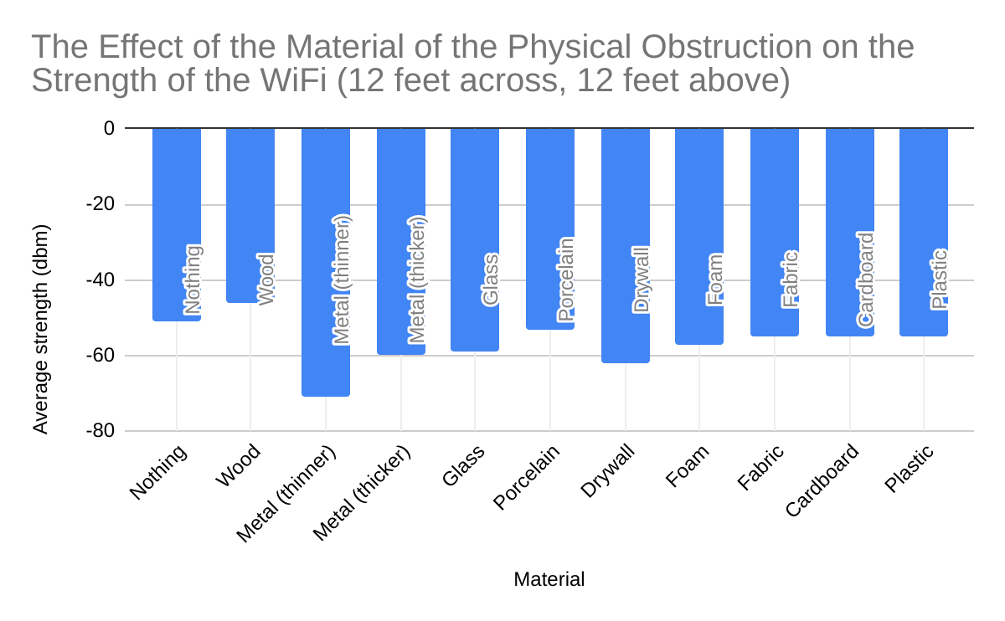
Data:
Averages: 12 feet away, 12 feet above

Slide 31
Data:
Comparison Charts: 12 feet away to 24 feet away
Material | Percent of change in ping | Percent of change in download speed | Percent of change in upload speed | Percent of change in strength
Nothing | 50 (decrease) | 6.46 (decrease) | 17.43 (decrease) | 15.56 (decrease)
Wood | 0 (no change) | 6.37 (decrease) | 9.82 (decrease) | 17.31 (decrease)
Metal (thinner) | 20 (increase) | 59.21 (decrease) | 5.75 (decrease) | 10.94 (decrease)
Metal (thicker) | 20 (decrease) | 35.51 (decrease) | 42.78 (decrease) | 13.33 (decrease)
Glass | 16.67 (decrease) | 7.75 (decrease) | 95.55 (increase) | 19.23 (decrease)
Porcelain | 0 (no change) | 19.01 (decrease) | 2.65 (decrease) | 30.77 (decrease)
Drywall | 50 (increase) | 11.74 (decrease) | 4.92 (decrease) | 14.29 (decrease)
Foam | 14.29 (decrease) | 20.85 (decrease) | 12.31 (increase) | 18 (decrease)
Fabric | 28.57 (decrease) | 3.52 (decrease) | 16.24 (increase) | 32.08 (decrease)
Cardboard | 0 (no change) | 46.1 (decrease) | 12.2 (decrease) | 15.38 (decrease)
Plastic | 0 (no change) | 11.17 (decrease) | 4.25 (increase) | 38.3 (decrease)
Note:
Remember, a
Decrease (ping) = positive effect
Increase (ping) = negative effect
Decrease (upload and download speed) = negative effect
Increase (upload and download speed) = positive effect
Decrease (strength) = negative effect
Increase (strength) = positive effect

Slide 32
Data:
Comparison Charts: 12 feet away to 12 feet away and above
Material | Percent of change in ping | Percent of change in download speed | Percent of change in upload speed | Percent of change in strength
Nothing | 33.33 (decrease) | 1.98 (decrease) | 16.48 (decrease) | 13.33 (decrease)
Wood | 33.33 (decrease) | 3.25 (decrease) | 31.07 (increase) | 11.54 (increase)
Metal (thinner) | 20 (increase) | 44.76 (increase) | 58.56 (increase) | 10.94 (decrease)
Metal (thicker) | 0 (no change) | 2.59 (decrease) | 39.49 (increase) | 0 (no change)
Glass | 16.67 (decrease) | 9.67 (increase) | 89.68 (increase) | 13.46 (decrease)
Porcelain | 20 (decrease) | 4.91 (decrease) | 63.62 (decrease) | 5.36 (increase)
Drywall | 25 (increase) | 1.33 (decrease) | 17 (increase) | 10.71 (decrease)
Foam | 28.57 (decrease) | 2.08 (decrease) | 2.59 (decrease) | 14 (decrease)
Fabric | 14.29 (decrease) | 49.07 (decrease) | 4.25 (increase) | 10 (decrease)
Cardboard | 16.67 (decrease) | 7.9 (increase) | 6.91 (decrease) | 5.77 (decrease)
Plastic | 20 (increase) | 14.04 (decrease) | 10.44 (decrease) | 17.02 (decrease)
Note:
Remember, a
Decrease (ping) = positive effect
Increase (ping) = negative effect
Decrease (upload and download speed) = negative effect
Increase (upload and download speed) = positive effect
Decrease (strength) = negative effect
Increase (strength) = positive effect

Slide 33
Data:
Comparison Charts: 24 feet away to 12 feet away and above
Material | Percent of change in ping | Percent of change in download speed | Percent of change in upload speed | Percent of change in strength
Nothing | 33.33 (increase) | 4.78 (increase) | 1.16 (increase) | 1.92 (increase)
Wood | 33.33 (decrease) | 3.33 (increase) | 45.34 (increase) | 23.33 (increase)
Metal (thinner) | 0 (no change) | 254.91 (increase) | 68.23 (increase) | 0 (no change)
Metal (thicker) | 20 (increase) | 51.04 (increase) | 143.81 (increase) | 11.76 (increase)
Glass | 0 (no change) | 18.87 (increase) | 3 (decrease) | 4.84 (increase)
Porcelain | 20 (decrease) | 17.11 (increase) | 62.63 (decrease) | 22.06 (increase)
Drywall | 16.67 (decrease) | 11.8 (increase) | 22.87 (increase) | 3.13 (increase)
Foam | 16.67 (decrease) | 23.72 (increase) | 13.27 (decrease) | 3.4 (increase)
Fabric | 20 (increase) | 47.21 (decrease) | 10.32 (decrease) | 21.43 (increase)
Cardboard | 16.67 (decrease) | 101.46 (increase) | 6.02 (increase) | 8.33 (increase)
Plastic | 20 (increase) | 3.23 (decrease) | 14.09 (decrease) | 15.38 (increase)
Note:
Remember, a
Decrease (ping) = positive effect
Increase (ping) = negative effect
Decrease (upload and download speed) = negative effect
Increase (upload and download speed) = positive effect
Decrease (strength) = negative effect
Increase (strength) = positive effect

Slide 34
Analysis:
Materials and distance effects:
The thin and thick metals affected the overall signal the most. The strength and speed decreased consistently and the thin metal achieved the lowest download rate of 1.44 mbps.
The glass and porcelain affected the upload speed the most. Both achieved the lowest upload speed of 0.0 mbps. The fabric and thin metal resulted in the lowest signal strength, with fabric reaching -74 dbm and the thin metal reaching -71 dbm.
With the router covered by nothing, it achieved the most desirable average ping among the bunch as well as the most desirable dbm of -44 at a 12 feet distance.
The wood and plastic were two of the obstructions that also did not change the signal speed and strength much.
When the distance increased, the speed and strength for all the materials seemed to constantly decrease, however the ping stayed relatively the same. The vast majority of the lowest scores were recorded at 24 feet away or 12 feet across and 12 feet above.
The reason for metal affecting the signal is since metal is a conductor of electricity and magnetism, therefore it will absorb and interfere with the radio waves the WiFi emits. The reason for glass being able to affect the WiFi drastically is due to the fact glass is able to block and reflect the WiFi signal. Porcelain is a material that can weaken the WiFi as it travels through as well as block it from reaching the device. The WiFi was the most desirable with nothing blocking the router since there was no extra interference restricting the signal from easily reaching the device.
Comparison of trends for same materials:
The comparison charts were made to compare the speed and strength changes for the same blocking materials with different distances. The purpose was to see if the signal attenuates with distance for different materials.
While the signal decreased with more distance, unfortunately there is no clear trend for different blocking materials. One possible reason is that the stability of the signal itself is questionable.

Slide 35
Analysis: (continued)
Additional variables:
Something that may have affected the signal was the extra furniture in the vicinity of the 12 and 24 feet areas. I was not able to remove the furniture from the rooms for the experiment, however the furniture was present for all of the tests. Since they were there for all the tests no material would have any extra furniture in the area than the other, but there would still most likely be a difference between the tests if the furniture was not present.
Another very important observation is that there were some data outliers within the same set of experiments. Although the average was taken for three trials, the outliers significantly affected the results and made them inconsistent. The possible reason for the fluctuation of the WiFi signal itself. Due to the data traffic differences, the numbers recorded at different times can be very different.
Ways to improve the experiment:
If I were to redesign this experiment I would either make sure to run even more tests to guarantee more accurate results and minimize the influence by the data outliers to find more exact results.
Another thing that may have made a small difference is that when measuring the speed and strength is that I was not always perfectly and consistently positioned in the exact spot of the measurements. When the rough area of where the spots were indicated, I estimated the rough position to run the tests.
The final outlier that would have affected the signal of the WiFi was if other devices were currently using the WiFi. This may have caused the signal to be weaker or slower due to the fact that the signal could’ve been busy transmitting waves to other devices operating on the same network.
A mistake that was possible is that when testing I occasionally wrote the strength (dbm) from memory subsequent to the testing and did not write it down during the actual test. This may have affected the accuracy of the strength by a small amount.

Slide 36
Conclusion:
The metals affected the WiFi signal speed and strength the most and the router covered with nothing, wood, or plastic affected the WiFi signal the least.
The distance from the router also affected the speed and strength. With a longer distance from the router, the signal decreases.
No clear trend of the signal strength change was observed for the same blocking material with different distances.
These experiments offer a useful guideline for where to place the wireless router at your home to achieve a better signal.
Next time, I would like to attempt this experiment with a larger variety of items/materials and find a place with less interfering furniture items present to get the most accurate results. I would also want to play around more with distances and the paths of the signal to additionally enhance the practicality of the experiment. I would like to try using more/different apps to measure the WiFi for further accuracy. If I were to attempt this experiment again in the future, I would definitely make sure to act more precisely and meticulously to guarantee the most exact outcome.

Slide 37
All Citations Used in this Presentation:
Images used (for colored/white boxes (in Background Information, Procedure, Analysis, and Conclusion) & (other images in Slide 5 (Testable Question & Hypothesis), Materials, Data):
LAVENDER: #EFDDFF 7443 C | Pantone colour palettes, Lavender aesthetic, Pantone
Pastels Of Lavender Color Scheme » Blue » SchemeColor.com
Buy 4.5" x 4.5" x 6" Premier Gloss White Box Base-100/Pack
Motorola mg7550 vs mb8600- Best for your cable plan?
Hotel, internet, restaurant, signal, wifi, wireless icon - Download on Iconfinder
Ireland
Transparent background purple flower clipart
All websites used in Background Information:
Top 12 Materials that Block WiFi Signals | Wilson Amplifiers
How WiFi Works | HowStuffWorks
How to measure signal strength in Decibels on your cell phone?
How to Check Your Wi-Fi Signal Strength
dB & dBm Differences in Relation to Cellular Signal Boosters
How Fast is My Internet? How Internet Speed Is Measured
Internet Speed Classifications | What is Fast Internet?
Source for Slide Template used:
Watercolor Waves. Free PowerPoint Template & Google Slides Theme

