Slide 1
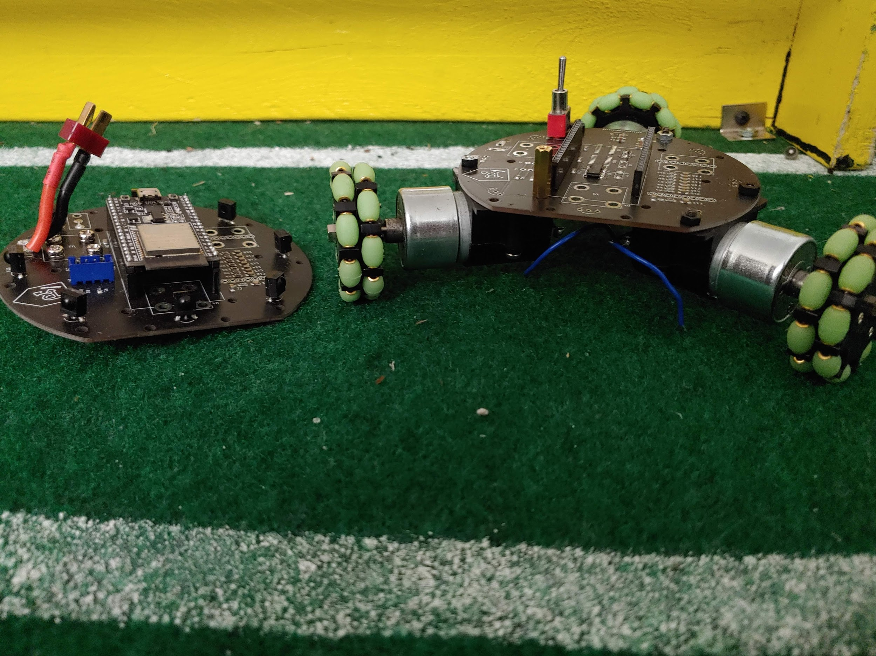
Zircon
Mark Ogata

Slide 2
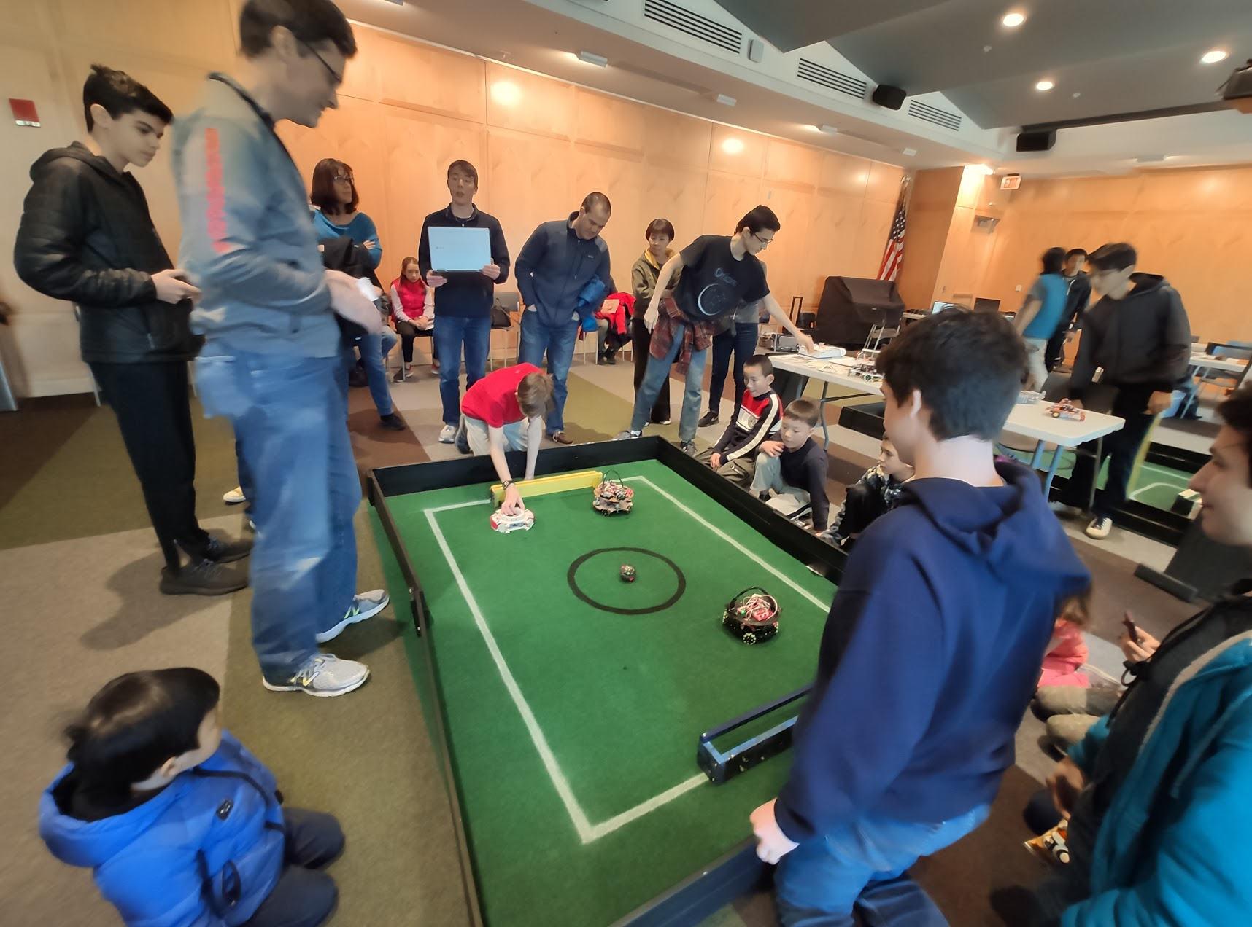
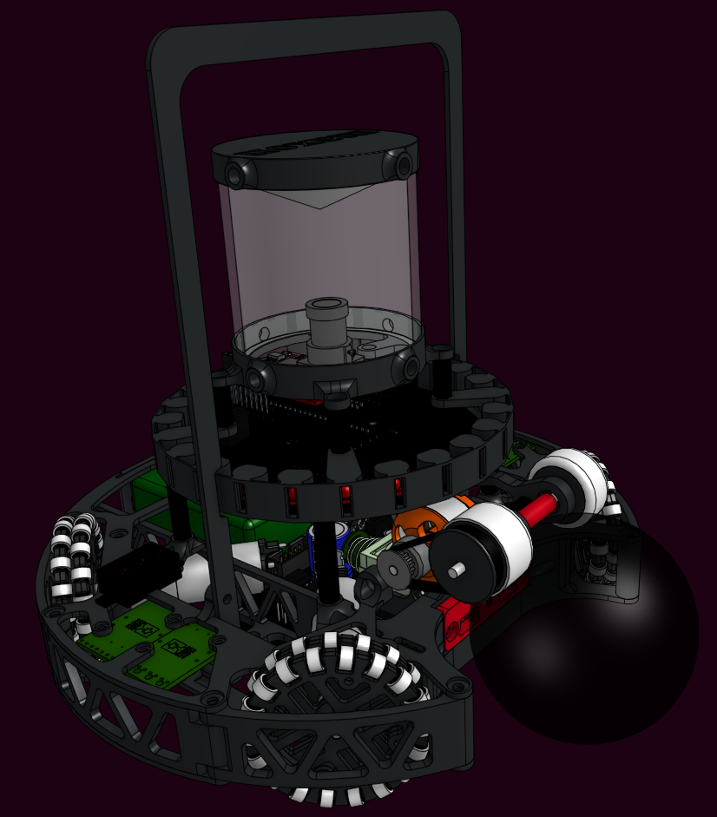
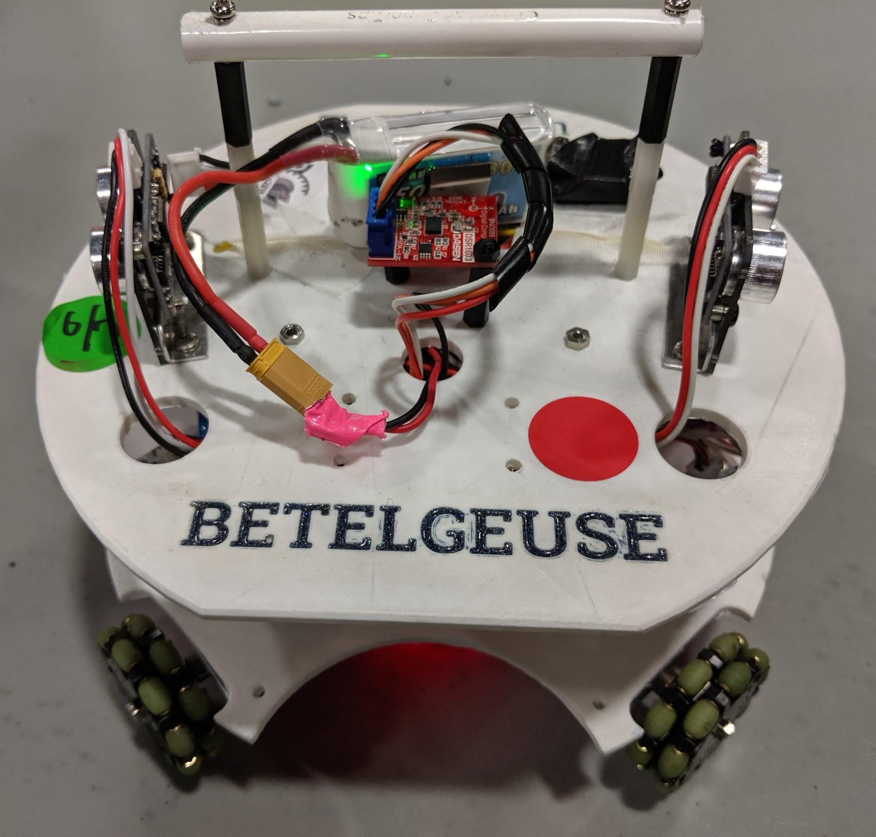
About ME
Founded PSR - 2018
National Champions - US Rep
Electronics + PCB design - 2021

Slide 3
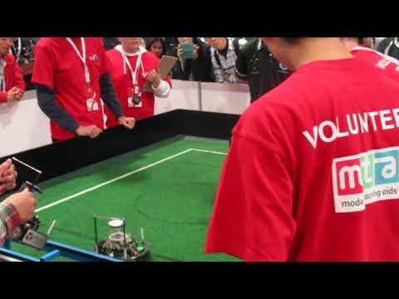
RoboCupjunior
2 vs 2
IR Ball
Lightweight
1100 grams
12V
22cm

Slide 4
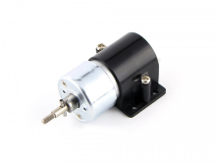
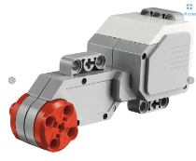
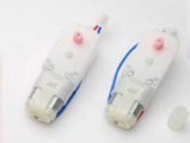
How does it compare?
 | Zircon | LEGO Mindstorm ev3 | TJ3B
Price | <$150 | $469 | $200
Motor Quality
Motor Quantity | 3 | 3 | 2
Ball Sensors | 8 | 1 | 1
Line Sensors | 3 | 1 | 1
Movement capability | Omni-Directional | Bi-Directional | Bi-Directional
customizability | Electrical, Mechanical, and foundational customizability | Basic mechanical | Mechanical, basic Electrical
Effective Learning? | Pushes Learning Electrical, mechanical design, and software. Does not require hardware first | Ends as toy | Pushes Learning Electrical and mechanical design.

Slide 5
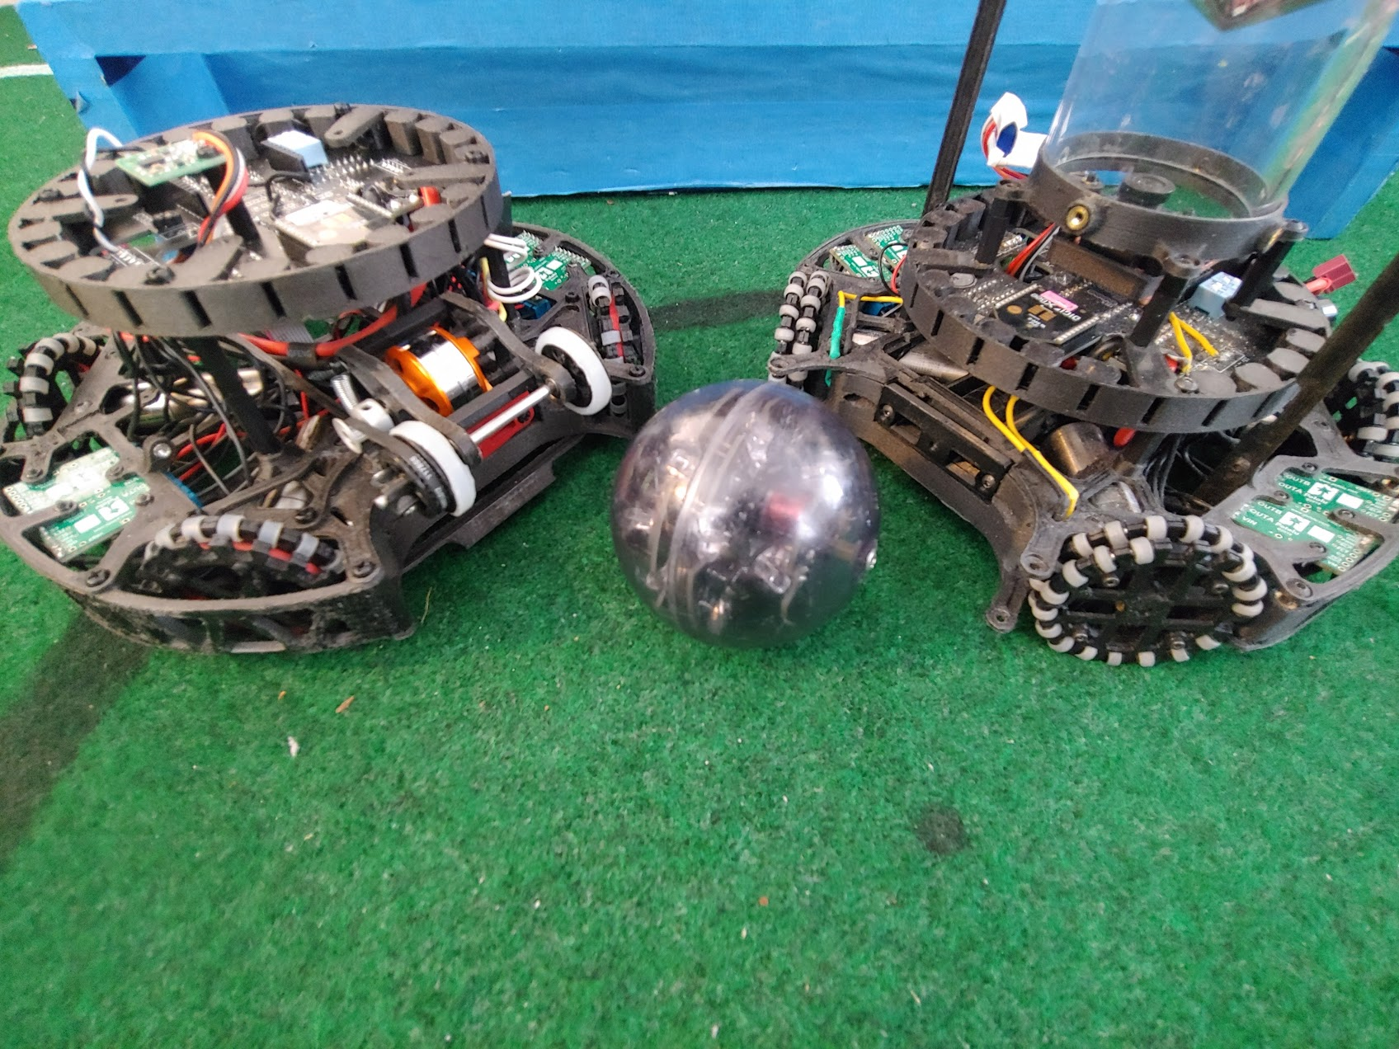
Solves
Money problem
Hardware first
Big commitment
Delayed Testing

Slide 6
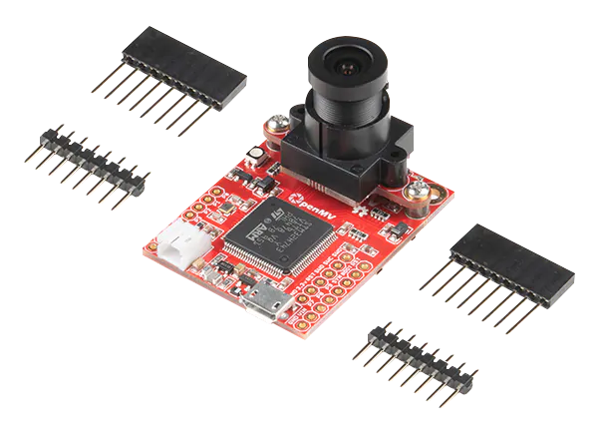
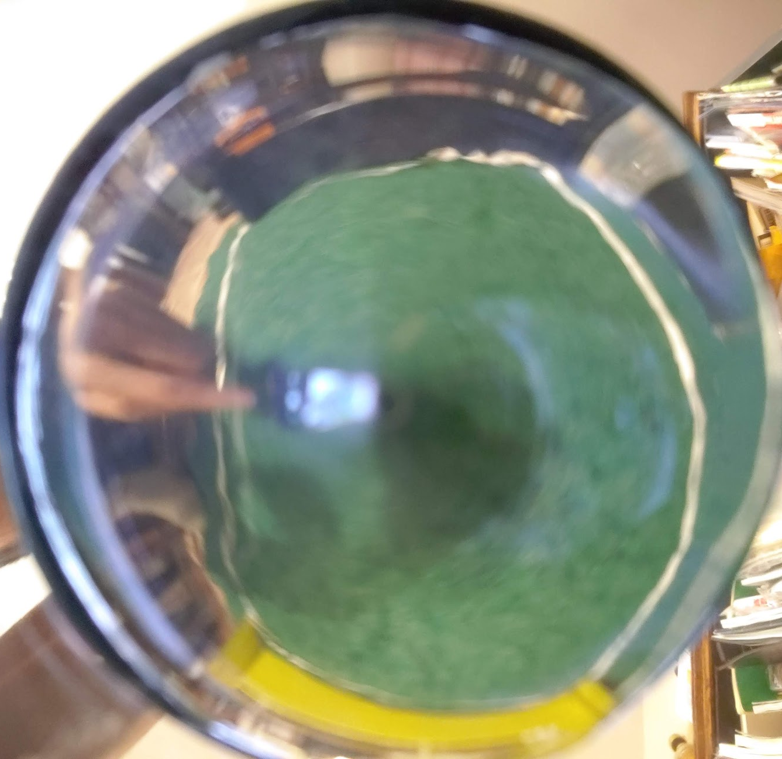
Future plans
Vision extension
Plug and screw
In-house wheels
-50% cost
Website/Documentation
Videos

Slide 7
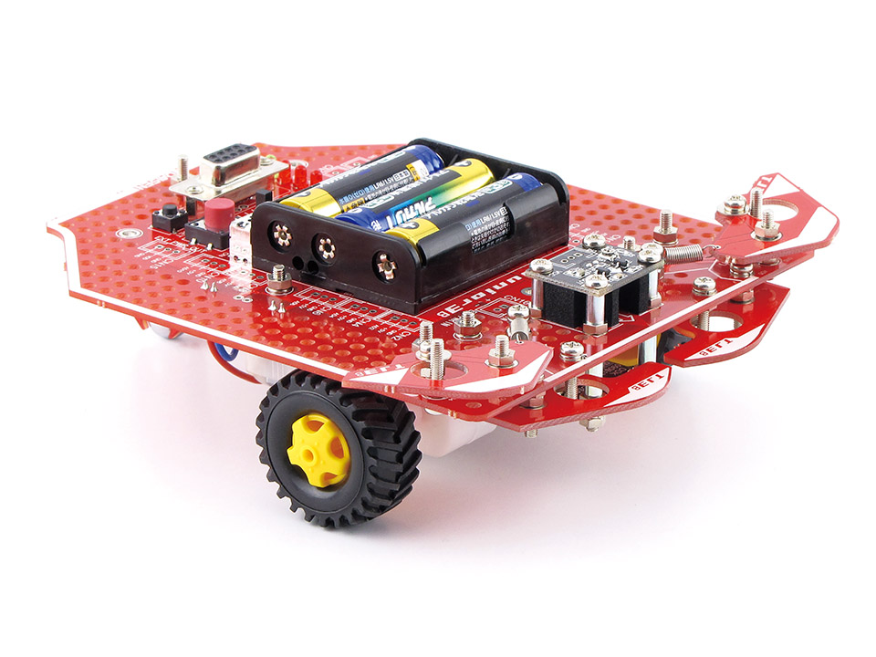
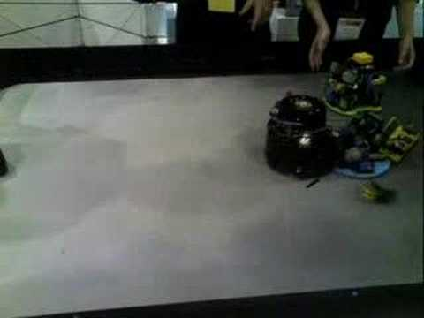
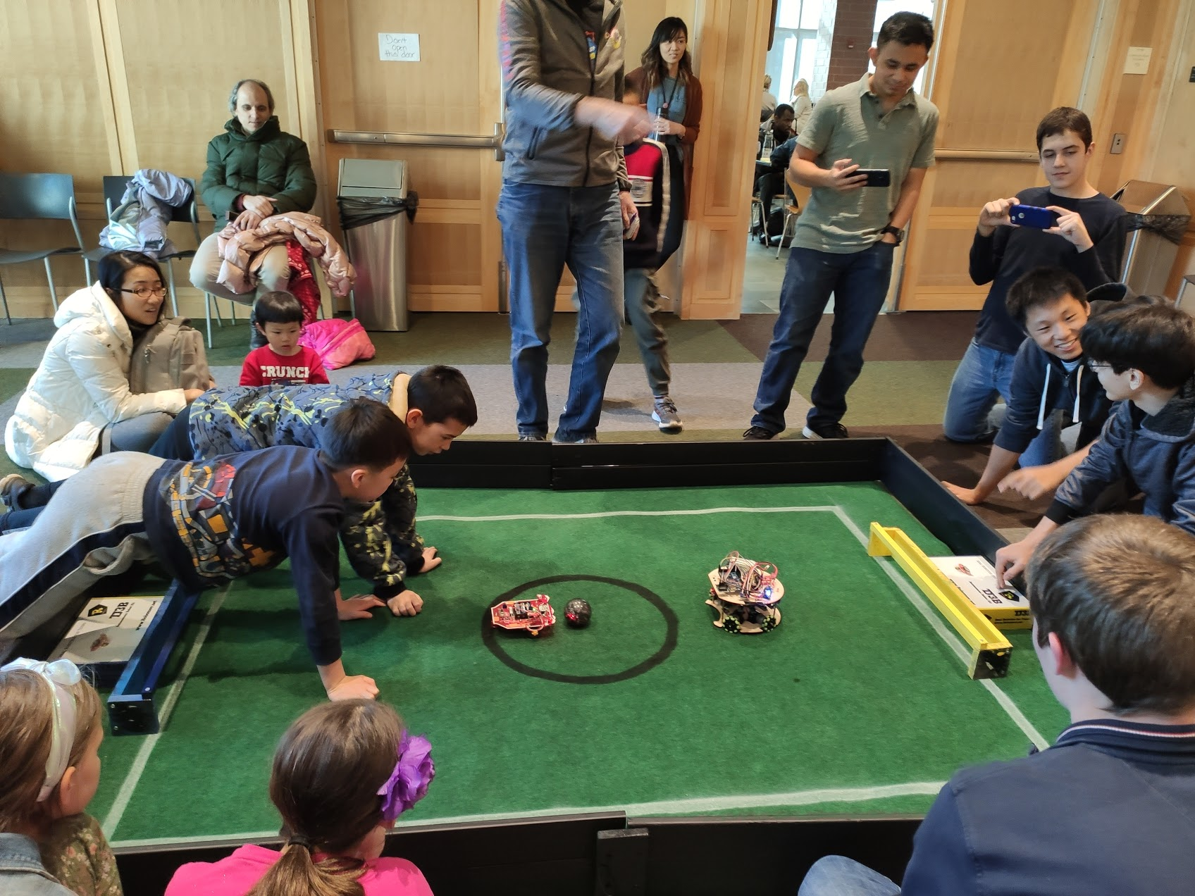
Questions?
About 50% max speed https://photos.app.goo.gl/XDWSKgmJZmLyfp3C8

