Slide 1
Safe Distance:
Quantitative Analysis on the Distance A Covid-19 Virus Spreads During Its Lifespan
Alvin Miao
Princeton International School of Mathematics and Science

Slide 2
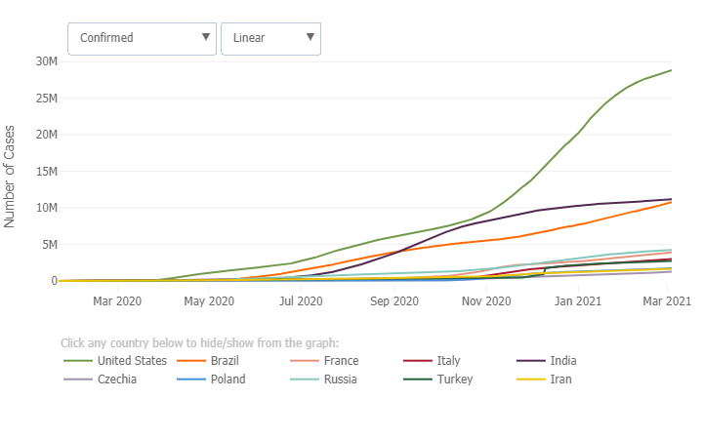
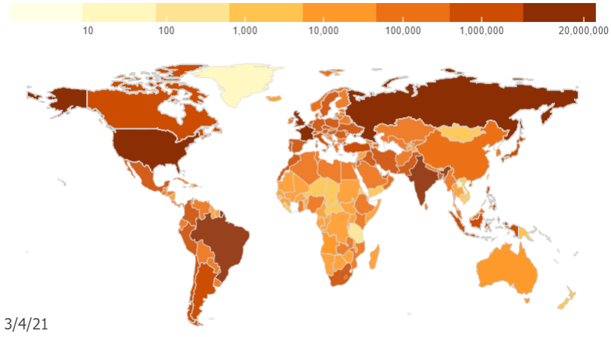
CRITICAL TRENDS
OF COVID-19
CUMULATIVE CASES OVER TIME
CUMULATIVE CASES BY DATE

Slide 3
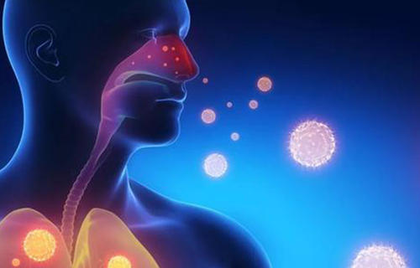
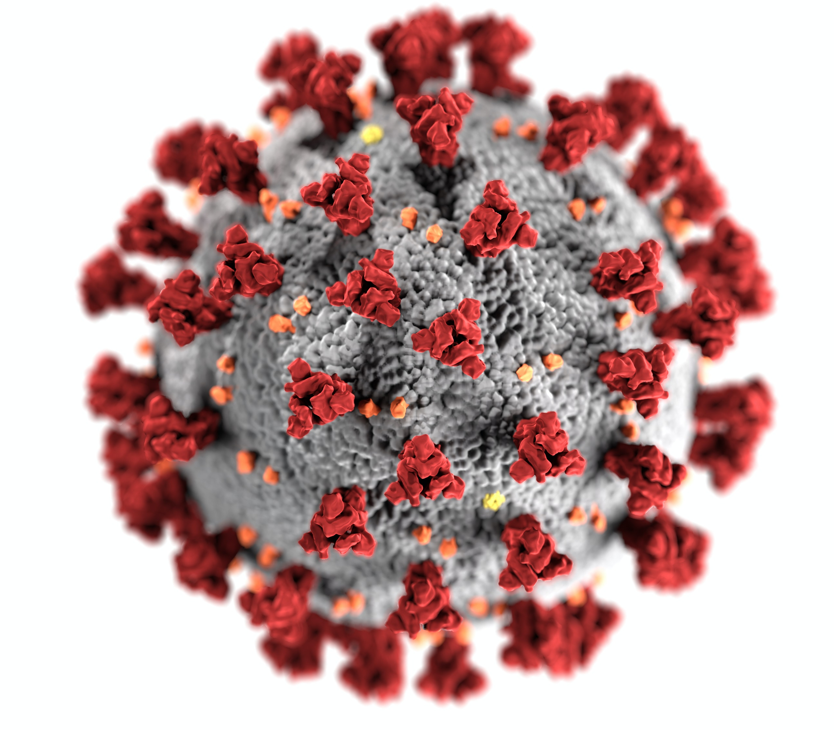
CORONAVIRUS

Slide 4
Research Plan
-- I did a research on finding out safe distance of COVID 19 virus in real life, with the consideration of air resistance, viscoelasticity of the mucosal vary liquid contaminated with the virus, and turbulence effect on the virus entity.
-- I divided the path of the virus surrounded by mucus into two sections: when it moves inside the bronchus and after it is emitted from the nose.
-- I create mathematical models for each part and combine Maxwell model of viscoelastic fluid, Einstein equation for diffusivity, and Gaussian distribution in Brownian movement to generate a trajectory equation for the pathogen- carrying particles.
-- I create mathematical models for the second portion of the path.

Slide 5
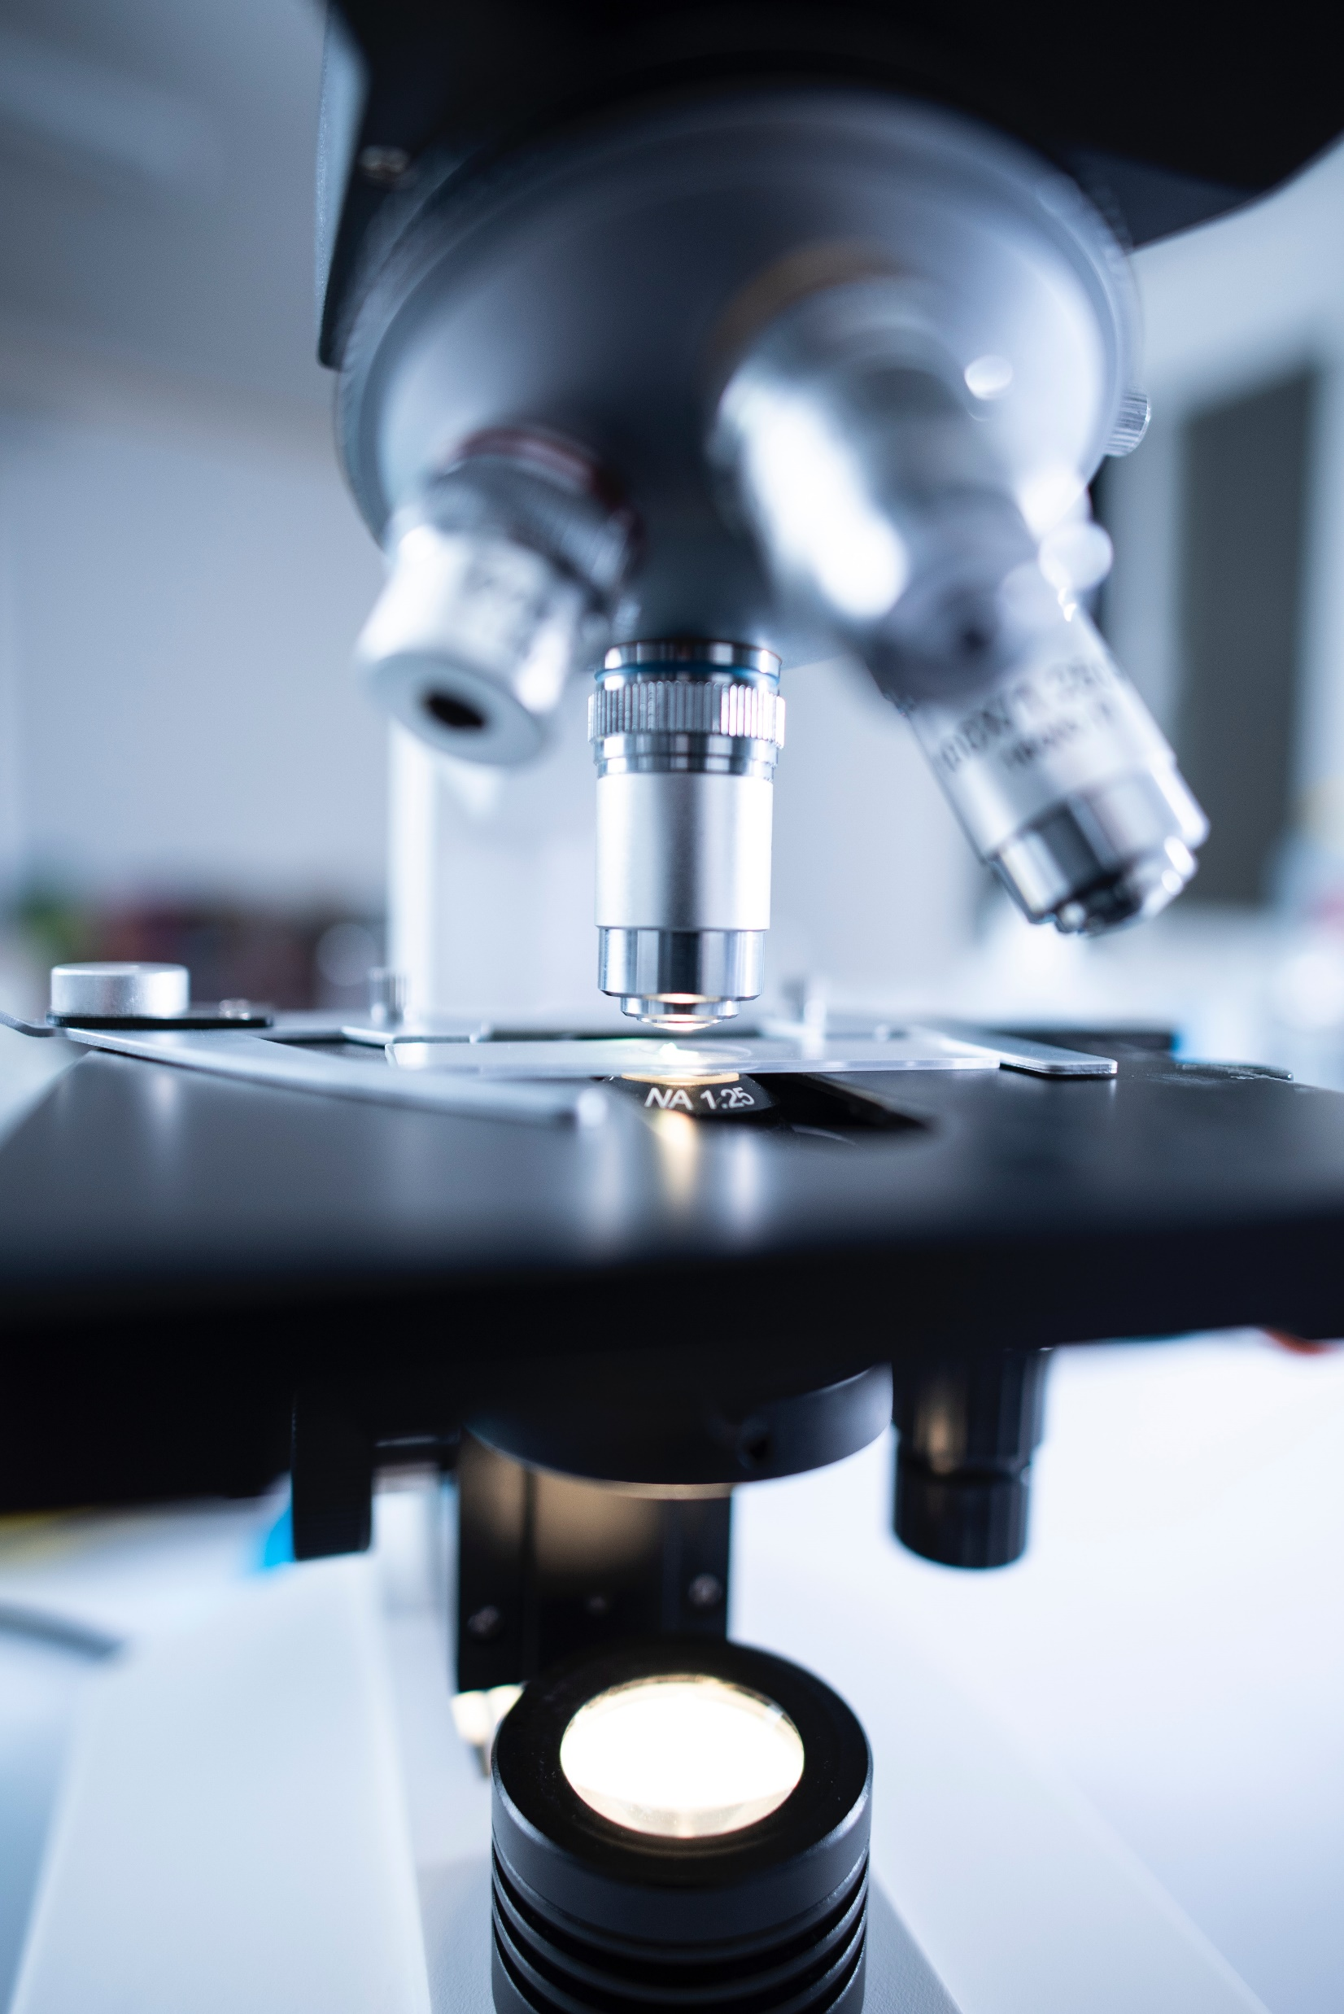
Innovation
-- I combine Einstein equation for diffusivity of a particle and the Gaussian distribution of the particles in Brownian movement in order to calculate the range a virus-containing mucosal vary droplet can reach.
-- I took into account the paths that viral particles pass through the lungs and bronchi before being emitted from the nasal passages, which is not available in other works.
-- I not only calculated the average value of the safe distance, but also gave an equation to solve for the exact value in different cases.

Slide 6
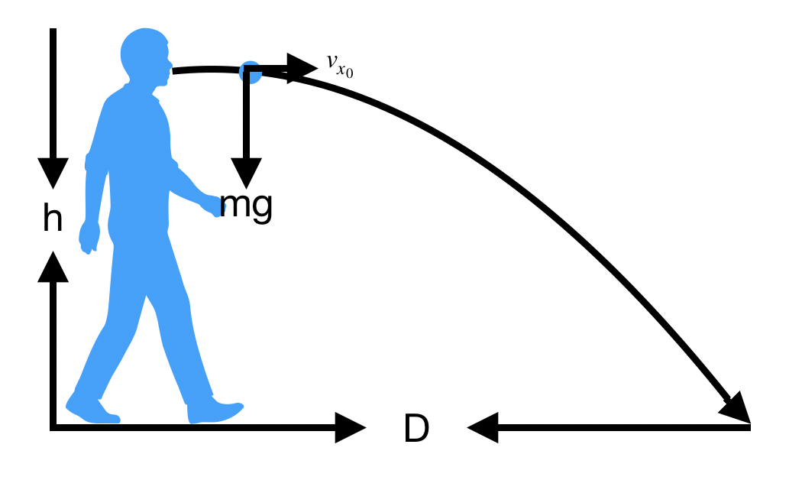
Materials and Methods
Relationship between constants:
$$F=ζv$$
$$ζ=6πηR$$
$$g=9.806m/s^{2}$$
$ρ=1⋅{10}^{3}kg⋅m^{3}$
$$R=5.0⋅{10}^{−6}m$$
$$η=2.98⋅{10}^{−3}Pa⋅S$$

Slide 7
Materials and Methods
Method 1: Combination of Theoretical Simulation and Data from Previous Paper
$$mg−ζv=ma$$
$$x_{t}=\frac{mv⋅ln\left[cosh\left(\sqrt{\frac{mgζ}{v}}t\right]\right.}{ζ}=h$$
$$mg−ζ\left(\frac{dx}{dt}\right)=m\left(\frac{d^{2}x}{dt^{2}}\right)$$
$$v_{t}=\frac{dx}{dt}=\sqrt{\frac{mgv}{ζ}}tanh\left(\sqrt{\frac{gζ}{mv}}t\right)$$
$x_{0}=0$ ($x=0\text{at}t=0$)
$x_{0}^{′}=\frac{dx}{dt}=v_{0}=0$ ($x=0\text{at}t=0$)

Slide 8
Materials and Methods
Method 1: Combination of Theoretical Simulation and Data from Previous Paper
$$coshx=\frac{e^{x}+e^{−x}}{2}$$
$$\frac{mv⋅ln\left[cosh\left(\sqrt{\frac{mgζ}{v}}\right)t\right]}{ζ}=h$$
$$x_{t}=\frac{mv⋅ln\left[cosh\left(\sqrt{\frac{mgζ}{v}}t\right]\right.}{ζ}=h$$
$$tanhx=\frac{e^{x}−e^{−x}}{e^{x}+e^{−x}}$$
$$v_{t}=\frac{dx}{dt}=\sqrt{\frac{mgv}{ζ}}tanh\left(\sqrt{\frac{gζ}{mv}}t\right)$$
$$v_{t_{max}}=\sqrt{\frac{mgv}{ζ}}=\frac{2ρgR}{9η}$$

Slide 9
Materials and Methods
Method 1: Combination of Theoretical Simulation and Data from Previous Paper
$R=$ $5.0∗{10}^{−6}m$
$η=$ $2.98∗{10}^{−3}Pa⋅s$
$$ρ=1.0⋅{10}^{3}kg/{m^{3}}$$
$$v_{t_{max}}=\sqrt{\frac{mgv}{ζ}}=\frac{2ρgR}{9η}$$
$$g=9.806m/{s^{2}}$$
$$3.66m/s$$
$r=$ $5.0∗{10}^{−6}m$
$$m_{ms}=ρ_{ms}⋅V_{ms}=ρ_{ms}⋅\frac{4}{3}πr^{3}$$
$$ρ=1.0⋅{10}^{3}kg/{m^{3}}$$
$$5.23⋅{10}^{−13}kg$$

Slide 10
Materials and Methods
Method 1: Combination of Theoretical Simulation and Data from Previous Paper
$$\frac{mv⋅ln\left[cosh\left(\sqrt{\frac{mgζ}{v}}\right)t\right]}{ζ}=h$$
$$h=1.71m$$
$$ζ=1.8⋅{10}^{−5}Pa/s$$
$t=2e^{\frac{ζh}{mv}−ln(e^{\sqrt{\frac{mgζ}{v}}}+e^{−\sqrt{\frac{mgζ}{v}}})}$
$$t=1.308s$$

Slide 11
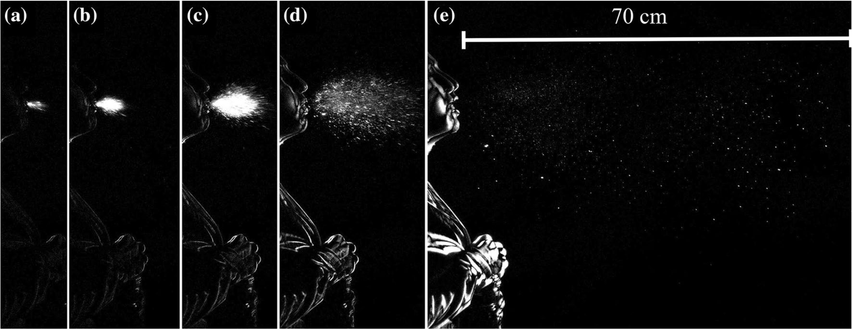
Materials and Methods
Method 1: Combination of Theoretical Simulation and Data from Previous Paper

Slide 12
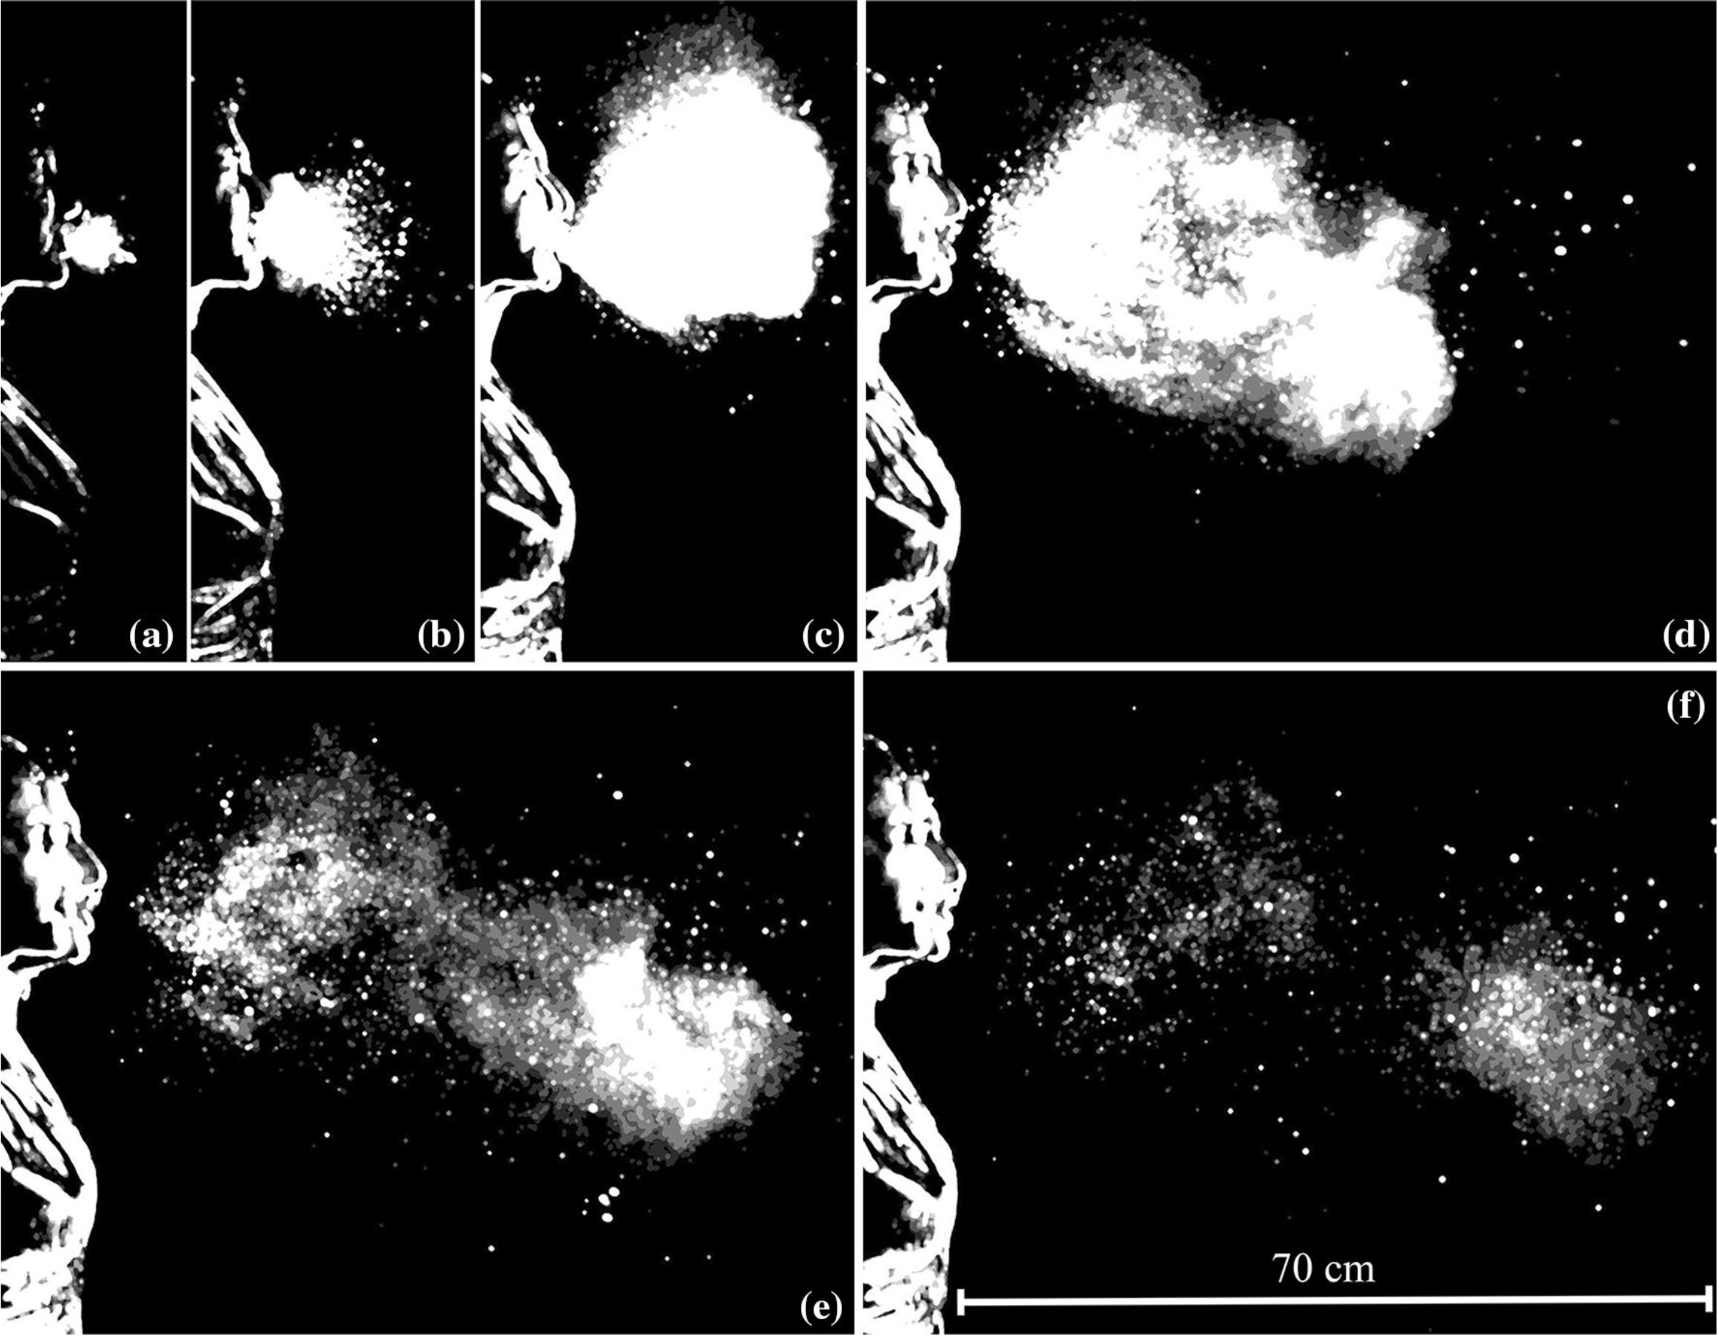
Materials and Methods
Method 1: Combination of Theoretical Simulation and Data from Previous Paper

Slide 13
Materials and Methods
Method 1: Combination of Theoretical Simulation and Data from Previous Paper
 | D / T | 1 | 2 | 3 | 4 | 5 | 6
Picture 1 | Distance measured in picture | 0.5cm | 0.8cm | 1.5cm | 3cm | 10.5cm
 | Distance in reality calculated | 3.35cm | 5.34cm | 10.05cm | 20.01cm | 70cm
 | Time | 0.005s | 0.008s | 0.015s | 0.032s | 0.150s
Picture 2 | Distance measured in picture | 1cm | 2cm | 3.7cm | 6.4cm | 8.9cm | 10.1cm
 | Distance in reality calculated | 6.93cm | 13.86cm | 25.64cm | 44.35cm | 61.68cm | 70cm
 | Time | 0.007s | 0.030s | 0.107s | 0.162s | 0.251s | 0.340s

Slide 14
Materials and Methods
Method 1: Combination of Theoretical Simulation and Data from Previous Paper
$$x_{h_{1}}=v_{0}t_{1}−\frac{1}{2}a{t_{1}}^{2}$$
$$x_{h}=v_{0}t−\frac{1}{2}at^{2}$$
$$a=−\frac{2\left(t_{1}x_{h_{2}}−t_{2}x_{h_{1}}\right)}{t_{1}t_{2}\left(t_{1}+t_{2}\right)}$$
$$x_{h_{2}}=v_{0}t_{2}−\frac{1}{2}a{t_{2}}^{2}$$
 | D / T | 1 | 2 | 3 | 4 | 5
Picture 1 | $Δ$Distance | 1.99cm | 4.71cm | 9.96cm | 40.99cm
 | $Δ$Time | 0.003s | 0.007s | 0.017s | 0.118s
 | Acceleration |  | 19.05$\frac{m}{s^{2}}$ | 72.48$\frac{m}{s^{2}}$ | 35.33$\frac{m}{s^{2}}$
Picture 2 | $Δ$Distance | 6.93cm | 11.78cm | 18.71cm | 17.33cm | 8.32cm
 | $Δ$Time | 0.023s | 0.077s | 0.055s | 0.089s | 0.089s
 | Acceleration |  | 29.66$\frac{m}{s^{2}}$ | 28.36$\frac{m}{s^{2}}$ | 20.20$\frac{m}{s^{2}}$ | 11.37$\frac{m}{s^{2}}$

Slide 15
Materials and Methods
Method 1: Combination of Theoretical Simulation and Data from Previous Paper
$$v_{0}=6.795m/s$$
$$x_{h}=v_{0}t+\frac{1}{2}at^{2}$$
$$a=32.345m/{s^{2}}$$
$$36.557m$$

Slide 16
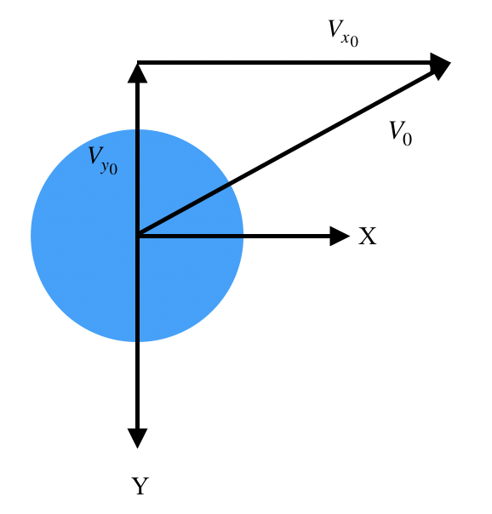
Materials and Methods
Method 2: Pure Theoretical Simulation
At time $t=0$:
$$v=v_{0}=\left(v_{x_{0}} , v_{y_{0}}\right)$$
$$\frac{d}{dt}mv=F=\left(F_{x} , F_{y}\right)$$
$$F_{D}=6πηRv_{x}$$
$$\frac{d}{dt}mv_{x}=6πηRv_{x}$$

Slide 17
Materials and Methods
Method 2: Pure Theoretical Simulation
$$m=\frac{4π}{3}R^{3}Δρ$$
$Δρ=ρ_{\text{liquid}}−ρ_{\text{air}}$
$$\frac{d}{dt}mv_{x}=6πηRv_{x}$$
$$\frac{dv_{x}}{dt}=−\frac{9ηv_{x}}{2RΔρ}$$
$\frac{dv_{x}}{dt}=−βv_{x}$
$$v_{x}=v_{x_{0}}e^{−βt}$$

Slide 18
Materials and Methods
Method 2: Pure Theoretical Simulation
$$F_{y}=mg−6πηRv_{x}$$
$$\frac{d}{dt}mv_{y}=mg−6πηRv_{x}$$
$$\frac{dv_{y}}{dt}=g−\frac{6πηRv−y}{\frac{4π}{3}R^{3}Δρ}=g−βv_{y}$$
$$v_{y}e^{βt}=g{\int{}}_{0}^{t}e^{βt^{′}}dt^{′}+v_{y_{0}}→v_{y}=\frac{g}{β}\left(1−e^{−βt}\right)+V_{y_{0}}e^{−βt}$$

Slide 19
Materials and Methods
Method 2: Pure Theoretical Simulation
the relationship between the horizontal displacement $x$ and time $t:$
$$x\left(t\right)=−\frac{v_{x_{0}}}{β}\left.\left.e^{−βt^{′}}\right.\right|{}_{0}^{t}==−\frac{2RΔρv_{x_{0}}}{9η}\left(1−e^{\frac{9η}{2RΔρ}t}\right)$$
the displacement on y-direction:
$$y=\frac{gt}{β}+\frac{g}{β^{2}}\left.\left.e^{−βt^{′}}\right.\right|{}_{0}^{t}+\frac{v_{y_{0}}}{β}\left(1−e^{−βt}\right)+h=\frac{gt}{β}+\frac{g}{β^{2}}\left(e^{−βt}−1\right)+\frac{v_{y_{0}}}{β}\left(1−e^{−βt}\right)+h$$

Slide 20
Materials and Methods
Method 2: Pure Theoretical Simulation
express $y$ in terms of $x:$
$$y=\frac{g}{β^{2}}ln\frac{1}{1−\frac{β}{v_{x_{0}}}x}−\frac{g}{βv_{x_{0}}}x+\frac{v_{y_{0}}}{v_{x_{0}}}x+h$$
relationship between the vertical displacement $y$ and time $t:$
$$y\left(t\right)=\frac{8gR^{3}Δρ^{3}}{81η^{2}t}−\frac{4gR^{2}Δρ^{2}}{81η^{2}}\left(1−e^{\frac{9η}{2RΔρ}t}\right)+\frac{2RΔρv_{y_{0}}}{9η}\left(1−e^{\frac{9η}{2RΔρ}t}\right)+h$$

Slide 21
Materials and Methods
Method 2: Pure Theoretical Simulation
equation for the horizontal and vertical displacement relative to the initial velocity and the time taken:
$$x\left(t\right)=−0.37v_{x_{0}}\left(1−e^{2.68t}\right)$$
$$y\left(t\right)=\frac{0.014}{t}−\left(1.36−0.37v_{y_{0}}\right)\left(1−e^{2.68t}\right)+1.71$$

Slide 22
Discussion
Method 1
estimate the initial condition of the particle
calculate the path of a particle with respect to air resistance and drag force
Method 2

Slide 23
Further Development
Currently, the first method of my research contains usage of data generated from my re-analysis of the result of a previous essay “Visualization of sneeze ejecta: steps of fluid fragmentation leading to respiratory droplets” by B. E. Scharfman et. all to get the average initial speed of sneeze ejecta edited from noses. If I was going to do this project again, without being limited by the COVID-19 situation, I would love to do the research studying this initial speed so that the abundance of my work can be expended, with an actual experiment introduced instead of only containing theoretical calculations.

Slide 24
Conclusion
Safe distance of the coronavirus:
36.557m
Equations for the range of coronavirus relative to the time of the motion and the initial velocity:
$$x\left(t\right)=−0.37v_{x_{0}}\left(1−e^{2.68t}\right)$$
$$y\left(t\right)=\frac{0.014}{t}−\left(1.36−0.37v_{y_{0}}\right)\left(1−e^{2.68t}\right)+1.71$$

Slide 25
References
https://en.wikipedia.org/wiki/Coronavirus_disease_2019#cite_note-JHU_ticker-8
https://www.cdc.gov/coronavirus/2019-ncov/symptoms-testing/symptoms.html
https://www.cdc.gov/coronavirus/2019-ncov/prevent-getting-sick/how-covid-spreads.html
"Coronavirus disease (COVID-19): How is it transmitted?". www.who.int. Retrieved 6 December 2020.
CDC (11 February 2020). "Coronavirus Disease 2019 (COVID-19)". Centers for Disease Control and Prevention. Retrieved 6 December 2020.
Visualization of sneeze ejecta: steps of fluid fragmentation leading to respiratory droplets. B.E.Scharfman, A.H.Techet, J.W.M.Bush, and L.Bourouiba. Exp Fluids (2016) 57:24. DOI 10.1007/s00348-015-2078-4.
https://baike.baidu.com/item/2019新型冠状病毒/24267858?fr=aladdin#3
Hirt, C.; Claessens, S.; Fecher, T.; Kuhn, M.; Pail, R.; Rexer, M. (2013). "New ultrahigh-resolution picture of Earth's gravity field". Geophysical Research Letters. 40 (16): 4279–4283. Bibcode:2013GeoRL..40.4279H. doi:10.1002/grl.50838
Ball, Philip (2008). "Water: Water—an enduring mystery". Nature. 452 (7185): 291–2. Bibcode:2008Natur.452..291B. doi:10.1038/452291a. PMID 18354466. S2CID 4365814. Archived
Symon, Keith R. (1971). Mechanics (3rd ed.). Addison-Wesley. ISBN 978-0-201-07392-8.
考虑空气阻力的斜抛运动研究. Xuepeng Guo. Physics Teaching. 39 (4): 14-16. DOI 1002-0748(2017)4 – 0014
Collins Concise Dictionary, p. 328
Collins Concise Dictionary, p. 1520
Roser, Max; Appel, Cameron; Ritchie, Hannah (8 October 2013). "Human Height". Our World in Data.
https://web.archive.org/web/20070715171817/http://aerodyn.org/Drag/tables.html

Slide 26
Acknowledge
Thanks to Professor Gerald Fuller for teaching me the basics of this project and helping me with my research.

Slide 27
Thanks
Alvin Miao
Princeton International School of Mathematics and Science

