Slide 1
The Effect of Silver Nanoparticles on the Viability of Bacteria, Fungi, Aquatic Organisms, and Plants
February 2021

Slide 2
BACKGROUND RESEARCH/PURPOSE
Silver has been used throughout history as an antimicrobial agent to fight disease and help the healing process.¹⁻³
> 400 consumer products such as sports clothes, socks, bandages, cosmetics, sunscreens, toothpastes, deodorants, sanitizers and food containers contain tiny silver particles called nanoparticles to help kill bacteria.³
Silver nanoparticles are only a few nanometers in diameter (1-100 nM), which is about 50,000 times smaller than the diameter of a strand of hair.^{4,5}
Silver nanoparticles can attach to and alter the bacterial membrane.^{4,5} They can penetrate inside the bacterial cell causing harm to important proteins and processes such as ATP production and DNA replication which cause the cells to die.⁶
As such, silver nanoparticles are considered to be cytotoxic or toxic to cells because of their ability to cause cell destruction.
How Silver Nanoparticles Kill Bacteria
Figure adapted from Chaloupka et al., Trends in Biotechnology, 2010¹⁴

Slide 3
BACKGROUND RESEARCH/PURPOSE (continued)
Silver Nanoparticles and Environmental Safety:
When silver nanoparticles in personal care products wash off of the skin, they enter the environment with unknown effects. The same antibacterial and antifungal characteristics that allow nanoparticles to be valuable also give them the potential to cause unpredictable consequences for ecological and human health.⁷
Silver nanoparticles that are discharged into lakes, streams, and oceans could be toxic to aquatic plant and animal life.
Likewise, silver nanoparticles that make their way into the soil can lead to toxic effects on terrestrial plants as well.

Slide 4
TESTABLE QUESTIONS & HYPOTHESIS
OBJECTIVES OF THIS PROJECT:
This project will investigate the antibacterial and antifungal effectiveness of different concentrations of silver nanoparticles using Escherichia coli (a type of bacteria that normally lives in the intestines where it helps the body break down and digest the food we eat) and Saccharomyces cerevisiae (a fungi/yeast used for baking and brewing beer). Furthermore, this project will investigate if consumer products containing silver nanoparticles are also effective antibacterial and antifungal agents.
This project will also explore what happens if the silver nanoparticles get into the water by investigating how freshwater organisms such as Daphnia magna or water flea and plants such as Vigna radiata (mung bean plant used in Asian cuisine) respond to exposure to different concentrations of nanosilver over time.
TESTABLE QUESTIONS:
What concentration of silver nanoparticles has a cytotoxic effect on the bacteria Escherichia coli, the fungi Saccharomyces cerevisiae, the aquatic organism Daphnia magna (water flea) and the plant Vigna radiata (mung bean)? Does silver nanoparticle treatment time have an effect on cytotoxicity?
HYPOTHESIS:
If higher concentrations of silver nanoparticles are used to treat E. coli, S. cerevisiae, Daphnia magna, and Vigna radiata, then more cell death will occur because higher concentrations of nanosilver are more cytotoxic.

Slide 5
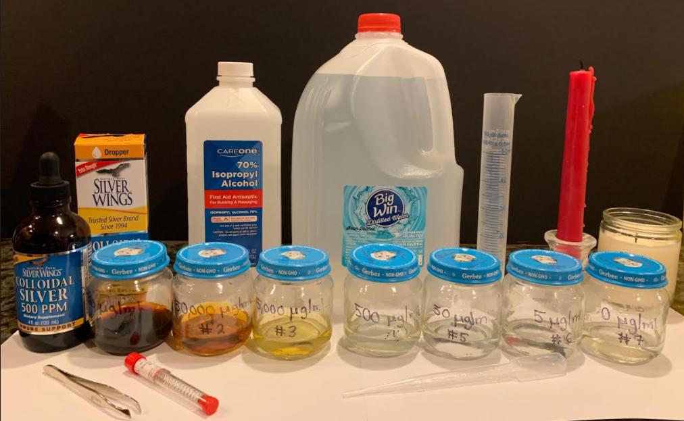
MATERIALS
Neutralizing Bacterial Kit, available from Home Science Tools (Item #: SB-BACTUSE), which includes nutrient agar plates, Escherichia coli K-12 culture (LyoQuick freeze dried and ready to reconstitute), 6 mm diameter sterile disks (Item #: LM-STERILE), sterile cotton swabs, nitrile gloves
Isopropyl alcohol, 70%
Metal forceps
Incubator (OppsDecor Egg Incubator, Amazon.com)
Candles
Baby food jars for silver nanoparticle serial dilutions
Distilled water
Natural Path Silver Wings Dietary Mineral Supplement, colloidal silver 500 PPM (Amazon.com)
Baker’s yeast Saccharomyces cerevisiae (Fleischmann’s Active Dry Yeast Original, ¼ oz packet)
Granulated sugar
10X magnifying glass
Metric ruler
Bleach
10 mL, 25 mL, 100 mL, 500 mL graduated cylinders
Petri dishes, polystyrene, 90 X 15 mm, 20 pack (Home Science Tools, Item #: BE-PETRI20)
Melt & pour yeast-extract dextrose (YED) media, 350 mL (Carolina Biological Supply Item #: C30910)
2 one-gallon jugs of pond water
Daphnia magna cultures (Carolina Biology Supply Company Item # 142331)
1 mL and 3 mL pipets
20 oz clear plastic cups
Nature Jim’s Sprouting Mung Bean Seeds (Amazon.com)
Consumer products containing silver nanoparticles from Amazon.com: Hylunia Colloidal Silver Mist (10 PPM), Silver Shield Sanitizer Multi-Purpose Hygiene Spray (15-20 PPM), Heritage Store Colloidal Silver Foaming Soap (20 PPM), Silver Biotics Tooth Gel (22 PPM), Curad Germ Shield (55 PPM), Organa Silver Gel (100 PPM), and Silver Lip Balm (2,500 PPM).

Slide 6
PART I:
Antibacterial and Antifungal Effectiveness of
Silver Nanoparticles

Slide 7
PROCEDURE: Effect of Silver Nanoparticles on the Viability of Escherichia coli using the Kirby-Bauer Antibiotic Testing Method
Perform a 1:10 serial dilution of the colloidal silver (Natural Path Silver Wings Dietary Mineral Supplement, colloidal silver 500 PPM) in 25 mL distilled water in baby food jars. The concentrations being tested are 500,000 µg/L (undiluted), 50,000 µg/L, 5,000 µg/L, 500 µg/L, 50 µg/L, 5 µg/L and 0 µg/L as negative control.
1
Jars containing Serial Dilutions of Colloidal Silver
Nanoparticles
2
Sterilize a pair of forceps in 70% isopropyl alcohol and place 6 sterile disks into each baby food jar containing the different concentrations of silver nanoparticles. The disks were soaked until a later step.
3
Working in a sterile environment next to lit candles, make bacterial lawns by following Neutralizing Bacteria Kit instructions to reconstitute freeze-dried E. coli bacteria. Label the back of 14 nutrient-agar media plates with respective silver nanoparticle concentrations (2 plates for each concentration tested).
Dispense 2 drops of the E. coli culture on the center surface of the agar plate. Use a sterile cotton swab to spread bacteria around the entire surface of the agar plate. Streak the bacteria by making a vertical line, then spread this left to right and top to bottom, rotate the plate 60 degrees clockwise and repeat the spreading and plate rotation steps 3 more times. Repeat for all 14 plates.
Placement of Nanosilver-Coated Filter Disks on Bacteria Culture Plate
4
With sterile forceps, evenly place three filter circles from a specific concentration of nanosilver onto the corresponding labeled bacteria plate. Use 2 bacteria plates for each concentration tested. Tap the sterile circle on the jar’s rim until no drops are coming off the circle (about 6 taps) before placing on the agar plate. It is important not to let the circle move once it is set on the surface. Using the forceps’ tips, press the surface of the circle once to ensure it is secured onto the agar.
Sterile Environment for Bacteria Plating
5
6
Secure the lid on each agar plate using a few pieces of clear tape. Incubate inverted plates in a 37ºC incubator with 70% humidity.
Incubator for Culturing Bacteria

Slide 8
PROCEDURE: The Effect of Silver Nanoparticles on the Viability of Escherichia coli using the Kirby-Bauer Antibiotic Testing Method
Observe each plate at 0 hour, 24 hours, 48 hours, 72 hours and 96 hours. A zone of inhibition around the filter disk suggests that the particular concentration of colloidal silver has antibacterial effects. Use a metric ruler to measure the width (diameter) in millimeters of any zones of inhibition around the filter circles seen on the plates. The filter disk diameter is actually part of the width measurement. If there is no zone of inhibition at all, report the width number as zero even though the disk itself is around 6 mm in diameter. Plot the average width measurements as a bar graph to examine which concentrations cause an antibacterial effect.
7
Measurement of the Zone of Inhibition around Filter Disk
Repeat this experiment using the following consumer products containing silver: Hylunia Colloidal Silver Mist (10 PPM), Silver Shield Sanitizer Multi-Purpose Hygiene Spray (15-20 PPM), Heritage Store Colloidal Silver Foaming Soap (20 PPM), Silver Biotics Tooth Gel (22 PPM), Curad Germ Shield (55 PPM), Organa Silver Gel (100 PPM), and Silver Lip Balm (2,500 PPM). Also include a distilled water negative control. Soak the sterile filter disks in the undiluted product and repeat steps 3 through 7 above to observe any antibacterial effects.
8
After you finish making observations, sterilize bacteria plates by soaking them in a 10% bleach solution for at least 1-2 hours and discard in the trash. Dilute the colloidal silver solution with tap water until you reach a selected unharmful concentration and pour the dilution into the sink.
9
Consumer Products Containing Silver Nanoparticles
Biological Agents and Risk Assessment: The source of the E. coli K-12 is contained in the Neutralizing Bacteria Kit from Home School Tools. According to the Public Health Service, “The E. coli K-12 strain is classified as Biosafety Level 1 and is non-pathogenic and as such would not be expected to cause harm to healthy people, animals or to the environment.” ^{8,9}
Safety Precautions: Even though considered safe, E. coli K-12 should be treated at all times as if it were a potential hazard. Experiments should be done with the highest safety precautions and standard sterile technique.^{10, 11,12} Nose and mouth should be kept away from tubes, pipettes, or other tools that come in contact with E. coli cultures and colloidal silver nanoparticles. Gloves should be worn, work surfaces should be disinfected with 70% isopropyl alcohol before and after use, and hands should be washed thoroughly after glove removal. When finished, all materials should be properly disinfected and disposed of safely. Sterilize bacteria plates and pipettes by soaking them in a 10% bleach solution for at least 1-2 hours and discard in the trash.

Slide 9
RESULTS: The Effect of Silver Nanoparticles on the Viability of E. coli Bacteria
Zone of Inhibition
A.
Figure 1. The Effect of Silver Nanoparticles on
E. coli Bacteria. (A) E. coli were plated on soft nutrient agar petri dishes. Immediately after plating, 6-mm sterile disks soaked in a specific concentration of a silver nanoparticle solution were placed on the agar plate and incubated at 37ºC for 72 hours. (B) The diameter of the zone of inhibition around 6 disks at each concentration was measured using a metric ruler and the average diameter was plotted. Error bars are the standard deviation.
Observations: Clear zones of inhibition were evident at 48 hours after incubation. The diameter of the zones of inhibition increased as the nanosilver concentration increased.
B.

Slide 10
RESULTS: The Effect of Time and Plating Density on Viability of E. coli Treated with Silver Nanoparticles
B.
Figure 2. The Effect of Time and Plating Density on the Viability of E. coli Treated with Silver Nanoparticles. (A) E. coli were plated on soft nutrient agar petri dishes. 6-mm sterile disks soaked in a specific concentration of a silver nanoparticle solution were placed on the agar plate and incubated at 37ºC for 48, 72 and 96 hours. The diameter of the zone of inhibition around 6 disks at each concentration was measured using a metric ruler and the average diameter was plotted. Error bars are the standard deviation. (B) E. coli were plated on soft agar petri dishes at 1X or 2X the kit manufacture’s recommended concentration and incubated 72 hours at 37ºC with 6-mm sterile disks each soaked at a different concentration of nanosilver solution. The diameter of the zone of inhibition around 6 disks at each concentration was measured using a metric ruler and the average diameter was plotted. Error bars are the standard deviation.
Observations: Clear zones of inhibition were evident at 48 hours after incubation and remained the same size at 72 and 96 hours after incubation. Doubling the amount of bacteria plated did not show a significant difference in the diameter of the zone of inhibition. The diameter of the zones of inhibition increased as the nanosilver concentration increased.

Slide 11
ANALYSIS: Impact of Silver Nanoparticles on Bacteria - E. coli
The Effect of Silver Nanoparticles on the Viability of E. coli Bacteria (Figure 1).
The purpose of this experiment was to determine whether silver nanoparticles can have a noticeable antibacterial effect and, if so, what concentration of silver nanoparticles is needed to achieve this antibacterial effect. The data supports the hypothesis that higher concentrations of silver nanoparticles cause more cell death because higher concentrations of nanosilver are more cytotoxic.
  A zone of inhibition, where no bacteria grew around the filter disk soaked in a silver nanoparticle solution, suggests that the particular concentration of silver nanoparticles has antibacterial or bacteria killing effects.
  There was a linear relationship between nanosilver concentration and the diameter of the zone of inhibition.
    A noticeable zone of inhibition around the filter paper circles occurred at a nanosilver concentration of 50 µg/L with a 7 mm zone of inhibition.
    The highest nanosilver concentration of 500,000 µg/L had the largest zone of inhibition of 14 mm.
    A nanosilver concentration of 5 µg/L did not cause a measurable antibacterial effect and displayed no zone of inhibition like the 0 µg/L control.
The Effect of Time and Plating Density on Viability of E. coli Treated with Silver Nanoparticles (Figure 2).
The purpose of this experiment was to determine if the density of bacteria on the nutrient agar plate and the incubation time had an effect on the diameter of the zone of inhibition.
Zones of inhibition at respective nanosilver concentrations remained the same size at 48, 72 and 96 hours after incubation, suggesting that longer treatment times did not alter antibacterial activity.
Doubling the amount of bacteria plated did not show a significant difference in the diameter of the zone of inhibition since the plates were not overgrown.

Slide 12
RESULTS: The Effect of Nanosilver-Containing Consumer Products on E. coli Viability
A.
B.
Zone of
Inhibition
Figure 3. The Effect of Nanosilver-Containing Consumer Products on E. coli Viability. (A) E. coli were plated on soft nutrient agar petri dishes. Immediately after plating, 6-mm sterile disks each soaked in a different consumer product containing silver nanoparticles were placed on the agar plate and incubated at 37ºC for 72 hours. (B) The diameter of the zone of inhibition around 6 disks per product was measured using a metric ruler and the average diameter was plotted. Error bars are the standard deviation. (C) Comparison of concentration of colloidal silver in parts per million (PPM) in each product and average zone of inhibition measurement (mm).
Observations: Clear zones of inhibition were evident with each product tested at 48 hours after incubation. The diameter of the zones of inhibition did not correlate with the concentration of colloidal silver in the products.
C.

Slide 13
ANALYSIS: The Effect of Nanosilver-Containing Products on E. coli Viability
All eight nanosilver-containing consumer products showed antibacterial effects with measurable zones of inhibition around the filter disks ranging from 9 to 16 mm compared to the distilled water control (figure 3). There was not a linear relationship between nanosilver concentration (PPM) and the diameter of zone of inhibition.
There could be many reasons for the lack of correlation between silver nanoparticle concentration in the consumer products and antibacterial effects.
Differences in the properties of the silver nanoparticles in these products may account for their level of effectiveness as antimicrobial agents.
Color and antimicrobial properties of silver vary tremendously depending on the size, shape, surface area, and coating of the silver nanoparticle.¹
Bacterial cell killing may vary significantly among these consumer products due to different components, conditions, and treatment times. For example:
  Differences in osmolarity of the consumer products can cause bacterial cell death. Fluid imbalances can cause bacterial cells to shrink or burst causing cell death.¹⁵
  pH properties of the consumer product can also cause more cell death depending upon whether the product is too acidic (low pH) or too basic (high pH).
  The presence of detergents in the consumer product can effectively destroy the cell membrane or produce pores that allow the release of intracellular components resulting in cell death.
  Essential oils and grapefruit extracts contained in some of these products also have antimicrobial/antiseptic properties.
Source of Error: One source of error for these experiments is the saturation of the filter disk after soaking in the baby food jar. It is important that you tap the filter disk on the jar’s rim until no drops are coming off the circle (about 6 taps) before placing on the nutrient agar plates. If there are residual drops, the colloidal silver solution may spread out when placed on the agar plate and result in larger zones of inhibition. Since the consumer products have various viscosities ranging from liquids to gels and even solids in the case of the lip balm, it was hard to ensure that all residual product was removed equally efficiently from the filter disk before placing it down on the bacterial plate.

Slide 14
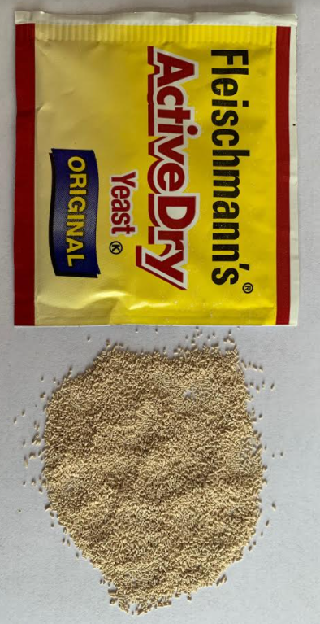
PROCEDURE: Evaluation of the Effect of Silver Nanoparticles on the Viability of S. cerevisiae using the Kirby-Bauer Testing Method⁴
Prior to beginning the experiment, melt yeast-extract dextrose (YED) media (350 mL) in a microwave swirling every 30 seconds to mix. Working in a sterile environment next to lit candles, pour melted growth media into 90 x 15 mm petri dishes (~25 mL to cover the bottom of the dish). Let petri dishes sit at room temperature for 2 hours to solidify the YED plates.
1
Jars containing Serial Dilutions of Colloidal Silver
Nanoparticles
Perform a 1:10 serial dilution of the colloidal silver (Natural Path Silver Wings Dietary Mineral Supplement, colloidal silver 500 PPM) in 25 mL distilled water in clean baby food jars. The concentrations being tested are 500,000 µg/L (undiluted), 50,000 µg/L, 5,000 µg/L, 500 µg/L, 50 µg/L, 5 µg/L and 0 µg/L as negative control.
2
3
Sterilize a pair of forceps in 70% isopropyl alcohol and place 6 sterile disks into each baby food jar containing the different concentrations of silver nanoparticles. The disks were soaked until a later step.
Saccharomyces cerevisiae
Working in a sterile environment next to lit candles, dissolve 1 teaspoon (tsp.) of granulated sugar in ½ cup of warm tap water (43°C to 46°C). When the sugar is fully dissolved, add ½ tsp. of baker’s yeast (Fleischmann’s Active Dry Yeast Original), mix well and let sit for 10 minutes at room temperature.
4
Using a sterile 1 mL transfer pipette, transfer 0.1 mL of the yeast extract onto the middle surface of the agar plate and use a sterile cotton swab to spread yeast around the entire surface of the YED agar plate. Streak the yeast by making a vertical line, then spread this left to right and top to bottom, rotate the plate 60º clockwise and repeat the spreading and plate rotation steps 3 more times. Repeat for all 14 plates.
5
Sterile Environment for Plating Yeast

Slide 15
PROCEDURE: Evaluation of the Effect of Silver Nanoparticles on the Viability of S. cerevisiae using the Kirby-Bauer Testing Method
With sterile forceps, evenly place three filter circles from a specific concentration of nanosilver onto the corresponding labeled yeast plate. Use 2 yeast plates for each concentration tested. Tap the sterile circle on the jar’s rim until no drops are coming off the circle (about 6 taps) before placing on the YED yeast plate. It is important not to let the circle move once it is set on the surface. Using the forceps’ tips, press the surface of the circle once to ensure it is secured onto the agar.
6
7
Secure the lid on each agar plate using a few pieces of clear tape. Incubate inverted plates in a 30ºC incubator with 70% humidity.
Incubator for Culturing Yeast
Observe each plate at 0 hour, 24 hours, 48 hours, and 72 hours. A zone of inhibition around the filter disk suggests that the particular concentration of colloidal silver has antifungal effects. Use a metric ruler to measure the width (diameter) in millimeters of any zones of inhibition around the filter circles seen on the plates. Place a metric ruler across the zone of inhibition at the widest diameter and measure from one edge of the zone to the other edge. The filter disk diameter is actually part of the width measurement. If there is no zone of inhibition at all, report the width number as zero even though the disk itself is around 6 mm in diameter.
8
Measurement of the Zone of Inhibition around Filter Disk
9
Plot the average width measurements as a bar graph to examine which concentrations cause an antifungal effect.
Repeat this S. cerevisiae experiment using the following consumer products containing silver nanoparticles: Hylunia Colloidal Silver Mist (10 PPM), Silver Shield Sanitizer Multi-Purpose Hygiene Spray (15-20 PPM), Heritage Store Colloidal Silver Foaming Soap (20 PPM), Silver Biotics Tooth Gel (22 PPM), Curad Germ Shield (55 PPM), Organa Silver Gel (100 PPM), and Silver Lip Balm (2,500 PPM). Also include a distilled water negative control. Soak the sterile filter disks in the undiluted product and repeat steps 4 through 9 to observe the antifungal effects.
10
Consumer Products Containing Silver Nanoparticles

Slide 16
PROCEDURE: Evaluation of the Effect of Silver Nanoparticles on the Viability of S. cerevisiae using the Kirby-Bauer Testing Method
11
After you finish making observations, sterilize yeast plates by soaking them in a 10% bleach solution for at least 1-2 hours and discard in the trash. Dilute the colloidal silver solution with tap water until you reach a selected unharmful concentration and pour the dilution into the sink.
Biological Agents and Risk Assessment: The source of S. cerevisiae (baker’s yeast) is the local grocery store. According to the Public Health Service, “S. cerevisiae is classified as Biosafety Level 1 and is non-pathogenic and as such would not be expected to cause harm to healthy people, animals or to the environment.”⁸ All safety precautions and disposal methods need to be strictly followed.¹⁰
Safety Precautions: Even though considered safe, S. cerevisiae should be treated at all times as if it were a potential hazard. Experiments should be done with the highest safety precautions and standard sterile technique.^{10,11,12} Nose and mouth should be kept away from tubes, pipettes, or other tools that come in contact with S. cerevisiae cultures and colloidal silver nanoparticles. Gloves should be worn, work surfaces should be disinfected with 70% isopropyl alcohol before and after use, and hands should be washed thoroughly after glove removal. When finished, all materials should be properly disinfected and disposed of safely. Sterilize yeast plates and pipettes by soaking them in a 10% bleach solution for at least 1-2 hours and discard in the trash.

Slide 17
RESULTS: The Effect of Silver Nanoparticles on Viability of the Fungi, Saccharomyces cerevisiae
Zone of Inhibition
A.
Figure 4: The Effect of Silver Nanoparticles on Viability of the Fungi, Saccharomyces cerevisiae. (A) S. cerevisiae were plated on soft YED agar petri dishes. Immediately after plating, 6-mm sterile disks soaked in a specific concentration of a silver nanoparticle solution were placed on the YED plate and incubated at 30ºC for 24 hours. (B) The diameter of the zone of inhibition around 6 disks at each concentration was measured using a metric ruler and the average diameter was plotted. Error bars are the standard deviation.
Observations: Clear zones of inhibition were evident at 24 hours after incubation. The diameter of the zones of inhibition increased as the nanosilver concentration increased.
B.

Slide 18
RESULTS: The Effect of Time and Plating Density on Viability of S. cerevisiae Treated with Silver Nanoparticles
A.
B.
Figure 5. The Effect of Time and Plating Density on the Viability of S. cerevisiae Treated with Silver Nanoparticles. (A) Yeast were plated on soft YED agar petri dishes. Immediately after plating, 6-mm sterile disks soaked in a specific concentration of a silver nanoparticle solution were placed on the YED plate and incubated at 30ºC for 24 and 72 hours. The diameter of the zone of inhibition around 6 disks at each concentration was measured using a metric ruler and the average diameter was plotted. Error bars are the standard deviation. (B) Yeast were plated on YED petri dishes at 1X or 2X density and incubated 24 hours at 30ºC with 6-mm sterile disks each soaked at a different concentration of nanosilver solution. The diameter of the zone of inhibition around 6 disks at each concentration was measured using a metric ruler and the average diameter was plotted. Error bars are the standard deviation.
Observations: Clear zones of inhibition were evident at 24 hours after incubation and remained the same size at 72 hours after incubation. Doubling the amount of yeast plated did not show a significant difference in the diameter of the zone of inhibition. The diameter of the zones of inhibition increased as the nanosilver concentration increased.

Slide 19
ANALYSIS: Impact of Silver Nanoparticles on Fungi - S. cerevisiae
The Effect of Silver Nanoparticles on the Viability of S. cerevisiae (Figure 4).
The purpose of this experiment was to determine whether silver nanoparticles can have a noticeable antifungal effect and, if so, what concentration of silver nanoparticles is needed to achieve this antifungal effect. The data supports the hypothesis that higher concentrations of silver nanoparticles cause more cell death because higher concentrations of nanosilver are more cytotoxic.
  A zone of inhibition, where no yeast grew around the filter disk soaked in a silver nanoparticle solution, suggests that the particular concentration of silver nanoparticles has antifungal effects.
  There was a linear relationship between nanosilver concentration and the diameter of the zone of inhibition. With increasing concentrations of nanosilver, there was an increasing diameter of the zone of inhibition.
  A noticeable zone of inhibition around the filter paper circles occurred at a nanosilver concentration of 5 µg/L with a 7 mm zone of inhibition. The highest nanosilver concentration of 500,000 µg/L had the largest zone of inhibition of 15 mm. No zone of inhibition was seen with the 0 µg/L control.
The Effect of Time and Plating Density on Viability of S. cerevisiae Treated with Silver Nanoparticles (Figure 5).
The purpose of this experiment was to determine whether the density of yeast on the YED plate and the incubation time had an effect on the diameter of the zone of inhibition.
  Zones of inhibition at respective nanosilver concentrations remained the same size at 24 hours up to 72 hours after incubation, suggesting that longer treatment times did not alter the antifungal effects.
  Doubling the amount of yeast plated did not show a significant difference in the diameter of the zone of inhibition as the plates were not overgrown.

Slide 20
RESULTS: The Effect of Nanosilver Consumer Products on Saccharomyces cerevisiae Viability
A.
B.
Zone of
Inhibition
Figure 6. The Effect of Nanosilver Consumer Products on S. cerevisiae Viability. (A) Yeast were plated on soft YED agar petri dishes. Immediately after plating, 6-mm sterile disks each soaked in a different consumer product containing silver nanoparticles were placed on the YED plate and incubated at 30ºC for 24 hours. (B) The diameter of the zone of inhibition around 6 disks per product was measured using a metric ruler and the average diameter was plotted. Error bars are the standard deviation. (C) Comparison of the concentration of colloidal silver in parts per million (PPM) in each product and average zone of inhibition measurement (mm).
Observations: Clear zones of inhibition were evident with each product at 24 hours after incubation. The diameter of the zones of inhibition did not necessarily correlate with the concentration of colloidal silver in the products.
C.

Slide 21
ANALYSIS: The of Nanosilver-Containing Consumer Products on S. cerevisiae Viability
All eight nanosilver consumer products showed antifungal effects with measurable zones of inhibition around the filter disks ranging from 9 to 21 mm compared to the water control. There was not a linear relationship between nanosilver concentration (PPM) and the diameter of zone of inhibition.
There could be many reasons for the lack of correlation between the colloidal silver concentration in consumer products and antifungal effect including different size, shape, surface area and coating of the silver nanoparticles and yeast cell death by other reasons such as osmolarity, pH properties, detergents, and antifungal effects of essential oils contained in the products.¹
Source of Error: One source of error for these experiments is the saturation of the filter disk after soaking in the baby food jar. It is important that you tap the filter disk on the jar’s rim until no drops are coming off the circle (about 6 taps) before placing on the nutrient agar plates. If there are residual drops, the colloidal silver solution may spread out when placed on the YED plate and result in larger zones of inhibition. Since the consumer products have various viscosities ranging from liquids to gels and even solids in the case of the lip balm, it was difficult to ensure that all residual product was removed equally efficiently from the filter disk before placing it down on the yeast plate.
Products with Greatest Antifungal Effects (19-21 mm zones of inhibition) | Products with intermediate antifungal effects (14-16 mm zones of inhibition) | Products with the lowest antifungal activity (9-10 mm zones of inhibition)
Silver Shield Sanitizer Multipurpose Hygiene Spray, 20 PPM | Silver Biotics Tooth Gel, 22 PPM | Hylunia Colloidal Silver Body Mist, 10 PPM
Heritage Store Colloidal Silver Foaming Soap, 20 PPM | Curad Germ Shield, 55 PPM | Silver Lip Balm, 2500 PPM
 | Silver Wings Colloidal Silver Dietary Supplement, 500 PPM | Organa Silver Gel, 100 PPM

Slide 22
PART II
What happens if silver nanoparticles get into the water?
How do freshwater organisms and plants respond to the exposure of different concentrations of nanosilver?

Slide 23
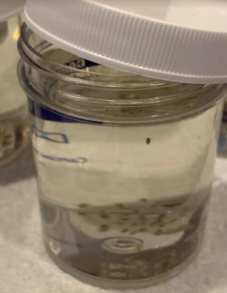
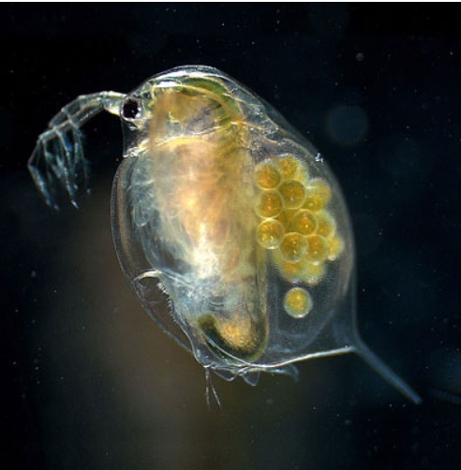
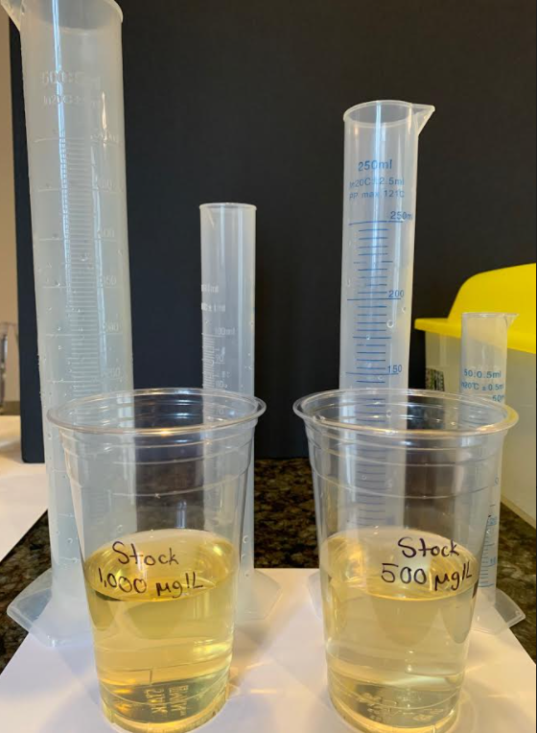
PROCEDURE: Evaluation of the Effect of Silver Nanoparticles on the Viability of the Aquatic Organism Daphnia magna⁵
Upon receipt of the Daphnia magna (water flea) culture in the mail, immediately unscrew the cap of the container and put it loosely on the top to let oxygen in, which Daphnia need to survive. Let the open jar rest for 24 hours so that the Daphnia can recover from shipping before beginning the experiment. Complete within 2 days of receiving the culture.
1
Culture of Daphnia magna
2
In clear plastic 20 oz cups, prepare three trials for each concentration of colloidal silver (25 µg/L, 10 µg/L, 5 µg/mL and a negative control 0 µg/L).
Prepare 1,000 µg/L and 500 µg/L nanosilver stock solutions. Using a 1 mL pipet, suck up 1 mL of the Natural Path Silver Wings Dietary Mineral Supplement colloidal silver 500 PPM solution and transfer it into an empty 20 oz plastic cup labeled with 1,000 µg/L. Measure out 499 mL of pond water with a 500 mL graduated cylinder and add this to the 1 mL nanosilver solution mixing well. Make a 1:2 dilution of the 1,000 µg/L solution to get a nanosilver concentration of 500 µg/L by adding 250 mL of 1,000 µg/L nanosilver solution to 250 mL pond water and mix well.
Female Adult Water Flea Daphnia magna
(Image credit: Ref. 5)
3
Make a 1:100 dilution of the 500 µg/L nanosilver solution to get a concentration of 5 µg/L. Using graduated cylinders, fill 3 cups labeled as 5 µg/L with 495 mL pond water and add 5 mL of the 500 µg/L nanosilver solution to each cup.
4
Stock Solutions of Colloidal Silver Nanoparticles
Make a 1:100 dilution of the 1,000 µg/L nanosilver solution to get a concentration of 10 µg/L. Fill 3 cups labeled as 10 µg/L with 495 mL pond water and add 5 mL of the 1,000 µg/L nanosilver solution to each cup.
5

Slide 24
PROCEDURE: Evaluation of the Effect of Silver Nanoparticles on the Viability of the Aquatic Organism Daphnia magna⁵
Make a 1:20 dilution of 500 µg/L nanosilver solution to get a concentration of 25 µg/L. Fill 3 cups labeled 25 µg/L with 475 mL pond water and add 25 mL of the 500 µg/L nanosilver solution to each cup.
6
7
Add an additional 3 cups with no colloidal silver as a negative control and fill with 500 mL pond water.
Add 10 live Daphnia from the culture to each of the prepared cups using a fresh watering pipet to slowly suck up one Daphnia from the culture. Cut the front end of the pipet at a 45º angle to avoid damaging the live Daphnia during transfer. Transfer as little culture water as possible.
8
10 Daphnia magna per Treatment Condition
Biological Agents and Risk Assessment: The culture of Daphnia magna is isolated from local ponds by Carolina Biological Supply Company. According to the Public Health Service’s definition for Biosafety Level/Shipping Class I, “this organism is considered to be non-pathogenic and as such would not be expected to cause harm to healthy people, animals or to the environment.”⁸
Safety Precautions and Disposal: For maximum safety, maintain proper handling, clean up and disposal of Daphnia magna. Nose and mouth should be kept away from tubes, pipettes or other tools that come in contact with the culture. Gloves must be worn at all times. For disposal, add 5 mL of bleach to each cup with collected dead/live Daphnia, mix well and after 20 min pour down the sink. Do not release in the wild. Alternatively, the culture may be used as a food source for fish in a freshwater aquarium. Dilute the nanosilver solution with tap water until you reach an unharmful concentration and pour the dilution into the sink.
9
Incubate the Daphnia magna cultures at room temperature during the duration of the experiment.
Wait until 2 hours have passed and then count living and dead daphnia in each cup using a 10X magnifying glass. Live Daphnia will move around the cup and a heartbeat will be detectable. Dead Daphnia do not move, lie on the bottom of the cup or float on the top. Repeat these observations at 4 hours, 8 hours, 12 hours, 16 hours, 20 hours, 24 hours and 28 hours.
10
Calculate the average number and the percentage of dead and live daphnia recorded for each nanosilver concentration and the control over exposure time. Plot a dose-response-curve from the results where the dose (concentration of silver nanoparticles) is depicted on the x-axis and the response (% dead Daphnia) is represented on the y-axis.
11

Slide 25
RESULTS: The Effect of Silver Nanoparticles on the Viability of the Aquatic Organism, Daphnia magna
Figure 7. The Effect of Silver Nanoparticles on the Viability of the Aquatic Organism, Daphnia magna. Ten Daphnia magna (water fleas) were placed in a 20-oz cup containing either 0 µg/L, 5 µg/L, 10 µg/L or 25ug/L concentrations of colloidal silver mixed in pound water at room temperature. The number of living and dead water fleas were counted at 0, 2, 4, 8, 12, 16, 20, 24 and 28 hours after treatment with the silver nanoparticle solution. The percentage of dead Daphnia was plotted for each nanosilver concentration and the control over exposure time.
Observations: Live Daphnia moved around the cup and a heartbeat was detectable. Dead Daphnia did not move, laid on the bottom of the cup or floated on the top. There were more dead Daphnia at higher nanosilver concentrations and more death occurred after longer incubation times. After 28 hours, natural death of the untreated Daphnia culture was evident and the experiment was stopped.

Slide 26
ANALYSIS: Impact of Silver Nanoparticles on Animals - Daphnia magna water flea
The Effect of Silver Nanoparticles on the Viability of the Aquatic Organism, Daphnia magna (Figure 7).
The purpose of this experiment was to investigate the effects of different nanosilver concentrations on the aquatic organism Daphnia magna.
The data supports the hypothesis that higher concentrations of silver nanoparticles cause more death because higher concentrations of nanosilver are more cytotoxic.
  The data showed that there was more Daphnia death at higher nanosilver concentrations. Also, more Daphnia death occurred with longer nanosilver treatment/exposure times.
  Treatment with 25 µg/L silver nanoparticles for 28 hours resulted in 57% Daphnia death.
  After 28 hours, natural death of the untreated Daphnia culture was observed and the experiment was stopped.
In summary, more cytotoxicity occurred when Daphnia were treated at higher nanosilver concentrations at longer times.
Source of Error: One source of error could be the presence of other things in the pond water used for this experiment. There may have been other microbes present that may change Daphnia’s response in some way or that consumed the silver nanoparticles resulting in less death of the Daphnia.

Slide 27
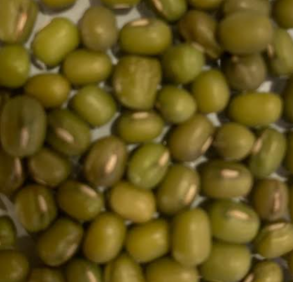
PROCEDURE: Evaluation of the Effect of Silver Nanoparticles on the Germination of the Plant Vigna radiata (Mung Bean)
Perform a 1:10 serial dilution of the colloidal silver (Natural Path Silver Wings Dietary Mineral Supplement, colloidal silver 500 PPM) in 25 mL distilled water in clean baby food jars. The concentrations being tested are 500,000 µg/L (undiluted), 50,000 µg/L, 5,000 µg/L, 500 µg/L, 50 µg/L, 5 µg/L and 0 µg/L as negative control.
1
Jars containing Serial Dilutions of Colloidal Silver
Nanoparticles
Add 3 mung bean seeds (Nature Jim’s Sprouting Mung Bean Seeds) to each jar (two jars at each concentration for a total of 6 mung beans per concentration) and observe effects of colloidal silver nanoparticles on seed germination over 6 days.
2
Mung Bean Seeds
Safety Precautions and Disposal: Gloves must be worn at all times when handling the silver nanoparticle solutions. Dilute the nanosilver solution with tap water until you reach a selected unharmful concentration and pour the dilution into the sink. Dispose mung bean seeds and seedlings in the trash.

Slide 28
RESULTS: The Effect of Silver Nanoparticles on Vigna radiata (Mung Bean) Seed Germination
Figure 8. The Effect of Silver Nanoparticles on Vigna radiata (Mung Bean) Seed Germination. Mung beans were placed into baby food jars containing 22.5 mL of the respective colloidal silver solutions (3 mung beans in 2 jars for a total of 6 beans per concentration). Mung bean germination and seedling formation was observed over the course of 6 days. Data shown is one representative mung bean at Day #6.
Observations: Mung bean seeds germinated into seedlings at lower nanosilver concentrations (5, 50, 500 µg/L) similar to the untreated control. At 5,000 and 50,000 µg/L nanosilver concentrations, seedling formation was significantly slowed resulting in a much shorter stem. Mung beans at 500,000 µg/L nanosilver did not germinate out of the seedcoat. Cotyledon size remained the same comparing across 0 µg/L to 50,000 µg/L.

Slide 29
ANALYSIS: Impact of Silver Nanoparticles on Plants - Vigna radiata (Mung Bean)
The Effect of Silver Nanoparticles on Vigna radiata (Mung Bean) Seed Germination (Figure 8).
The purpose of this experiment was to investigate the effects of different nanosilver concentrations on mung bean seed germination. The data supports the hypothesis that higher concentrations of silver nanoparticles are more detrimental to seed germination because higher concentrations of nanosilver are more cytotoxic.
  The results of this experiment showed that seedling formation was significantly affected after treatment with higher nanosilver concentrations.
  Mung beans treated with the 500,000 µg/L nanosilver concentration was so cytotoxic that the seed coat was not shed.
  Mung beans treated with 50,000 and 5,000 µg/L showed more drastic cytotoxic effects and inhibited growth of the stem even though the mung bean shed its seed coat.
  500 µg/L treatment resulted in a shorter stem compared to the control but the cytotoxic effects were not as drastic as the higher concentrations.
  5 µg/L and 50 µg/L nanosilver concentrations had little cytotoxic effect since the stem compared in length to the untreated control.
Source of Error: One source of error could be the dark brown color of the highest concentrations of nanosilver (see figure below). It is possible that mung bean seeds could be affected by light conditions for germination to happen. Furthermore, osmolarity at higher concentrations of nanoparticles may be another factor contributing to more cytotoxicity at the 500,000 µg/L, 50,000 µg/L and 5,000 µg/L concentrations.

Slide 30
CONCLUSIONS
The results from these experiments treating E. coli, S. cerevisiae, Daphnia magna, and Vigna radiata with increasing concentrations of silver nanoparticles supported the hypothesis that higher concentrations of silver nanoparticles cause more cell death because higher concentrations of nanosilver are more cytotoxic.
For E. coli and S. cerevisiae experiments, there was a linear relationship between nanosilver concentration and cell death. With increasing concentrations of colloidal silver, there was an increasing diameter of the zone of inhibition. Plating density and incubation times did not have an effect on diameter of the zone of inhibition. At each concentration of colloidal silver tested, S. cerevisiae had larger zones of inhibition versus E. coli suggesting yeast may be more susceptible to colloidal silver.
Eight consumer products containing nanosilver particles all showed varying degrees of antibacterial and antifungal activity as measured by the diameter of the zone of inhibition. There was no correlation between the zone of inhibition and nanosilver concentration in the product. This could be due to multiple factors including differences in size, shape, surface area and coating of the silver nanoparticles in the products, and cell death by other reasons such as osmolarity, pH, detergents, and antimicrobial effects of essential oils contained in the products.
There was more Daphnia magna death at higher nanosilver concentrations (25 µg/L) and longer nanosilver treatment/exposure times (28 hours).
High concentrations of silver nanoparticles (>5,000 µg/L) were more detrimental to Vigna radiata seed germination and seedling formation.
In addition to confirming the antibacterial and antifungal properties of silver nanoparticles, these studies provided important information on the harmful environmental effects of silver nanoparticles on plants and aquatic organisms. The same antibacterial properties that make silver nanoparticles useful in consumer products may also cause the accidental killing of beneficial microbes that play critical roles in ecosystems and help treat wastewater. Therefore, the potential negative environmental effects of silver nanoparticles should be carefully studied and weighed against their environmental impact to control hazards associated with widespread use.

Slide 31
FUTURE STUDIES
This project can be expanded to include a larger variety of bacteria and yeast strains and a broader representation of terrestrial plants and aquatic plants (i.e., duck weed or Elodea, etc.) and animals (i.e., snails or fish, etc.).
It would also be interesting to study how different sizes, shapes, surface areas, and coatings of the silver nanoparticles affect their cytotoxic properties.
Colloidal silver can be isolated from consumer products known to have silver nanoparticles in them to test for its cytotoxicity. Furthermore, since consumer projects may have multiple components that could cause antibacterial or antifungal effects, one could ask vendors to send a sample of the individual product components to test which individual component causes the most cytotoxic effect.
One can also inquire if different life stages of Daphnia or other aquatic organisms (baby, juvenile or adult) react the same way to nanosilver.
It would also be very interesting to test the effects of silver nanoparticles on human-derived cell lines in culture.

Slide 32
REFERENCES
Antimicrobial Properties of Nanoparticles. https://nanohub.org/resources/23236/downloads/SilverNanoparticles_Lab_activity.doc
Alexander JW. History of the Medical Use of Silver. Surg Infect. 2009; 10:289-292.
Nanosilver: Naughty or Nice? https://www.sciencenewsforstudents.org/article/nanosilver-naughty-or-nice
https://www.sicencebuddies.org/science-fair-projects/project/can-silver-nanoparticles-neutralize-e-coli-bacteria#procedure
https://www.sicencebuddies.org/science-fair-projects/project/nanosilver-in-consumer-products-affect-pond-life#procedure
Imelda Galvan Marquez et. al. Zinc oxide and silver nanoparticles toxicity in the baker’s yeast, Saccharomyces cerevisiae. PLoS ONE (2018) 13(3).
Matthew Cimitile. Nanoparticles in Sunscreen Damage Microbes. Scientific American, 2009. https://www.scientificamerican.com/article/nanoparticles-in-sunscreen/
Biosafety in Microbiological and Biomedical Laboratories. https://www.cdc.gov/labs/pdf/CDC-BiosafetyMicrobiologicalBiomedicalLaboratories-2009-P.PDF
Final risk assessment of Escherichia coli k-12 derivatives https://www.epa.gov/sites/production/files/2015-09/documents/fra004.pdf
Microbiology Techniques and Troubleshooting. https://www.sciencebuddies.org/science-fair-projects/references/microbiology-techniques-troubleshooting
Microorganisms Safety Guide. https://www.sciencebuddies.org/science-fair-projects/references/microorganisms-safety
https://www.carolina.com/teacher-resrouces/lab-science-classroom-safety-information/10856.com
Care and handling of Daphnia - https://yourtube.com/watch?v=sD9Tg0Qw-Yg; Carolina Biological Supply handling care instructions
Chaloupka et al., Nanosilver as a New Generation of Nanoproduct, Trends in Biotechnology, 2010 Nov;28(11):580-8.
https://www.khanacademy.org/science/high-school-biology/hs-energy-and-transport/hs-osmosis-and-tonicity/v/hypotonic-isotonic-and-hypertonic-solutions-tonicity
All photos and figures are by the student except the photo of the Daphnia magna which is credited to Science Buddies. The figure describing “How Silver Nanoparticles Kill Bacteria” was adapted from Chaloupka et al., Trends in Biotechnology, 2010.

