Slide 1
Team Kasa Jizo
Using various online programs to build an
optimized soccer robot

Slide 2
About our team
Marwan El Youssoufi: Team Captain, Main Electronics Designer and Primary Programmer.
Matthew Livingston: Main Logistics Planner, Secondary Electronics and CAD Designer.
Oliver Cai: Primary CAD Designer for multiple novel components of the original robot.
Daniel Portalski: Secondary Programmer and Treasurer.

Slide 3
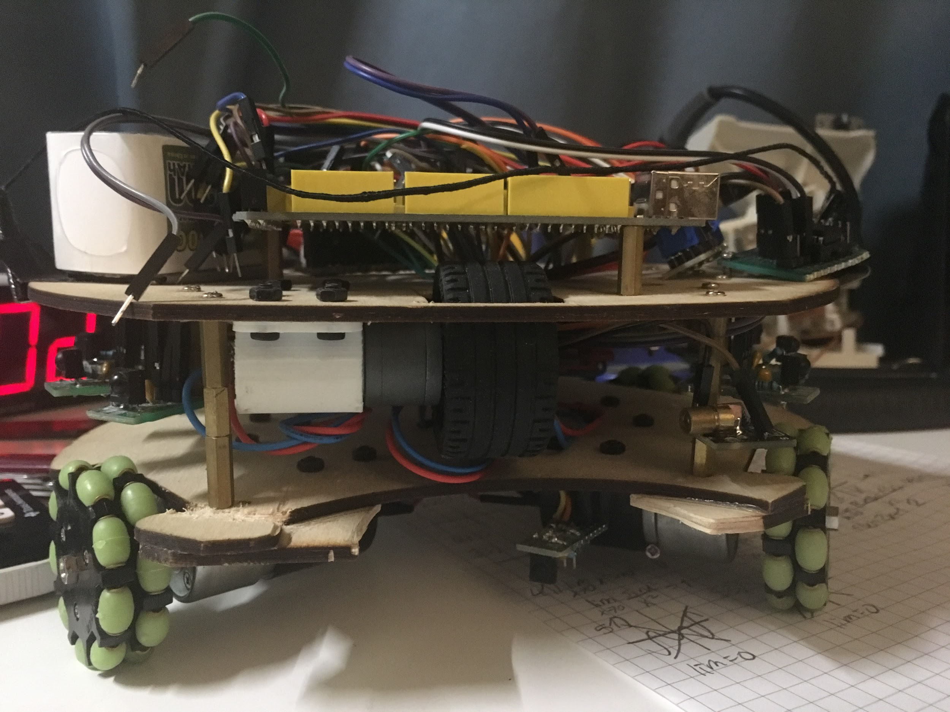
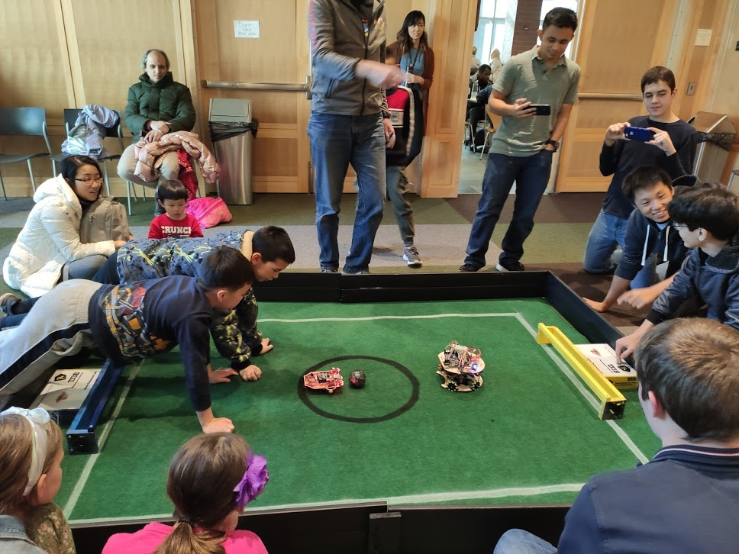
Photos

Slide 4
Innovations
We were the first of our soccer robotics team to implement a dribbler, and we did so with LEGO, saving us costs and weight.
For our new robot, we use Pololu motors which allows us to create a more compact design through clamping motor mounts, and this is much more efficient than the Daisen motors we used previously.
We are planning on using triple layered omni wheels for our new robot, which significantly increase traction to the carpet, and will most likely weigh less than our current omni wheels due to the plastic dowels we will use.

Slide 5
Future steps
We are currently in the process of CADing a new robot for the upcoming Robocup Jr. competition.
With this new design we are also implementing PCBs designed through Eagle for the first time to facilitate adding our electrical components onto our robot.
We are creating clamping motor mounts and triple layered omni wheels in Onshape to fully utilize the compact design of Pololu motors to save weight.

