Slide 1
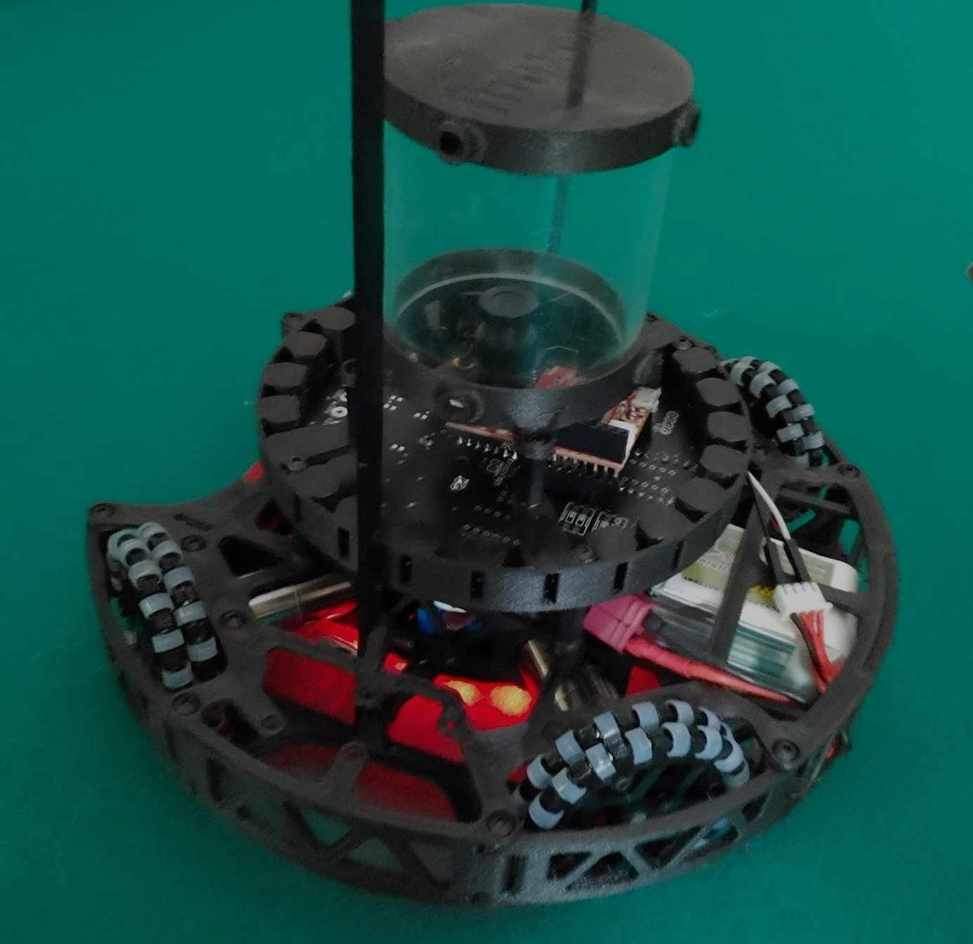
Team Orion
Keiji Imai
Danil Korennykh
Mark Ogata
Niklas Austermann

Slide 2
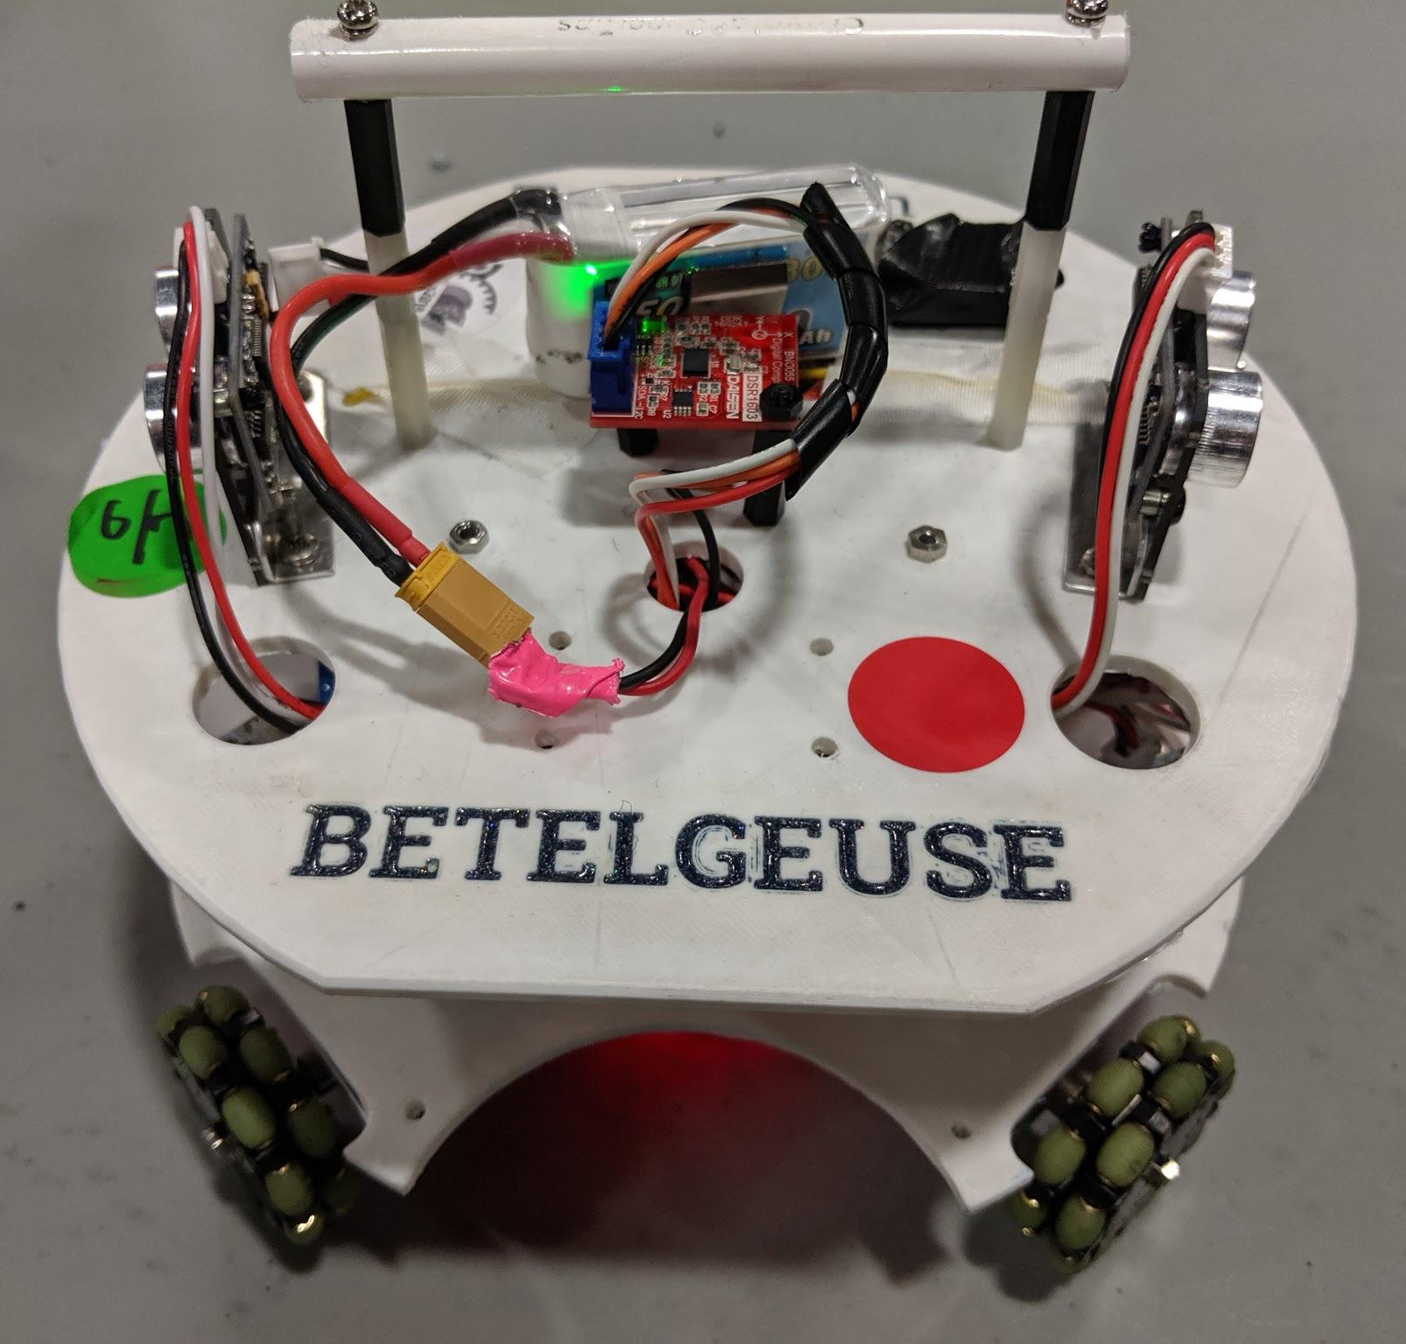
About Us
History
RobocupJunior Lightweight Soccer Team
Founded in 2018
US 2019 National Champions
Our Goals
Win international competition
Learn engineering skills
Mechanical design
Electrical design
Programming
Share knowledge with others
Mentor to 4 affiliated teams
Robotics club with 18 members

Slide 3
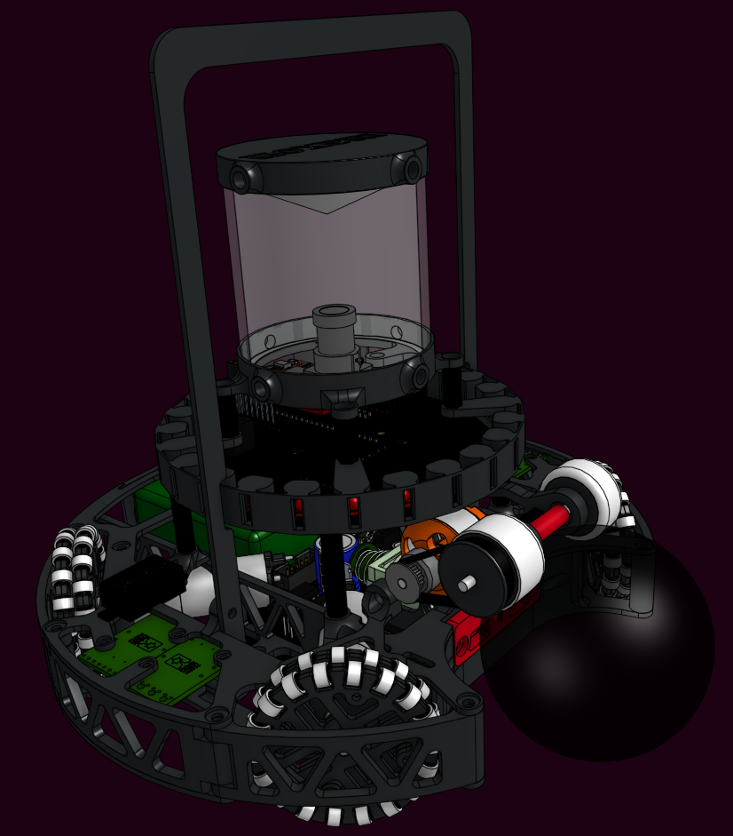
Mechanical Design
Solenoid Kicker
Double Layered Omni Wheels
Omnidirectional Camera
Thermoformed conic mirror
Lightweight
1020 grams
3D Printed in NylonX

Slide 4
Software
Task system
Providers and Processes
Line detection
Sensor Filtering

Slide 5
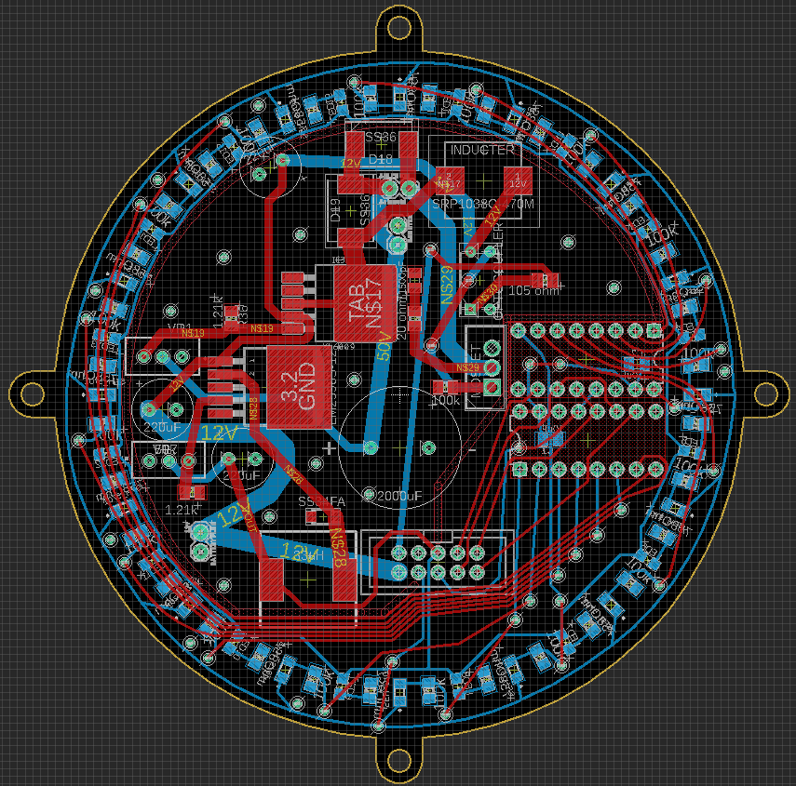
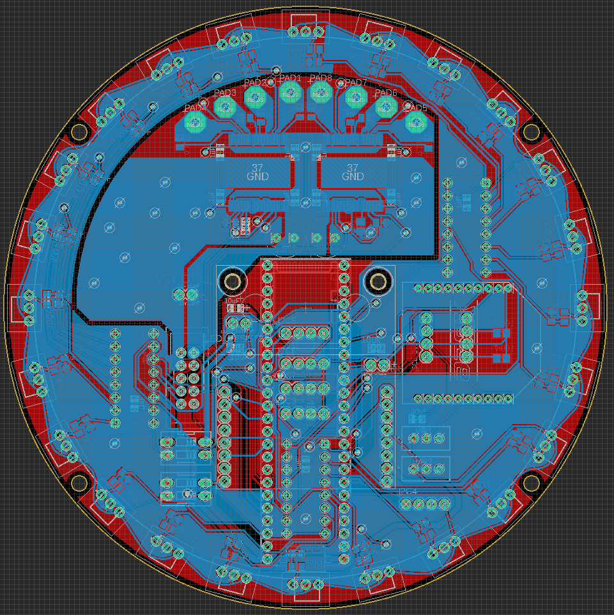
Electrical Design
Line Sensor PCB
Power Control
SMD + THT
Ball Sensor PCB
Sensor Smoothing

Slide 6
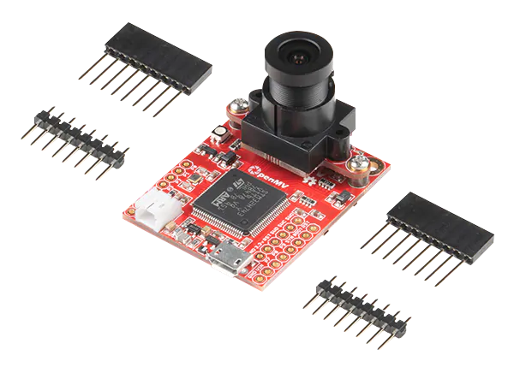
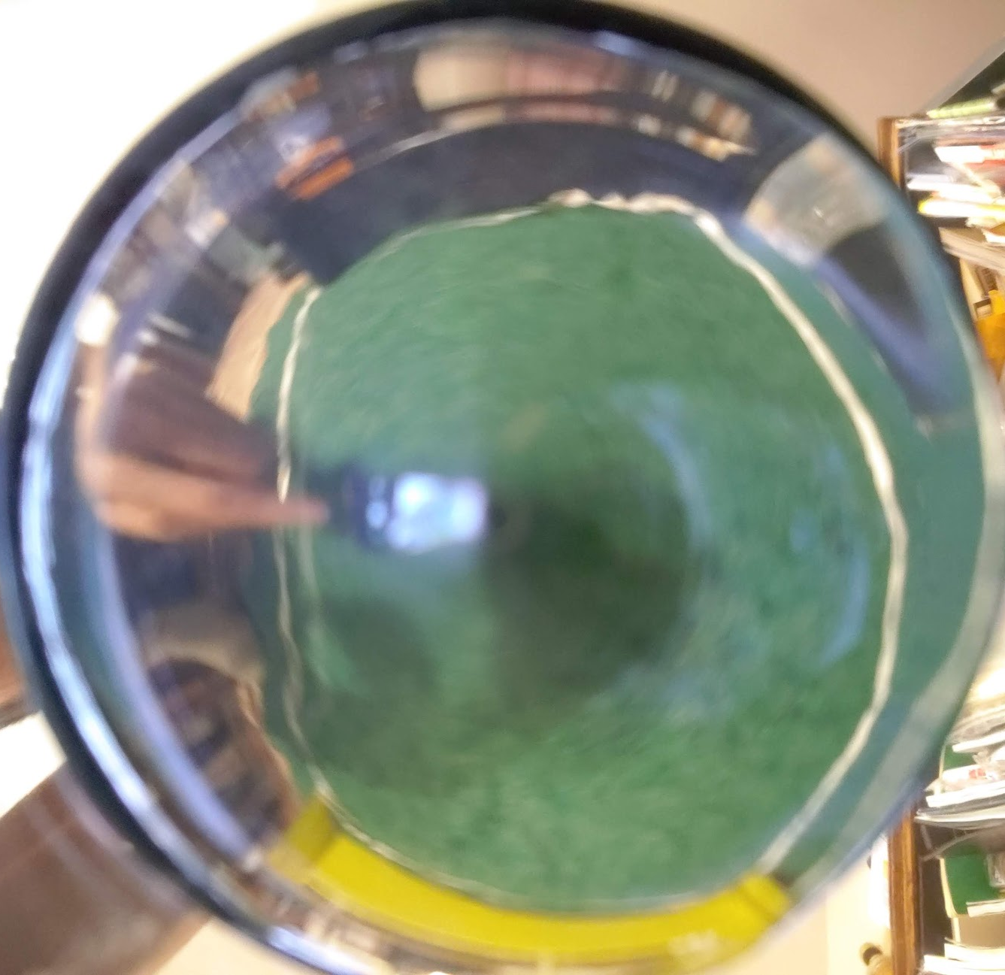
Vision
OpenMV Camera
Programmed in MicroPython
Tracks goal angle and distance
Blob processing library
Finds opponents’ goalie
Masks and Anomalies

Slide 7
Questions?

